Slide 1
TIM Offset of Page Segments
Date: 2013-05-05
Authors:

Slide 4
Background
The 11ah SFD has defined a fixed length page segment per TIM segment within one DTIM beacon interval
A Segment Count IE is used for indication of assignment of STAs within one page in TIM segments.
Each ordered page segment is assigned sequentially to TIM segments, where first page segment being assigned to DTIM segment

Slide 5
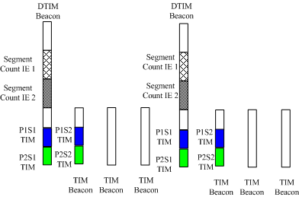
Issues
One DTIM Beacon may carry multiple Segment Count IEs to indicate the page segments for different pages.
The page segments of each page are assigned sequentially to TIM segments. While the first page segment of each page will always be assigned to the same DTIM segment.
The first several DTIM/TIM segments will be periodically crowded with segments of different pages.
Some TIM Beacons may not have assigned TIM segments
Some beacons have to carry multiple TIM IEs of different pages
Not easy for AP to flexibly schedule TIM segments over beacon intervals.

Slide 6
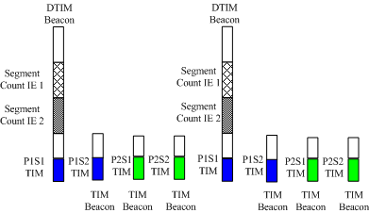
Proposal (1/2)
We propose to add a “TIM offset” field in Segment Count IE to allow AP to indicate the TIM Beacon offset to the DTIM Beacon which carries the segment Count IEs of the pages.
The TIM for the first page segment of a specific page can be allocated at the indicated TIM offset to the DTIM
The TIM Segments can be flexibly scheduled for page segments of different pages over beacon intervals

Slide 7
Proposal (2/2)
The proposed Segment Count IE with “TIM Offset” field is as below:

Slide 8
SP 1
Do you support the concept of the TIM Beacon offset for the first page segment of the page as described in slide 6?
Y
N
A

Slide 9
SP 2
Do you support indicating the TIM Beacon offset using a “TIM offset” filed with 4 reserved bits in Segment Count IE?
Y
N
A

Slide 10
Reference
[1]IEEE802.11-13/1137r14.pdf

