Slide 1
HEW Usage Scenarios and Applications
Date: 2013-05-13
Authors:

Slide 2
Abstract
This presentation provides new or enhanced applications and usage scenarios for consideration in the development of requirements in HEW SG.

Slide 3
Usage Scenarios Already Presented in WNG SC (see reference list)
While many of these usage scenarios have already been presented in WNG SC, we have sorted the list in importance for enhancing high efficiency in a dense deployment (1, most important; 10 least important)
Previously presented usage scenarios in black, additional usage scenarios in red,
When VHT SG went though a similar exercise they performed ranking (e.g. 07/2988r4), so we have do so here as well
Wireless Office
Cellular offload (home, corporate, hotspot)
Residential / apartment building
Shopping mall
Education
Airport waiting halls/lounges
Stadium
Lecture Hall
Airliner / railroad car
Remote diagnosis and treatment

Slide 4
New/Enhanced Applications for Consideration
Enterprise
Wireless docking
Unified Communications
Including Video conferencing
Display Sharing:
1 to 1,
1 to many (classroom, medical)
Many to 1
Cloud Computing
Operators
Seamless hand-over between Cellular & WiFi / Data offload to WiFi
Community Wi-Fi Deployment
Consumer
Video distribution at home
Progressive Streaming
User Generated Content (UGC) Upload & Sharing
Interactive Multimedia & Gaming
Real-time Video Analytics & Augmented Reality
Support of wearable devices
Device 2 Device
Autonomous (low power) Discovery
Shopping mall
Education

Slide 5
Enterprise - Dense usage of wireless docking
Enterprise dense deployment of wireless docking using Wi-Fi Direct/Display
Cubicles every few meters using wireless docking
Network access from AP

Slide 6
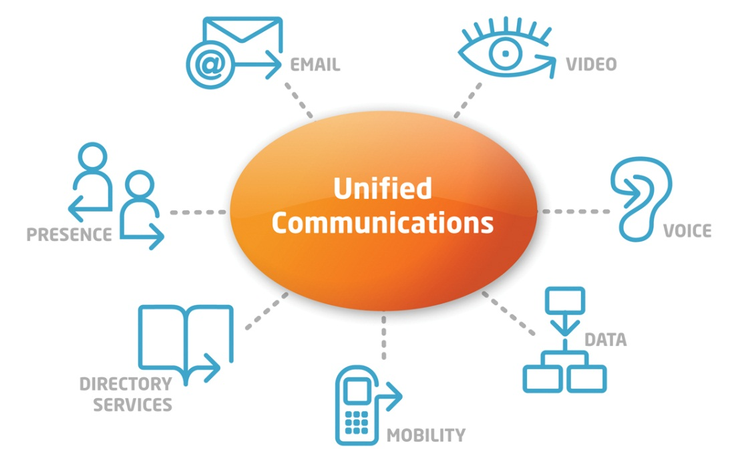
Enterprise - Unified Communications
Unified Communications
Cloud assisted UC optimized over WiFi channels
Collaboration between devices
UC without the need for cloud access
Robust Video conferencing
Robust high quality video conferencing over WiFi channels
Optimized BW control

Slide 7
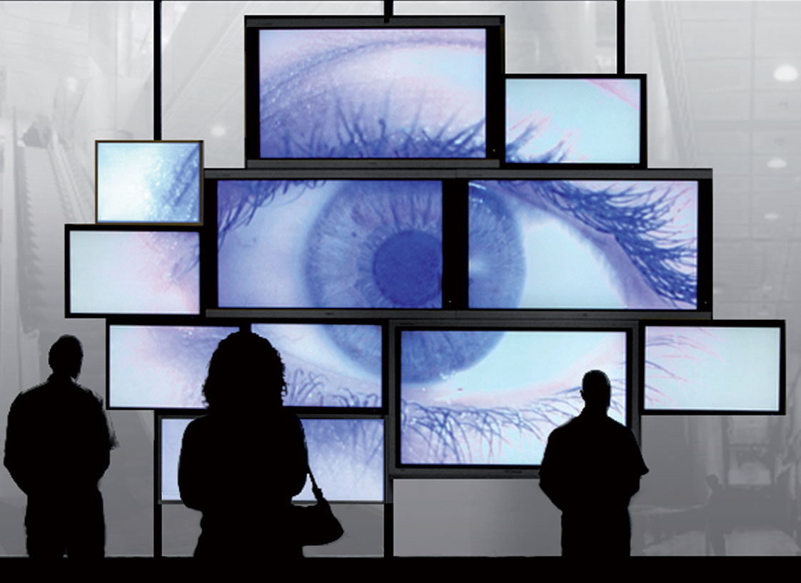
Enterprise - Display Sharing
1:1 Display I/O via Wi-Fi – already defined in Miracast (WFA )
1 to many display sharing using multicast
Classrooms
Digital signage
Social events
Many to 1 display sharing
Network management
Security & public safety

Slide 8
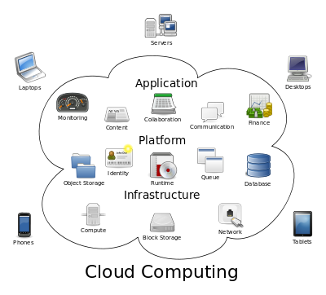
Enterprise - Cloud Computing
Sharing near-by computing resources over WiFi
Secured
Very low latency
Bursty data

Slide 9
Operators – Seamless hand-over between Cellular & WiFi
User starts session with cellular coverage (no Wi-Fi). Device makes connections to various back-end networks:
VoLTE network
Internet
VoD network
User moves within Wi-Fi coverage
Voice connection stays on VoLTE network
Internet and VoD connections move to Wi-Fi
Need to support migration of select services between cellular and Wi-Fi

Slide 10
Operators - Community Wi-Fi Deployment (Residential Hotspots)
User in a car stops at a red light
User detects operator AP and automatically authenticates to the AP
Light then changes to green and the car moves down the road to the next red light
User discovers a different operator AP, and automatically authenticates to new AP
In cities with block of apartments with high density number of APs, this may cause many signaling requests as user moves near the building

Slide 11
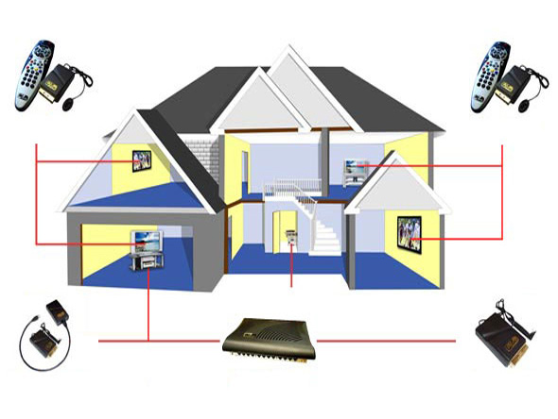
Consumer - Multimedia distribution at home
Robust distribution over WiFi of Broadcast channels (Cable, Satellite, IPTV)
Support of several concurrent different streams
Multicasting same content to several screens (TV Everywhere)
High reliability full home coverage
May be a complementary solution to wired technologies
Support of Linear multi-channels TV

Slide 12
Consumer - Progressive Streaming
From the cloud & between devices
Enable direct streaming between devices
Agile & adaptive to varying radio conditions
Guarantees SLA in dense environments
Low latency, low (re-)buffering time

Slide 13
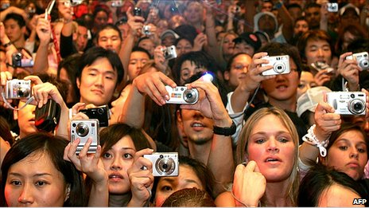
Consumer - User Generated Content (UGC)
Upload & Sharing
Support of handheld devices:
Low power
Optimized wireless BW
Support of new applications
Short latency: Near real-time performance
Real-time Sharing between devices
http://www.bbc.co.uk/news/business-11600902

Slide 14
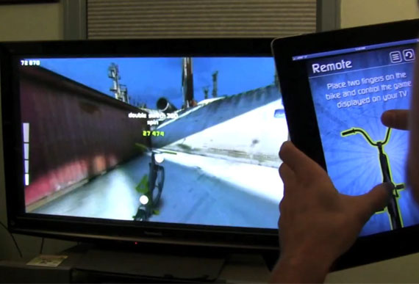
Consumer – Interactive Multimedia & Gaming
Short distance
Low latency
High resolution and frame rate resulting high bitrate
Bi-directional traffic (non symmetrical)
Operation in dense environment, multiple links in parallel
Low power

Slide 15
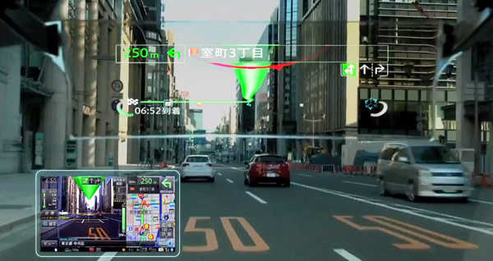
Consumer - Real-time Video Analytics & Augmented Reality
Use of a mobile camera for recognizing and analyzing the environment for meaningful information to the user
Short round-trip cycling for receiving the information
Conservation of the BW thru pre-processing of the visual information in the mobile device
Setting SLA parameters for critical missions, as in driving

Slide 16
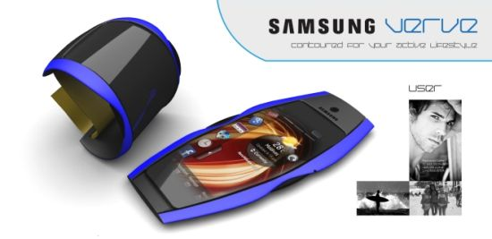
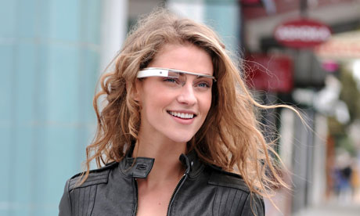
Consumer - wearable devices
Secure
Short range
Low power
Ability to work in crowded environment
Resource sharing (computing)

Slide 17
Device 2 Device
Autonomous Discovery
Low power, low latency autonomous discovery of near-by users, devices and services
Secured auto-login
Additional Applications
Remote control
Smart home
Internet of Things

Slide 18
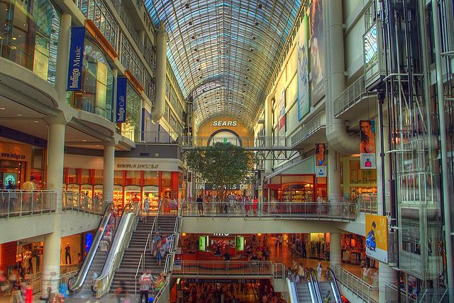
Shopping Mall
Internet access
Push, data download (coupons)
Indoor location
Cellular offload
Multicast

Slide 19
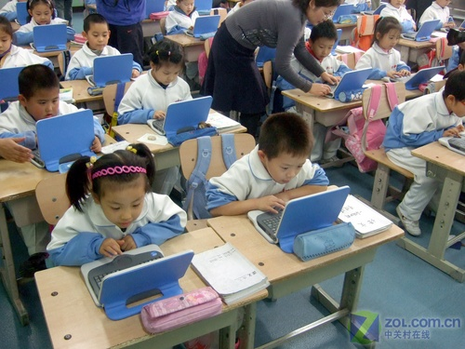
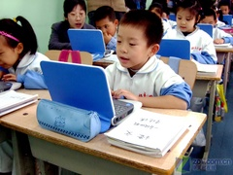
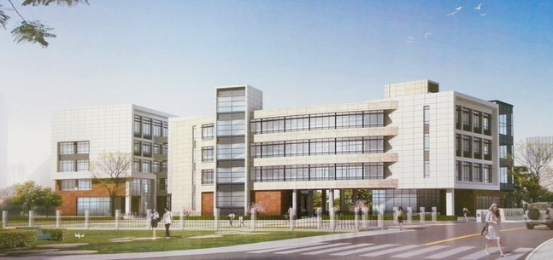
e-Education
Scenario Characteristics:
Dense STAs (40~60 STAs) in one classroom with one AP
20~30 classrooms in one typical school building (3~6 floors)
Thus, nearby 1,000 STAs with 20~30 APs within a building space.
Typical education applications:
Video streaming among teacher and students;
Teachers/Students demonstrate theirs desktop to others;
File transfer and sharing;
4+ subgroup in one classroom with multicasting traffic for screen sharing or video;
Throughput Requirement: longtime/stable throughput in one classroom >= 20 Mbps
Challenges and Issues:
Fast Connection: Very long STAs registering time (1~5 minutes) delay the start of a class;
Interference Control and Delay Optimization:
Annoying lag in screen sharing, video streaming and command response (sometimes it is longer than 20 seconds)
Very low bandwidth for e-homework submission in the same period.

Slide 20
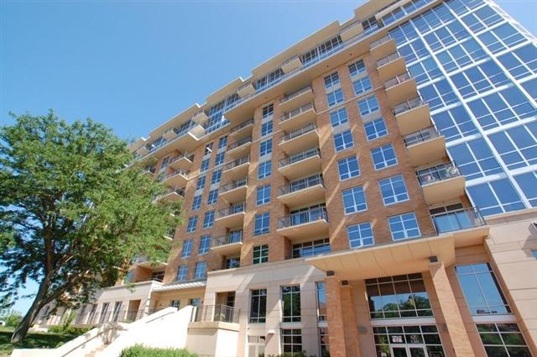
Residential Wi-Fi: Dense Apartment and Condominium Buildings
Building automation and connectivity
Wireless Sensors
Security:
shared common area video
private in room video – intuition sensor monitor
Heating and cooling control and complex heating/cooling balancing
Utilities Monitoring – Water/Gas/Electric/etc, Both Private and Building
Waste management systems – waste shoots – selection of recycle/compost/waste
Private and shared common appliance monitoring and automation
Lighting control and entry access (electronic doors)
High density device control while servicing Wi-Fi connectivity and cellular offload
Video streaming in common areas and buildings
Normal connectivity
www.restainohomes.com

Slide 21
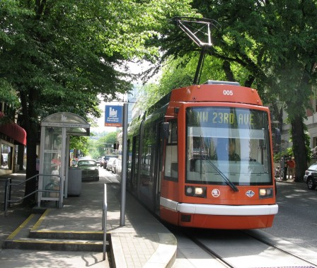
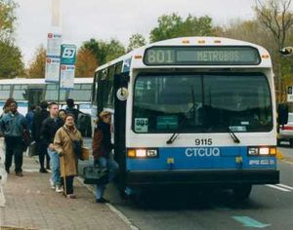
Seamless Wi-Fi Connectivity in Public Transportation
Ubiquity of low power computing devices available to commuters who spends hours on public transportation demands for Wi-Fi deployment not only on subway stations (as deployed already across the world), but also inside trains and upon transfer to another transportation service.
Dense and efficient Wi-Fi deployment would allow seamless connectivity to commuters who hop off subway train on major stations to transfer to road buses and street cars that also offer Wi-Fi connectivity.
http://www.urbanrail.net/as/jp/kobe/kobe.htm
http://www.tc.gc.ca
metro-cincinnati.org

Slide 22
Next Steps
Refine the usage scenarios and applications
Request input from WFA
Translate these into requirements that can be captured in the PAR and 5 C’s

Slide 23
References
https://mentor.ieee.org/802.11/dcn/13/11-13-0331-05-0wng-high-efficiency-wlan.ppt
https://mentor.ieee.org/802.11/dcn/13/11-13-0287-03-0wng-beyond-802-11ac-a-very-high-capacity-wlan.pptx
https://mentor.ieee.org/802.11/dcn/13/11-13-0343-00-0wng-operator-oriented-wi-fi.pptx
https://mentor.ieee.org/802.11/dcn/13/11-13-0309-00-0wng-next-gen-wlan.pptx
https://mentor.ieee.org/802.11/dcn/13/11-13-0313-00-0wng-usage-models-for-next-generation-wi-fi.pptx
https://mentor.ieee.org/802.11/dcn/13/11-13-0314-00-0wng-on-future-enhancements-to-802-11-technology.pptx
https://mentor.ieee.org/802.11/dcn/13/11-13-0113-00-0wng-applications-and-requirements-for-next-generation-wlan.pptx

