Slide 1
Power save during Fast Initial Link Setup
Date: 2015-05-13
Authors:
Name | Affiliations | Address | Phone | email
George Cherian Santosh Abraham | Qualcomm | 5775 Morehouse Dr, San Diego, CA, USA | +1 (858)-651-6645 +1 (858)-651-6107 | gcherian@qti.qualcomm.com sabraham@qti.qualcomm.com
Jouni Malinen | Qualcomm | Hermiankatu 6-8 D Tampere, Finland |  | jouni@qca.qualcomm.com

Slide 2
Abstract
This document proposes a solution for power save issue pointed out in 13/414

Slide 3
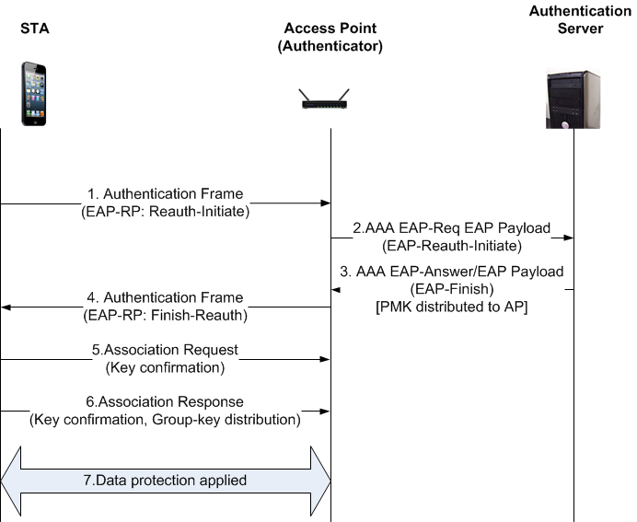
Problem Description
IEEE 802.11ai redesigned the authentication mechanism as shown below.
In the 802.11ai design, a single roundtrip of Authentication signaling is performed prior to the Association
So, the STA will not be able to sleep between steps 1 & 4

Slide 4
However…
The time period between steps 1-4 is not expected to be very large
In most cases, it will be less than 100ms
But a poor backhaul to the authentication server can cause additional delay
Do we want to optimize power during this time?
If Yes, two potential options are proposed in this contribution

Slide 5
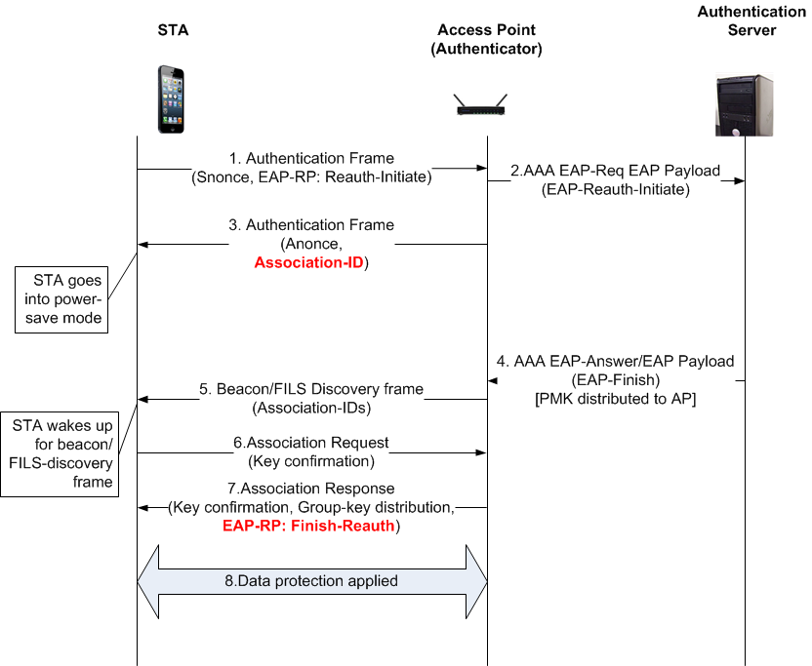
Option-1: Enter Power-save mode based on Authentication frame
STA requests the following at Step-1
“request for PS mode operation”,
“maximum wait-time”
AP operation upon receiving Step-1
If AP is sure to get response back from AS within “maximum wait-time”, then the AP behaves as is defined in the current draft (see also slide-3)
Otherwise the AP sends an Association ID during authentication exchange (shown in Step 3)
“EAP-RP: Finish Reauth” is not included in the Authentication Response frame (message-3 in the above diagram)
The validity of the association ID is set to several TBTTs as chosen by the AP
STA derives the key after step3
STA enters power save mode upon receiving message-3. STA periodically wakes up to see if it gets paged
AP pages the STA when it receives the Authentication Response from the Authentication Server
STA responds to the page by sending Association Request
AP includes the response from AS in the Association Response
IP address assignment with large backhaul delay
Proposed technique is helpful for IP address assignment also, when the backhaul delay for IP address assignment is large (which can be the case when DHCP is used for IP address assignment)
The STA can operate in power-save mode after sending Association Request frame
AP will page the device when the AP is ready with the Association Response
Limitation
FILS association may be delayed depending on how often the beacon frames are broadcasted
Advantage
AP doesn’t need an accurate estimate of the delay from AS
No additional signaling messages

Slide 6
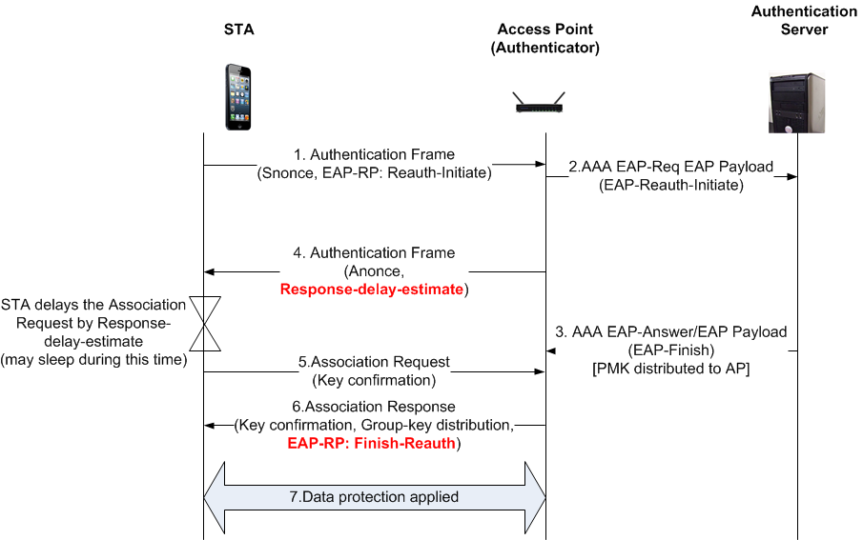
Option-2: STA to delay Association Request
STA requests the following at Step-1
“request for PS mode operation”,
“maximum wait-time”
AP operation upon receiving Step-1
If AP is sure to get response back from AS within “maximum wait-time”, then the AP behaves as is defined in the current draft (see also slide-3)
Otherwise the AP sends “Response Delay Estimate” at step-4
“EAP-RP: Finish Reauth” is not included in step-4
STA holds Association Request based on the “Response delay estimate”
AP includes the response from AS in the Association Response
If the AP hasn’t received response from the AS yet, the AP holds the Association Response until a maximum time chosen by the AP
Limitation
“Response delay estimate” may not be accurate.
Advantage
FILS association is not delayed (if estimation is accurate)
No additional signaling messages

Slide 7
Straw polls
Do you support optimizing power during FILS Association?
Yes
No
Need More information
Do you prefer :
option-1 (STA to operate in power-save mode after receiving Auth Response) or
option-2 (AP to include expected backhaul delay in Auth Response)
Option-1
Option-2
Either is okay
Neither

