Slide 1
802.11mc
Investigation into CID 32 – “11b is Poison”
Date: 2013-04
Authors:

Slide 2
Background
It has been proposed, CID 32, that 11b be dropped
This presentation investigates technical areas between using 1Mbps DSSS and 6Mbps OFDM.

Slide 3
Areas for consideration
Range
Network capacity
Association time
Power consumption issues

Slide 4
Sensitivity
Note: I have considered the range question in some detail because this is the most common reason that is quoted for keeping 11b.
We must be careful when simply looking at data sheets.
OFDM receive sensitivity is 10% PER for 1000B packet (802.11 2012 - 18.3.10.2)
DSSS receive sensitivity is 8% PER for 1024B packet
(802.11 2012 – 16/17.4.8.2)
We see varying differences of the sensitivity for 1Mbps and 6Mbps in data sheets of 1 – 10dB.
Note: It is not known whether all data sheets do measure sensitivity exactly to the specification or under equal conditions.
To avoid any misconceptions, let’s look at the required theoretical SNR:
1Mbps DSSS and 6Mbps OFDM both use DBPSK modulation
We will use the same conditions, 10% PER, 1000B packet

Slide 5
BPSK
The probability of a bit error for DBPSK is
Pb=0.5 exp (-Eb/No) (Many references)
The Packet Error Rate, PER is
PER = 1-(1-Pb)^n
Where, n is the number of bits in the packet.
Hence, for PER = 10%, Packet 1000B
  Pb = 1.32 E-05
  Eb/No = 10.2dB
Note: Eb/No is energy per bit/ Noise per Hertz
For BPSK, SNR = Eb/No.

Slide 6
Sensitivity 1Mbps DSSS
For BPSK for PER 10% with 1000B packet
  Eb/No or SNR is 10.2dB
  Pb = BER = 1.32 E-05
The Processing gain for DSSS is from the 11 bit Barker spreading code
10log(11)= 10.4dB
Hence, the theoretical best SNR for 1Mbps = - 0.2dB

Slide 7
Sensitivity – 6Mbps
The coding gain is due to the convolutional coding, R=1/2, Constraint length 7.
Note that theoretical Coding Gain = 10 log(rate x Dfree) = 10 log (1/2 . 10) = 7dB )
Coding Gain = 5.5dB
ECEN 5682 Theory and Practice of Error Control Codes Convolutional Code Performance – Peter Mathys, Univ of Colorado 2007
ELEC 7073 Digital Communications III, Dept. of E.E.E., HKU

Slide 8
Sensitivity
Theoretically, required SNR for 1000B packet for 10%PER is:
1 Mbps SNR = 10.2 – 10.4 = - 0.2dB
(Note: 4dB often quoted as SNR requirement)
Minimum SNR*=10dB for 11Mbps, 8dB for 5.5Mbps, 6dB for 2Mbps, 4dB for 1Mbps (IEEE 19.5.1 for a 8% BER) =16dB for 11Mbps, 11dB for 5.5Mbps, 7dB for 2Mbps, 4dB for 1Mbps (Industry products for a 10% BER) Columbis Univ
http://www.cisl.columbia.edu/grads/ozgun/ProjectApplication.html
6 Mbps SNR = 10.2– 5.5 = 4.7dB
(Note: EVM spec is -5dB (802.11 - 2012 Table 18-13 )
Sensitivity
Pr = -174 + 10 log BW +NF + SNR dBs
For BW = 16.5MHz (see next slide), NF = 9dB, we get:
1Mbps Pr = -95.3 dBm
6Mbps Pr = -90.4dBm
This looks reasonable and seems to be in the right ballpark. Therefore, for AWGN 1Mbps has a theoretical 4.9dB advantage in sensitivity over 6Mbps
(No implementation losses)

Slide 9
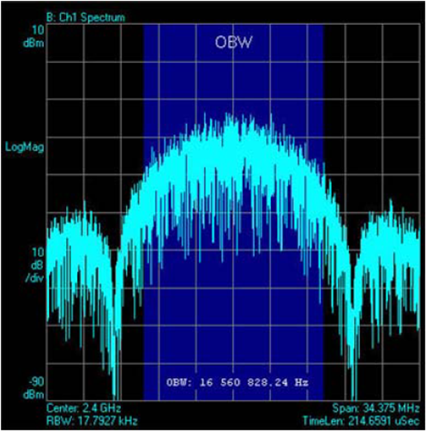
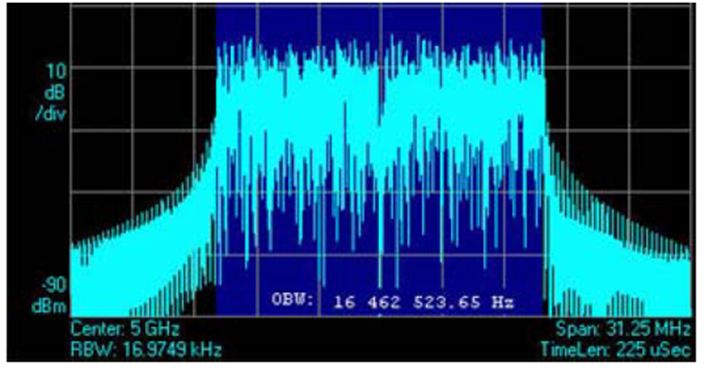
Bandwidth
The received noise is proportional to the channel bandwidth
The occupied bandwidth for both OFDM and DSSS is 16.5MHz,

Slide 10
Practical Channels
The 4.9dB sensitivity difference is theoretical for SNR with AWGN,
What is important is the actual performance over the air.
In practice, the propagation will normally be subject to multipath, delay spread
Fading channel models
  Rayleigh – no LOS
  Rician – some LOS
  Nagasaki – some LOS

Slide 11
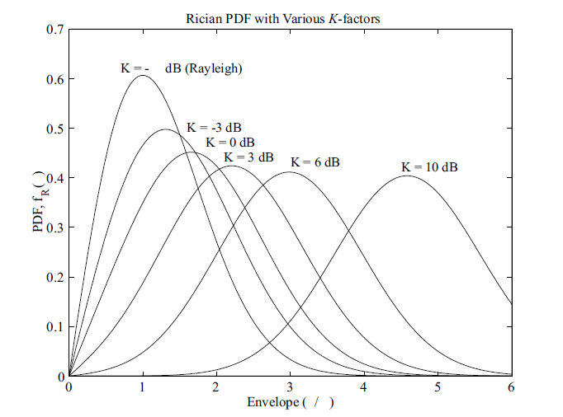
NLOS channel - Rician
It is common to use the Rician Distribution to model the channel channel.
K = 0 , Rayleigh distribution, no LOS
K = 10, outdoor, suburban and
indoor with some LOS
K = 20, outdoor urban
K = 1000, strong LOS (AWGN)

Slide 12
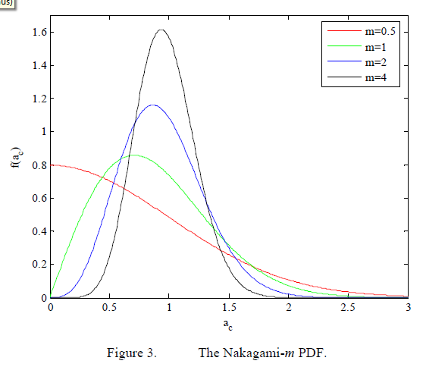
Nakagami - m
The Nakagami-m distribution is used to model fading channel conditions that are either more or less severe than the Rayleigh distribution (m=1). For small values of m (i.e., 0.5 ≤ m ≤1), the fading conditions are severe, while for larger values of m the fading conditions are less severe. As m → ∞ , no fading is present.

Slide 13
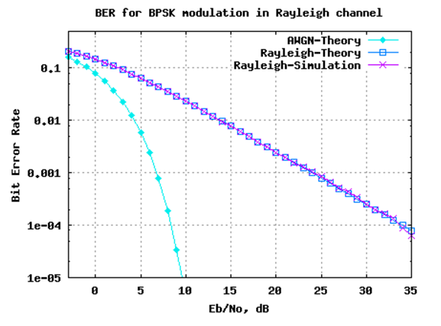
BPSK in Rayleigh fading channel
Ref: Kristna Sanka, DSPLOG
2008
Reference: Proakis – Digital Comms
Note 35dB SNR at 1e-04, rising to over 42dB at 1e-05
So basic BPSK is not good in Rayleigh fading channels

Slide 14
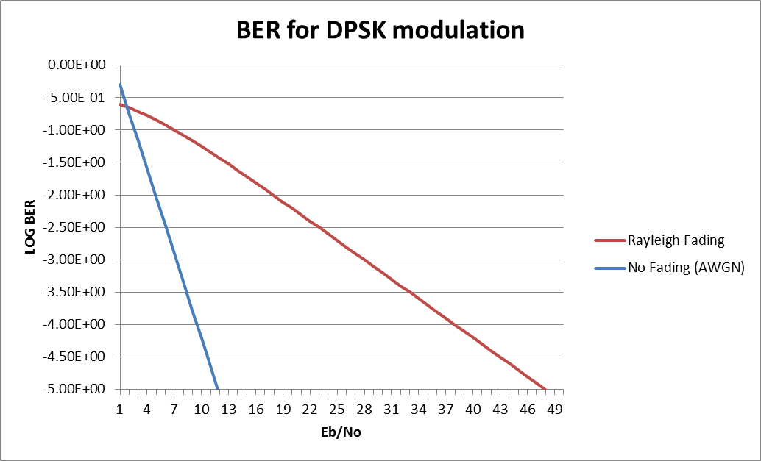
DPSK in Rayleigh Fading
Eb/No = 11dB
For BER 10-5
Ref: Andrea Goldsmith, Wireless Comms, 2005
Ave Pb = 1/(2(1+Eb/No)) in Rayleigh fading
Agrees generally with previous graph, DPSK is not good in Rayleigh fading

Slide 15
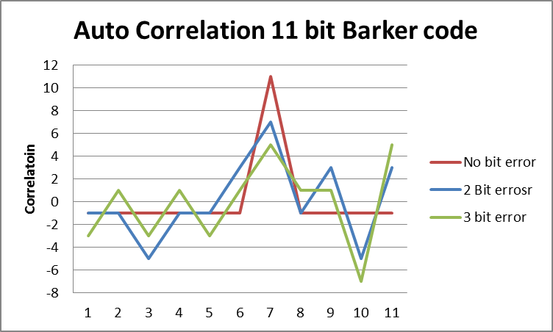
DSSS
DSSS relies upon the 11 bit processing gain.
Note that with 3 bit errors out of 11, the decoded bit is in error
With 2 bit errors, small error margin of only 2 (7 cf 5 or 1.5dB)
Detected peak will fail for 3 or more errors 78% of the time (my experiment)

Slide 16
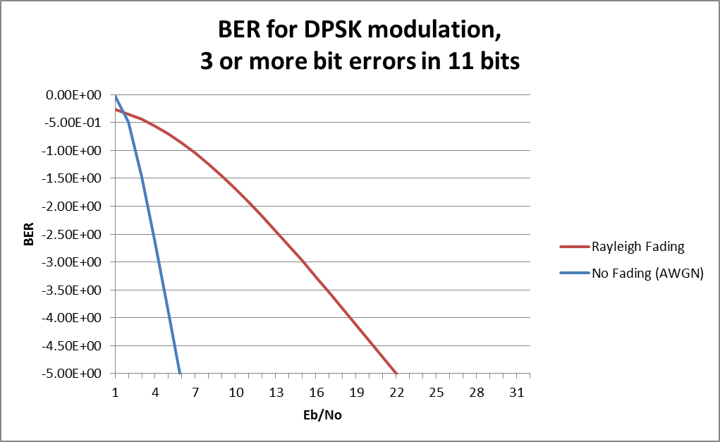
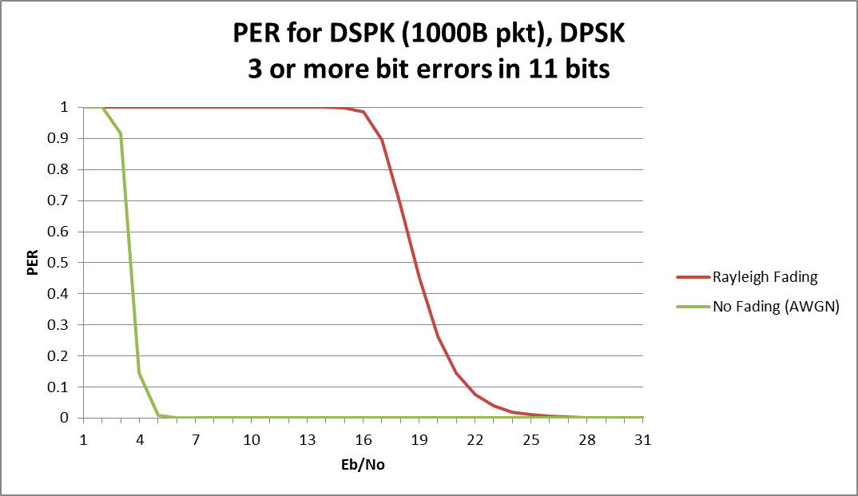
1Mbps DSSS in Rayleigh Fading
SNR required for Rayleigh
Fading is 21dB
(a 26dB improvement!)
But note that SNR required is 3.2dB
for AWGN by this analysis
Only 7dB improvement compared
to 10.4dB theoretical processing Gain

Slide 17
Fading – Coherence bandwidth
Systems operating within the Coherence bandwidth* have flat fading
Systems operating greater than the Coherence bandwidth have selective fading
Coherence bandwidth is related to the delay time spread
With 16.5MHz BW, selective fading will be experienced for delay spreads of about 30ns and more*.
The 11n channel models (Erceg et al , 2004)
  15ns Residential Intra-room, room-room
  30ns Residential/Small Office Conference room, classroom
  50ns Typical Office Sea of cubes, large conference room
  100ns Large Office Multi-storey, campus small hotspots
  150ns Large Space Large hotspot, industrial, city square
Hence, both 1Mbps and 6Mbps will suffer from selective fading over most conditions.
*Note: Coherence BW Bc = 1/(4πT) where T = Delay Spread
Ref: Foundations of Mobile Radio Engineering, Yacoub

Slide 18
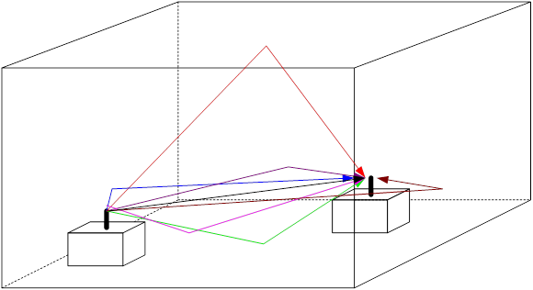
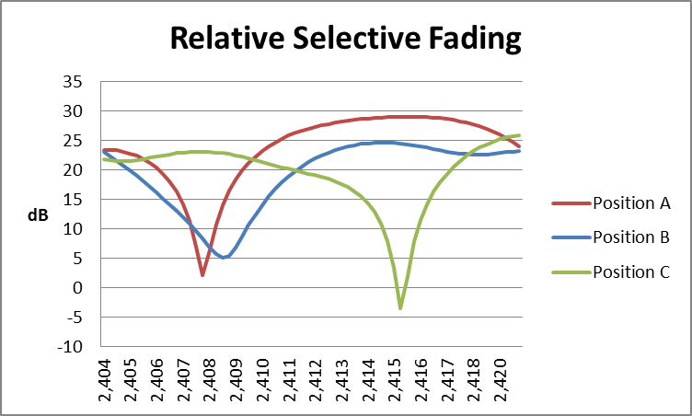
Selective Fading - Examples
Use ray tracing to produce delays
Room 100ft by 70 feet (x, y)
Ceiling 20ft
RX position 65, 44 (3ft off ground)
10dB obstruction to direct
and floor rays
Position A 21, 45 (delays 23 -100ns)
Position B 30, 45 (delays 27 to 102ns)
Position C 13, 45 (delays 21 to 99ns)
Y
X
Fades up to 25dB
Show spread sheet if time

Slide 19
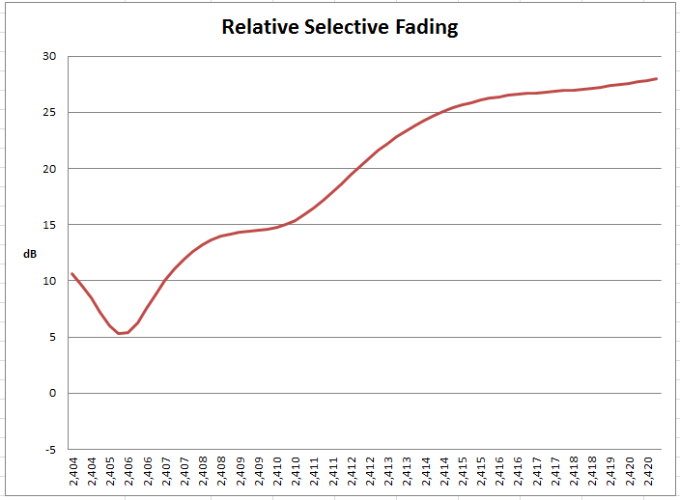
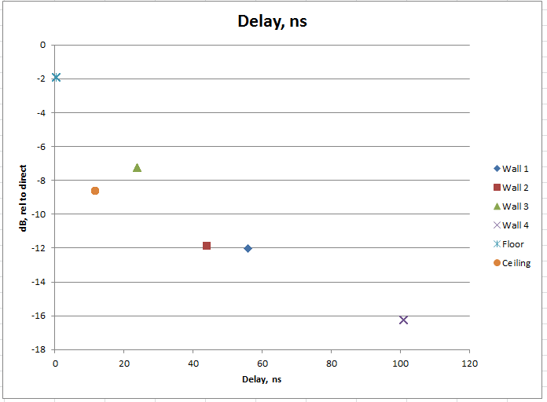
Selective Fading, Delay Spread
TX Position 22, 45
RX position 65, 44
5dB attenuation to direct and floor rays
25dB Deep Fade
Delay Spread about 30-40ns

Slide 20
Fading - DSSS
Selective Fading can easily cause loss of 3 or more bits.
Chipping rate is 11Mbps, 90.9ns per bit, hence:
Large Multipath delays can cause inter symbol distortion.
  Delayed signal will interfere with the start of a signal that has less delay.
Basically, DSSS does not have much protection to multipath fading.

Slide 21
Fading - OFDM
OFDM uses convolutional coding
    Adds redundancy bits (1/2 rate 1 code bit added to every data bit)
    Encodes bits across several symbols (Constraint limit of 7)
    Can correct ~50% bit errors
    Compare to DSSS which only accepts 2 errors in 11 (<20%)
  Uses scrambling to avoid selective fading
  Uses SNR weighting on Viterbi decoder
OFDM uses Guard Interval to protect against excessive delay spread.
OFDM is designed to counter multipath fading.

Slide 22
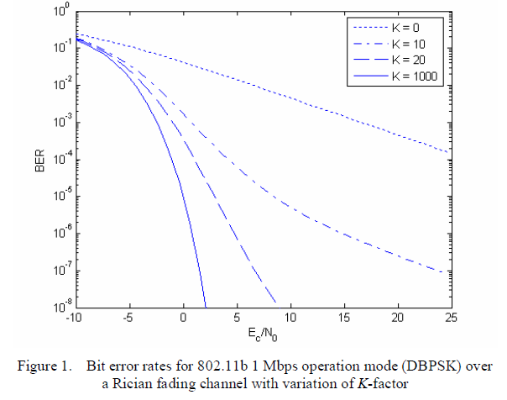
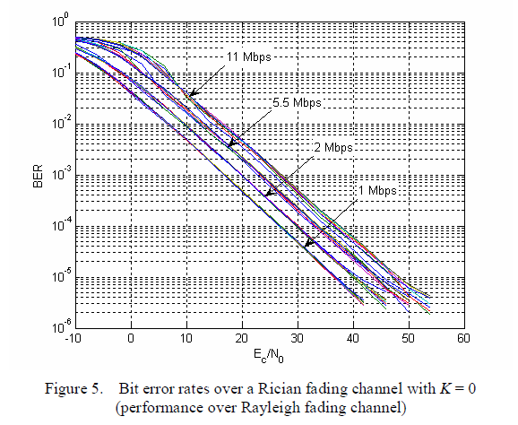
11b 1Mbps in fading Rician channel
Rayleigh Faded channel requires Eb/No of 36dB (k=0),
and 9dB for outdoor urban channel (k = 20)
BER Analysis of 802.11b Networks under Mobility, Puttipong Mahasukhon, et al Computer and Electronics Engineering Department
University of Nebraska-Lincoln

Slide 23
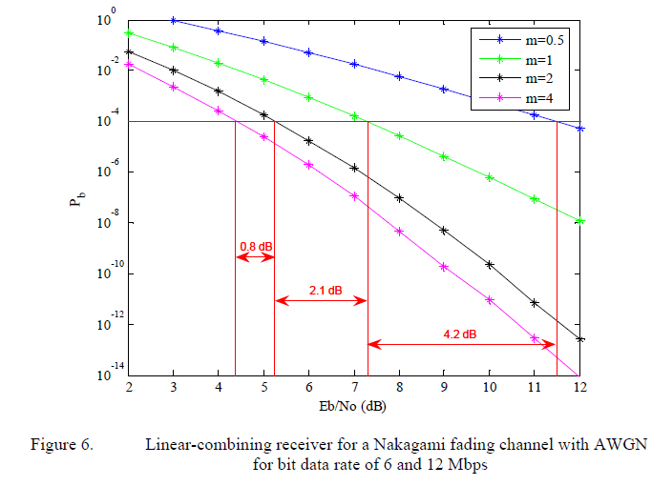
OFDM 6Mbps in fading channel
Eb/No for Rayleigh Channel = 8.5dB
Eb/No for m = 4 is 5.5dB
(This is comparable with Rican k = 20)
Performance Analysis of IEEE 802.11g Waveform Transmitted Over A Fading Channel with Pulse-Noise Interference,
Konstantinos Taxeidis, Naval Postgraduate School, Monterey, CA, 2006

Slide 24
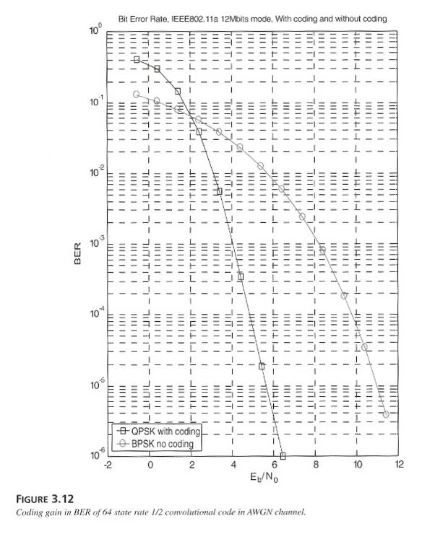
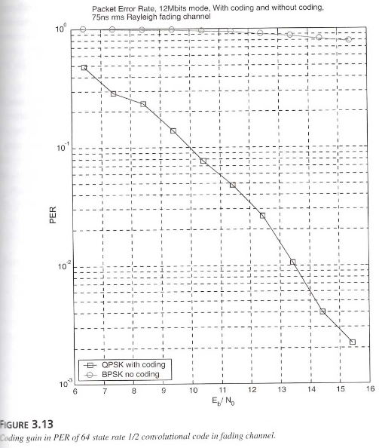
12Mbps BER and PER AWNG and fading
AWGN BER 10-5 Eb/No = 5.5dB
Rayleigh Fading 10% PER Eb/No = 10dB
Ref: OFDM Wireless LANs, John Heiskala, John Terry, 2002

Slide 25
Range Performance comparison
Receive Sensitivity (AWGN)
  1Mbps DSSS is 4.9dB more sensitive than 6Mbps OFDM by basic theory
  1Mbps DSSS is about 2dB more sensitive than 6Mbps in reality.
Performance in a fading channel (simulated)
  6Mbps is 27dB better performance than 1Mbps in Rayleigh fading
  6Mbps is 4.5dB better performance than 1Mbps in Rician (k=20) fading (outdoor urban with some LOS)
  Based upon these results, in practice, unless the path is highly LOS, 6Mbps range will be comparable if not superior to 1Mbps.

Slide 26
1Mbps vs 6Mbps Range
If perfect LOS 1Mbps has a theoretical 12-32% improvement in range over 6Mbps
  32% assumes Free Space Loss only. (4.9dB advantage)
  In practice this is probably more like 12% improvement (2dB advantage)
In normal indoor environment, 6Mbps has a theoretical 12% advantage in range over 1Mbps
  Assumes Rician k=20
  SNR 1Mbps = 9dB, 6Mbps = 7dB for 10% PER 1000B packets
In no LOS conditions (Rayleigh fading)
6Mbps has a 5x advantage in range over 1Mbps
  SNR 1Mbps = 36dB, 6Mbps = 11dB for 10% PER1000B packet
  Conclusion: DOUBTFUL IF THERE IS ANY PRACTICAL OVERALL ADVANTAGE TO USE 1Mbps over 6Mbps for RANGE REASONS

Slide 27
Areas for consideration
Range
Network capacity
Association time
Power consumption issues

Slide 28
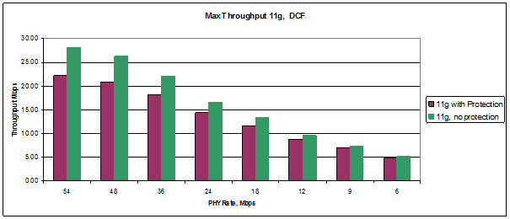
Throughputs – 11b Protection
When 11b STA is in the network, ‘protection’ is used (CTS-to-Self)
  CTS-to-Self must be sent at 11b rate. Theoretically safest is to send at 1Mbps
  BUT most implementations use 11Mbps CTS-to-Self, (1Mbps is too harmful)
  11g, no protection, throughput @54Mbps = 27Mbps
  11g, with protection, throughput @ 54Mbps = 21Mbps, if 11Mbps CTS
  11n, no protection, throughput @130Mbps = 36Mbps (no aggregation)
  11n, with protection, throughput @130Mbps = 27Mbps, 11Mbps CTS
  25% loss of capacity due to use of 11b protection alone.

Slide 29
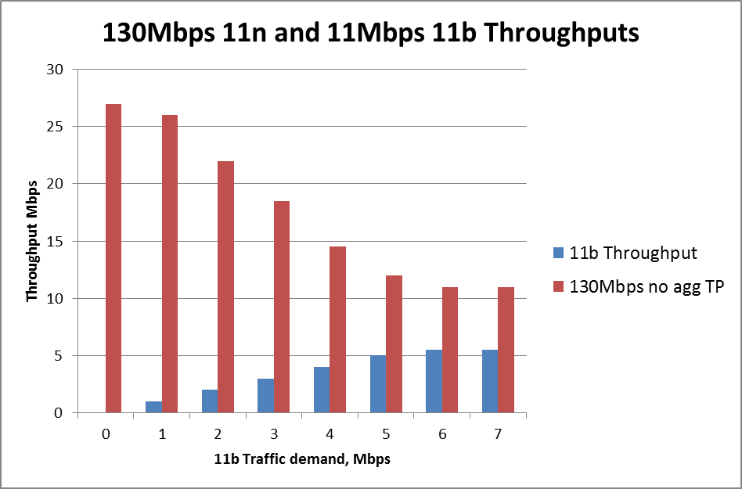
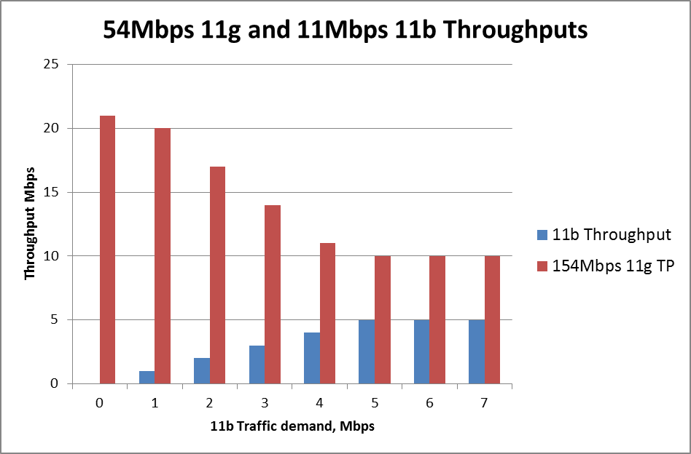
Throughput – Mixed Mode, 11Mbps
When one OFDM and one 11b are competing, the theoretical overall throughput is significantly reduced, even if 11Mbps (short preamble) used
  Theoretical analysis with no fallback, in practice will be worse than this.
If both compete then overall throughput is reduced to 15Mbps total
in theory, practice has shown even worse results (see WPA2 Test Plan very low pass marks)
Compare the mixed mode throughputs to 36Mbps for 11n and 27Mbps for 11g

Slide 30
Mixed Mode Throughput – 1Mbps
BUT if we look at mixed mode 1Mbps and OFDM
11b at 1Mbps | 54Mbps | 130Mbps | 130Mbps 65k Agg
0 | 26Mbps | 36Mbps | 115Mbps
Protection | 21Mbps | 27Mbps | 113Mbps
0.8Mbps | 0.87Mbps | 1.7Mbps | 48Mbps
A 1Mbps stream almost kills any other traffic. Only heavy aggregation overcomes.
Note: The same number of packets are transmitted as for no aggregation, but each packet is now 46 MPDUs.
Just 1Mbps traffic at 1Mbps 11b PHY Rate,
kills 11g or 11n no aggregation traffic - dead

Slide 31
Areas for consideration
Range
Network capacity
Association time
Power consumption issues

Slide 32
Association
Association consists of:
  Probe Request and Response,
  Authentication Request and Response,
  Association Request and Response
  4 way handshake
  A simulation was written for 100 STAs as part of work for 11ai. This was used
  to calculate the above times. All 10 STAs start simultaneously and the variation is due to the random selection of backoff slots for the 10 packets
  Association using 11b only (Probes at 1Mbps, all other packets at 11Mbps)
  Time to complete per STA (zero processing time) = 8.3 to 11ms
  Time to complete per STA (5ms processing time)= 60ms
  Association using OFDM only (Probes at 6Mbps, all other packets at 24Mbps)
  Time to complete per STA (zero processing time) = 3ms
  Time to complete per STA (5ms processing time) = 47ms (Dominated by Processing time)

Slide 33
Association
  If all packets sent at 1Mbps , total time for all 10 STAs to complete = 220-300ms
  assuming zero processing time
  If Probes sent at 1Mbps, all other packets at 11Mbps, time = 83 – 109ms
  This is minimum time using 11b
  If all at 6Mbps, then total time for 10 STAs is 44–50ms
  This would be the maximum time if OFDM only.
  If Probes sent at 6Mbps, all other packets at 24Mbps, time = 26 – 36ms
  This is average, minimum time using OFDM
  Compare 83 – 109ms with 26 – 36ms
  OFDM is at least 3x faster.

Slide 34
Areas for consideration
Range
Network capacity
Association time
Power consumption issues

Slide 35
Power Consumption – Power Amplifier
Power Amplifier
  6Mbps OFDM requires -5dB EVM
  1Mbps DSSS requires 4dB SNR, (or -4dB EVM)
  11Mbps CCK requires 12dB SNR (or -12dB EVM)
  At -5dB EVM, the OFDM PA can be just as efficient as an 11b only PA.
  Note that
    6Mbps = -5dB or 56.2% EVM
    12Mbps = -10dB or 31.6% EVM
    18Mbps = -13dB or 22.4% EVM (Note that 18Mbps is comparable to 11Mbps for EVM)
    24Mbps = -16dB or 15.8% EVM
  At all these rates the PA can be at full gain and output (usually specifying 3-5% EVM)
  As far as PA is concerned there is no practical power consumption penalty between 11b and the lower rates of OFDM (up to 24Mbps)
  It is true that the OFDM PAPR means that a backoff of about 4dB is required, so a PA design solely for 11b may have some advantage, but it would be negligible.
  New OFDM PA designs such as Doherty amplifiers are achieving 70% efficiencies for low EVM <5%

Slide 36
Power Consumption – On Air Time
For comparison purposes we look at the packet + ACK duration for various packet sizes.
We compare
1Mbps time vs. or 6Mbps (minimum rate)
11Mbps time vs. 12Mbps (comparable PHY rate)
11Mbps time vs. 24Mbps (highest basic rate)
1Mbps duration 6x that for 6Mbps
11Mbps duration 1.2 to 1.7 x that for 12Mbps
Packet durations are significantly less for OFDM compared to 11b
Note: In all calculations 11Mbps Short Preamble is used.

Slide 37
Power Consumption – Beacons
Assuming a beacon of 160B, time on air is
  1472us for 1Mbps
  240us for 6Mbps
Beacon is 1/6 duration at 6Mbps compared to 1Mbps.

Slide 38
Power Consumption
Comparing an 11g OFDM Only device with 11b/g device
Association time is 3-5 times quicker
Beacons are1/6 the time at 6Mbps cf 1Mbps
Packet durations are less than ½ at the higher rates (24Mbps vs. 11Mbps)
  Short packets are even more efficient up to 1/3
Hence, time on air to associate or transmit/receive packets is significantly less for OFDM compared to 11b
  Time to wake up, associate, send 100B packet using 11b is 443us (1 and11Mbps)
  Time to wake up, associate, send 100B packet using OFDM is 158us (6 and 24Mbps)
  11b is 3x longer on air.

Slide 39
Summary and Comments
1Mbps has a 4.6dB theoretical receive sensitivity advantage over 6Mbps
  This is only true for pure LOS channel (AWGN)
  When considering fading channels, 6Mbps has range advantage over NLOS paths.
  For channels with some LOS (Rician k=20) then the range performance is comparable
  6Mbps may well be the better for range when taken over most practical conditions
  The statement that “1Mbps has better range than 6Mbps” is not true in many conditions
Throughput is significantly (drastically if 11b is 1Mbps) reduced in a mixed mode network
  The need to use ‘protection’ (CTS-to-Self) reduces the capacity of the network by 25%
  Mixed mode total throughput is reduced by 58% for 11g and 70% for 11n (2SS, 20MHz, no agg) with 11Mbps 11b.
  1Mbps 11b traffic reduces total throughput to <2Mbps unless aggregation is used, then still reduced by 76% even for 65k aggregation.
  Note that this is also true for overlapping networks

Slide 40
Summary and Comments
Beacon duration, Association time, packet durations are all significantly less at OFDM than with 11b. Power Consumption would therefore benefit
  Beacon duration is reduced by 84% if sent at 6Mbps compared to 1Mbps
  (240us, cf 1472us for 160B beacon)
  Time for a STA to Associate is reduced by 70%, but packet processing time can reduce this.
  Packet duration for 11Mbps compared to 12Mbps (equivalent in receive sensitivity) are 1.2 to 1.7 longer for 1500B and 100B packets respectively.
Power Consumption is better for 2.4GHz OFDM only solution than for 11b only or even mixed
  Without the need for ’protection’ (which takes up time), and with the significantly reduced association times and packet durations power consumption has to be less.
  PA design for 11b only can be very efficient but present PAs are designed for 11b/g hence they are only about 40% efficient to cater for the low EVM. Designing for only up to, say 24Mbps (covering all the Basic Rates) would allow much higher efficiency for sensor type applications.

Slide 41
Summary and Comments
Power Amplifier
  PA design for 11b only can be very efficient but present PAs are designed for 11b/g hence they are only about 40% efficient to cater for the low EVM. Designing for only up to, say 24Mbps (EVM 16%) (covering all the Basic Rates) would allow much higher efficiency for SensorNet type applications.
  For applications that presently use 11b/g/n the PA is not optimized at all for the 11b rates, so dropping 11b makes no difference.
  New designs using the Doherty amplifier and other similar techniques can raise the OFDM PA efficiently to 70% for EVM 5% or less (several papers recently presented at IEEE Radio Wireless Week, 2013)
Catering for 11b requires a separate Baseband for DSSS and CCK. This is totally separate and an extra expense.
11b uses different SIFS, Slot times, CW and TXOPs all these cause confusion in implementations. Only one set of WMM parameters (including TXOP limits) is advertised so 11b is not correctly covered anyway. Also devices will use 9us slot time not 20us even if using 11b in an 11g device. (Specification).

Slide 42
Conclusions
In all technical aspects other than the 4.9dB theoretical advantage in AWGN sensitivity of 1Mbps over 6Mbps, there is no reason why 11b should be preferred in any scenario. The real life performance over real channels starts to favor 6Mbps as the LOS conditions diminish.
A major problem is the mixed mode throughput where the existence of a 1Mbps stream kills any overlapping or co-existing devices. If 11b were dropped the mixed mode throughput problem would be solved. If nothing else this a major reason to drop 11b.
Without any doubt the capacity of 2.4GHz networks is improved if ‘protection’ is not required. Many APs send CTS-to-Self automatically because of possibility of overlapping networks.

Slide 43
Poll
In view of the points presented, do you agree that it would be beneficial to 802.11 if if 11b was to be phased out?
Yes, No,

Slide 44
Additional Information

Slide 45
Range – Indoor Propagation
INDOOR Propagation
  Distance factor is 40logD, or 12dB per octave
  2 dB difference relates to a 12% difference in range
  Also note that loss through a:
    drywall is 3dB,
    floor is 5dB
    wall is 10dB
  Indoor range, no obstructions ~ 442ft, sensitivity -91dBm
  Indoor range, no obstructions ~ 394ft, sensitivity -89dBm
5dB Margin loss added (rule of thumb).
For 11b this may need to be higher, ~9dB
For OFDM this is about right.
Good indoor coverage with either
Assuming a wall every 12 feet, -89dBm just makes the 9th room,
-91dBm just covers the 9th room

Slide 46
Range – Outdoor Propagation
OUTDOOR Propagation
  Distance factor is 35logD, or 10.5dB per octave
  2dB difference relates to a 14% difference in range
Using Hata, the range difference is 12%
Note about 20dB extra loss between suburban and large urban environments.
For 11b 1Mbps this may be about right (9dB cf 36dB)
For 6Mbps this is too much (7dB cf 11dB)

