Slide 1
Supplementary Plenary Information - May 2013
Date: 2013- May -12
Authors:
Name
Company
Address
Phone
email
Bruce Kraemer
Marvell
5488 Marvell Lane,
Santa Clara, CA, 95054
+1 (321) 751-3958
bkraemer@
marvell
.com
Abstract: Additional Information on topics for 802.11 Plenary meeting – May 2013
Notes:
November 2011

Slide 2
Monday
Notes:
November 2011

Slide 3
IEEE LOA Database – May 09, 2013
Friday Agenda Item 3.2.1
http://standards.ieee.org/db/patents/pat802_11.html
9 entries with 2013 submission dates

Slide 4
Room Schematic
Monday Agenda Item 4.1.3
Kohala
King’s
Monarchy
Queen’s
Kona
Waikoloa
Lagoon

Slide 5
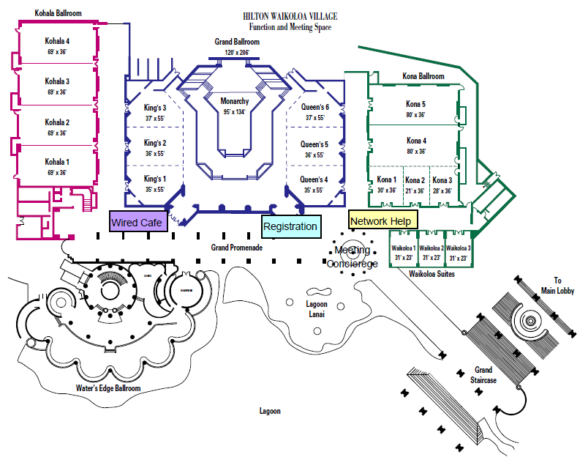
Monday Agenda Item 4.1.3

Slide 6
Joint Meetings
Monday Agenda Item 4.1.4
External:
With 802.1 Tuesday 10:30 am2 – conference call
Subject: ISO JTC1
Internal: Tuesday 10:30 am am2 ARC & 802.11AK

Slide 7
July 2013 PARS
Monday Agenda Item 4.1.5
None submitted yet

Slide 8
Group Room assignments
Monday Agenda Item 4.1.6
WG | Room
1
16 | Waikoloa 1
18 | Kona 1
19 | Kohala 4
21 | Kona 2
22 | Kona 3
24 | King’s 1
OMNI RAN | King’s 1
Notes:
November 2011

Slide 9
WG Agendas
Monday Agenda Item 4.1.6
18: Agenda 18-13-0043r9
Opening Report 18-13-
19: Agenda 19-13-0056 r0
Opening Report 19-13-
21: Agenda 21-13-0066 r0
Opening Report 21-13-
22: Agenda 22-13- 0072 r0
Opening Report 22-13-
24: Agenda 22-13-0019 r0
Opening Report 22-13-
OmniRAN Agenda 22-13-0030 r1
Opening Report 22-13-

Slide 10
802.18 topics – Timeslots to be assigned
Monday Agenda Item 4.1.6
STATUS UPDATES OF OPEN PROCEEDINGS (TV BAND INCENTIVE AUCTION, ETC.)
FCC Review of RF Exposure Policies (18-13/046r0)
REPORT ON RECENT DEVELOPMENTS CONCERNING PLT AND WIRED TELECOMMUNICATION SYSTEMS (18-13/052r0)
ITU-R Question 236/1 Followup - Inputs from 802 WG's? (18-12/052r0)
FCC 5 GHz UNII Rules Revision NPRM (18-13/17r0)
FCC Request for Comments on TAC White Paper on Interference Limits Policy (18-13/053r0, 18-13/054r0)
IEEE USA Petition for Declaratory Ruling Related to New Equipment and Services at Frequencies Greater than 95 GHz (18-13/055r0)
ITU-T SG 5 Liaison Letter and draft 3rd revision of draft Recommendation K.mhn (18-13/056r0, 18-13/057r0) OfCom Consultation license on exempt 2400MHz (18-13/059r0)

Slide 11
July 14-19, 2013 Geneva
Monday Agenda Item 4.1.7
IEEE 802 Plenary Session – July 14-19, 2013 Geneva, Switzerland
International Telecommunication Union (ITU)
Place des Nations, 1211 Geneva 20, Switzerland (MAP)
ATTENDEE REGISTRATION (http://802world.org/plenary)
DEADLINES (6 PM Pacific Time)
•
EARLY: MAY 24, 2013 , • STANDARD: JUNE 28, 2013, • LATE: AFTER JUNE 28, 2013
FEES: $US 500 US 600 $US 800
Hotel Registration OPEN
Meeting Registration OPEN
http://www.ieee802.org/11/Meetings/Meeting_Plan.html

Slide 12
Meeting Registration
Monday Agenda Item 4.1.8
Working Group | Number | Percent
802.11 | 212 | 62.17%
802.15 | 81 | 23.75%
none | 6 | 1.76%
802.16 | 8 | 2.35%
802.21 | 8 | 2.35%
802.19 | 7 | 2.05%
802.22 | 9 | 2.64%
802.24 | 3 | 0.88%
802.18 | 3 | 0.88%
802.25 | 3 | 0.88%
802.xx | 1 | 0.29%
 | 341

Slide 13
IEEE Staff on site
Monday Agenda Item 4.1.9
None

Slide 14
Other Special Events
Monday Agenda Item 4.1.10
Breakfast & Breaks:
Grand Promenade
Lunch: Included in registration – no fee
Grand Promenade
Wednesday Social 6:30 pm start
Badge needed for admission – Guest also
Kamehameha Court

Slide 15
Social Location – Kamehameha Court
Monday Agenda Item 4.1.10
Kamehameha Court
Wednesday Social 6:30 pm start
Badge needed for admission – Guest also

Slide 16
Current Membership Status
Monday Agenda Item 4.1.11
Status | Number
Aspirant | 87
Potential Voter | 31
Voter | 324
Definitions:
Aspirant: a member who has attended 1 qualifying meeting
Potential Voter: a member who has attended 2 qualifying meetings and will become a voter at the start of the next plenary they attend
Data as of 2012-11-16

Slide 17
Wednesday Plenary Topics
Monday Agenda Item 4.1.12
The fate of 11b
Further discussion in MC
Nufront – coexistence discussion
Further discussion in ?? on Thursday

Slide 18
802.1 Architecture Document
Monday Agenda Item 4.1.13

Slide 19
802.11 Topics for July 2013 EC
Monday Agenda Item 4.1.15
Begin Sponsor Ballot
Conditional approval for AF - Open Sponsor Ballot Group formation
Requests to submit to RevCom?
x
New project PAR to NesCom?
x
PAR Extension ?
AF
Revision PAR?
Nothing needed at this time
Study Group start up?
Depends upon results of WNG meeting
Study Group extension?
HEW
Press Release

Slide 20
July Tutorials
Monday Agenda Item 4.1.16
http://ieee802.org/Tutorials.shtml
Tutorial #1 (6:00–7:30 pm): White Rabbit - Ethernet-based solution for sub-ns synchronization and deterministic, reliable data delivery Presentation Maciej Lipinski, CERN / Warsaw University of Technology | Sponsored by Tony Jeffree, Chair, IEEE 802.1 WG
Tutorial #2 (7:30–9:00 pm): Interspersing Express Traffic on IEEE 802.3 Networks Presentation Ludwig Winkel, Siemens Michael J Teener, Broadcom Albert Tretter, Siemens Oliver Kleiniberg, Hirschmann Christian Boiger, Deggendorf University of Applied Sciences Path Thaler, Broadcom

Slide 21
Wednesday
Notes:
November 2011

Slide 22
Social Location – Kamehameha Court
Monday Agenda Item 2.7
Kamehameha Court
Wednesday Social 6:30 pm start
Badge needed for admission – Guest also

Slide 23
Wednesday Agenda Item 5.1
Room Changes
Remove AF Thursday am1
Remove AF Thursday pm1
Add HEW Thursday pm1
Notes:
November 2011

Slide 24
Wednesday Agenda Item 5.2
Revised Agenda Graphic
If needed

Slide 25
Wednesday Agenda Item 5.3
Mid-week Officer Changes
If needed

Slide 26
Friday

Slide 27
Announcements
Friday Agenda Item 2.07
Coffee will be continuously available from 7:30am to 11:00am
Propose that we proceed continuously through the agenda with target completion time of 10:00 am

Slide 28
IEEE LOA Database – May 11, 2013
Friday Agenda Item 2.08
http://standards.ieee.org/db/patents/pat802_11.html
9 entries with 2013 submission dates

Slide 29
IEEE Store Contents - May 2013
Friday Agenda Item 2.09
http://www.techstreet.com/ieeegate.html
http://standards.ieee.org/about/get/802/802.11.html
Amendment | Draft in TechStreet May 11 | Draft in Members Area | Publication in Get 802 May 11
AF | D4.0 $300 pdf | 4.0
AC | D5.0 $250 pdf | 5.0
AD-2012 | $360 print | 9.0
AE-2012 | $105 print |  | P
AA-2012 | $180 print |  | P
802.11 -2012 | $540 print |  | P
b, k, i, n, p, y, r, w, u, v, z, s | $100 - $305
802.11-2007
Notes:
November 2011

Slide 30
802.11 drafts to ISO/IEC JTC1/SC6
Friday Agenda Item 2.10
Task Group | After Vancouver
TGae
TGaa
TGREVmb
TGad
TGac | D5.0
Notes:
November 2011

Slide 31
July Tutorials
Friday Agenda Item 2.11
http://ieee802.org/Tutorials.shtml
Tutorial #1 (6:00–7:30 pm): White Rabbit - Ethernet-based solution for sub-ns synchronization and deterministic, reliable data delivery Presentation Maciej Lipinski, CERN / Warsaw University of Technology | Sponsored by Tony Jeffree, Chair, IEEE 802.1 WG
Tutorial #2 (7:30–9:00 pm): Interspersing Express Traffic on IEEE 802.3 Networks Presentation Ludwig Winkel, Siemens Michael J Teener, Broadcom Albert Tretter, Siemens Oliver Kleiniberg, Hirschmann Christian Boiger, Deggendorf University of Applied Sciences Path Thaler, Broadcom

Slide 32
University Outreach
Wednesday Agenda Item 6.2
There is Outreach planned

Slide 33
Future Venues -2013
Friday Agenda Item 6.3
2013
# 137 January 13-18, 2013 - --Hyatt Regency Vancouver, BC, CA
#137.5 January 23-24, Grand Mercure, Shenzhen, CN
# 138 March 17-22, 2013 –Caribe Royale, Orlando, FL, USA
# 139 May 12-17, 2013 ----Hilton Waikoloa, Big Island, HI
#139.5 April 24-25 – Beijing, China
# 140 July 14-19, 2013 --- Geneva , CH ITU headquarters
# 141 September 15-20, 2013- Zhong Shan Hotel, – Nanjing, China
# 142 Nov 10-15, 2013 Hyatt Regency Dallas, TX, USA
Notes:
November 2011

Slide 34
July 2013 Plenary - Geneva
Friday Agenda Item 6.3
Saturday July 13 prior to the session there will be a Workshop
Further details to follow

Slide 35
Future Venues - 2014
Friday Agenda Item 6.3
2014
# 143 January 19-24, 2014 -Hyatt Century Plaza, Los Angeles, CA, US
#143.5 January 8-9, 2014 - China
# 144 March 16-21, 2014 – Beijing, China
# 145 May 11-16, 2014 ----Hilton Waikoloa, Big Island, HI
#145.5 May21-22, 2014 - China
# 146 July 13-18, 2014 - Manchester Grand Hyatt, San Diego, CA, US
# 147 September 14-19, 2014----1st priority– Kobe, Japan
#147.5 September24-25, 2014 - China
# 148 November 2-7, 2014 Hyatt Regency San Antonio, TX, US
Notes:
November 2011

Slide 36
2014
Friday Agenda Item 6.3
For Year 2014 |  | Session | Type
January 19-24 | Hyatt Century Plaza, Los Angeles | 143 | Interim*
January 6-10 | China (TBD) | 143.5 | China Interim
March 16-21 | China World Hotel (TBC) Beijing, China | 144 | Plenary
May 11-16 | Hilton Waikoloa Village, HI, USA | 145 | Interim*
May 20-24 | China (TBD) | 145.5 | China Interim
July 13-18 | Manchester Grand Hyatt San Diego | 146 | Plenary
September 14-19 | Kobe Convention Center, Japan (To be confirmed) | 147 | Interim*
September 23-27 | China (TBD) | 147.5 | China Interim
November 2-7 | Grand Hyatt San Antonio, San Antonio, TX, USA | 148 | Plenary

Slide 37
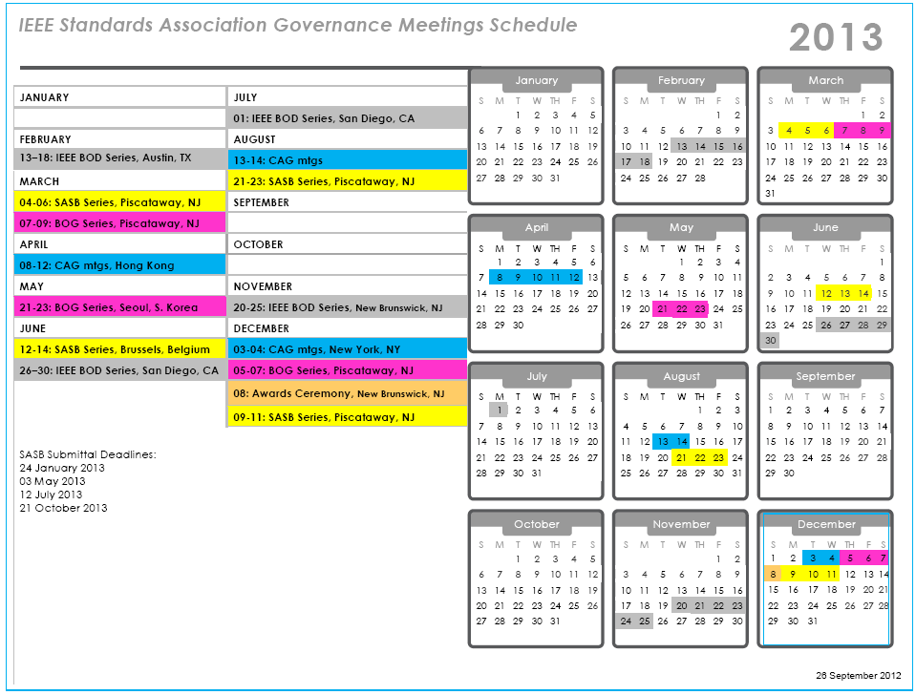

Slide 38
