Slide 1
WG11 Plenary - Supplementary Information - April 2013
Date: 2013-04-21
Authors:
Abstract: Additional Information on topics for the 802.11 Beijing interim meeting – April 2013
Notes:
November 2011

Slide 2
Wednesday
Notes:
November 2011

Slide 3
IEEE 802.11

Slide 4
Current Procedures
Wednesday Agenda Item 3.1.1
IEEE 802 Policies & Procedures
(link to AudCom, approved by IEEE-SA Standards Board 25 August, 2010)
http://standards.ieee.org/board/aud/LMSC.pdf
IEEE 802 Operations Manual (effective 20 July, 2012),
http://grouper.ieee.org/groups/802/PNP/approved/IEEE_802_LMSC_OM_approved_120725.pdf
IEEE 802 Working Group Policies and Procedures (effective 16 March, 2012)
http://grouper.ieee.org/groups/802/PNP/approved/IEEE_802_LMSC_WG_PandP_approved_120604-v1.pdf
IEEE 802.11 Operations Manual (WG11 OM) (Effective July 20, 2012)
https://mentor.ieee.org/802.11/documents?is_dcn=2&is_year=2009
Policies and Procedures hierarchy
http://www.ieee802.org/11/Rules/rules.shtml

Slide 5
Participants, Patents, and Duty to Inform
Wednesday Agenda Item 3.1.3
All participants in this meeting have certain obligations under the IEEE-SA Patent Policy.
Participants
[Note: Quoted text excerpted from IEEE-SA Standards Board Bylaws subclause 6.2]:
“Shall inform the IEEE (or cause the IEEE to be informed)” of the identity of each “holder of any potential Essential Patent Claims of which they are personally aware” if the claims are owned or controlled by the participant or the entity the participant is from, employed by, or otherwise represents
“Personal awareness” means that the participant “is personally aware that the holder may have a potential Essential Patent Claim,” even if the participant is not personally aware of the specific patents or patent claims
“Should inform the IEEE (or cause the IEEE to be informed)” of the identity of “any other holders of such potential Essential Patent Claims” (that is, third parties that are not affiliated with the participant, with the participant’s employer, or with anyone else that the participant is from or otherwise represents)
The above does not apply if the patent claim is already the subject of an Accepted Letter of Assurance that applies to the proposed standard(s) under consideration by this group
Early identification of holders of potential Essential Patent Claims is strongly encouraged
No duty to perform a patent search

Slide 6
Patent Related Links
Wednesday Agenda Item 3.1.3
All participants should be familiar with their obligations under the IEEE-SA Policies & Procedures for standards development.
Patent Policy is stated in these sources:
IEEE-SA Standards Boards Bylaws
http://standards.ieee.org/develop/policies/bylaws/sect6-7.html#6
IEEE-SA Standards Board Operations Manual
http://standards.ieee.org/develop/policies/opman/sect6.html#6.3
Material about the patent policy is available at
http://standards.ieee.org/about/sasb/patcom/materials.html
If you have questions, contact the IEEE-SA Standards Board Patent Committee Administrator at patcom@ieee.org or visit http://standards.ieee.org/about/sasb/patcom/index.html
This slide set is available at https://development.standards.ieee.org/myproject/Public/mytools/mob/slideset.ppt

Slide 7
Call for Potentially Essential Patents
Wednesday Agenda Item 3.2
If anyone in this meeting is personally aware of the holder of any patent claims that are potentially essential to implementation of the proposed standard(s) under consideration by this group and that are not already the subject of an Accepted Letter of Assurance:
Either speak up now or
Provide the chair of this group with the identity of the holder(s) of any and all such claims as soon as possible or
Cause an LOA to be submitted

Slide 8
IEEE LOA Database
Wednesday Agenda Item 3.3
http://standards.ieee.org/about/sasb/patcom/pat802_11.html
8 entries with 2013 submission dates

Slide 9
Other Guidelines for IEEE WG Meetings
Wednesday Agenda Item 3.4
All IEEE-SA standards meetings shall be conducted in compliance with all applicable laws, including antitrust and competition laws.
Don’t discuss the interpretation, validity, or essentiality of patents/patent claims.
Don’t discuss specific license rates, terms, or conditions.
Relative costs, including licensing costs of essential patent claims, of different technical approaches may be discussed in standards development meetings.
Technical considerations remain primary focus
Don’t discuss or engage in the fixing of product prices, allocation of customers, or division of sales markets.
Don’t discuss the status or substance of ongoing or threatened litigation.
Don’t be silent if inappropriate topics are discussed … do formally object.
---------------------------------------------------------------
See IEEE-SA Standards Board Operations Manual, clause 5.3.10 and “Promoting Competition and Innovation: What You Need to Know about the IEEE Standards Association's Antitrust and Competition Policy” for more details.
Notes:
9

Slide 10
Reminder for Posting Documents
Wednesday Agenda Item 3.5
From 802.11OM –
All submissions presented to and all minutes shall be posted to the 802.11 document server.
Please check to ensure all documents are posted
If you have a “pending” document that is in error, let Adrian or Jon know.

Slide 11
4-hour rule clarification
Wednesday Agenda Item 3.5
4-hour rule applies only to the time between a submission being placed on the server and a motion being made to modify the draft referencing that submission.
The 4-hour rule does not apply to:
A submission be placed on the server that proposes changes to a draft and presentation or discussion of those changes.
A submission supporting a motion that does not modify the draft.
Any other kinds of submission.

Slide 12
Roll Call of Attendees
Wednesday Agenda Item 4.1, 4.2
Introduction of new meeting attendees
Photographs with name tags
Plan to post on 802.11 website

Slide 13
May 12-17 2013 Meeting Waikoloa, Hawaii, USA
Wednesday Agenda Item 2.3
http://www.ieee802.org/11/Meetings/Meeting_Plan.html
Hotel Registration OPEN
Early bird room rate sold out
Now $169 per night
Meeting Registration OPEN
Early bird registration expires
Friday May 3

Slide 14
July 14-19 2013 Meeting Geneva , Switzerland
Wednesday Agenda Item 2.3
http://www.ieee802.org/11/Meetings/Meeting_Plan.html
Hotel Registration OPEN
No special hotel
Meeting Registration OPEN
Early bird registration expires
Friday

Slide 15
802.1 Architecture Document
Wednesday Agenda Item 4.10
D1.5 of the P802 is latest version
Comment collection period started on D1.5
802.11 members can provide comments following
http://www.ieee802.org/11/LetterBallots/CC3ARC/CC3_instructions.html

Slide 16
802.24 – Smart Grid WG
Wednesday Agenda Item 4.10
One ad-hoc meeting will be held
Tuesday 2012-09-18, 16:00-18:00
The agenda will be to review action items from July and prepare for our first official meeting during the November plenary.
Meeting set up in IMAT so that attendance credit can be claimed for 802.11.

Slide 17
Tutorials
Wednesday Agenda Item 4.10
None during September 2012
November 2012 tutorials:
Monday
AVB (Sponsored by Tony Jeffree)
L2 Routing (Sponsored by Bob Heile)
Medical Device Interop (Sponsored by Bob Heile)
Tuesday
Smart Grid TAG overview (Sponsored by James Gilb)

Slide 18
Reports
Wednesday Agenda Item 5.1-5.4
Membership Summary
Refer to Document 11-12-0038r4

Slide 19
Wednesday Agenda Item 5.2, 5.3, 5.4
Recess to convene 802.11aj

Slide 20
Thursday

Slide 21
IEEE LOA Database – March 19, 2013
Friday Agenda Item 2.08
http://standards.ieee.org/db/patents/pat802_11.html
8 entries with 2013 submission dates

Slide 22
IEEE Store Contents - March 2013
Friday Agenda Item 2.09
http://www.techstreet.com/ieeegate.html
http://standards.ieee.org/about/get/802/802.11.html
Amendment | Draft in TechStreet Mar 18 | Draft in Members Area | Publication in Get 802 Mar 18
AF | D3.0 $300 | 3.0
AC | D5.0 $250 | 5.0
AD-2012 | $300 | 9.0
AE-2012 | $105 |  | P
AA-2012 | $180 |  | P
802.11 -2012 | $540 print |  | P
b, k, i, n, p, y, r, w, u, v, z, s | $100 - $305
802.11-2007
Notes:
November 2011

Slide 23
802.11 drafts to ISO/IEC JTC1/SC6
Friday Agenda Item 2.10
Task Group | After Vancouver
TGae
TGaa
TGREVmb
TGad
TGac | D5.0
Notes:
November 2011

Slide 24
Tutorials
Friday Agenda Item 2.11
Call for July 2013 suggestions

Slide 25
IOT Summary
Friday Agenda Item 6.1
IEEE has a website with a long list of standards
Include amendment projects underway
Prepare a sentence or two for each item describing how it contributes to IOT
Update web presence
Compare to ETSI one M2M
Add info from SXSW
Add info on Shenzhen IOT event
Feed info into IoT Steering Committee

Slide 26
802.11 drafts to ISO/IEC JTC1/SC6
Thursday Agenda Item 2.10
Task Group | After Okinawa | After Atlanta | After Jacksonville | After Waikoloa | After Atlanta | After San Diego
TGad |  |  | D5.0 | D7.0 | D8.0 | D9.0
TGac | - |  | D2.0 |  | D3.0
The WG told SC6 it would liaise 802.11ac as soon as it passes a LB
802.11-2012 was submitted to SC6 when approved by the SASB – April 2012
Notes:
November 2011

Slide 27
Future Venues -2013
Friday Agenda Item 6.3
2013
# 137 January 13-18, 2013 - --Hyatt Regency Vancouver, BC, CA
#137.5 January 23-24, Grand Mercure, Shenzhen, CN
# 138 March 17-22, 2013 –Caribe Royale, Orlando, FL, USA
# 139 May 12-17, 2013 ----Hilton Waikoloa, Big Island, HI
#139.5 April 24-25 – Beijing, China
# 140 July 14-19, 2013 --- Geneva , CH ITU headquarters
# 141 September 15-20, 2013- Zhong Shan Hotel, – Nanjing, China
# 142 Nov 10-15, 2013 Hyatt Regency Dallas, TX, USA
Notes:
November 2011

Slide 28
July 14-19 2013 Plenary – Geneva, Switzerland
Friday Agenda Item 6.3
Saturday July 13 prior to the session there will be a Workshop
The July 2013 IEEE 802 Plenary Session will take place July 14-19, 2013 in Geneva, Switzerland at: International Telecommunication Union (ITU)
Place des Nations, 1211 Geneva 20, Switzerland
All IEEE-802 Working Groups will be participating
Registration ( http://802world.org/plenary ) is available now.
Registration Fees and Deadline Dates:
Early Registration: $500 US for all attendees (no group hotel stay required)
Before 6pm Pacific Time, Friday, May 24, 2013 (UTC Time: 1am Saturday, May 25, 2013)

Slide 29
Future Venues - 2014
Friday Agenda Item 6.3
2014
# 143 January 19-24, 2014 -Hyatt Century Plaza, Los Angeles, CA, US
#143.5 January 8-9, 2014 - China
# 144 March 16-21, 2014 – Beijing, China
# 145 May 11-16, 2014 ----Hilton Waikoloa, Big Island, HI
#145.5 May21-22, 2014 - China
# 146 July 13-18, 2014 - Manchester Grand Hyatt, San Diego, CA, US
# 147 September 14-19, 2014----1st priority– Kobe, Japan
#147.5 September24-25, 2014 - China
# 148 November 2-7, 2014 Hyatt Regency San Antonio, TX, US
Notes:
November 2011

Slide 30
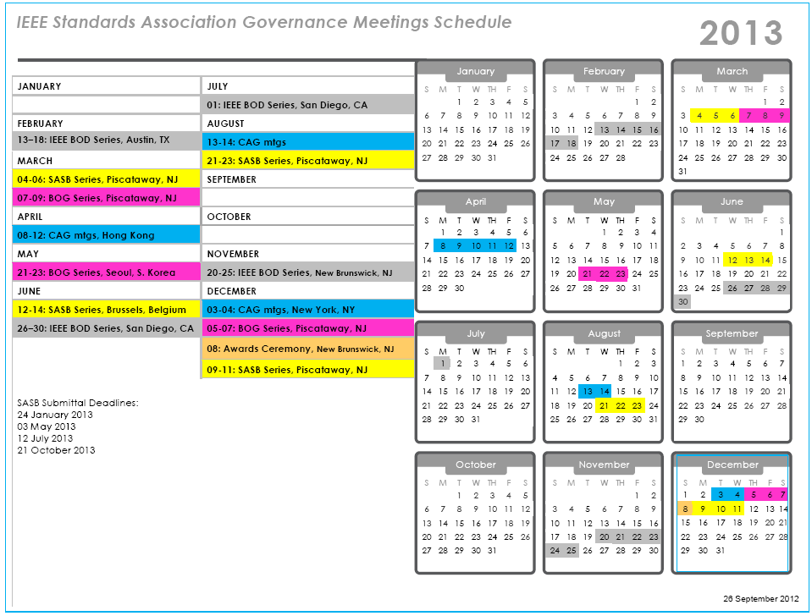
SASB Submittal Deadlines
24 January 2013
03 May 2013
12 July 2013
21 October 2013

Slide 31
