Slide 1
IEEE 802.11TGai
Closing Report
Date: 2013-3-21
Authors:
Name | Company | Address | Phone | email
Hiroshi MANO | AlliedtelesisR&D center,K.K. | 8F TOC2 Bldg. 7-21-11 Nishi-Gotanda, Shinagawa-ku, Tokyo 141-0031 JAPAN | +81-3-5719-7630 | hmano@root-hq.com

Slide 2
Abstract
This presentation is the closing report for the Orlando meeting of the IEEE 802.11 TGai.

Slide 3
IEEE 802.11 FILS TGai – Orland March 2013
Goals for the Meeting:
  Approve minutes of past meeting and teleconference
  Comment resolution to volunteer review comments
  Approve final technical contribution
  Move to forward TGai call for comment
  Joint meeting with TGaq
  Approve Timeline
  Approve Teleconference schedule
  Approve Plan for May

Slide 4
Accomplishments TGai 1/2
Review and approve January 2013 Vancouver Session Minutes
  https://mentor.ieee.org/802.11/dcn/13/11-13-0182-01-00ai-january-2013-vancouver-session-minutes.doc
Review and approve January-March Teleconference Minutes
  https://mentor.ieee.org/802.11/dcn/13/11-13-0191-04-00ai-january-march-teleconference-minutes.doc

Slide 5
Accomplishments TGai 2/2
8 regular slots and 1 Joint adhoc with TGaq were held.
Experimental-test-report-of-FILS was reported on adhoc.
63 unsolved open technical before this session.
All comments were resolved.
21 Technical motions ( 20 passed/ 1 failed)
Instructed editor to prepare draft 0.5 and incorporating these resolutions and, approve 20 day peer review starting on/or after April 8th , 2013 to assist with producing an improved draft for working LB.

Slide 6
Plan for May
Goals for the Meeting:
  Approve minutes of past meeting and teleconference
  Comment resolution of Task Group review of TGai draft.
  Approve Timeline
  Approve Teleconference schedule
  Approve Plan for July

Slide 7
Time line of TGai (no change)
  PAR Approved, Modified, or Extended 2010-12-08
  WG Letter Ballots Initial / Recirc Jul 13/ Nov13
  Form Sponsor Ballot Pool / Reform Mar14
  MEC Done Mar 14
  IEEE-SA Sponsor Ballots Initial / Recirc Jul14/ Sep14
  Final 802.11 WG Approval Nov14
  final or Conditional 802 EC Approval Nov14
  RevCom & Standards Board Final or
  Continuous Process Approval Feb15
  ANSI Approved N/A

Slide 8
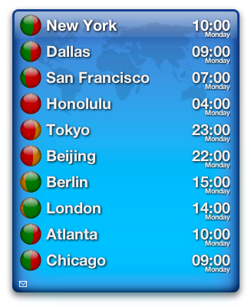
Teleconference Schedule
Motion:
  Approve the following schedule of weekly teleconferences.
  Tuesdays 10:00 ET from 26th March 2013 until 21st May 2013.
  Duration 1Hour
  Using WEB-EX that will be provided by Task Group Chair
Approved by unanimous consent

Slide 9
Reference
Agenda /13-0321r2
  https://mentor.ieee.org/802.11/dcn/13/11-13-0321-02-00ai-tgai-agenda-march-2013-orland.pptx
Submission list / 13-0322r3
  https://mentor.ieee.org/802.11/dcn/13/11-13-0322-03-00ai-tgai-submission-list-orlando.xls
Motions / 13-0341r1
  https://mentor.ieee.org/802.11/dcn/13/11-13-0341-00-00ai-tgai-motion-straw-poll-march-2013-orlando.pptx
TGai Draft Review Combined Comments 13-0036r14
  https://mentor.ieee.org/802.11/dcn/13/11-13-0036-14-00ai-tgai-draft-review-combined-comments.xls
Experimental-test-report-of-FILS /13-0323r2
  https://mentor.ieee.org/802.11/dcn/13/11-13-0323-02-00ai-tgai-experimental-test-report-of-fils.pptx

Slide 10
Thanks to all who participated!

