Slide 1
TGai FILS: GAS/ANQP Signaling Reduction
Authors:
Name | Affiliations | Address | Phone | email
George Calcev | Huawei Technologies Co., Ltd. |  |  | George.Calcev@huawei.com

Slide 2
Signaling Storm in Specification Framework Document
Nov 2012
The 802.11ai Specification Framework Document addresses the signaling storms before association such as Probe Request/Response
”Data Storms (11-12/0907r10)
The proposal shall include method(s) for mitigating Probe Request/Response storms”
However, before association other signaling, related to the network discovery and selection, may take place as specified by 802.11u amendment

Slide 3
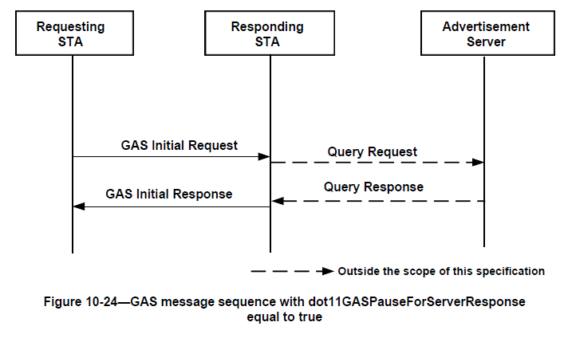
GAS Request/Response

Slide 4
ANQP Request/Response
Used by a STA to select the network for association purpose
The GAS Request are unicast messages sent by a STA to an AP before association after the AP was discovered
The unicast GAS Request/Response carry ANQP Request/Response messages
The ANQP element as defined today cannot be carried in any other frames
Example of ANQP elements: Roaming Consortium, Domain Name, Network Authentication Type, IP Address Type Availability

Slide 5
ANQP Request/Response Adds to Probe Request/Response Signaling
Probe Request
Probe Response

Slide 6
ANQP Request/Response Problem
In order to speed its response, the AP may cache the static ANQP elements locally
If multiple stations try to access the network at the same time there is a flurry of Probe Request/Response and ANQP Request/Response messages
Because the GAS Request/Response are unicast message multiple stations could ask for the same ANQP elements
ANQP Request/Response messages add additional delay to the association process

Slide 7
Signaling Storm Mitigation
ANQP (GAS) signaling storm could be mitigated by providing the ANQP elements prior to GAS request for instance in Probe Response or Beacons
Examples of mitigation:
  A STA could indicate in Probe Request via a bit map the ANQP elements requested, the AP could provide this information in Probe Response via ANQP information elements (IE)
  An AP could provide proactively ANQP IE in some broadcast messages when the rate of ANQP requests for a particular ANQP element is high

Slide 8
Straw Poll
Straw-Poll-1:
Do you support to include in SFD Section Data Storms (11-12/0907r10):
Tgai specification should include method(s) for mitigating GAS/ANQP signaling storm before association
Result Yes No Abstain_______________

Slide 9
References
IEEE 802.11

