Slide 1
Antenna Array Gain from Measured Data for 802.11n/ac TxBF
Date: 2013-03-20
Authors:

Slide 2
Abstract
Theoretical calculation of antenna array gain is 10*log10(# of antenna elements)
With 802.11n/ac MIMO/OFDM transmit beamforming (TxBF), antenna weights matrices are computed on a subcarrier basis
In a multipath environment, while the TxBF PER performance gain will be substantial, the composite effective array gain will be much less than 10log10(N)

Slide 3
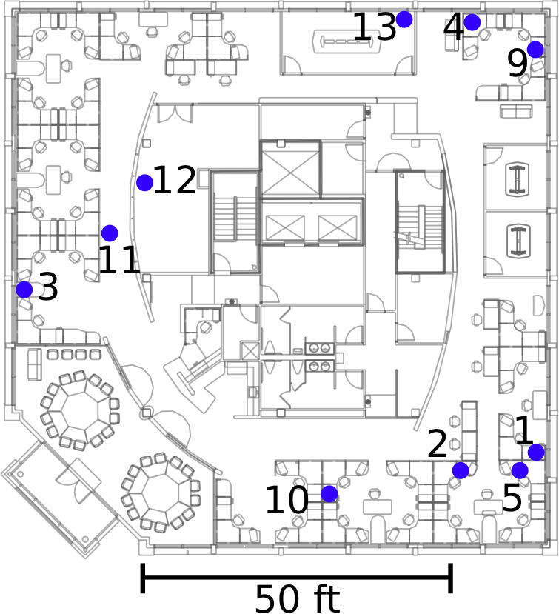
Measurements in an Office Environment
Measurements captured in 802.11n test bed deployed on one floor of an occupied indoor office environment
Dimensions of the floor of the building are 90 ft X 90 ft (~27.4 m X 27.4 m)
In center of floor are labs, elevators, and a kitchen area
Along the walls are workspaces with groups of cubicles and conference rooms
Numbered circles indicate device locations

Slide 4
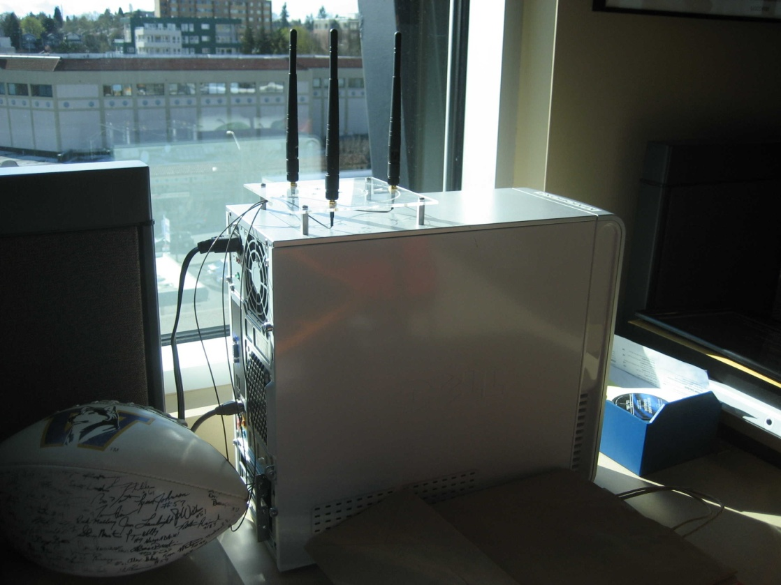
Measurement Device Description
Devices are actual 802.11n stations consisting of a desktop PC with an Intel Wi-Fi Wireless Link 5300 radio card and external antennas
3 Tx antennas, 3 Rx antennas, 3 stream packet format
5 GHz transmission on an empty channel

Slide 5
Captured Measurements
CSI is measured by having each device in turn transmit a stream of 802.11n packets, while all the other devices on the floor receive the packets
Packets are transmitted every 0.8 ms
3000 packets
measured from the long training field of each packet
3x3 CSI matrix
Received signal level data and noise level data also captured
Used to compute received SNR

Slide 6
Antenna Gain Calculation
3x1 TxBF weights computed from CSI for each of the receive antennas
Computation performed on each packet
Antenna gain computed from weights as shown on next slide
Computing statistics:
antenna gain computed over 360 deg azimuth and 90 deg elevation for each subcarrier
Average antenna gain (linear) computed over all subcarriers for each angle
Maximum antenna gain found over all angles
Repeat for each time instance and CDF formed
Antenna gain reported at 50% and 90% probability point of CDF

Slide 7
Transmission at angle φ, θ

Slide 8
Summary of Array Gain Results (90% Prob)
 |  | Morning measurement |  |  | Afternoon measurement
SRC | Dest | Rx ant 1 | Rx ant 2 | Rx ant 3 | Rx ant 1 | Rx ant 2 | Rx ant 3
1 | 5 | 2.6 dB | 2.3 dB | 1.7 dB | 2.5 dB | 2.6 dB | 2.0 dB
2 | 5 | 3.3 dB | 3.2 dB | 3.0 dB | 2.0 dB | 3.0 dB | 1.0 dB
1 | 2 | 3.3 dB | 2.1 dB | 2.3 dB | 1.5 dB | 2.2 dB | 2.5 dB
4 | 9 | 1.6 dB | 2.9 dB | 2.7 dB | 1.6 dB | 2.4 dB | 2.0 dB
13 | 4 | 2.4 dB | 3.3 dB | 2.1 dB | 2.7 dB | 3.5 dB | 2.0 dB
13 | 9 | 1.9 dB | 2.3 dB | 2.3 dB | 1.9 dB | 1.6 dB | 2.3 dB
12 | 11 | 3.0 dB | 1.9 dB | 3.4 dB | 2.3 dB | 2.1 dB | 1.6 dB
11 | 3 | 3.4 dB | 2.3 dB | 2.0 dB | 3.4 dB | 2.1 dB | 2.1 dB
3 | 12 | 2.4 dB | 2.5 dB | 1.9 dB | 2.6 dB | 2.5 dB | 2.7 dB
5 | 13 | 2.3 dB | 2.5 dB | 1.5 dB | 1.5 dB | 2.9 dB | 2.3 dB
4 | 11 | 2.0 dB | 1.9 dB | 0.9 dB | 1.1 dB | 1.8 dB | 2.1 dB
3 | 10 | 2.4 dB | 3.1 dB | 2.3 dB | 1.9 dB | 1.2 dB | 2.4 dB
11 | 2 | 1.7 dB | 2.0 dB | 2.8 dB | 1.5 dB | 2.1 dB | 2.7 dB

Slide 9
Summary of Array Gain Results (50% Prob)
 |  | Morning measurement |  |  | Afternoon measurement
SRC | Dest | Rx ant 1 | Rx ant 2 | Rx ant 3 | Rx ant 1 | Rx ant 2 | Rx ant 3
1 | 5 | 2.1 dB | 1.6 dB | 1.1 dB | 2.2 dB | 2.3 dB | 1.6 dB
2 | 5 | 2.4 dB | 2.6 dB | 1.2 dB | 1.8 dB | 2.9 dB | 0.8 dB
1 | 2 | 2.7 dB | 1.4 dB | 1.8 dB | 1.0 dB | 1.5 dB | 1.8 dB
4 | 9 | 1.1 dB | 2.3 dB | 2.2 dB | 1.6 dB | 2.2 dB | 1.7 dB
13 | 4 | 2.1 dB | 3.1 dB | 1.9 dB | 2.5 dB | 3.0 dB | 1.1 dB
13 | 9 | 1.2 dB | 1.8 dB | 2.2 dB | 1.7 dB | 1.3 dB | 2.2 dB
12 | 11 | 2.9 dB | 1.9 dB | 3.4 dB | 1.7 dB | 1.3 dB | 1.1 dB
11 | 3 | 3.3 dB | 2.1 dB | 2.0 dB | 3.4 dB | 2.0 dB | 2.0 dB
3 | 12 | 2.1 dB | 2.1 dB | 1.4 dB | 2.4 dB | 2.4 dB | 2.6 dB
5 | 13 | 1.9 dB | 2.1 dB | 1.2 dB | 0.9 dB | 2.4 dB | 1.4 dB
4 | 11 | 1.6 dB | 1.3 dB | 0.6 dB | 0.8 dB | 1.4 dB | 1.7 dB
3 | 10 | 1.9 dB | 2.6 dB | 2.2 dB | 1.7 dB | 1.1 dB | 2.4 dB
11 | 2 | 1.3 dB | 1.5 dB | 2.3 dB | 1.1 dB | 1.7 dB | 2.3 dB

Slide 10
Observations
Array gain for 3 TX antennas is typically less that 3 dBi
Results can vary quite a bit even between RX antennas
Large variation in time
2-3 dB variation can occur over 2.5 sec
Results vary from morning measurements to afternoon measurements
90th percentile (spatially) over 50 percentile (area) gain values (slide 8)
= 2.7 dB
2 dB less than 10log(3)

Slide 11
Example analysis

Slide 12
SRC = 1; Dest = 5 RX antenna 1

Slide 17
max array gain over angles for each time instance; CDF over all instances

Slide 18
SRC = 1; Dest = 5 RX antenna 2

Slide 23
max array gain over angles for each time instance; CDF over all instances

Slide 24
SRC = 1; Dest = 5 RX antenna 3

Slide 29
max array gain over angles for each time instance; CDF over all instances

