Slide 1
Sector Discovery for 11ah
Date: 2013-03-18
Authors:
Name | Affiliations | Address | Phone | Email
Minho Cheong | ETRI | 161 Gajeong-dong, Yuseong-gu, Daejeon, Korea | +82-42-560-5635 | minho@etri.re.kr
Hyoung Jin Kwon | ETRI | Daejeon, Korea | +82-42-860-1698 | kwonjin@etri.re.kr
Jae Seung Lee | ETRI | Daejeon, Korea | +82-42-860-1326 | jasonlee@etri.re.kr
Jae Woo Park | ETRI | Daejeon, Korea | +82-42-860-5723 | parkjw@etri.re.kr
Sok-kyu Lee | ETRI | Daejeon, Korea | +82-42-860-5919 | sk-lee@etri.re.kr
Eric Wong | Broadcom | Sunnyvale, CA, USA | +1-408-922-6672 | ewong@broadcom.com
Matthew Fischer | Broadcom | Sunnyvale, CA, USA | +1-408-543-3370 | mfischer@broadcom.com
Yong Liu | Broadcom | Sunnyvale, CA, USA |  | yongliu@broadcom.com
Minyoung Park | Intel | Hillsboro, OR, USA | +1-503-712-4705 | minyoung.park@intel.com
Adrian Stephens | Intel | U.K. | +44-1954-204609 | adrian.p.stephens@intel.com
Tom Tetzlaff | Intel |  |  | thomas.a.tetzlaff@intel.com
Emily Qi | Intel | Hillsboro, OR, USA |  | emily.h.qi@intel.com
Simone Merlin | Qualcomm | San Diego, CA, USA | +1-858-845-1243 | smerlin@qualcomm.com
Santosh Abraham | Qualcomm | San Diego, CA, USA |  | sabraham@qualcomm.com
Menzo Wentink | Qualcomm | Breukelen, Netherlands |  | mwentink@qualcomm.com
Alfred Asterjadhi | Qualcomm | Breukelen, Netherlands |  | aasterja@qualcomm.com
Amin Jafarian | Qualcomm | San Diego, CA, USA
Hemanth Sampath | Qualcomm | San Diego, CA, USA |  | hsampath@qualcomm.com
VK jones | Qualcomm | Santa Clara, CA, USA |  | vkjones@qualcomm.com

Slide 2
Authors:
Name | Affiliations | Address | Phone | Email
Hongyuan Zhang | Marvell | Santa Clara, CA, USA | +1-408-222-1837 | hongyuan@marvell.com
Su Khiong Yong | Marvell | Santa Clara, CA, USA |  | skyong@marvell.com
Sudhir Srinivasa | Marvell | Santa Clara, CA, USA |  | sudhirs@marvell.com
George Calcev | Huawei | Rolling Meadows, IL, USA |  | george.calcev@huawei.com
Osama Aboul Magd | Huawei | Ottawa, Canada |  | osama.aboulmagd@huawei.com
Young Hoon Kwon | Huawei | San Diego, CA, USA |  | younghoon.kwon@huawei.com
Betty Zhao | Huawei | Beijing, China | +86-10-59728332 | betty.zhao@huawei.com
David Xun Yangxun | Huawei | Shenzhen, China |  | david.yangxun@huawei.com
Bin Zhen | Huawei | Shenzhen, China |  | zhenbin@huawei.com
ChaoChun Wang | MediaTek | San Jose, CA, USA | +1-408-526-1899 | chaochun.wang@mediatek.com
James Wang | MediaTek | San Jose, CA, USA |  | james.wang@mediatek.com
Jianhan Liu | MediaTek | San Jose, CA, USA |  | jianhan.liu@mediatek.com
Vish Ponnampalam | MediaTek | San Jose, CA, USA |  | vish.ponnampalam@mediatek.com
James Yee | MediaTek | Hsinchu, Taiwan |  | james.yee@mediatek.com
Huai-Rong Shao | Samsung Electronics | San Jose, CA, USA |  | hr.shao@samsung.com
Chiu Ngo | Samsung Electronics | San Jose, CA, USA |  | chiu.ngo@samsung.com
Yongho Seok | LG Electronics | LG R&D Complex, Anyang, Korea | +82-42-450-1947 | yongho.seok@lge.com
Jeongki Kim | LG Electronics | Anyang, Korea |  | jeongki.kim@lge.com
Jinsoo Choi | LG Electronics | Anyang, Korea |  | jinsoo.choi@lge.com
Hangyu Cho | LG Electronics | Anyang, Korea
Sun, Bo | ZTE | Xi’an, China |  | sun.bo1@zte.com.cn
Lv, Kaiying | ZTE | Xi’an, China |  | lv.kaiying@zte.com

Slide 3
Authors:
Name | Affiliations | Address | Phone | Email
Sayantan Choudhury | Nokia | Berkeley, CA, USA |  | sayantan.choudhury@nokia.com
Klaus Doppler | Nokia | Berkeley, CA, USA |  | klaus.doppler@nokia.com
Chittabrata Ghosh | Nokia | Berkeley, CA, USA | +1-650-200-7566 | chittabrata.ghosh@nokia.com
Esa Tuomaala | Nokia | Berkeley, CA, USA
Ken Mori | Panasonic | Osaka, Japan |  | mori.ken1@jp.panasonic.com
Rojan Chitrakar | Panasonic | Tai Seng Ave, Singapore | +65-6550-5347 | rojan.chitrakar@sg.panasonic.com
Haiguang Wang | I2R | 1 Fusionopolis Way, Singapore |  | hwang@i2r.a-star.edu.sg
Shoukang Zheng | I2R | 1 Fusionopolis Way, Singapore |  | skzheng@i2r.a-star.edu.sg
Yeow Wai Leong | I2R | 1 Fusionopolis Way, Singapore |  | wlyeow@i2r.a-star.edu.sg
Zander Lei | I2R | 1 Fusionopolis Way, Singapore |  | leizd@i2r.a-star.edu.sg
Yuan Zhou | I2R | 1 Fusionopolis Way, Singapore | +65-6408-2472 | yzhou@i2r.a-star.edu.sg
Anna Pantelidou | Renesas Mobile | Oulu, Finland | +358-50-410-5316 | anna.pantelidou@renesasmobile.com
Juho Pirskanen | Renesas Mobile | Oulu, Finland | +358-50-363-6632 | juho.pirskanen@renesasmobile.com
Timo Koskela | Renesas Mobile | Oulu, Finland | +358-50-487-6991 | timo.koskela@renesasmobile.com
Liwen Chu | STMicroelectronics | Santa Clara, CA, USA | +1-408-467-8436 | liwen.chu@st.com
George Vlantis | STMicroelectronics | Santa Clara, CA, USA | +1-408-893-9357 | george.vlantis@st.com

Slide 4
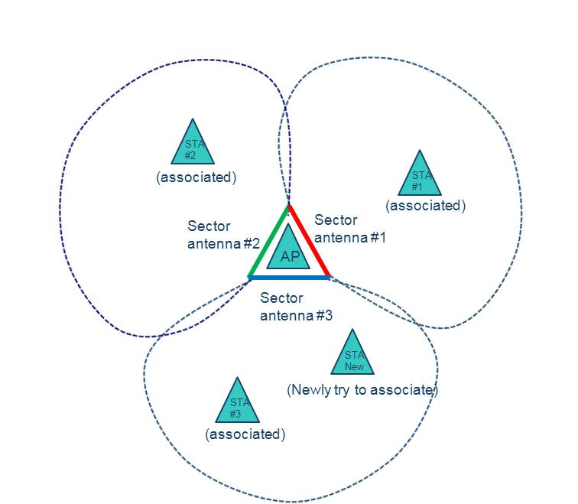
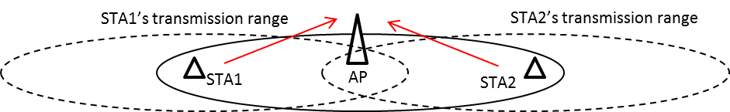
Background
Sectorized transmission may be used in 802.11ah to mitigate hidden problems and OBSS interferences
STA1 hidden from STA2

Slide 5
Type 0 Sectorization Scheme
[1] IEEE11-12-0852-00-00ah Sectorization for Hidden Node Mitigation
Sectorization was proposed by Huawei to mitigate hidden node (because the number of active nodes is reduced in a specific sector)
  AP divides the space in multiple sectors and use a TDM approach to allow STA transmissions in one sector at the time
  Stations are allowed to transmit and receive data only in the time interval corresponding with their sector (called as Sector Interval in the drawing)
  Some time interval can be left for channel access of all sectors at the same time
Note 1: SFD 4.2.I provides the basis for this sectorization scheme
Note 2: This approach applies to either BSS with only sectorized (no omni) beam or BSS with both sectorized beam and omni beam
Beacon
Sector 1
Beacon
Sector 2
Beacon
Sector 3
Omni
Beacon
Access STAs in Sector 1
Access STAs in sector 2
Access STAs in sector 3
Access all STAs in the BSS
Sector Interval 1
Sector Interval 2
Sector Interval 3
Omni Interval

Slide 6
Type 1 Sectorization Scheme
[2] IEEE11-12-1355-02-00ah Sectorized Beam Operation – Follow Up by January 2013
A proposal introducing a more flexible sectorized beam operation was presented in the IEEE September, 2011
  AP can switch back and forth between sectorized beam(s) and omni beam
  Sectorized beam is used only when AP is aware of the STA’s sector either in scheduled transmission such as RAW or during a TXOP of a STA. AP switches back to omni otherwise.
  The sectorized receive beam is used in conjunction with the sectorized transmit beam within an TXOP
  AP indicates the sectorized beam operation in Beacons, Probe Response, or Association Response.
Note 1: SDF 4.6 provides the basis for this sectorization operation
Note 2: This proposal requires an AP to be able to transmit/receive both omni and sectorized beam (We assumes that only AP (not STA) uses the sectorized beam)
Note 3: The forming of the sector beam is implementation specific
AP
Beacon
RAW1
RAW1
TXOP
Beacon
RAW2
RAW2
Beacon
RAW3
Sector 2
STA

Slide 7
Operation Procedure for Sectorization
During the association
  AP and STA exchange their Sector Capabilities to find out whether and which type sectorized transmission could be done
Beacon transmission
  AP transmit beacon with the Sector Operation field (Type 0 or Type 1)

Slide 8
Finding out Sector ID for a STA
In Type 0 sectorization
  When a STA associated during a sectorized beacon interval
    it may send its sector ID to AP and AP sets its AID based on the sector ID
    or it may wait for other sectorized beacons as well to find out its best sector for robust communications
  When a STA associated during an omni-beacon interval
    AP sets the STA’s AID temporarily until the STA will find out its best sector
  Thus, AP may still have associated STAs which have not found yet its real AID appropriate for its best sector ID (only having temporary AID)
In Type 1 sectorization
  Before a explicit sector training, any associated STA does not know its sector ID at all

Slide 9
Finding out Sector ID for a STA (2)
Fast sector discovery for multiple STAs may be needed
  To help all the temporary STAs to find out their best sectors quickly
  To allow (movable) offloading STAs to switch to new sectors quickly
  To reduce long air-time needed for an entire cycling of all the sectorized beacons in Type 0 sectorization
    Typically, could be even longer than a long-beacon cycle
  Not to disallow that power-efficient STAs don’t want to listen all the sectorized beacons for their power saving
  To reduce delay from unscheduled feedbacks of sector ID report
  To reduce potential contentions with the normal data delivery due to multiple feedbacks of sector ID
  To do the AID reassignment based on a new sector ID as well if possible

Slide 10
Fast Sector Discovery
Fast Sector Discovery (optional)
  Based on the number of sector capable STAs, which do not have its sector ID yet, piled up in AP’s knowledge, AP can set a Sounding RAW
  During that Sounding RAW (to all AIDs or to some group of AIDs), a non-AP STA having the corresponding AID, is prohibited to transmit (for reliable sounding), but may wake-up and hear the entire sounding
    Due to this new behavior of STAs, which is not defined in the current RPS I.E., we need one bit indication (Sounding or not)
  In order not to make more contentions with the normal data delivery due to feedbacks of sector ID from multiple STAs, it is desirable to protect those with separate RAW (Sector Report RAW)
  AID reassignment based on new sector ID can be done accordingly

Slide 11
Sounding RAW
RAW Parameter Set Element
Feature | Value | Interpretation
Page ID | 2 bits | Indicates the page index for hierarchical AID (based on hierarchical AID) of the allocated group
Block Offset | 5 bits | Assuming 32 blocks per page, these bits indicate the starting block index of the allocated group
Block Range | variable bits | Indicates the number of blocks (starting from the block offset) for the allocated group
RAW Start Time | 8 bits | Duration in TU from end of beacon transmission to RAW Start time
RAW Duration | variable bits | Duration of RAW in TU
Access restricted to paged STA only | 2 bits | Bit 1: Set to 1 if only STA with their TIM bit set to 1 are allowed to perform UL transmissions Bit 2: Set to 1 if RAW is reserved for frames with duration smaller than slot duration, such as PS-Polls / trigger frames (ignored if Bit 1 is not set)
Group/Resource allocation frame indication | 1 bit | Set to 1 to indicate if STAs need to wake up at the beginning of the RAW to receive group addressed frames such as resource allocation (format of the resource allocation frame TBD)
Sounding RAW | 1 bit | Set to 1 to indicate if non-AP STAs are prohibited to transmit but are allowed to listen the entire RAW Set to 0 otherwise
Slot definition | variable bits | Include Slot duration signaling Slot assignment to STA Cross boundary transmissions allowed/not allowed Format is TBD

Slide 12
Sector Report RAW
Sector Report RAW
  After a STA gets to know its best sector ID by receiving a Sounding RAW, it needs to quickly report its best sector ID to AP
  Because multiple “Sector ID report frames” may make worse contentions with normal data delivery frames, it is better for sector ID report frames for fast sector discovery be protected as Sector Report RAW
    Sector Report RAW may have multiple RAWs and slots in it if needed
    E.g.,) Slots assignment within Sector Report RAW based on (current) AIDs
    E.g.,) one RAW for STAs which have temporary AIDs, another RAW for STAs which try to switch to other sectors
  During the Sector Report RAW, AP receives Sector ID report frames from STAs and AP sends back ACKs which may include newly assigned AIDs based on sector ID report
  For fast sector discovery with less contentions, sector ID report frame may be an NDP frame (re-use one of already-defined NDP frame format)

Slide 13
Operation of Fast Sector Discovery
Example of Sounding RAW and Sector Report RAW
Sounding RAW
Sector
Report RAW
AP
Omni-
Beacon
Sector 1
Beacon
Sector 2
Beacon
Omni Beacon Interval
Sector 1 Beacon Interval
Sector 2 Beacon Interval
STA
Slot duration
Sector 1
Beacon
NDPA
NDP
NDP
NDP
P
A
P
A
P
A
P
A
AP
NDPA
Sec 1
Sec 2
to AP
To STA
Sec N
to AP
to STA
to AP
to STA
to AP
to STA
STA
Sector Report RAW
(Sector ID report and AID reassign)
Sounding RAW

Slide 14
Operation of Fast Sector Discovery (2)
AP’s behavior
  AP exchanges the Sector Capabilities with a STA during the Association
  AP informs all the STAs its Sector Operation element by its beacons
    Sectorization type, sectorized beacons cycling period, etc.
  AP may announce a Sounding RAW and Sector Report RAW by its beacon
    AP may assign multiple RAWs and slots in a Sector Report RAW
    E.g.,) one RAW for STAs which have temporary AIDs, another RAW for STAs which need to switch to other sectors
  AP receives Sector ID report frames from STAs
  AP sends ACKs which may include newly assigned AIDs based on sector ID report

Slide 15
Operation of Fast Sector Discovery (3)
STA’s behavior
  STA exchanges the Sector Capabilities with AP during the Association
  STA still may not be aware of its best sector (only having temporary AID)
  STA gets to know a Sounding RAW and Sector Report RAW by AP’s beacon
  STA wakes-up and listens the Sounding RAW and finds out its best sector
  STA sends its Sector ID report frame to AP at a slot during Sector Report RAW
  STA receives AP’s ACK and may get to know a newly assigned AID based on its sector ID

Slide 16
ACK to Sector ID Report
ACK to Sector ID Report
  may include the (already-defined) AID response element for the AID reassignment
  cannot be packed into a NDP frame due to two octet of new AID
 | Element ID | Length | AID | AID Switch Count | Wakeup Interval
Octets: | 1 | 1 | 2 | 1 | 2

Slide 17
References
[1] IEEE11-12-0852-00-00ah Sectorization for Hidden Node Mitigation
[2] IEEE11-12-1355-02-00ah Sectorized Beam Operation

Slide 18
Straw Poll
Do you support that Sector Report RAW may be assigned after Sounding RAW (sector training) for fast sector discovery?

Slide 19
Motion
Move to include in the TGah Specification Framework Document that Sector Report RAW may be assigned after Sounding RAW (sector training) for fast sector discovery (signaling TBD)
Notes:
Motion passes by (6/3/4) (ETRI/Broadcom/MediaTek/ZTE/Qualcomm or Samsung Yes) (Huawei/Panasonic/? No)

