Slide 1
PRAW Follow Up
Date: 2013-3-18
Authors:

Slide 2
Authors:

Slide 3
Authors:

Slide 4
Background
TGah accepted concept of PRAW [1]:
AP allocates resource for group of scheduled active polling STAs and indicates the resource allocation once in a long while.
Not indicated in every short beacon frame (E.g., once in every long beacon frame)
Once PRAW is setup, AP allocates the resource periodically to a group of scheduled active polling STAs.
Allocated resource for PRAW will not be changed until updated PRAW information is broadcasted.
Resource for scheduled active polling STAs can be allocated within the PRAW duration.
Whenever scheduled active polling STA has data packet to send, it wakes up at its designated slot within the PRAW and send the packet after basic CCA.
TIM STAs are not allowed to access the channel during this window.
Within PRAW, each STA follows EDCA based channel access scheme.
In this contribution, we’d like to define PRAW signaling method.

Slide 5
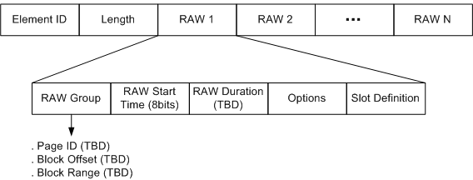
RPS IE
Current RPS IE contents [2]:

Slide 6
PRAW Signaling
Propose to modify current RPS_IE to include PRAW Signaling.
For each RAW indication, add 1 bit for “PRAW indication”.
If PRAW indication = 0, it means this RAW indication is for a normal RAW definition.
If PRAW indication is set,
it includes PRAW specific information such as
Periodicity (TBD bits): Period of PRAW occurrence in the unit of short beacon interval
Start Offset (TBD bits): Offset value to a short beacon frame that the first window of the PRAW appears from a reference point. (How to set a reference point and unit is TBD)
Also, Option and Slot definition subfields can be removed if PRAW indication is set.
As PRAW broadcasting is for TIM STAs who are not allowed to attend during PRAW duration, detailed slot definition within PRAW is not informative.
RAW group, RAW start time, and RAW duration are included.
RAW group: Indicates Non-TIM user group that may be scheduled in the PRAW.
RAW start time: Indicates start time of PRAW with respect to the end of beacon transmission.
RAW duration: Indicates duration of PRAW.

Slide 7
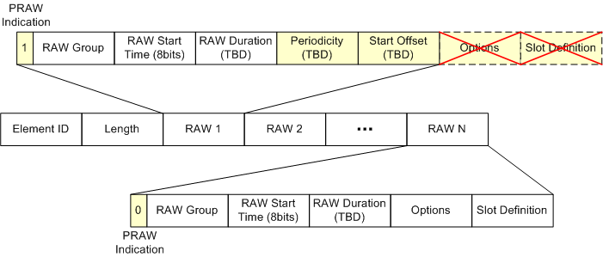
PRAW Signaling
Modified RPS_IE example:

Slide 8
Conclusions
Proposed to modify RPS_IE to include PRAW signaling.

Slide 9
Straw Poll
Do you support to modify RPS_IE to include PRAW signaling as shown in slide 6?

Slide 10
References
[1] IEEE 802.11-12/1311r0 Periodic channel access
[2] IEEE 802.11-12/0843r0 Restricted Access Window signaling for uplink channel access

