Slide 1
Restricted Access Window - Slot Assignment Follow Up
Date: 2013-03-17
Authors:

Slide 4
Introduction
RAW slot assignment improvement
  RAW slot assignment is defined in SFD R 4.2.4.
  RAW slot assignment is based on
    RAW PS IE (Page ID + Block Offset + Block Range)
      If both paged and unpaged STAs are allowed to access the medium
    RAW PS IE (Page ID + Block Offset + Block Range) and TIM IE (AIDs set to 1)
      If only paged STAs are allowed to access the medium
  With current RAW definition, the minimum number of STAs in a RAW is 64 STAs (1 Block)
  In this presentation, we propose to allow a smaller number of STAs in a RAW by modifying the RAW Group field of the RAW PS IE
Define the remaining TBD for N_{offset}
  N_{offset} is an offset value in the mapping function that is provided to address fairness among the STAs indicated in the TIM
    Use an existing field of the received Beacon frame for N_{offset} (e.g. Timestamp, FCS)

Slide 5
RAW Parameter Set Element
4.4.3.1.2 in the TGah SFD defines the fields in the RAW PS IE:
Feature | Value | Interpretation
Page ID | TBD bits | Indicates the page index for hierarchical AID (based on hierarchical AID) of the allocated group
Block Offset | TBD bits | Assuming 32 blocks per page, these bits indicate the starting block index of the allocated group
Block Range | TBD bits | Indicates the number of blocks (starting from the block offset) for the allocated group
RAW Start Time | 8 bits | Duration in TU from end of beacon transmission to RAW Start time
RAW Duration | TBD bits | Duration of RAW in TU
Access restricted to paged STA only | 2 bits | Bit 1: Set to 1 if only STA with their TIM bit set to 1 are allowed to perform UL transmissions Bit 2: Set to 1 if RAW is reserved for frames with duration smaller than slot duration, such as PS-Polls / trigger frames (ignored if Bit 1 is not set)
Group/Resource allocation frame indication | 1 bit | Set to 1 to indicate if STAs need to wake up at the beginning of the RAW to receive group addressed frames such as resource allocation (format of the resource allocation frame TBD)
Slot definition | TBD bits | Include Slot duration signaling Slot assignment to STA Cross boundary transmissions allowed/not allowed Format is TBD
The Page ID, Block Offset, Block Range fields define a group of STAs that are allowed to access the RAW.
  Base unit is one Block (= 64 STAs)
With the current definition, at least 64 AIDs (one Block) are mapped to a RAW

Slide 6
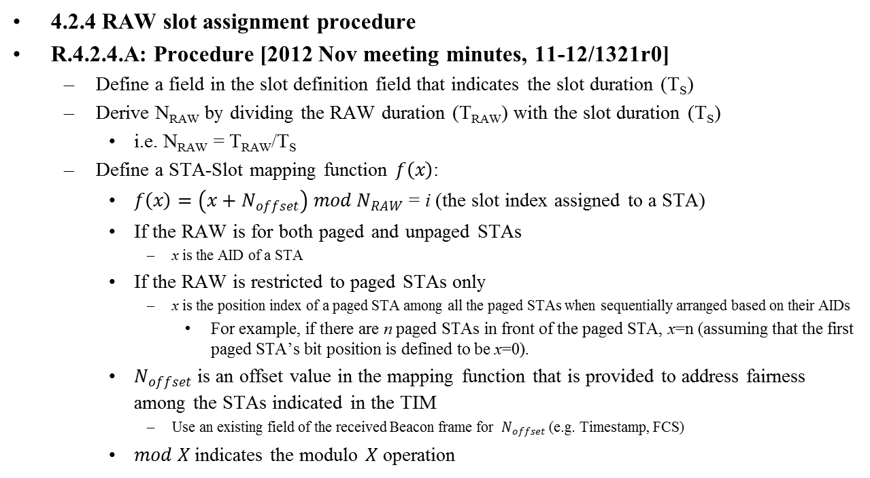
4.2.4 RAW slot assignment procedure
4.2.4 RAW slot assignment procedure
R.4.2.4.A: Procedure [2012 Nov meeting minutes, 11-12/1321r0]
  Define a field in the slot definition field that indicates the slot duration (T_{S})
  Derive N_{RAW} by dividing the RAW duration (T_{RAW}) with the slot duration (T_{S})
    i.e. N_{RAW} = T_{RAW}/T_{S}
  Define a STA-Slot mapping function $f\left(x\right)$:
    $f\left(x\right)=\left(x+N_{offset}\right) mod N_{RAW}$ = i (the slot index assigned to a STA)
    If the RAW is for both paged and unpaged STAs
      x is the AID of a STA
    If the RAW is restricted to paged STAs only
      x is the position index of a paged STA among all the paged STAs when sequentially arranged based on their AIDs
        For example, if there are n paged STAs in front of the paged STA, x=n (assuming that the first paged STA’s bit position is defined to be x=0).
    $N_{offset}$ is an offset value in the mapping function that is provided to address fairness among the STAs indicated in the TIM
      Use an existing field of the received Beacon frame for $N_{offset}$ (e.g. Timestamp, FCS)
    $mod X$ indicates the modulo $X$ operation

Slide 7
Proposal
We propose to allow a smaller number of STAs in a RAW by modifying the RAW PS IE
Proposed modification to the Block Offset field and the Block Range field in the RAW PS IE
  Replace the Block Offset field with the RAW Start AID field as below
  Replace the Block Range field with the RAW End AID field as below
  RAW Start AID field is 11 bits in length and indicates the 11 LSBs of the AID of the STA with the lowest AID in the RAW.
  RAW End AID field is 11 bits in length and indicates the 11 LSBs of the AID of the STA with the highest AID in the RAW.
  A STA is in the RAW group if the AID of the STA is within the range of [Page ID (2bits) +RAW Start AID (11 bits)] and [Page ID (2bits) +RAW End AID (11 bits)].
This enables the exact number of STAs to be assigned to a RAW
2 bits | 11 bits | 11 bits
Page ID | RAW Start AID | RAW End AID

Slide 8
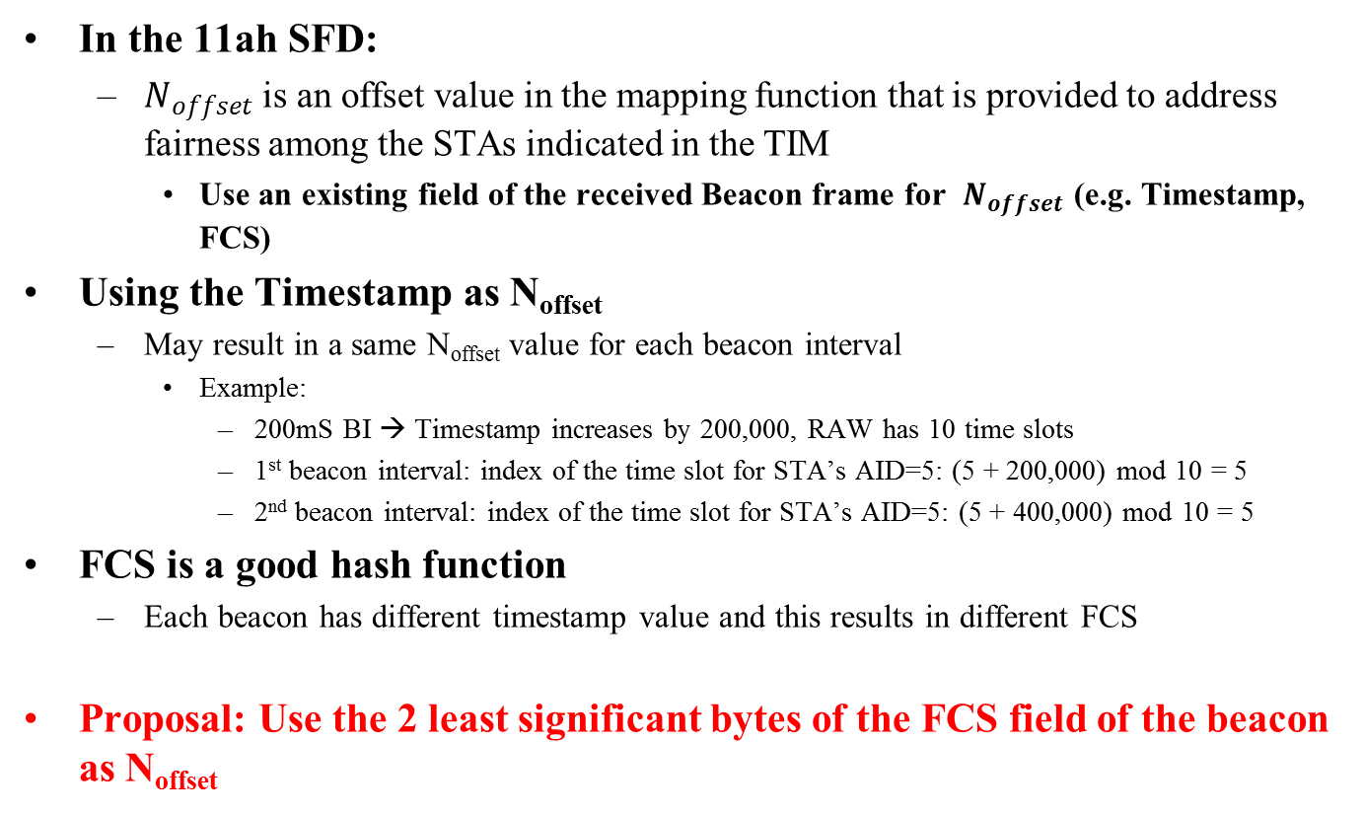
Proposal for N_{offset}
In the 11ah SFD:
  $N_{offset}$ is an offset value in the mapping function that is provided to address fairness among the STAs indicated in the TIM
    Use an existing field of the received Beacon frame for $N_{offset}$ (e.g. Timestamp, FCS)
Using the Timestamp as N_{offset}
  May result in a same N_{offset} value for each beacon interval
    Example:
      200mS BI → Timestamp increases by 200,000, RAW has 10 time slots
      1st beacon interval: index of the time slot for STA’s AID=5: (5 + 200,000) mod 10 = 5
      2nd beacon interval: index of the time slot for STA’s AID=5: (5 + 400,000) mod 10 = 5
FCS is a good hash function
  Each beacon has different timestamp value and this results in different FCS
Proposal: Use the 2 least significant bytes of the FCS field of the beacon as N_{offset}

Slide 9
Straw Poll 1
Do you support the proposed changes to the Block Offset field and the Block Range field as shown in slide 7?
  Y/N/A

Slide 10
Straw Poll 2
Do you support that the 2 least significant bytes of the FCS field of the received beacon shall be used as N_{offset}?
  Y/N/A

