Slide 1
IEEE P802.11af
DRAFT Teleconference Plan and Agenda
Date: 2013-01-29
Authors:

Slide 2
Abstract
This presentation is the agenda and meeting plan for the January 29th IEEE 802.11 TGaf teleconference.

Slide 3
Agenda
Introduction
Administrative items
Editorial/Comment resolution review
Regulatory update
  NPRM FCC 12-118 Comments received
  NTIA 5 GHz Report
AOB

Slide 4
Introduction
Welcome to the IEEE P802.11af January 29, 2013 teleconference, with the holidays rapidly approaching
Chairs and secretary
  Chair: Rich Kennedy (Research In Motion)
  Vice-chair, Technical Editor and Webex Facilitator: Peter Ecclesine (Cisco Systems)
  Vice-chair, Recording Secretary: Zhou Lan (NICT)
Recording your attendance
  Send email to: LAN@nict.go.jp, rikennedy@rim.com and petere@cisco.com

Slide 5
Participants, Patents, and Duty to Inform
All participants in this meeting have certain obligations under the IEEE-SA Patent Policy. Participants:
  “Shall inform the IEEE (or cause the IEEE to be informed)” of the identity of each “holder of any potential Essential Patent Claims of which they are personally aware” if the claims are owned or controlled by the participant or the entity the participant is from, employed by, or otherwise represents
    “Personal awareness” means that the participant “is personally aware that the holder may have a potential Essential Patent Claim,” even if the participant is not personally aware of the specific patents or patent claims
  “Should inform the IEEE (or cause the IEEE to be informed)” of the identity of “any other holders of such potential Essential Patent Claims” (that is, third parties that are not affiliated with the participant, with the participant’s employer, or with anyone else that the participant is from or otherwise represents)
  The above does not apply if the patent claim is already the subject of an Accepted Letter of Assurance that applies to the proposed standard(s) under consideration by this group
Quoted text excerpted from IEEE-SA Standards Board Bylaws subclause 6.2
Early identification of holders of potential Essential Patent Claims is strongly encouraged
No duty to perform a patent search

Slide 6
Patent Related Links
  All participants should be familiar with their obligations under the IEEE-SA Policies & Procedures for standards development.
  Patent Policy is stated in these sources:
  IEEE-SA Standards Boards Bylaws
  http://standards.ieee.org/develop/policies/bylaws/index.html (HTML)
  http://standards.ieee.org/develop/policies/bylaws/sb_bylaws.pdf (PDF)
  IEEE-SA Standards Board Operations Manual
  http://standards.ieee.org/develop/policies/opman/index.html (HTML)
  http://standards.ieee.org/develop/policies/opman/sb_om.pdf (PDF)
  Material about the patent policy is available at
  http://standards.ieee.org/board/pat/pat-material.html
If you have questions, contact the IEEE-SA Standards Board Patent Committee Administrator at patcom@ieee.org or visit http://standards.ieee.org/board/pat/index.html
This slide set is available at http://standards.ieee.org/board/pat/pat-slideset.ppt

Slide 7
Call for Potentially Essential Patents
If anyone in this meeting is personally aware of the holder of any patent claims that are potentially essential to implementation of the proposed standard(s) under consideration by this group and that are not already the subject of an Accepted Letter of Assurance:
  Either speak up now or
  Provide the chair of this group with the identity of the holder(s) of any and all such claims as soon as possible or
  Cause an LOA to be submitted

Slide 8
Other Documents and WebPages to Review
Please review the documents at the following links:
- IEEE Patent Policy - http://standards.ieee.org/board/pat/pat-slideset.ppt
- Patent FAQ - http://standards.ieee.org/board/pat/faq.pdf
- LoA Form - http://standards.ieee.org/board/pat/loa.pdf
- Affiliation FAQ -http://standards.ieee.org/faqs/affiliationFAQ.html
- Anti-Trust FAQ - http://standards.ieee.org/resources/antitrust-guidelines.pdf
- Ethics - http://www.ieee.org/portal/cms_docs/about/CoE_poster.pdf
- IEEE 802.11 Working Group OM -https://mentor.ieee.org/802.11/dcn/09/11-09-0002-10-0000-802-11-operations-manual.doc
New 802 WG P&P: https://mentor.ieee.org/802-ec/dcn/09/ec-09-0007-02-00EC-draft-lmsc-wg-p-p.pdf
New 802 LMSC P&P:https://mentor.ieee.org/802-ec/dcn/09/ec-09-0005-02-00EC-draft-revised-lmsc-p-p-for-wg-p-p-ballot.pdf
New 802 LMSC OM: https://mentor.ieee.org/802-ec/dcn/09/ec-09-0006-02-00EC-draft-revision-of-the-lmsc-om-for-wg-p-p.pdf
802.11 WG Style Guide 09/1034r5: https://mentor.ieee.org/802.11/dcn/09/11-09-1034-05-0000-802-11-editorial-style-guide.doc

Slide 9
Other Guidelines for IEEE WG Meetings
All IEEE-SA standards meetings shall be conducted in compliance with all applicable laws, including antitrust and competition laws.
  Don’t discuss the interpretation, validity, or essentiality of patents/patent claims.
  Don’t discuss specific license rates, terms, or conditions.
    Relative costs, including licensing costs of essential patent claims, of different technical approaches may be discussed in standards development meetings.
      Technical considerations remain primary focus
  Don’t discuss or engage in the fixing of product prices, allocation of customers, or division of sales markets.
  Don’t discuss the status or substance of ongoing or threatened litigation.
  Don’t be silent if inappropriate topics are discussed … do formally object.
---------------------------------------------------------------
See IEEE-SA Standards Board Operations Manual, clause 5.3.10 and “Promoting Competition and Innovation: What You Need to Know about the IEEE Standards Association's Antitrust and Competition Policy” for more details.

Slide 10
PAR Scope and Purpose
PAR Scope: An amendment that defines modifications to both the 802.11 physical layers (PHY) and the 802.11 Medium Access Control Layer (MAC), to meet the legal requirements for channel access and coexistence in the TV White Space
PAR Purpose: The purpose of this amendment is to allow 802.11 wireless networks to be used in the TV white space

Slide 11
Purpose, Principles and Vision/Outcome
“If you don't know where you are going, you might wind up someplace else.”*
11-06-0056-00-0000-cbp-and-david-allens-methods
http://en.wikipedia.org/wiki/Getting_Things_Done
Purpose: the Task Group should create an amendment whose implementation in solutions is likely to receive Regulatory approval for operation in the TV White Spaces under the applicable regulatory rules in the different regulatory domains.
Principles:
  The amendment should not duplicate functionality that is being standardized in other Task Groups.
  There is no need for backwards compatibility with 2.45 GHz ISM operation.
  The PHY is based on Clause 23, representing modifications of and references to Clause 22, and required, related changes to Clauses 3, 4, 6, 7, 8, 9 and 10, and Annexes B, C, D and E
Vision/Outcome: Use 802.11 PHYs to specify the basis for a system that the regulators can approve for operation in the TVWS bands.
* Yogi Berra

Slide 12
Task Group Chair’s Functions
[From the 802.11 Working Group Operations Manual]
The TG Chair may decide non-technical issues or may put them to a vote of the TG. The TG participants and the Chair decide technical issues by vote. The TG Chair decides what is non-technical and what is technical.
The TG Chair is responsible for presiding over TG sessions.
The TG Chair shall operate the TG in an unbiased fashion. To maintain impartiality, the TG Chair shall refrain from taking sides in debate on technical motions.
It is the responsibility of the TG Chair to lead the TG in producing a quality draft standard in a timely fashion as specified by the specific PAR [Chair’s note: Quality submissions are expected from all]

Slide 13
Issues We Must Consider (some other time)
P802.11ae, P802.11aa and P802.11ad have been completed, and P802.11ac will finish ahead of us and must be considered as we resolve comments
IEEE 802.11-2012 has been published
Letter Ballot 189 closed on Sunday, August 19th
It passed with 79.1% approval
We resolved 500 comments in Indian Wells and all but 28 in San Antonio; 14 were withdrawn and 14 will be carried forward
Instead of a Draft 3.0 letter ballot, we begun a Comment Collection to get pre-ballot comments to get 3.0 ready for a January letter ballot
FCC has opened a proceeding on sharing the 3550 to 3650 MHz band using geo-location; can TGaf be extended to support it?

Slide 14
NPRM FCC 12-118
TV Band reverse auction – spectrum “buyback”
Repacking the band
Allocating spectrum for Wireless Broadband and TVBDs
See 18-12/0098r0 (https://mentor.ieee.org/802.18/dcn/12/18-12-0098-00-0000-tv-band-incentive-auction-nprm.pdf )
802.18 response in 18-12/109r8 (https://mentor.ieee.org/802.18/dcn/12/18-12-0109-08-0000-draft-802-comments-fcc-tvband-auction-nprm.doc)
Many of the questions cannot be accurately answered until the repacking, and the “white spaces” are known
Comments received at apps.fcc.gov/ecfs/comment_search/execute?proceeding=12-268

Slide 15
NTIA 5 GHz Report
http://www.ntia.doc.gov/report/2013/evaluation-5350-5470-mhz-and-5850-5925-mhz-bands
NTIA assessment of issues with sharing:
  5350 to 5470 MHz
  5850 to 5925 MHz
  The TDWR band (5600 to 5650 MHz)

Slide 16
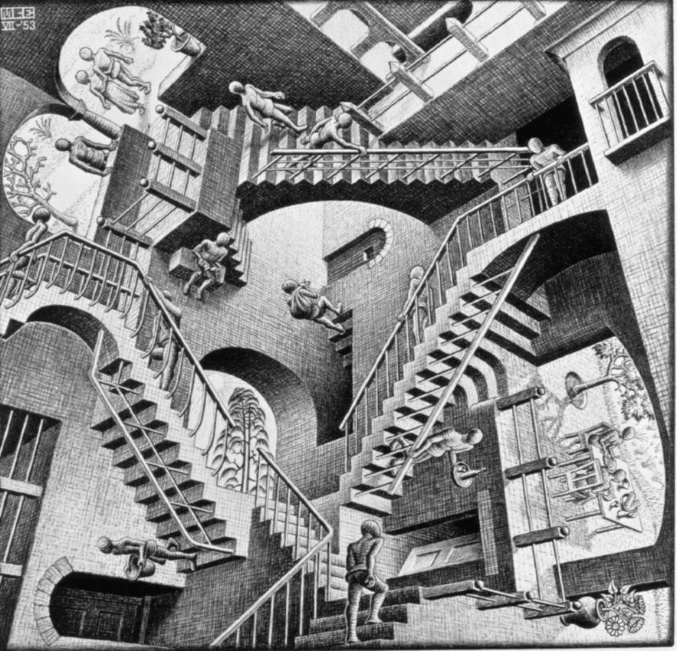
Steps to TVWS Regulatory Approval

Slide 17
Any Other Business?

