Slide 1
Proposal of Preliminary Functional Requirements for 802.1Qbz-802.11ak
Date: 2013-03-11
Authors:

Slide 2
Abstract
A series of submissions have been addressed with regard to 802.1/802.11 bridging aspects [1]-[8].
We propose the preliminary functional requirements of 802.11ak/802.1Qbz, in order to select the goal of 802.1 / 802.11 bridging models and corresponding solutions.
  Compatibility with 802.1Q
  Compatibility with 802.11
  Tolerance to wireless low link reliability
  Scalability
  Manageability
  and may rise some problems to be solved…

Slide 3
Background
A number of issues have been identified concerning 802.1/802.11 bridging[1][2].
Various corresponding solutions and bridging models are also proposed[3]-[8].
Each 802.1/802.11 bridging model and solution should fulfill the functional requirements which were agreed within the 802.11ak TG and 802.1.
  All functional requirements proposed in this submission are based on 802.11ak/802.1Qbz PAR and use cases of 802.1/802.11 bridging which can be found in [9] and [10].
    Appendix A provides summary, plus one additional industrial use case.

Slide 4
Proposed Functional Requirements
Compatibility with 802.1Q
  Interoperable with current and future 802.1Q devices
Compatibility with 802.11
  Support of major 802.11 functionalities, for example
    Support of ESS, including coexistence of multiple SSID
    TDLS/DLS
  Minimum distinction between wire and wireless links
  Interoperable with legacy 802.11 non-AP STA / AP
Tolerance to low link reliability on wireless media
Scalability
Manageability

Slide 5
1. Compatibilities with 802.1Q
802.11ak AP/Bridge and STA/Bridge should be interoperable with current and future 802.1Q devices
  Some mandatory functionalities have to be supported, for example;
    802.1Q-2011 compliant VLAN Bridge
  Some 802.1 optional functionalities may be required, for example;
    802.1 AVB/TSN for home (A/V) network and industrial network
  Some 802.1 optional functionalities may not be supported by 11ak, for example;
    802.1Qbu Frame Preemption
    802.1Qbv Enhancements for Scheduled Traffic → may require HCCA
  Future 802.1Q amendment should not force 802.11ak to be revised.

Slide 6
1. Required functionalities as with 802.1
Tentative M – Must, W – Want, P – Partial, N – Not supported
Std. No. | Description | Home | Industrial
802.1Q-2011 | VLAN Bridge Conformance | M | M
 | Multiple Spanning Tree (MST) operation |  | W
 | Connectivity Fault Management (CFM) |  | W
 | Forwarding and queuing for time-sensitive streams | W | W
 | Multiple Stream Reservation Protocol (MSRP) | W | W
802.1aq-2012 | Shortest Path Bridging |  | W
802.1AB-2009 | Station and Media Access Control Connectivity Discovery
802.1AS / ASbt | Timing and Synchronization / Enhancements | W | M
P802.1AX-Rev | Link Aggregation including DRNI |  | W
P802.1Qbp | Equal Cost Multiple Paths |  | W
P802.1Qbu | Frame Preemption | N | N
P802.1Qbv | Enhancements for Scheduled Traffic | N | P?
P802.1Qca | Path Control and Reservation |  | W
P802.1Qcb | Frame Replication and Elimination for Reliability |  | W

Slide 7
2. Compatibilities with 802.11
802.1/802.11 bridged network have to support the essential 802.11 functionalities, for example;
  ESS including fast BSS transition
  QoS BSS
  Power Management
  DLS (Dynamic-Link Setup) and/or TDLS (Tunneled DLS)
  RSNA (Robust security network association)
There may be some unsupported 802.11 functionalities, for example;
  IBSS, PBSS (802.11ad), MBSS (802.11s), STA transmission of data frames outside the context of a BSS^{*1}, and WDS (Wireless Distribution System, which will be obsoleted in future 802.11 standard).
*1 Refer to IEEE Std 802.11-2012 subclause 4.3.11 and 10.20

Slide 8
2a. Required functionalities as with 802.11
Tentative M – Must, W – Want, P – Partial, N – Not supported
Std. No. | Description | Home | Industrial
802.11-2012 | Infrastructure BSS, ESS and DS | M | M
 | Fast BSS transition | W | W
 | Independent BSS (IBSS) | N | N
 | Mesh BSS (MBSS) | N | N
 | Transmission of data frames outside the context of a BSS | N | N
 | QoS BSS | M | M
 | Power Management | W | M
 | DLS (Dynamic-Link Setup) and/or TDLS (Tunneled DLS) | W | M
 | RSNA (Robust security network association) | M | M
802.11aa-2012 | Robust audio video (AV) streaming | W | W
802.11ad-2012 | Personal BSS (PBSS) | N | N
 | Centralized Coordination Service Set (CCSS) | W | ?
 | DMG Relay | W | ?

Slide 9
2a-i. Support of ESS
AP/Bridges with same SSID in a 802.1Qbz / 802.11ak network may form ESS
To minimize interrupt time on switching associated AP, Support of Fast BSS transition (802.11r) are desired.
    For interoperability, DS implementation standard is necessary.
ESS
AP/B1
AP/B2
BSS#1
BSS#2
S
S
Sm

Slide 10
2a-ii. TDLS (DLS) as Generic Link
If 11ak STA/Bridge has a TDLS (DLS) link to another STA-X, this link may be used as a link of bridged network.
  If STA-X is located at the edge of communication area and STA/Bridge is located middle of STA-X and AP, using TDLS (DLS) link can reduce power consumption of STA-X [11].
    STA-X should not use the direct link to the AP
  802.11ad DMG relay also provides same functionality.
AP communicates with STA-X via STA/Bridge, instead of direct communication.
AP/Bridge
STA/B
TDLS
link
N
STA-X
STA-X communicates with STA/B directly.

Slide 11
2b. Minimum Distinction Between
Wire and Wireless
Distinction between wire and wireless should be minimized.
In an extreme case, a STA/Bridge may have only wireless links.
  This is not an 802.11s mesh
    AP/Bridges are connected hierarchically
      2nd AP/Bridge has two wireless I/Fs.
      One I/F works as non-AP STA associated with 1st AP, another I/F works as AP.
      These two I/Fs may be virtual I/F and share one physical I/F.
  This is a generic case of 11ah relay proposal [12]
AP/B1
SSID#1
S
S/AP/B2
SSID#2
S
S

Slide 12
2c. Interoperability with
Legacy 802.11 non-AP STA
A legacy non-AP STA should be able to associate with an 802.11ak AP/Bridge and to behave properly.
There are two options; 1st option may be excessive .
  Legacy non-AP STAs and 802.11ak non-AP STAs are associated with same BSSID of an AP (i.e. receive same broadcast frames).
  An AP/Bridge has separate BSSID for legacy non-AP STA and 802.11ak non-AP STA[6] →
    A legacy 802.11 non-AP STA
    discards all 802.11ak frames.
    For instance, 11ak AP/STAs
    can use encapsulation of
    Ethernet frames over LLC
    (Ref. subclause 9.4 of P802-REV/D1.6)
BSSID for 11ak STA
AP/B
BSSID for legacy STA
S
S

Slide 13
2c. Interoperability with
Legacy 802.11 AP
An 802.11ak STA/Bridge associated with a legacy 802.11 AP may not bridge over Wireless Media.
  If an 802.11ak STA/Bridge associated with a legacy 802.11 AP can bridge to the AP, it may be useful for home network where a legacy AP is already deployed.
    There may be some limitations..
      No VLAN tags?
      No looped links?
    Hence, it is not a mandatory
    requirement.
802.1Q Bridge
Legacy AP
11ak STAs
Is bridging possible?
S
Legacy STAs

Slide 14
3. Tolerance to Low Link Reliability
Wireless links are inherently less dependable than wired links.
  Furthermore, broadcast /multicast is less reliable than unicast, as there is no MAC-level recovery/retransmission.
  The conditions of the wireless link (Channel, Data rate, Rate of packet loss, ... ) may change dynamically.
802.1/802.11 bridging should be tolerant to low link reliability of wireless link.
  Address lower link reliability of broadcast/multicast
  Network wide recalculation of a spanning tree due to changing condition of wireless link should be minimized

Slide 15
3a. Lower Link Reliability of Broadcast/Multicast
In 802.11, there is no MAC-level recovery on broadcast / multicast transmission from AP except DMS and GCR^{*1}.
  The reliability of broadcast/multicast is lower than unicast.
  For example, assume probability of frame loss in PHY is 10%^{*2}
    Probability of broadcast/multicast frame loss = 10%
    Probability of unicast frame loss = (0.1)^{RetryLimit} ≤ 0.01%
      Default value of dot11LongRetryLimit is 4
    Cf. the worst-case probability of losing frame in 802.3 ≤ 0.0121%^{*3}
      Also, broadcast/multicast transmission from AP often uses lowest mandatory data rate. This may be inefficient.
*1 GCR; Group Cast with Retry, introduced in 802.11aa
*2 PER=10% is criteria of receiver sensitivity for most 802.11 PHYs
*3 Refer to IEEE P802-REV/D1.6 subclause 6.3

Slide 16
3a. Addressing Broadcast/Multicast’s
Lower Link Reliability
When is broadcast/multicast used by an 11ak AP/Bridge?
  Discovery protocols like ARP, DHCP, UPnP, …
    Higher layer protocol may address broadcast frame loss
  Audio/Video multicast streaming
    Some degree of frame loss may be acceptable
  Forwarding unicast frame that destination is not learned by bridge
    Need to keep same link reliability as unicast.
Transmission of a unicast frame has to keep appropriate link reliability even if it has been transmitted as multicast.
  Possible solutions - Expand to unicast, DMS, GCR (802.11aa), or avoid multicast by proactive learning of forwarding table (similar to 11ah “Reachable address message” proposal [13]).

Slide 17
3b. Addressing Wireless Link Instability
Network wide recalculation of a spanning tree due to changing condition of wireless link should be minimized
  Possible solutions, for instance;
    Exclude instable links from spanning tree calculation
    Conceal wireless links in a virtual bridge
    Provisioning redundant path
    Introduce hysteresis and/or timer to postpone recalculation
A framework to set adequate cost of wireless link is required for spanning tree construction.
  Wireless link cost may be significantly larger than wire.

Slide 18
4. Scalability
An 802.1/802.11 bridged network may be arbitrarily sized.
A number of management frames and BPDUs transmitted over a wireless link when a STA/Bridge associating with an AP/Bridge, has to be an important factor;
  Preferably equal to O(Np) (Np = number of ports on STA/Bridge).
  If number of management frames and BPDUs is O(Ns) (Ns = number of nodes under STA/Bridge), bridged network will not scale.
AP/B
Wireless Media
S
Np = Number of ports
Nodes under STA/Bridge ‘S’

Slide 19
5. Manageability
802.1/802.11 bridged network should be managed by the same way as today’s 802.1Q network
  802.11ak AP/Bridge, STA/Bridge, or corresponding virtual bridge should support the conventional 802.1Q managed objects.
    If managed objects are pertaining to virtual entity, methods to access these objects are necessary.
      Possible solution; AP delegates the virtual entities.
Also, there may be 802.1/802.11 bridging specific managed objects.

Slide 20
Conclusion & Future Work
Preliminary functional requirements are proposed.
Building consensus on the functional requirements before down selection[14] is the next step.
- Example -
To be explored

Slide 21
Appendix. A; Use cases summary
Home entertainment systems [8][9]
  In a home or small studio, Ethernet-like links: 802.3, 802.11, MoCA, 1901 power line, etc. will replace other modes for exchanging data.
  You expect wired stacks connected via wireless..
Process control and manufacturing [8]
  Communications with moving transport containers or objections on assembly lines where there are multiple network devices within the moving item.
Wi-Fi is not at the edge of the network [9]
Use of 802.11 in Data Centers involves communication with multiple servers behind a station [8].
Automatic communication between a car and the service bay of the car dealer [8].

Slide 22
Additional Industrial Use case
Wireless backhaul connecting sub control or analyzer house to main control room in a industrial plant.
Timeliness (Real Time) & High availability are essential.
~ 100’s m
GC
GC
11ak AP/Bridges
B
STA
AP
B
GC
B
Analyzer house
B
Remote
I/O Unit
AP
Control System
STA
Main Control Room
Fieldbus GW
B
11ak STA/Bridges
Sub control house
*GC; Gas Chromatography equipment

Slide 23
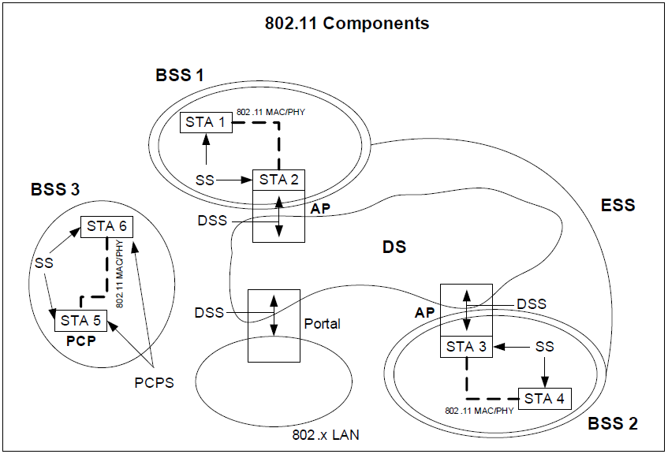
Appendix B; Revisit 802.11 architecture
The IEEE 802.11 architecture consists of several components that interact to provide a WLAN that supports STA mobility transparently to upper layers.
* IEEE Std 802.11ad-2012
Figure 4-11

Slide 24
References (1)
[1] “Issues list for P802.1Qbz / P802.11ak point-to-point model” (11/12-1441r0)
[2] “Problems to be solved by 802.11ak” (11/13-0185r0)
[3] “CSN & 802.11 BSS Bridging” (11/12-1232r1)
[4] “Virtual Wireless Port based 802.11 Bridging” (11/12-1449r0)
[5] “1Qbz-11ak Solution: Architecture Issue” (11/13-0139r0)
[6] “1Qbz-11ak Solution: Station Subsetting” (11/13-0141r1)
[7] “802.1Qbz–802.11ak Solutions: Unreliable Links” (11/13-0146r0)

Slide 25
References (2)
[8] “802.1Qbz–802.11ak Solutions: Tagging” (11/13-0147r0)
[9] “General 802.11 Links” (11/12-0589r2)
[10] “Wired – Wireless Bridging” (new-nfinn-wired-wirelessbridges-0612-v02.pdf)
[11] “Two-Hop Relaying” (11/12-1330r0)
[12] “Relays for 802.11ah” (11/12-1323r0)
[13] “Reachable Address Message” (11/13-0076r0)
[14] “TGak Process and Schedule” (11/12-0119r0)

