Slide 1
WG11 Plenary - Supplementary Information - September 2012
Date: 2012-09-21
Authors:
Abstract: Additional Information on topics for the 802.11 Beijing interim meeting – September 2012
Notes:
November 2011

Slide 2
Wednesday
Notes:
November 2011

Slide 3
IEEE 802.11

Slide 4
Current Procedures
Wednesday Agenda Item 3.1.1
IEEE 802 Policies & Procedures
(link to AudCom, approved by IEEE-SA Standards Board 25 August, 2010)
http://standards.ieee.org/board/aud/LMSC.pdf
IEEE 802 Operations Manual (effective 20 July, 2012),
http://grouper.ieee.org/groups/802/PNP/approved/IEEE_802_LMSC_OM_approved_120725.pdf
IEEE 802 Working Group Policies and Procedures (effective 16 March, 2012)
http://grouper.ieee.org/groups/802/PNP/approved/IEEE_802_LMSC_WG_PandP_approved_120604-v1.pdf
IEEE 802.11 Operations Manual (WG11 OM) (Effective July 20, 2012)
https://mentor.ieee.org/802.11/documents?is_dcn=2&is_year=2009
Policies and Procedures hierarchy
http://www.ieee802.org/11/Rules/rules.shtml

Slide 5
Participants, Patents, and Duty to Inform
Wednesday Agenda Item 3.1.3
All participants in this meeting have certain obligations under the IEEE-SA Patent Policy.
Participants
[Note: Quoted text excerpted from IEEE-SA Standards Board Bylaws subclause 6.2]:
“Shall inform the IEEE (or cause the IEEE to be informed)” of the identity of each “holder of any potential Essential Patent Claims of which they are personally aware” if the claims are owned or controlled by the participant or the entity the participant is from, employed by, or otherwise represents
“Personal awareness” means that the participant “is personally aware that the holder may have a potential Essential Patent Claim,” even if the participant is not personally aware of the specific patents or patent claims
“Should inform the IEEE (or cause the IEEE to be informed)” of the identity of “any other holders of such potential Essential Patent Claims” (that is, third parties that are not affiliated with the participant, with the participant’s employer, or with anyone else that the participant is from or otherwise represents)
The above does not apply if the patent claim is already the subject of an Accepted Letter of Assurance that applies to the proposed standard(s) under consideration by this group
Early identification of holders of potential Essential Patent Claims is strongly encouraged
No duty to perform a patent search

Slide 6
Patent Related Links
Wednesday Agenda Item 3.1.3
All participants should be familiar with their obligations under the IEEE-SA Policies & Procedures for standards development.
Patent Policy is stated in these sources:
IEEE-SA Standards Boards Bylaws
http://standards.ieee.org/develop/policies/bylaws/sect6-7.html#6
IEEE-SA Standards Board Operations Manual
http://standards.ieee.org/develop/policies/opman/sect6.html#6.3
Material about the patent policy is available at
http://standards.ieee.org/about/sasb/patcom/materials.html
If you have questions, contact the IEEE-SA Standards Board Patent Committee Administrator at patcom@ieee.org or visit http://standards.ieee.org/about/sasb/patcom/index.html
This slide set is available at https://development.standards.ieee.org/myproject/Public/mytools/mob/slideset.ppt

Slide 7
Call for Potentially Essential Patents
Wednesday Agenda Item 3.2
If anyone in this meeting is personally aware of the holder of any patent claims that are potentially essential to implementation of the proposed standard(s) under consideration by this group and that are not already the subject of an Accepted Letter of Assurance:
Either speak up now or
Provide the chair of this group with the identity of the holder(s) of any and all such claims as soon as possible or
Cause an LOA to be submitted

Slide 8
IEEE LOA Database
Friday Agenda Item 2.08
http://standards.ieee.org/db/patents/pat802_11.html
8 entries with 2012 submission dates
2 entries with 2013 submission dates

Slide 9
Other Guidelines for IEEE WG Meetings
Wednesday Agenda Item 3.4
All IEEE-SA standards meetings shall be conducted in compliance with all applicable laws, including antitrust and competition laws.
Don’t discuss the interpretation, validity, or essentiality of patents/patent claims.
Don’t discuss specific license rates, terms, or conditions.
Relative costs, including licensing costs of essential patent claims, of different technical approaches may be discussed in standards development meetings.
Technical considerations remain primary focus
Don’t discuss or engage in the fixing of product prices, allocation of customers, or division of sales markets.
Don’t discuss the status or substance of ongoing or threatened litigation.
Don’t be silent if inappropriate topics are discussed … do formally object.
---------------------------------------------------------------
See IEEE-SA Standards Board Operations Manual, clause 5.3.10 and “Promoting Competition and Innovation: What You Need to Know about the IEEE Standards Association's Antitrust and Competition Policy” for more details.
Notes:
9

Slide 10
Reminder for Posting Documents
Wednesday Agenda Item 3.5
From 802.11OM –
All submissions presented to and all minutes shall be posted to the 802.11 document server.
Please check to ensure all documents are posted
If you have a “pending” document that is in error, let Adrian or Jon know.

Slide 11
Roll Call of Attendees
Wednesday Agenda Item 4.1, 4.2
Introduction of meeting attendees
Photographs with name tags
Plan to post on 802.11 website

Slide 12
Current Procedures
Wednesday Agenda Item 4.5
IEEE 802 Policies & Procedures
(link to AudCom, approved by IEEE-SA Standards Board 25 August, 2010)
http://standards.ieee.org/board/aud/LMSC.pdf
IEEE 802 Operations Manual (effective 20 July, 2012),
http://grouper.ieee.org/groups/802/PNP/approved/IEEE_802_LMSC_OM_approved_120725.pdf
IEEE 802 Working Group Policies and Procedures (effective 16 March, 2012)
http://grouper.ieee.org/groups/802/PNP/approved/IEEE_802_LMSC_WG_PandP_approved_120604-v1.pdf
IEEE 802.11 Operations Manual (WG11 OM) (Effective July 20, 2012)
https://mentor.ieee.org/802.11/documents?is_dcn=2&is_year=2009
Policies and Procedures hierarchy
http://www.ieee802.org/11/Rules/rules.shtml

Slide 13
First Meeting Orientation
Wednesday Agenda Item 4.6
Please refer to document 11-12-0628r1

Slide 14
802.1 Architecture Document
Wednesday Agenda Item 4.10
D1.6 of the P802 is latest version
This is moving to Sponsor Ballot

Slide 15
802.24 – Smart Grid WG
Wednesday Agenda Item 4.10
One ad-hoc meeting will be held
Tuesday 2012-09-18, 16:00-18:00
The agenda will be to review action items from July and prepare for our first official meeting during the November plenary.
Meeting set up in IMAT so that attendance credit can be claimed for 802.11.

Slide 16
802.11 Topics for March 2013 EC
Monday Agenda Item 4.1.15
Begin Sponsor Ballot
Conditional approval for AC - Open Sponsor Ballot Group formation
Requests to submit to RevCom?
x
New project PAR to NesCom?
x
PAR Extension ?
x
Revision PAR?
Nothing needed at this time
Study Group start up?
Depends upon results of WNG meeting
Study Group extension?
x
Press Release

Slide 17
Tutorials
Monday Agenda Item 4.1.16
http://ieee802.org/Tutorials.shtml
802.11 sponsored tutorial on 5GHz Spectrum

Slide 18
Reports
Wednesday Agenda Item 5.1-5.4
Membership Summary
Refer to Document 11-12-0038r4

Slide 19
Activity Reports
Wednesday Agenda Item 5.2, 5.3, 5.4
Refer to document 11-13-0170
Standing Committees
Task Groups
Study Groups
Recess to convene 802.11aj

Slide 20
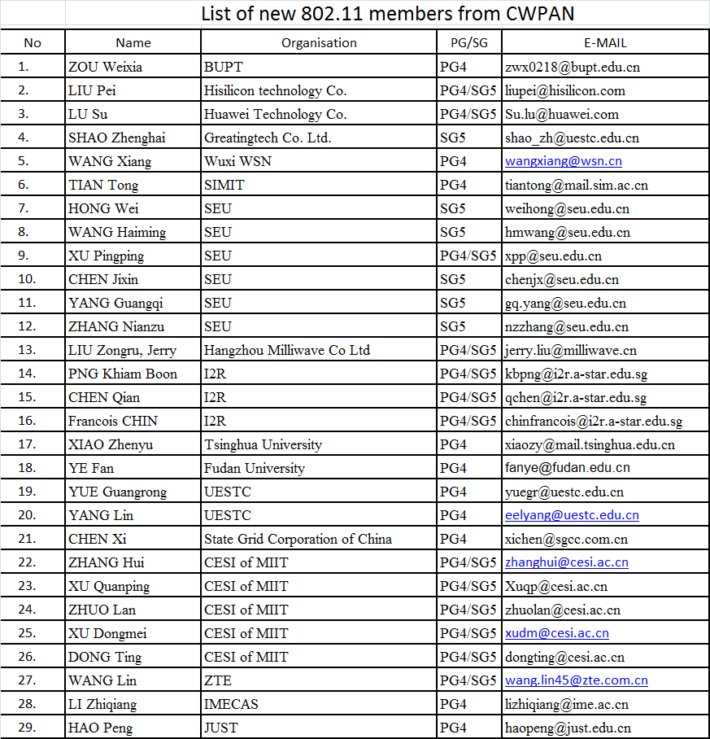
Wednesday Agenda Item 4.3
New Members from CWPAN

Slide 21
Thursday

Slide 22
IEEE LOA Database
Thursday Agenda Item 2.08
http://standards.ieee.org/db/patents/pat802_11.html
8 entries with 2012 submission dates
2 entries with 2013 submission dates

Slide 23
IEEE Store Contents - January 2013
Thursday Agenda Item 2.09
http://www.techstreet.com/ieeegate.html
Amendment | Draft in TechStreet Jan 18 | Draft in Members Area | Publication in Get 802 Jan 18
AF |  | 2.0
AC | D4.0 $5 | 5.0
AD-2012 | $5 | 9.0
AE-2012 | $5 |  | P
AA-2012 | $5 |  | P
802.11 -2012 | $5 |  | P
b, k, i, n, p, y, r, w, u, v, z, s | $5
802.11-2007 | $5
Notes:
November 2011

Slide 24
802.11 drafts to ISO/IEC JTC1/SC6
Thursday Agenda Item 2.10
Task Group | After Vancouver
TGae
TGaa
TGREVmb
TGad
TGac | D5.0
Notes:
November 2011

Slide 25
Tutorials
Thursday Agenda Item 2.11
Call for March 2013 suggestions
802.11 sponsored tutorial on 5GHz Spectrum

Slide 26
Teleconferences
Thursday Agenda Item 4.1.2
Group | Dates | Start Time | Duration
TGmc | Friday Feb 22, Monday March 11 (2 hours) | 10:00 ET | 2 hours
TGai | Tuesdays 29th January to 12th March | 17:00 ET | 1 Hour
TGah | Wed March 13th at 7 PM ET 1 hour | 19:00 ET | 1 Hour
TGac | Jan 31, Feb 14, Feb 28, March 14, April 4 Jan 24, Feb 7, Feb 21, March 7, March 28 | 10:00 ET 20:00 ET | 2 Hours 2 Hours
TGaf | Tuesdays to July 30th | 21:00 ET | 2 Hours
TGak | January 28th, February 18th, March 4th | 17:00 ET | 1 Hour
TGaq | February 21st | 10:00 ET | 1 Hour
TGaj
REG SC | Thursdays, | 12:30 ET | 1.5 Hours

Slide 27
Future Venues -2013
Thursday Agenda Item 6.3
2013
# 137 January 13-18, 2013 - --Hyatt Regency Vancouver, BC, CA
#137.5 January 23-24, Grand Mercure, Shenzhen, CN
# 138 March 17-22, 2013 –Caribe Royale, Orlando, FL, USA
# 139 May 12-17, 2013 ----Hilton Waikoloa, Big Island, HI
#139.5 April 24-25 – Beijing, China
# 140 July 14-19, 2013 --- Geneva , CH ITU headquarters
# 141 September 15-20, 2013- Zhong Shan Hotel, – Nanjing, China
# 142 Nov 10-15, 2013 Hyatt Regency Dallas, TX, USA
Notes:
November 2011

Slide 28
July 2013 Plenary - Geneva
Thursday Agenda Item 6.3
Saturday xx prior to the session there will be a Workshop
Further details in March

Slide 29
Future Venues - 2014
Thursday Agenda Item 6.3
2014
# 143 January 19-24, 2014 -Hyatt Century Plaza, Los Angeles, CA, US
#143.5 January 8-9, 2014 - China
# 144 March 16-21, 2014 – ASIA
# 145 May 11-16, 2014 ----Hilton Waikoloa, Big Island, HI
#145.5 May21-22, 2014 - China
# 146 July 13-18, 2014 - Manchester Grand Hyatt, San Diego, CA, US
# 147 September 14-19, 2014----1st priority– Kobe, Japan
#147.5 September24-25, 2014 - China
# 148 November 2-7, 2014 Hyatt Regency San Antonio, TX, US
Notes:
November 2011

Slide 30
March 17-22 2013 Meeting Orlando, Florida, USA
Thursday Agenda Item 7
Hotel Registration OPEN
Meeting Registration OPEN
Early bird registration expires
Friday January 25
http://www.ieee802.org/11/Meetings/Meeting_Plan.html

Slide 31
April 24-25 2013 Meeting Beijing China
Thursday Agenda Item 7
Hotel Registration Not OPEN
Meeting Registration Not OPEN
http://www.ieee802.org/11/Meetings/Meeting_Plan.html
Venue :
Hotel Nikko New Century Beijing (http://www.newcenturyhotel.com.cn/indexen.html)
Same hotel as the Sept 2012 meeting in Beijing.

Slide 32
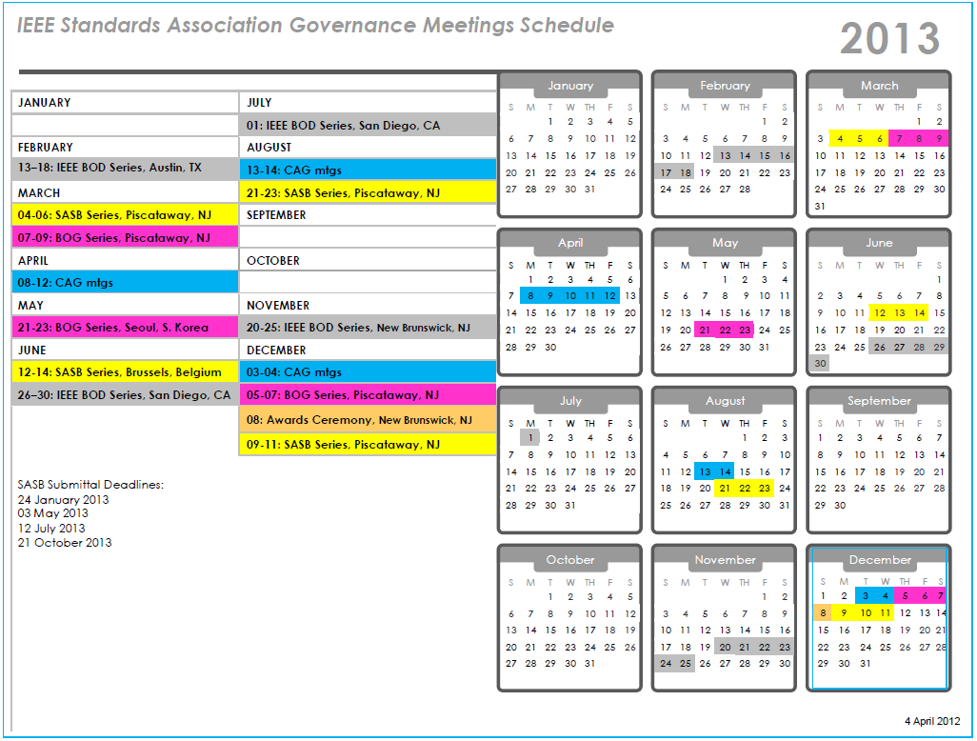

Slide 33
