Slide 1
Supplementary Plenary Information - March 2013
Date: 2013- March -16
Authors:
Name
Company
Address
Phone
email
Bruce Kraemer
Marvell
5488 Marvell Lane,
Santa Clara, CA, 95054
+1 (321) 751-3958
bkraemer@
marvell
.com
Abstract: Additional Information on topics for 802 Plenary meeting – March 2013
Notes:
November 2011

Slide 2
Monday
Notes:
November 2011

Slide 3
IEEE LOA Database – March 19, 2013
Friday Agenda Item 2.08
http://standards.ieee.org/db/patents/pat802_11.html
8 entries with 2013 submission dates

Slide 4
Joint Meetings
Monday Agenda Item 4.1.3
External:
With 802.1 Thursday 8:00 am1 – Caribbean VII
Subject: Bridging
Internal: Monday 8:30 am 802.11AQ & 802.11AI

Slide 5
March 2013 PARS
Monday Agenda Item 4.1.4
802 - Standard for Local and Metropolitan Area Networks: Overview and Architecture - PAR modification request
802.1Qcb - amendment for Frame Replication and Elimination for Reliability - PAR and 5C
802.3bm - PAR modification Request & Updated 5C
802.3bq - amendment for 40GBASE-T, PAR and 5C
802.15.4p - PAR modification Request
802.21c - PAR Extension

Slide 6
Convention Center Schematic
Monday Agenda Item 4.1.5
Curacao
Bonaire
Antigua
Sierra
Boca
Caribbean

Slide 7
Caribbean Ballroom
Monday Agenda Item 4.1.5
I
VII
III
IV
V
II
VI

Slide 8
Monday Agenda Item 4.1.5
8
7
6
5
Curacao
4
3
2
1
Curacao
8
7
6
5
Bonaire
4
3
2
1
Bonaire
4
3
2
1
Antigua

Slide 9
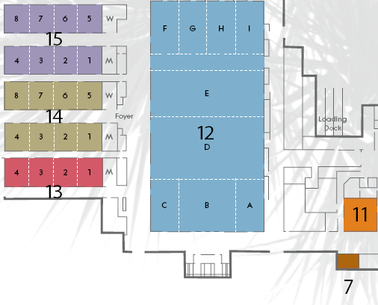
Caribe Royale meeting areas
Monday Agenda Item 4.1.5
Perspectives
34th floor
Notes:
November 2011

Slide 10
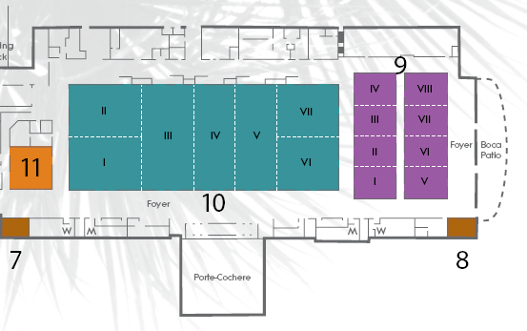
Caribe Royale meeting areas
Monday Agenda Item 4.1.5

Slide 11
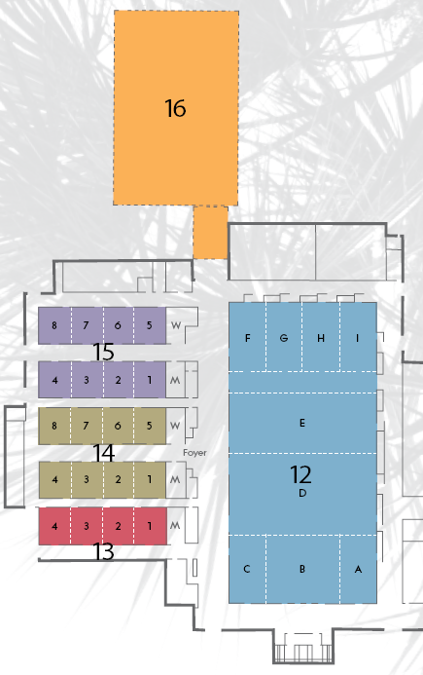
Social Location
Monday Agenda Item 4.1.5
Caribe Pavilion

Slide 12
Group Room assignments
Monday Agenda Item 4.1.5
WG | Room
1 | Grand Sierra F, Curacao ½
16 | Antigua 3, 4
18 | Boca 7
19 | Antigua 1
21 | Antigua 2
22 | Bonaire 4
24 | Boca 6
OMNI RAN | Boca 6
Notes:
November 2011

Slide 13
WG Agendas
Monday Agenda Item 4.1.5
18: Agenda 18-13-0013 r8
Opening Report 18-13-0032 r1
19: Agenda 19-13-0032 r0
Opening Report 19-13-0031 r0
21: Agenda 21-13-0191 r0
Opening Report 21-13-0044 r0
22: Agenda 22-13- 0034 r0
Opening Report 22-13- 0xxxr0
24: Agenda 22-13-0009 r2
Opening Report 22-13-0x10 r1
OmniRAN Agenda 22-13-0015 r0
Opening Report 22-13-0014 r1

Slide 14
March 17-22 2013 Meeting Orlando, Florida, USA
Monday Agenda Item 4.1.6
Hotel Registration OPEN
Meeting Registration OPEN
Early bird registration expires
Friday January 25
http://www.ieee802.org/11/Meetings/Meeting_Plan.html

Slide 15
April 24-25 2013 Meeting Beijing China
Monday Agenda Item 4.1.6
Hotel Registration OPEN
Meeting Registration OPEN
http://www.ieee802.org/11/Meetings/Meeting_Plan.html

Slide 16
Meeting Registration
Monday Agenda Item 4.1.7
Data collected: 2013-01-13

Slide 17
Current Membership Status
Monday Agenda Item 4.1.7
Status | Number
Aspirant | 87
Potential Voter | 31
Voter | 324
Definitions:
Aspirant: a member who has attended 1 qualifying meeting
Potential Voter: a member who has attended 2 qualifying meetings and will become a voter at the start of the next plenary they attend
Data as of 2012-11-16

Slide 18
Recent voting member history
Monday Agenda Item 4.1.7

Slide 19
IEEE Staff on site
Monday Agenda Item 4.1.8
Bill Ash
Kathryn Bennett
Christina Boyce
Patricia (Trish) Gerdon
Jodi Haasz
Karen McCabe
Lisa Perry
Walter Pienciak
Michelle Turner
Meng Zhao

Slide 20
802.11ac Sponsor Ballot Classifications

Slide 21
Other Special Events
Monday Agenda Item 4.1.9
Breakfast & Breaks:
Caribbean & Sierra Ballroom Foyer
Lunch: for purchase
Boca Foyer East side
Wednesday Social 6:30 pm start
Badge needed for admission – Guest also
Caribe Pavillion - north of Grand Sierra F

Slide 22
Wednesday Plenary Topics
Monday Agenda Item 4.1.11
Special Interest Groups
Sub group Agendas
Awards

Slide 23
IoT
Monday Agenda Item 4.1.12
The IEEE-SA Corporate Advisory Group (CAG) Internet of Things (IoT) strategy team is requesting information from you concerning your IEEE standards projects and standards that may relate to the Internet of Things (IoT), as part of IEEE-SA's effort to bolster IEEE’s position in relation to IoT. The team requests a response by 29 March 2013.
The IEEE-SA CAG has been designated by the IEEE-SA Board of Governors (BOG) as responsible for creating the IEEE-SA strategy for IoT and for coordinating its activities in this area. The IoT is "a scenario in which every thing has a unique identifier and the ability to communicate over the Internet or a similar wide-area network." (whatis.com)
The IoT strategy team is aware that there are many existing IEEE standards and projects that are relevant to a vibrant IoT. The team is soliciting your input as to which of your current standards and projects you deem to be valuable to the IoT. Please respond with this information to Mary Lynne Nielsen at m.nielsen@ieee.org by 29 March 2013.
If you have any questions concerning this request, please address them to Mary Lynne Nielsen. Thank you for your consideration and response to this request.

Slide 24
802.1 Architecture Document
Monday Agenda Item 4.1.13

Slide 25
802.11 Topics for March 2013 EC
Monday Agenda Item 4.1.15
Begin Sponsor Ballot
Conditional approval for AC - Open Sponsor Ballot Group formation
Requests to submit to RevCom?
x
New project PAR to NesCom?
x
PAR Extension ?
x
Revision PAR?
Nothing needed at this time
Study Group start up?
Depends upon results of WNG meeting
Study Group extension?
x
Press Release

Slide 26
Tutorials
Monday Agenda Item 4.1.16
http://ieee802.org/Tutorials.shtml
Tutorial #1 (6:00–7:30 pm): IEEE 802.1Q: Media Access Control Bridges and Virtual Bridged Local Area Networks Presentation | Sponsored by Paul Nikolich
Tutorial #2 (7:30–9:00 pm): Shared 5 GHz bands update Presentation | Sponsored by Bruce Kraemer
http://www.ieee802.org/802_tutorials/2013-03/802-0313-TUTORIAL%20SECTIONS-Mar17.pdf

Slide 27
Wednesday
Notes:
November 2011

Slide 28
May 12-17 2013 Meeting Waikoloa, Hawaii, USA
Wednesday Agenda Item 2.3
http://www.ieee802.org/11/Meetings/Meeting_Plan.html
Hotel Registration OPEN
Early bird room rate sold out
Now $169 per night
Meeting Registration OPEN
Early bird registration expires
Friday May 3

Slide 29
Social Location
Monday Agenda Item 2.7
N
Caribe Pavilion
Wednesday Social
6:30 pm start
Badge needed for admission – Guest also
Caribe Pavillion - north of Grand Sierra F

Slide 30
Wednesday Agenda Item 5.1
Room Changes
??
Notes:
November 2011

Slide 31
Wednesday Agenda Item 5.2
Revised Agenda Graphic
If needed

Slide 32
Wednesday Agenda Item 5.3
Mid-week Officer Changes
If needed

Slide 33
Wednesday Agenda Item 5.13
11ad Awards
WG Task-Force Chair | Eldad Perahia
Technical Editor | Carlos Cordeiro
WG Task-Force Vice Chair | James Yee
WG Task-Force Vice Chair | Vinko Erceg
WG Task-Force Vice Chair | Chris Hansen

Slide 34
11ad Awards

Slide 35
11ad Awards

Slide 36
11ad Awards

Slide 37
Friday

Slide 38
Announcements
Friday Agenda Item 2.07
Coffee will be continuously available from 7:30am to 11:00am
Propose that we proceed continuously through the agenda with target completion time of 10:00 am

Slide 39
IEEE LOA Database – March 19, 2013
Friday Agenda Item 2.08
http://standards.ieee.org/db/patents/pat802_11.html
8 entries with 2013 submission dates

Slide 40
IEEE Store Contents - March 2013
Friday Agenda Item 2.09
http://www.techstreet.com/ieeegate.html
http://standards.ieee.org/about/get/802/802.11.html
Amendment | Draft in TechStreet Mar 18 | Draft in Members Area | Publication in Get 802 Mar 18
AF | D3.0 $300 | 3.0
AC | D5.0 $250 | 5.0
AD-2012 | $300 | 9.0
AE-2012 | $105 |  | P
AA-2012 | $180 |  | P
802.11 -2012 | $540 print |  | P
b, k, i, n, p, y, r, w, u, v, z, s | $100 - $305
802.11-2007
Notes:
November 2011

Slide 41
802.11 drafts to ISO/IEC JTC1/SC6
Friday Agenda Item 2.10
Task Group | After Vancouver
TGae
TGaa
TGREVmb
TGad
TGac | D5.0
Notes:
November 2011

Slide 42
Tutorials
Friday Agenda Item 2.11
Call for July 2013 suggestions

Slide 43
IOT Summary
Friday Agenda Item 6.1
IEEE has a website with a long list of standards
Include amendment projects underway
Prepare a sentence or two for each item describing how it contributes to IOT
Update web presence
Compare to ETSI one M2M
Add info from SXSW
Add info on Shenzhen IOT event
Feed info into IoT Steering Committee

Slide 44
University Outreach
Wednesday Agenda Item 6.2
1 happy student in March 2013
Invitations sent to
University of Florida
University of South Florida
Florida Institute of Technology

Slide 45
Future Venues -2013
Friday Agenda Item 6.3
2013
# 137 January 13-18, 2013 - --Hyatt Regency Vancouver, BC, CA
#137.5 January 23-24, Grand Mercure, Shenzhen, CN
# 138 March 17-22, 2013 –Caribe Royale, Orlando, FL, USA
# 139 May 12-17, 2013 ----Hilton Waikoloa, Big Island, HI
#139.5 April 24-25 – Beijing, China
# 140 July 14-19, 2013 --- Geneva , CH ITU headquarters
# 141 September 15-20, 2013- Zhong Shan Hotel, – Nanjing, China
# 142 Nov 10-15, 2013 Hyatt Regency Dallas, TX, USA
Notes:
November 2011

Slide 46
July 2013 Plenary - Geneva
Friday Agenda Item 6.3
Saturday July 13 prior to the session there will be a Workshop
Further details to follow

Slide 47
Future Venues - 2014
Friday Agenda Item 6.3
2014
# 143 January 19-24, 2014 -Hyatt Century Plaza, Los Angeles, CA, US
#143.5 January 8-9, 2014 - China
# 144 March 16-21, 2014 – Beijing, China
# 145 May 11-16, 2014 ----Hilton Waikoloa, Big Island, HI
#145.5 May21-22, 2014 - China
# 146 July 13-18, 2014 - Manchester Grand Hyatt, San Diego, CA, US
# 147 September 14-19, 2014----1st priority– Kobe, Japan
#147.5 September24-25, 2014 - China
# 148 November 2-7, 2014 Hyatt Regency San Antonio, TX, US
Notes:
November 2011

Slide 48
April 24-25 2013 Meeting Beijing China
Friday Agenda Item 7
Hotel Registration OPEN
Meeting Registration OPEN
http://www.ieee802.org/11/Meetings/Meeting_Plan.html
Venue :
Hotel Nikko New Century Beijing (http://www.newcenturyhotel.com.cn/indexen.html)
Same hotel as the Sept 2012 meeting in Beijing.

Slide 49
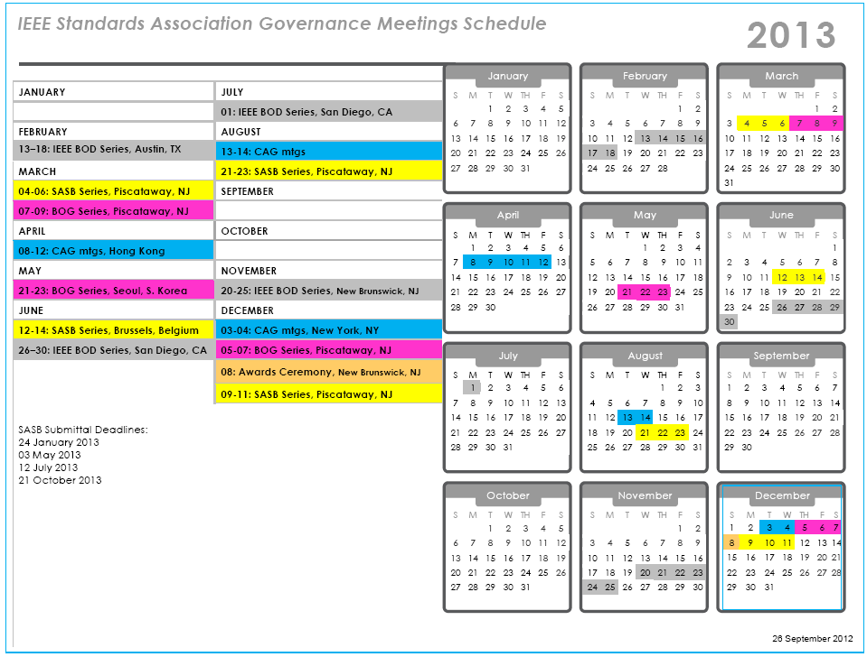

Slide 50
