Slide 1
EIFS Issues
Author:
Name | Affiliation | Address | Phone | Email
Menzo Wentink | Qualcomm | Straatweg 66-s, Breukelen, The Netherlands | +31-65-183-6231 | mwentink@qualcomm.com

Slide 2
CID 287
This contribution is related to Revmc pre-ballot CID 287
11-12-1082-11-000-revmc-pre-ballot-comments.xls
CID 287:
“EIFS is intended to protect a hidden ACK, but it may also get started after an ACK that is sent at a higher PHY rate than its PLCP header. This may cause unwanted deferral after a TXOP, resulting in major channel access unfairness and in some cases even a capture effect. A similar issue may occur at hidden nodes that do EIFS for a hidden ACK that is shorter than what is assumed in the EIFS.”

Slide 3
Introduction
There are two design issues with EIFS
EIFS can be started after an Ack frame
EIFS can be (much) longer than a hidden Ack
The proposed resolution is as follows:
allow EIFS=DIFS for PPDUs that look like an ACK
allow EIFS to be based on the PPDU’s Rate/MCS

Slide 4
Definition of EIFS
EIFS is defined as aSIFSTime + DIFS + ACKTxTime
EIFS = SIFS+ACK+DIFS
2.4 GHz
EIFS = 10+304+10+2*9 = 342 us
5 GHz
EIFS = 16+44+16+2*9 = 94 us

Slide 5
EIFS-after-Ack Issue (1)
EIFS is intended to avoid that STAs interfere with an ACK from a hidden STA, by deferring for EIFS when a valid packet is detected but a Duration field could not be decoded (i.e. the FCS fails)
However, EIFS may also get started after ACK frames, when the MPDU MCS is higher than the L-SIG MCS
an ACK MPDU at 24 Mbps can only be received correctly at about half the distance of its L-SIG
EIFS deferral after a TXOP causes major unfairness between contending devices, and in some cases even a capture effect

Slide 6
EIFS-after-Ack Issue (2)
L-SIG range of the Ack from the AP to STA2
Area where the EIFS-after-Ack issue occurs
MPDU range of the Ack
AP
STA
Ack

Slide 7
EIFS-after-Ack Issue (3)
Assuming channel D and certain path loss conditions, an ACK MPDU at 24 Mbps can only be received correctly at about half the distance of its L-SIG
this means that EIFS is started in 90% of the region where the L-SIG of the ACK is received, assuming spherical range
For higher attenuation, for instance through walls, the EIFS-after-ACK issue starts much closer to the device sending the ACK
therefore, the issue can be caused by devices in the home network or in a neighboring network

Slide 8
EIFS-after-Ack Issue (4)
EIFS duration
2.4 GHz
EIFS = 342 us
in terms of AIFSN: 36 slots
36 slots is extremely long when CWmin is 15 or even 31 slots
5 GHz
EIFS = 94 us
in terms of AIFSN: 9 slots
by comparison, the AIFSN for background traffic is ‘only’ 7 slots

Slide 9
Simulation Setup for EIFS-after-ACK
L-SIG range of the Ack from the AP to STA2
Area where the EIFS-after-Ack issue occurs
MPDU range of the Ack
STA1 starts EIFS after ACKs from the AP to STA2
STA1
AP
STA2
UDP
UDP

Slide 10
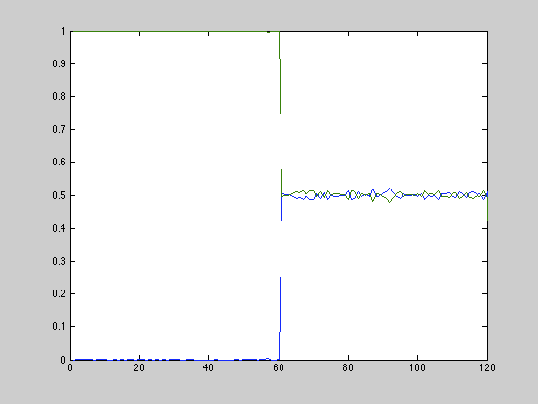
EIFS-after-ACK - Best Effort Traffic (2.4 GHz)
STA2
Capture Effect
Channel access becomes fair when STA1 no longer starts EIFS after ACKs
A capture effect occurs because CWmin=15 at STA2 results in a backoff that is always less than EIFS at STA1
%
TXOPs
STA1
Time

Slide 11
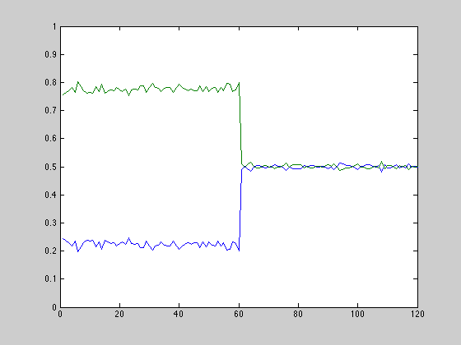
EIFS-after-ACK - Best Effort Traffic (5 GHz)
STA2
Channel access becomes fair when STA1 no longer starts EIFS after ACKs
Channel access is unfair because STA1 starts an EIFS after ACKs sent by the AP to STA2
%
TXOPs
STA1
Time

Slide 12
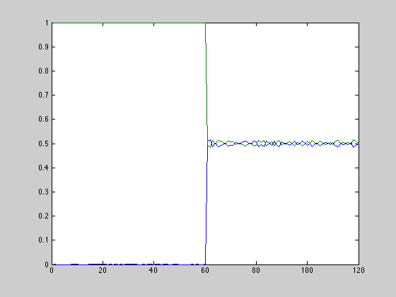
EIFS-after-ACK - Video Traffic (5 GHz)
STA2
Capture Effect
Channel access becomes fair when STA1 no longer starts EIFS after ACKs
A capture effect occurs because CWmin=7 at STA2 results in a backoff at STA2 that is always less than EIFS at STA1
%
TXOPs
STA1
Time

Slide 13
Proposed Solution for EIFS-after-ACK Issue (1)
Allow EIFS=DIFS PPDUs that contain a 14 or 32 Byte MPDU
ACK/CTS = 14 Bytes, Block Ack = 32 Bytes
These MPDU sizes are unique amongst the 802.11 control frames
There is a hypothetical case that a 4 Byte data packet is sent without encryption and without A-MPDU, which results in a 32 Byte MPDU
There are also 2 action frames that are exactly 32 Bytes
WNM Notification Request/Response frame
EIFS protection can be realized by adding a (reserved) optional subelement or by sending the frame at 6 Mbps
Can be limited to non-HT(-duplicate) and (HR-)DSSS packets
These capture the majority of the CTS, ACK and Block Ack packets

Slide 14
Proposed Solution for EIFS-after-ACK Issue (2)
The MPDU size can be determined from the PLCP header
non-HT(-dup): L-SIG
DSSS: SIGNAL and LENGTH
HR-DSSS: SIGNAL, SERVICE and LENGTH
The L-SIG length of HT and VHT packets is always a multiple of 3, so there will be no confusion at devices that receive only the L-SIG of an HT/VHT packet

Slide 15
EIFS-too-Long Issue (1)
EIFS is based on the longest possible ACK duration, but the actual ACK can be a lot shorter
2.4 GHz
SIFS+ACK(1Mbps)+DIFS = 10+304+10+2*9 = 342 us
SIFS+ACK(24Mbps)+DIFS = 16+28+16+2*9 = 78 us
Difference = 264us = 29 slots
5 GHz
SIFS+ACK(6Mbps)+DIFS = 16+44+16+3*9 = 94 us
SIFS+ACK(24Mbps)+DIFS = 16+28+16+3*9 = 78 us
Difference = 16us = 2 slots

Slide 16
Simulation Setup for EIFS-too-Long
L-SIG range of the Ack from STA2 to the AP
STA1 is hidden from ACKs sent by STA2, but not for the Data PPDUs sent by the AP. EIFS by STA1 can be too long in this case.
STA1
AP
STA2
UDP
UDP

Slide 17
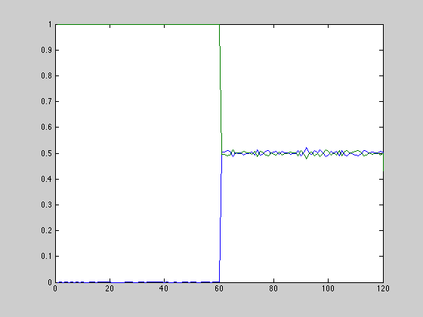
EIFS-too-Long - Best Effort Traffic (2.4 GHz)
STA2
Capture Effect
Channel access becomes fair when EIFS at STA1 adapted to the expected ACK time
A capture effect occurs because EIFS at STA1 is always longer than the OFDM ACK + backoff at STA2
%
TXOPs
STA1
Time

Slide 18
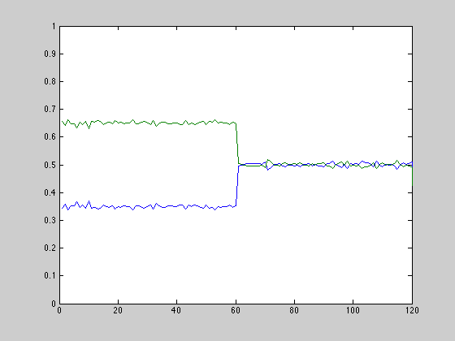
EIFS-too-Long - Best Effort Traffic (5 GHz)
STA2
Channel access becomes fair when EIFS at STA1 adapted to the expected ACK time
Channel access is unfair because EIFS at STA1 is longer than SIFS+ACK+DIFS at STA2
%
TXOPs
STA1
Time

Slide 19
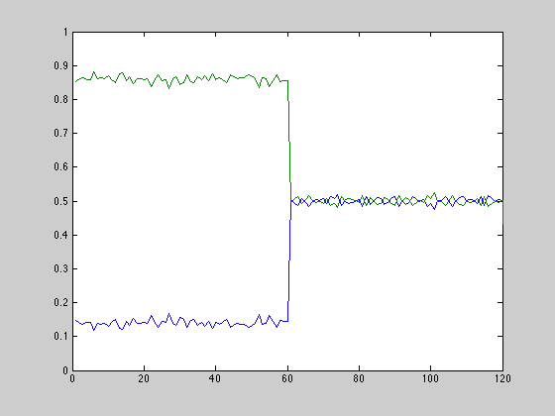
EIFS-too-Long - Video Traffic (5 GHz)
STA2
Channel access becomes fair when EIFS at STA1 adapted to the expected ACK time
Channel access is unfair because EIFS at STA1 is longer than SIFS+ACK+DIFS at STA2
%
TXOPs
STA1
Time

Slide 20
Proposed Solution for EIFS-too-Long Issue (1)
Dynamic EIFS
EIFS is based on a predicted duration of the expected response frame
the response rate/MCS is determined using the PHY mandatory MCSs (see tables on next slide)
assume Block Ack for VHT packets and for HT packets with Aggregation = 1
otherwise, assume an ACK
VHT single MPDU is undetectable in the PLCP, in which case the EIFS will be too long (which is probably acceptable)
The dynamic EIFS values should be minimum values, so that the existing (static) EIFS implementations are also still compliant

Slide 21
Proposed Solution for EIFS-too-Long Issue (2)
Example dynamic EIFS tables based on the received PPDU’s Rate/MCS and expected response frame (BA or ACK)
DSSS / HR-DSSS (always ACK)
Rate of received frame | Response Rate | ACK Tx Time | Dynamic EIFS (for ACK) | EIFS
1 Mbps | 1 Mbps | 304 us | 342 us | 342 us
≥ 2 Mbps | 2 Mbps | 152 us | 190 us | 342 us
OFDM / ERP-OFDM / HT / VHT (BA or ACK)
Modulation of received frame | Response Rate | BA Tx Time | Dynamic EIFS for BA | ACK Tx Time | Dynamic EIFS for ACK | EIFS
BPSK | 6 Mbps | 68 us | 118 us | 44 us | 94 us | 94 us
QPSK | 12 Mbps | 44 us | 94 us | 32 us | 82 us | 94 us
≥16-QAM | 24 Mbps | 32 us | 82 us | 28 us | 78 us | 94 us

Slide 22
Summary
There are two design issues with EIFS
EIFS may get started after an Ack frame
EIFS may be (much) longer than a hidden Ack
Proposed solutions
allow EIFS=DIFS for 14 or 32 Byte packets
allow EIFS to be based on the PPDU’s Rate/MCS

