Slide 1
Applications and Requirements for Next Generation WLAN
Date: 2013-01-15
Authors:

Slide 2
Motivation
In the past few 802.11 WNG meetings, several topics were proposed for next generation WLAN
  Carrier-operated Wi-Fi
  6-10 GHz Wi-Fi, etc.
In this presentation, we share our views on some applications and requirements for next generation WLAN

Slide 3
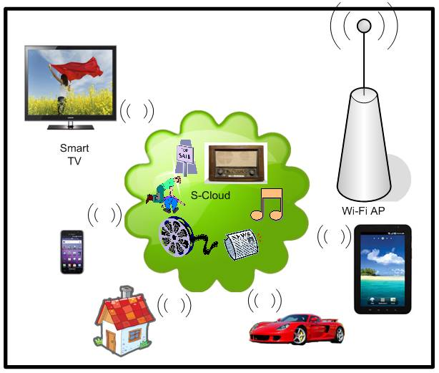
Trend: Wireless Connectivity for “Cloud”
Currently, various applications and systems are under Cloud umbrella
Wi-Fi is one essential local connectivity solution for devices to access cloud resources
Cloud computing assumes low layer communications always reliable and available
However, it may not be true for today’s WLAN
Cloud

Slide 4
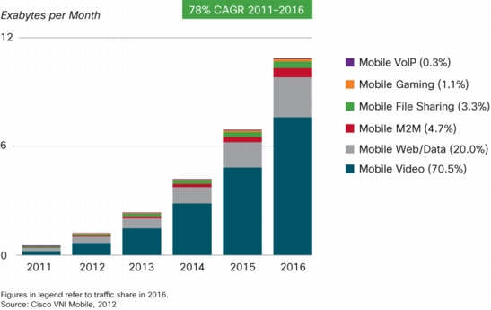
Traffic Type: Mobile Video
The Cisco® Visual Networking Index (VNI) Global Mobile Data Traffic Forecast Update showed that
  >50% for the first time in 2011
  Forecasted >70% by 2016

Slide 5
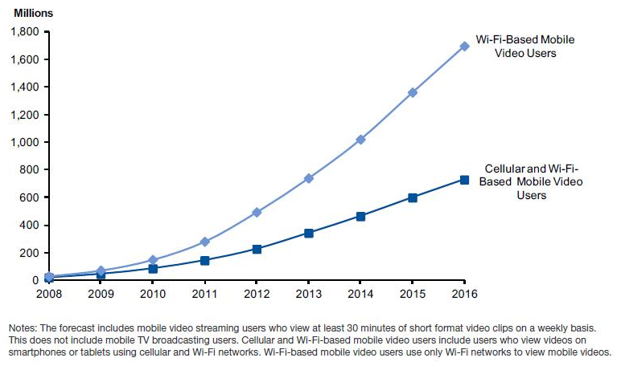
Mobile Video: Wi-Fi vs Cellular
Gartner Group projected in the report of “Market Trends: Worldwide, the State of Mobile Video, 2012”
  70% of mobile video users will use only Wi-Fi to view mobile video
  The remainder of the market relying on a mix of cellular and Wi-Fi networks to gain access.

Slide 6
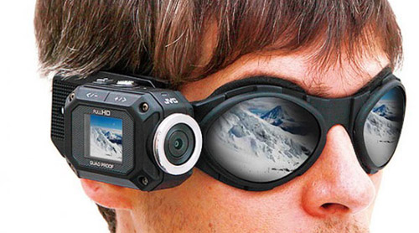
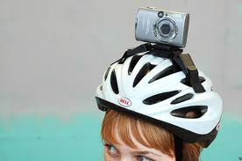

Uplink Video
At present, video streaming is predominately downlink
In the future, it is possible more and more video will be real-time streamed or uploaded through uplink
  e.g., Whatever you see will be recorded and streamed/uploaded through a video camera mounted on your head
    Both indoor and outdoor
  Further, extra videos may be added with what you do automatically
    When you look at something in a store, the video introductions can be streamed/uploaded together

Slide 7
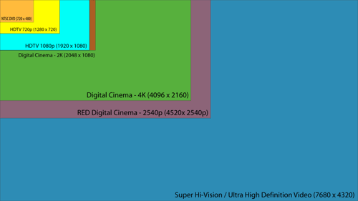
Ultra High Definition (UHD) Video
CES 2013 showed many TVs to support UHD 4K video
UHD 8K video is predicted to be widely available in 2016 to 2020
  UHD video data rate requirement
    Pixel resolution of UHD: 7680x4380
      16 times of standard HD video
    Data rate per uncompressed UHD stream:
      144 Gbps
    Compressed data rate per UHD stream:
      14.4 ~ 28.8 Gbps based on 60GHz H.264 visually lossless compression ratio: 5~10 times

Slide 8
Ultra High Definition (UHD) Video
Two major video application areas
  Pre-stored video such as TV broadcasting and Blue-ray movies
    High compression ratio: can go up to several hundreds (MPEG, H.264 and now HEVC)
    Long latency: Both intra-frame and inter-frame video processing, also multi-frame reference schemes
  Real-time video such as Wi-Fi display and 60GHz display extension
    Low compression ratio: usually at the order of 10
    Low-latency: Mainly intra-frame video processing
 | Uncompressed video | Compressed video (natural video ) | Compressed video (synthetic video or hybrid video)
Wi-Fi display | 3 Gbps | About 70~150 Mbps | About 100~300 Mbps
60 GHz display extension | 3~10 Gbps | About 300 Mbps ~ 1 Gbps | About 600~1.5 Gbps
UHD 8K | Up to 144 Gbps | About 7 ~14 Gbps | About 14 ~28 Gbps

Slide 9




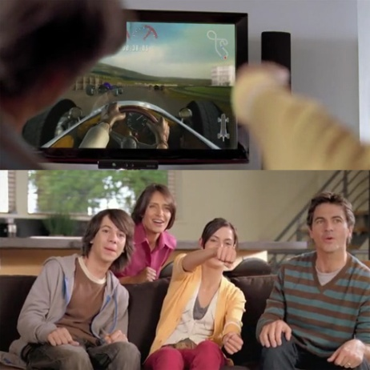
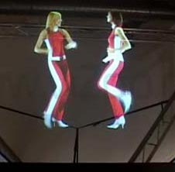
Immersive Interactive Multimedia
6 sense information types: AV, smell, touch, gesture etc.; and real 3D video objects (e.g. cheoptics360)
Much more information is included in the content streams than that presented to the user
Information rendered to the user can be dynamically changed based on the real-time interaction from user
Scenario Description:
  A user watch TV (Streaming case) or for video tel-conf (Two way real-time video case) is surrounded by a immersive multimedia environment
    Contents adjusted based on users’ status and intensions
      For example, if user moves closer to a video object, more detailed information will be transmitted from the server or the other part of the tel-conf
      Second example, if a user starring at one object for a while, many related information will be delivered from different sources from the Internet

Slide 10
Technical Challenges/Requirements
Scalability in terms of
  Network size: several devices up to hundreds
  User data rate: up to several hundred Gbps
  Transmission latency: <10ms
  Reliability: No end-to-end error (ideally)
Low power consumption
  Very important for mobile devices
QoS
  Still the key hurdle for AV applications particularly for end-to-end QoS
Security & privacy
  Protection from virus and hacking while prevent illegal information exchanging
Robustness management
  See next page

Slide 11
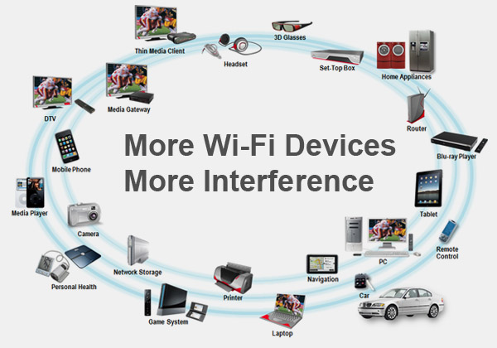
Robustness Management
Interference becomes more serious
  Wi-Fi are widely used by mobile and CE devices and more and more interferences are observed
    Most devices such as smart phones can act as APs now
  Many other types of devices emitting in the unlicensed band dwarf the number of 802.11 devices
    Microwave ovens, cordless phones, Bluetooth devices, wireless video cameras, outdoor microwave links, wireless game controllers, Zigbee devices, fluorescent lights, and so on.
Service interruption caused by network switching
  As an example in Hyatt Vancouver, already connected to hotel Wi-Fi and run different applications, and then need to manually switch to “Verilan” for 802 meeting attendance sign in
  This kind of network switching may be OK for some applications, but may not OK for time critical applications
    Real-time video streaming, On-line group gaming, Video chatting and tel-conference, etc.

Slide 12
Next Step
Detailed analysis on the requirements from each application and use case.
Identify the aspects of current 802.11 that need to be improved.
Discuss with interested parties and identify marketing and technical issues of next generation WLANs.

Slide 13
Thank you!

