Slide 1
A resolution proposal comments related to for next generation security in 802.11 built on changes in 802.11ac
14 January 2013
Authors:
Name | Company | Phone | email
Andrew Myles | Cisco | +61 418 656587 | amyles@cisco.com
Brian Hart | Cisco | +1 408 5253346 | brianh@cisco.com
Dan Harkins | Aruba | +1 408 227 4500 | dharkins at arubanetworks dot com

Slide 2
LB188 contains comments requesting the inclusion of updated security options in 802.11ac
Number
6198
from Brian Hart (Cisco)
6513
from Dan Harkins (Aruba)
Comment
11ac does not seem to have a sufficiently rich set of security options to meet Suite-B requirements
Add support for GCM-256 and Suite B
Proposed change
Define a sufficient security toolkit for 11ac so that 11ac can meet Suite B requirements, including any transitional measures if required
Adopt the changes specified in document 11-12/0711rX, where X is any revision (currently at zero)
Now at r1

Slide 3
LB190 also contains comments requesting the inclusion of updated security options in 802.11ac
Number
7020
from Brian Hart (Cisco)
7282
from Dan Harkins (Aruba)
Comment
11ac does not seem to have a sufficiently rich set of security options to meet Suite-B requirements. This comment was raised during LB3.0 and initial discussions were held leading to a greater understanding of the security and implementation issues, with strong support to continue the work. Since, over time, the security issue remains but the implementation issues become less problematic, it is time to revisit this issue.
Add support for GCM-256 and Suite B
Proposed change
Define a sufficient security toolkit for 11ac so that 11ac can meet Suite B requirements, including any transitional measures if required
Adopt the changes specified in document 11-12/0711rX, where X is any revision (currently at zero)

Slide 4
LB190 also contains comments requesting the inclusion of updated security options in 802.11ac
Number
7017
from Andrew Myles (Cisco)
7310
from Reza Hedayat (Cisco)
Comment
802.11ac should incorporate security features required for it to satisfy Suite-B and similar security requirements. The reasons are specified in 946r3 and the necessary changes are specified in 711r2
11ac does not seem to have a sufficiently rich set of security options to meet Suite-B requirements
Proposed change
Incorporate the changes specified in 711r2
Define a sufficient security toolkit for 11ac so that 11ac can meet Suite B requirements, including any transitional measures if required

Slide 5
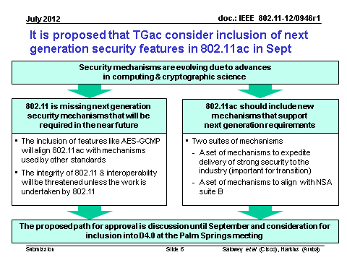
The reasons for the various comments were discussed in July and September 2012
802.11-12/946r3

Slide 6
Requests have been made for members to articulate any concerns about the proposals
  A general request was made in TGac for members to communicate any concerns about the proposal with a specific request on ~6 Dec 12
    There were at least three comments in the LB on 802.11ac D4.0 that suggested that security features (eg GCMP-256) be added to 802.11ac, which would enable support for Suite B and similar security features. Dan Harkins (Aruba) and I have been anointed as the “assignees” for these comments.
    We would like to ensure that all views about the proposed resolution (the inclusion of 711r2) are understood and resolved before the January meeting in Vancouver.
    …
    If anyone has particular objections to accepting the comments on D4.0 that suggest the inclusion of Suite-B supporting features then could you please contact Dan and myself with your concerns. We will attempt to work with you to ensure you have all the information necessary to enable you to vote “yes” or “abstain” in January.

Slide 7
A number of concerns have been heard and hopefully mitigated
These features will be optional
  There is a fear that these features will be mandatory.
  This fear is unfounded in at least the short to medium term. The proposed amendment is very clear that these features are optional.
  We expect they will always be optional in the standard. Of course, in the long term it is possible that they may become mandatory in practice as a result of market demand.
These features will not certified by the WFA in 1st phase
    There is a fear that these features will be included in the first certification of 802.11ac in the WFA
    I can’t say too much about the activities of the WFA, except to say that I believe such a scenario has zero probability.

Slide 8
A number of concerns have been heard and hopefully mitigated
The market for these features will be small to start with
  There have been questions about the market for these features.
  It will be focused on government and military applications in the short term.
  However, it could expand to other markets in time, including healthcare, smart grid and the enterprise.

Slide 9
The integrity of 802.11 & interoperability will be threatened unless the work is done by 802.11
  The 802.11 WG could decide to not undertake this work
  The “world will not end” because 802.11i based security will still be sufficient for many use cases
  However, increasingly it will not be sufficient in some use cases.
  In these situations there is a risk, if next generation security features are not included in 802.11ac, that:
    Other organisations will attempt to define variants of the 802.11 standard to meet this need …
    … threating the integrity of the 802.11 standard
    Some companies will define proprietary solutions …
    … threatening the on-going interoperability of 802.11 based systems

Slide 10
A resolution is proposed for to CIDs 7020, 7282, 7017 & 7310
Motion
  TGac approves the following resolution to CIDs 7020, 7282, 7017 & 7310
    “Accept”
    “Incorporate the changes specified in 711r2”
  Moved: Andrew Myles
  Seconded: Dan Harkins

