Slide 1
802.11: Looking Ahead to the Future – Part II
Date: 2013-01-13
Authors:

Slide 2
Abstract
A call for initiating discussion on issues facing IEEE 802.11 WG to address the ever increasing volume of traffic.

Slide 3
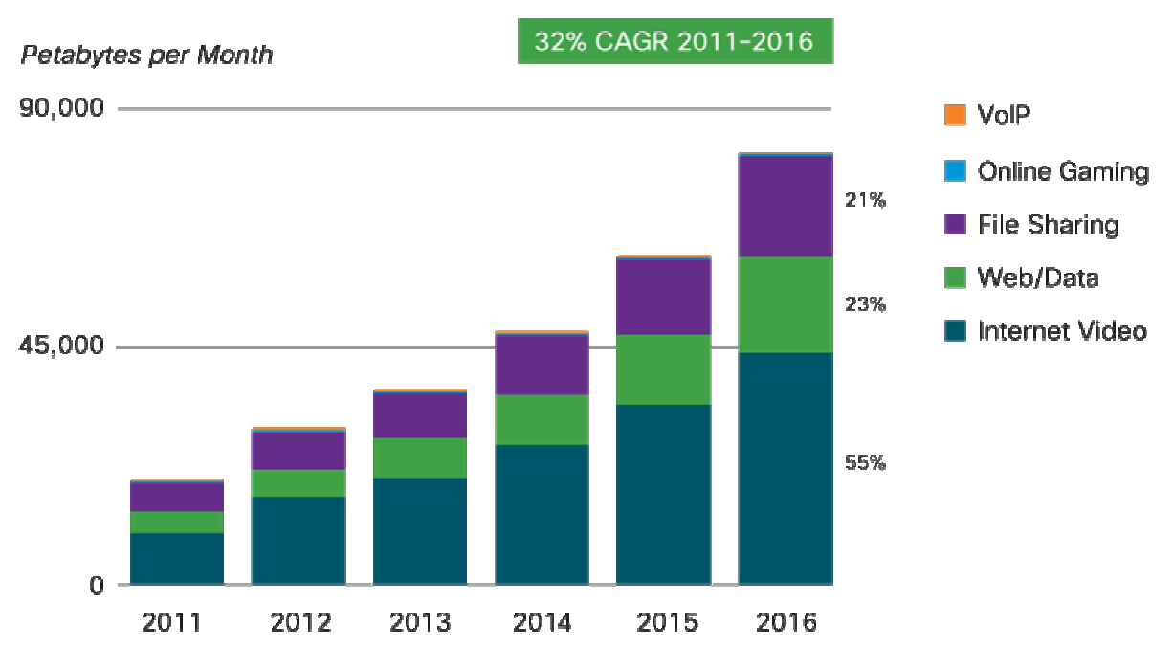
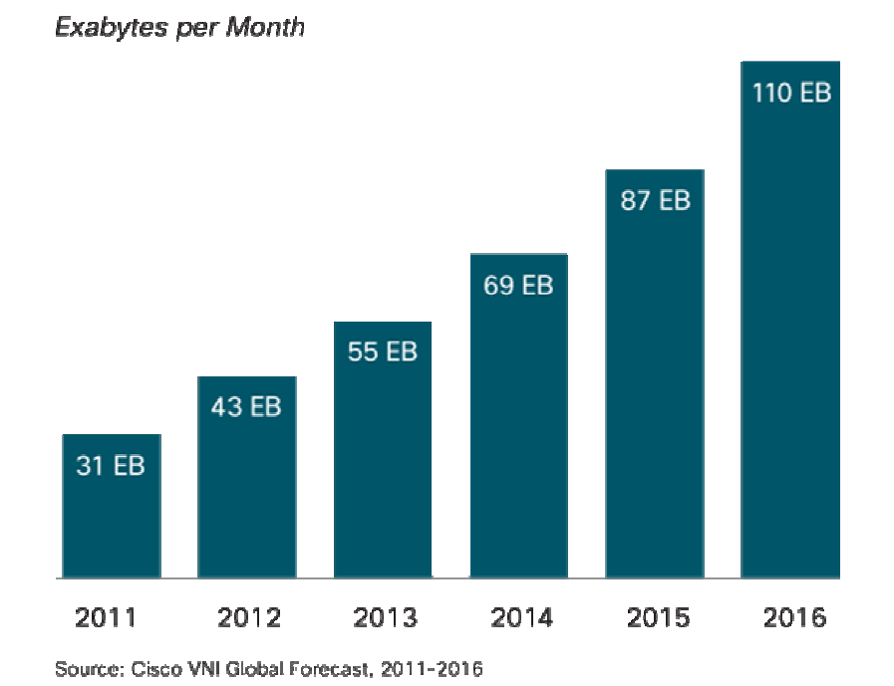
Traffic Volume Continues to Increase
Annual global IP traffic will pass the Zettabyte threshold by end of 2016.
IP traffic has been dominated by video traffic
  Video traffic will be 55% of all consumer Internet traffic by 2016

Slide 4
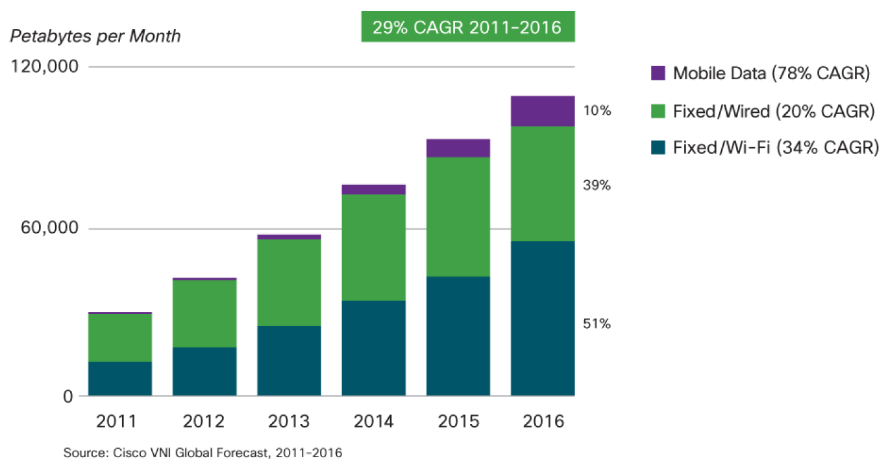
Smart Mobile Devices Drive Increased Traffic Volume
Almost 50% of the total traffic originates at Wi-Fi connections

Slide 5
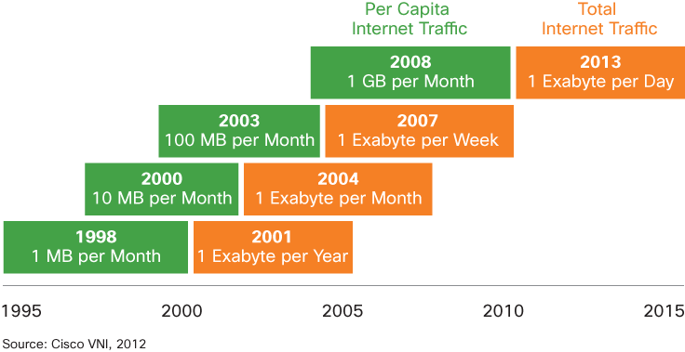
Beyond the VHT Era
Start of TGac
Start of VHT SG
Traffic volume is expected to increase significantly
  Per Capita traffic will reach 12 GB per month by 2016
Coincidently, the iPhone was introduced in June 2007.
  The number of mobile devices and smart phones exceeds forecasts

Slide 6
Evolution of Use Cases
Enterprise is evolving towards a cloud-based model
  No longer files and information are stored on local machines
Mobile access to cloud is expected to increase with the increase of smart mobile devices.

Slide 7
Technology Drivers
1999
1999
2003
2009
2013
Where to go from here?
802.11a
802.11b
802.11g
802.11n
802.11ac
Band: 5 GHz
Bandwidth: 20MHz
HDR = 54 Mbps
Key technology: OFDM
Band: 2.4 GHz
Bandwidth: 20MHz
HDR = 11 Mbps
Key technology: CCCK
Band: 2.4 GHz
Bandwidth: 20MHz
HDR = 54 Mbps
Key technology: OFDM
Band: 2.4 and 5 GHz
Bandwidth: 20/40MHz
HDR = 600 Mbps
Key technology: MIMO
Band: 5 GHz
Bandwidth: 20/40/80/160 MHz
HDR = 6.9 Gbps Mbps
Key technology: MU-MIMO
256 QAM
Based on past history, initiating the discussion this year will mean concluding the effort around 2018/2019 time frame.

Slide 8
Challenges
Unlike wired technologies; adding multiple APs in the same vicinity doesn’t help
  Interference becomes a major issue in dense environment.
Traditionally the PHY layer was the engine for achieving higher throughput.
  What new PHY technologies need to be considered?
MAC contribution to higher throughput may be limited.

Slide 9
Candidate Topics
Some topics were discussed during 802.11ac development
  UL-MIMO proposed during 802.11ac development
  MU-DLS: Direct extension to 802.11ac DL MU-MIMO
Recent submission to WNG proposed a number of topics that are worth discussing .

Slide 10
Next Steps
Continue to analyze and refine Problem space; solicit input and coordinate with interested parties
Continue to analyze and refine contemplated solution timeline; solicit input and coordinate with interested parties
Develop associated use case(s) and other content/detail for a future presentation.

Slide 11
References
Darwin Engwer, “802.11 – Looking Ahead to the Future”, 11-07/0421r1, March 2007.
V. Erceg, et. al., “6-10 GHz UWB Link Budget and Discussion”, 11-12/0935r0, July 2012.
The Zettabyte Era, Cisco Visual Network Index, May 30, 2012
Cisco Global Cloud Index: Forecast and Methodology, 2011-2016.

