Slide 1
802.11REVmc Editor’s Report – May 2016
Date: 2016-05-17
Authors:

Slide 2
Acknowledgement
The following people have kindly aided the technical editor in one way or another during the development of REVmc:
  Dorothy Stanley, Jon Rosdahl, Mark Hamilton, Mark Rison, Peter Ecclesine, Mike Montemurro, Liwen Chu, Eldad Perahia, Brian Hart, Sai Shankar, James {Yee|Wang|P.K. Gilb}, Assaf Kasher, Carlos Cordeiro, Edward Au, Kaberi Banerjee, Rich Kennedy, Yongho Seok, Carlos Aldana, Gabor Bajko, Scott Marin, Graham Smith, Sigurd Schelstraete, Emily Qi
And a big thank you to Edward Au and Emily Qi, who are the sub-editors

Slide 3
Status of Draft

Slide 4
Reference Documents
Draft: P802.11REVmc D5.4 (members’ area)
WG Ballot composite comments
  11-15/0532 – currently R40
    LB193 comments start at CID 1000
    LB199 comments start at CID 2000
    LB202 comments start at CID 3000
    LB206 comments start at CID 4000
    SB0 is shown as “LB1000”, comments start at CID 5001
    SB1 is shown as “LB1001”, comments start at CID 7001
    Includes pre-ballot comments
MAC comment resolutions
  11-15/0565
GEN comment resolutions
  11-15/0665
MAC/GEN sheets usually used for motioning tech resolutions.
  Composite SS may lag contents of these sheets during a session, but is the eventual resting place of approved resolutions.

Slide 5
Comments by commenter
 | N |  |  | N Total | Y |  |  | Y Total | Grand Total
Owning Ad-hoc | E | G | T |  | E | G | T
RISON, Mark |  |  |  |  | 317 | 16 | 324 | 657 | 657
Hunter, David | 1 |  |  | 1 | 561 |  | 58 | 619 | 620
Stephens, Adrian | 15 | 23 | 4 | 42 | 14 | 39 | 50 | 103 | 145
Schelstraete, Sigurd | 17 |  | 73 | 90 |  |  |  |  | 90
Hamilton, Mark | 7 |  | 3 | 10 | 7 |  | 40 | 47 | 57
Fischer, Michael | 38 |  |  | 38 | 2 |  | 2 | 4 | 42
Hiertz, Guido | 9 |  |  | 9 | 21 | 1 | 1 | 23 | 32
Stanley, Dorothy | 9 |  |  | 9 | 21 |  | 1 | 22 | 31
Thomas, Angela |  |  |  |  |  |  | 29 | 29 | 29
Eastlake 3rd, Donald | 24 |  | 2 | 26 |  |  |  |  | 26
Bahr, Michael | 13 |  | 7 | 20 |  |  |  |  | 20
Aldana, Carlos | 3 |  | 15 | 18 |  |  |  |  | 18
TorabJahromi, Payam |  |  |  |  | 2 |  | 15 | 17 | 17
Trainin, Solomon |  |  |  |  |  |  | 12 | 12 | 12
Yang, Yunsong | 8 |  | 4 | 12 |  |  |  |  | 12
Fischer, Matthew |  |  |  |  |  |  | 11 | 11 | 11
Cordeiro, Carlos |  |  |  |  | 2 |  | 9 | 11 | 11
Seok, Yongho |  |  |  |  | 2 |  | 9 | 11 | 11
Gwynne, Gloria | 5 |  | 1 | 6 | 2 | 1 |  | 3 | 9
Ecclesine, Peter |  |  | 1 | 1 |  |  | 5 | 5 | 6
Bajko, Gabor |  |  |  |  | 1 |  | 5 | 6 | 6
Adachi, Tomoko | 3 |  | 3 | 6 |  |  |  |  | 6
Malinen, Jouni |  |  | 2 | 2 | 1 |  | 3 | 4 | 6
Qi, Emily | 2 |  | 3 | 5 |  |  |  |  | 5
Wentink, Menzo |  |  |  |  |  |  | 4 | 4 | 4
Yee, James | 3 |  |  | 3 |  |  |  |  | 3
McCann, Stephen |  |  | 3 | 3 |  |  |  |  | 3
Smith, Graham |  |  |  |  |  |  | 3 | 3 | 3
Sakoda, Kazuyuki |  |  | 2 | 2 |  |  |  |  | 2
Kasher, Assaf |  |  |  |  |  |  | 2 | 2 | 2
Hach, Rainer |  |  |  |  |  | 1 |  | 1 | 1
Eitan, Alecsander |  |  | 1 | 1 |  |  |  |  | 1
Grow, Robert |  |  |  |  |  |  | 1 | 1 | 1
Grand Total | 157 | 23 | 124 | 304 | 953 | 58 | 584 | 1595 | 1899

Slide 6
Status (2016-05-17)

Slide 7
GEN & MAC detail

Slide 8
Editor detail

Slide 9
Assignees

Slide 10
Status of editing

Slide 11
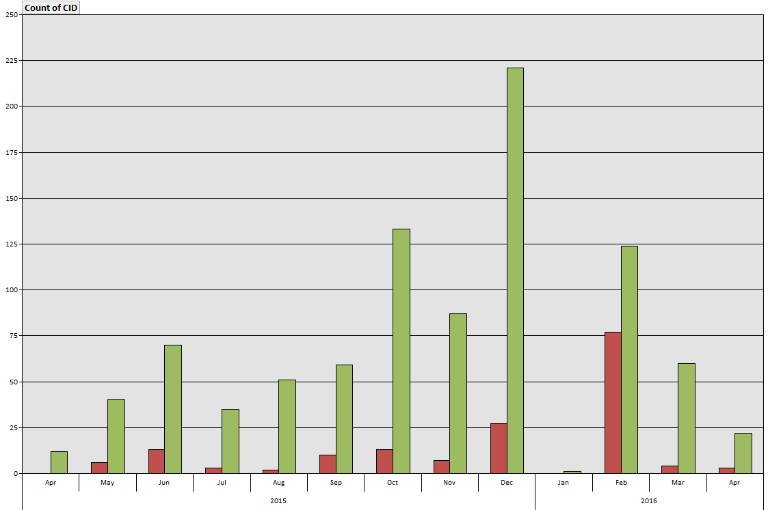
Approval progress (T & G comments only)

Slide 12
A prediction
We took 249 days to resolve 1899 comments from SB0.
We have 200 comments unresolved from SB1.
Assuming linear progress, this implies 26 days left (from date of writing) to resolve these comments at the same rate
I previously said: “it is reasonable to expect completion of these comments mid-April”

