Slide 1
802.11REVmc Editor’s Report – Feb 2016
Date: 2016-02-22
Authors:

Slide 2
Acknowledgement
The following people have kindly aided the technical editor in one way or another during the development of REVmc:
  Dorothy Stanley, Jon Rosdahl, Mark Hamilton, Mark Rison, Peter Ecclesine, Mike Montemurro, Liwen Chu, Eldad Perahia, Brian Hart, Sai Shankar, James {Yee|Wang|P.K. Gilb}, Assaf Kasher, Carlos Cordeiro, Edward Au, Kaberi Banerjee, Rich Kennedy, Yongho Seok, Carlos Aldana, Gabor Bajko, Scott Marin, Graham Smith, Sigurd Schelstraete, Emily Qi
And a big thank you to Edward Au and Emily Qi, who are sub-editors and did most of the editing on D4.4.

Slide 3
Status of Draft

Slide 4
Reference Documents
Draft: P802.11REVmc D5.0 (members’ area)
WG Ballot composite comments
  11-15/0532 – currently R30
    LB193 comments start at CID 1000
    LB199 comments start at CID 2000
    LB202 comments start at CID 3000
    LB206 comments start at CID 4000
    SB0 is shown as “LB1000”, comments start at CID 5001
    Includes pre-ballot comments
MAC comment resolutions
  11-15/0565
GEN comment resolutions
  11-15/0665
MAC/GEN sheets usually used for motioning tech resolutions.
Composite SS may lag contents of these sheets during a session, but is the eventual resting place of approved resolutions.

Slide 5
Comments by commenter
 | N |  |  | N Total | Y |  |  | Y Total | Grand Total
Owning Ad-hoc | E | G | T |  | E | G | T
RISON, Mark |  |  |  |  | 317 | 16 | 324 | 657 | 657
Hunter, David | 1 |  |  | 1 | 561 |  | 58 | 619 | 620
Stephens, Adrian | 15 | 23 | 4 | 42 | 14 | 39 | 50 | 103 | 145
Schelstraete, Sigurd | 17 |  | 73 | 90 |  |  |  |  | 90
Hamilton, Mark | 7 |  | 3 | 10 | 7 |  | 40 | 47 | 57
Fischer, Michael | 38 |  |  | 38 | 2 |  | 2 | 4 | 42
Hiertz, Guido | 9 |  |  | 9 | 21 | 1 | 1 | 23 | 32
Stanley, Dorothy | 9 |  |  | 9 | 21 |  | 1 | 22 | 31
Thomas, Angela |  |  |  |  |  |  | 29 | 29 | 29
Eastlake 3rd, Donald | 24 |  | 2 | 26 |  |  |  |  | 26
Bahr, Michael | 13 |  | 7 | 20 |  |  |  |  | 20
Aldana, Carlos | 3 |  | 15 | 18 |  |  |  |  | 18
TorabJahromi, Payam |  |  |  |  | 2 |  | 15 | 17 | 17
Trainin, Solomon |  |  |  |  |  |  | 12 | 12 | 12
Yang, Yunsong | 8 |  | 4 | 12 |  |  |  |  | 12
Fischer, Matthew |  |  |  |  |  |  | 11 | 11 | 11
Cordeiro, Carlos |  |  |  |  | 2 |  | 9 | 11 | 11
Seok, Yongho |  |  |  |  | 2 |  | 9 | 11 | 11
Gwynne, Gloria | 5 |  | 1 | 6 | 2 | 1 |  | 3 | 9
Ecclesine, Peter |  |  | 1 | 1 |  |  | 5 | 5 | 6
Bajko, Gabor |  |  |  |  | 1 |  | 5 | 6 | 6
Adachi, Tomoko | 3 |  | 3 | 6 |  |  |  |  | 6
Malinen, Jouni |  |  | 2 | 2 | 1 |  | 3 | 4 | 6
Qi, Emily | 2 |  | 3 | 5 |  |  |  |  | 5
Wentink, Menzo |  |  |  |  |  |  | 4 | 4 | 4
Yee, James | 3 |  |  | 3 |  |  |  |  | 3
McCann, Stephen |  |  | 3 | 3 |  |  |  |  | 3
Smith, Graham |  |  |  |  |  |  | 3 | 3 | 3
Sakoda, Kazuyuki |  |  | 2 | 2 |  |  |  |  | 2
Kasher, Assaf |  |  |  |  |  |  | 2 | 2 | 2
Hach, Rainer |  |  |  |  |  | 1 |  | 1 | 1
Eitan, Alecsander |  |  | 1 | 1 |  |  |  |  | 1
Grow, Robert |  |  |  |  |  |  | 1 | 1 | 1
Grand Total | 157 | 23 | 124 | 304 | 953 | 58 | 584 | 1595 | 1899

Slide 6
Status (2016-02-22)

Slide 7
GEN & MAC detail

Slide 8
Assignees

Slide 9
Editorial Resolutions

Slide 10
Status of editing

Slide 11
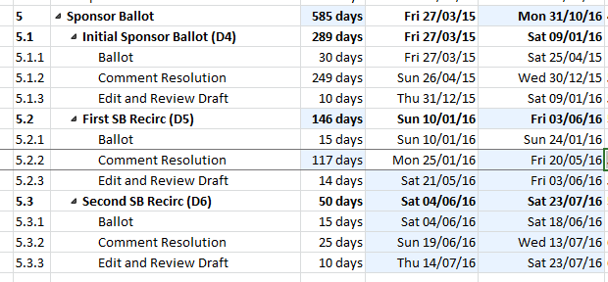
A prediction
We took 249 days to resolve 1899 comments from SB0.
We received 899 comments on SB1.
This implies 117 days to resolve these comments at the same rate.

