Slide 1
Spectral Masks for 11ah
Date: 2013-01-14
Authors:

Slide 4
Abstract
In this submission, we propose spectral masks for 11ah
  Approach: Define a comfortable “IEEE mask”, as the regulatory rules are hard to keep track of
  All masks are obtained by scaling 802.11ac mask
  Additionally, allow some relaxation on 1MHz mask
    Relax the 1 MHz mask by moving out the end-point of 0dBr to -20dBr roll-off
    Place the end point of the roll-off at the same distance from band-edge as the 2MHz mask

Slide 5
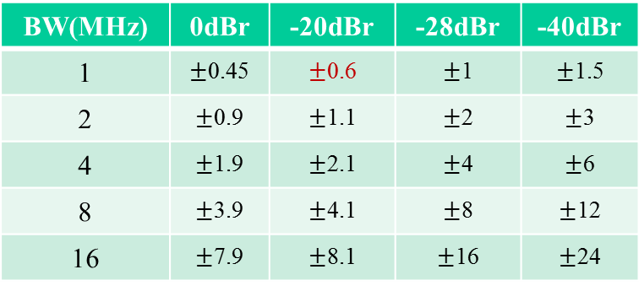
11ah 1/2/4/8/16MHz Spectral Mask
BW(MHz) | 0dBr | -20dBr | -28dBr | -40dBr
1 | $±$0.45 | $±$0.6 | $±$1 | $±$1.5
2 | $±$0.9 | $±$1.1 | $±$2 | $±$3
4 | $±$1.9 | $±$2.1 | $±$4 | $±$6
8 | $±$3.9 | $±$4.1 | $±$8 | $±$12
16 | $±$7.9 | $±$8.1 | $±$16 | $±$24
The bottleneck of meeting a 1 MHz mask (scaled 11ac mask without relaxation) is at the band edge (See Appendix)
Move out 0.55MHz (scaled 11ac mask) to 0.6 MHz in the first slope to relax the 1 MHz mask’s band edge requirement
As in 11ac, low TX power devices may not be required to meet -40 dBr, and generic values may be allowed. Assuming -40 dBr level for a 0 dBm transmission
  For 1 MHz channel, the transmit spectrum should have the maximum of -40 dBr and -40 dBm/MHz at 1.5 MHz frequency offset and above
  For 2 MHz channel, the transmit spectrum should have the maximum of -40 dBr and -43 dBm/MHz at 3 MHz frequency offset and above
  For 4 MHz channel, the transmit spectrum should have the maximum of -40 dBr and -46 dBm/MHz at 6 MHz frequency offset and above
  For 8 MHz channel, the transmit spectrum should have the maximum of -40 dBr and -49 dBm/MHz at 12 MHz frequency offset and above
  For 16 MHz channel, the transmit spectrum should have the maximum of -40 dBr and -49 dBm/MHz at 24 MHz frequency offset and above

Slide 6
11ah 1/2/4/8/16MHz Spectral Mask (2)
PSD
PSD
PSD
0
dBr
0
dBr
0
dBr
-
20
dBr
-
20
dBr
-
20
dBr
-
28
dBr
-
28
dBr
-
28
dBr
-
40
dBr
-
40
dBr
-
40
dBr
Freq
[
MHz
]
Freq
[
MHz
]
Freq
[
MHz
]
-
-
6
-
4
-
2.1
-
1.9
1.9
2.1
4
6
1.5
-
1
-
0.6
-
0.45
0.45
0.6
1
1.5
-
3
-
2
-
1.1
-
0.9
0.9
1.1
2
3
PSD
PSD
0
dBr
0
dBr
-
20
dBr
-
20
dBr
-
28
dBr
-
28
dBr
-
40
dBr
Freq
[
MHz
]
-
40
dBr
Freq
[
MHz
]
-
12
-
8
-
4.1
-
3.9
3.9
4.1
8
12
-
24
-
16
-
8.1
-
7.9
7.9
8.1
16
24

Slide 7
Straw-poll 1
Do you support adopting spectral masks shown on slides 5 and 6 of this document as the 11ah spectral masks?
  Y
  N
  A

Slide 8
Motion 1
Move to adopt spectral masks shown on slides 5 and 6 of this document as the 11ah spectral masks and make changes to the SFD accordingly ?
  Y
  N
  A

Slide 9
Appendix 1: EU Spectral Mask vs. Scaled 11ac Mask

Slide 10
11ah Spectral Mask for 2 MHz channel
(900 MHz band, EU market)
On subband 865-870MHz, allowable PSD is -0.8 dBm/100kHz, required PA backoff is 5 – 6 dB;
On subband 863-870MHz, allowable PSD is -4.5 dBm/100kHz, required PA backoff is 4dB;
For baseline 11ac scaled mask, 3 dB backoff is needed.

Slide 11
Appendix 2: Compliance Testings

Slide 12
Backoff Requirement for the Spectral Mask without relaxation
11ah 2MHz (with 64FFT) PSD waveforms
  52 data tones, 4 pilot tones, 1 DC, 4+3 guard tones
Simulation results on 1MHz (with 32FFT)
  24 data tones, 2 pilot tones, 1DC, 3+2 guard tones
Basic simulation setup
  8x oversampled IFFT
  64QAM 5/6
  Rapp model of PA with P=3

Slide 13
PA input backoff = 3 dB is required for 64 FFT
(2MHz with 4/3 Guards)

Slide 14
PA input backoff = 3+ dB is required for 32 FFT
(1MHz with 3/2 Guards)

Slide 15
PA input backoff = 3- dB is required for 1MHz TX to Meet 2MHz Mask (1MHz with 3/2 Guards)

Slide 16
PA input backoff = 2+ dB is required for 1MHz TX to Meet 2MHz Mask (1MHz with 3/2 Guards)

Slide 17
Observations
To meet the proposed 1 MHz spectral mask without relaxation, a little more than 3 dB back-off is needed
  The waveform with 3 dB back-off is only slightly above the mask at the band edge, and with 4 dB back-off, it is well below the mask
    Sims with greater granularity of back-off can show the exact number
To meet the proposed 2MHz spectral mask, 3 dB back-off is enough for 1 MHz transmission with 3/2 guard tones
  Result should be similar for 1MHz mask with the proposed relaxation

