Slide 1
Sectorization Follow Up 2
Date: 2013-01-10
Authors:

Slide 7
Type 0 Sectorization Scheme
(IEEE11-12-0852-00-00ah Sectorization for Hidden Node Mitigation by Huawei )
January 2013
Sectorization was proposed by Huawei to mitigate hidden node (because the number of active nodes is reduced in a specific sector)
  AP divides the space in multiple sectors and use a TDM approach to allow STA transmissions in one sector at the time
  Stations are allowed to transmit and receive data only in the time interval corresponding with their sector (called as Sector Interval in the drawing)
  Some time interval can be left for channel access of all sectors at the same time
Note 1: SFD 4.2.I provides the basis for this sectorization scheme
Note 2: This approach applies to either BSS with only sectorized (no omni) beam or BSS with both sectorized beam and omni beam
Beacon
Sector 1
Beacon
Sector 2
Beacon
Sector 3
Omni
Beacon
Access STAs in Sector 1
Access STAs in sector 2
Access STAs in sector 3
Access all STAs in the BSS
Sector Interval 1
Sector Interval 2
Sector Interval 3
Omni Interval

Slide 8
Type 1 Sectorization Scheme
(IEEE11-12-1355-02-00ah Sectorized Beam Operation – Follow Up by January 2013 et al, SDF:4.6)
A proposal introducing a more flexible sectorized beam operation was presented in the IEEE f-to-f September, 2011
  AP can switch back and forth between sectorized beam(s) and omni beam
  Sectorized beam is used only when AP is aware of the STA’s sector either in scheduled transmission such as RAW or during a TXOP of a STA. AP switches back to omni otherwise.
  The sectorized receive beam is used in conjunction with the sectorized transmit beam within an TXOP
  AP indicates the sectorized beam operation in Beacons, Probe Response, or Association Response.
Note 1: SDF 4.6 provides the basis for this sectorization operation
Note 2: This proposal requires an AP to be able to transmit/receive both omni and sectorized beam (We assumes that only AP (not STA) uses the sectorized beam)
Note 3: The forming of the sector beam is implementation specific
AP
Beacon
RAW1
RAW1
TXOP
Beacon
RAW2
RAW2
Beacon
RAW3
Sector 2
STA

Slide 9
Type 1 Sectorization Scheme
A simple solution to the issues described in the preceding chart is to employ the omni-beam transmission to set up proper protection duration (for both AP and STAs) at the beginning of a TXOP and then use the sectorized beam for the remainder of the duration
This allows STAs to set their NAVs properly and prevents STAs in same BSS and OBSS AP/STA from accessing the channel at the same time
TXOP
AP
Omni-Beam Duration
Sectorized-Beam Transmission and Reception Duration
NAV
STA
NAV

Slide 10
Type 1 Sectorization Scheme
During the sectorized beam transmission, some SO (spatially-orthogonal) OBSS STAs and APs will not receive the AP1 and STA1 signals.
To enhance the spatial re-use of the medium, the SO OBSS STA or AP is allowed to access the channel during the sectorized beam transmission protected duration
SO OBSS STA2
OBSS STA3
Note: SO (Spatially Orthogonal) OBSS STA/AP is defined as the OBSS STA/AP which can receive the omni transmission but not the sectorized transmission from AP1 and not the transmission from STA1
SO OBSS AP2
AP1
STA1
TXOP
Omni-Beam Duration
Sectorized-Beam Transmit and Receiver Duration
AP1
NAV
Spatial Re-use by out-of-range OBSS STAs and APs
STA1
NAV

Slide 11
Spatial Re-use Channel Access Rules (SFD 4.6)
When the protection is set up by omni transmission for a duration within a TXOP and if the SO condition is confirmed by an OBSS STA/AP, the OBSS STA/AP can cancel its NAV to initiate a new SO exchange starting with a non-BF RTS/CTS.
Once an AP switches to the sectorized beam transmission during an exchange, it shall continue with greenfield sectorized beam transmission for the remainder of the protected duration
Note: SO (Spatially Orthogonal) condition is defined as a OBSS STA/AP which receives the omni transmission but not the sectorized transmission from the AP (which is either the TXOP holder or responder) and not the transmission from the STA (which is either the TXOP responder or holder).

Slide 12
Part 1: Type 1 Sectorization Scheme
OBSS Simulation
Omni vs. Sectorization

Slide 13
OBSS Scenario using Omni Antennas
AP-STA Intereference
# STAs/BSS: 1000 (uniform distribution)
BSS radius:1.13 km
AP-AP separation: 1.5km
Link Budget per IEEE 11-11-0053
  RX Ant gain = 0
Receive Sensitivity = -98 dBm
CCA = -88 dBm
# OBSS STAs to BSS A
  450 (out of 2000)
# OBSS STAs, potentially interfering with AP_A (due to CCA 10dB higher than Sensitivity)
  378 (out of 2000)
Most of OBSS STAs (378 out of 450) is below CCA level (interfering with AP_A)
BSS B
Circle=1km radius
AP_B
# OBSS STAs to BSS A
AP_A
AP_C
BSS_A
BSS C
# OBSS STAs (interference to AP_A)
AP_A

Slide 14
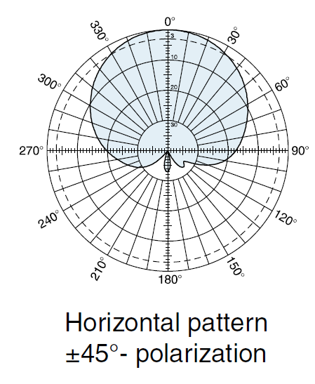
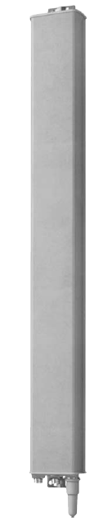
An Example of a Sectorized Beam Implementation
Use 6 panel antennas (60 degree each) to create 6 sectors
When TX power is equally split into 6 antennas, an omni beam is formed
AP switch between omni and directional beams
Peak EIRP for the sectorized beam the same as that for the omni beam (FCC rules)

Slide 15
OBSS Scenarios with Sectorized Beams
AP-STA Interference
BSS B
# STAs/BSS: 1000
BSS radius:1km
# OBSS STAs to BSS A
  450 (out of 2000)
Avg. # OBSS STAs, potentially interfering with AP_A (due to CCA <0)
  89
Reduction in Interfering OBSS STAs
  1 - 89/378 = 76%
Avg. # Spatially Orthogonal STAs (Increase in spatial re-use)
  440 (out of 450) = 98%
Number of BSS_A STAs in Sectorized Beam = 272 (reduced from 1000)
AP_B
AP_A
AP_C
BSS_A
BSS C
Spatially Orthogonal STAs
# OBSS STAs (interference to AP_A)

Slide 16
OBSS Scenarios: AP-AP interference
AP-to-AP path loss model currently not defined.
Estimating range using LTE Base Station to Relay, NLOS model (at the Rooftop level):
  1.6km
If AP antenna is above rooftop, AP should see other APs 1.5km away
Note that if all AP using omni antenna, then all 3 APs compete for medium all the time
Note that if AP_A using sectorized beam antenna, then spatial re-use AP_B (and AP_C) is
  5/6 = 83% (5 out of 6 sectors)
AP_B
1.5km
AP_A
AP_C
AP_B
AP_C

Slide 17
Simulation Results -1
Simulation shows that
  Sectorized beam operation reduces the number of interferring OBSS STAs by 76%
  Sectorized beam reduces the STAs in BSS_A from 1000 (Omni) to 272 (Sectorized beam)
  Sectorized beam operation allows 98% of OBSS STAs to spatial re-use without causing interference
  Outdoor APs can hear each other from long distance since AP-AP path loss is significantly lower than AP-STA.
  Sectorized beam operation allows AP_B and AP_C to spatial re-use 83% of time
  If CCA is 10dB higher than receiver sensitivity, 84% of OBSS STAs (in BSS B and BSS C) interferes with AP_A

Slide 18
Simulation Results - 2
Most of OBSS STA is SO regardless the separation of Aps
# Interfering OBSS STAs reduces significantly when the difference in CCA and Rcvr. Sensitivity levels is reduced (from 10 dB to 3 dB)
Ratio of # SO OBSS STAs to # OBSS STAs reduces slightly when the difference in CCA and Rcvr. Sensitivity levels is reduced (from 10 dB to 3 dB)
CCA-Rcvr Sensivity=10 dB
CCA-Rcvr Sensivity=3 dB

Slide 19
Part 1: More Details on Type 1 Sectorization Operation

Slide 20
IE for Type 1 Sectorization Scheme
I.E. for Type 1 Sectorization Scheme
  S. Scheme: 1 (Type 1 Sectorization scheme)
  P. Training ON/OFF Indicator: 0 - Periodic Training not Present, 1 – Present
  Training Period (# of Beacon Intervals for the periodic training)
  Remaining BI: remaining beacon intervals to the periodic training (including the current beacon interval)
IE #
# Bytes
S. Scheme
P. Training Ind.
Training Period
Remaining BI
Rvd
8 bits
1 bit
1 bit
6 bits
6 bits
TBD bits

Slide 21
Spatially-Orthogonal Conditions Detection
Previously, 4 spatially orthogonal condition detection schemes were proposed (11-12-1355-02-00ah).
AP follows one the 4 transmission sequences to allow STAs to set up NAV during omni transmission and switch to sectorized beam transmission
Propose to include a 1-bit sector ID indicator (from reserved bits) in CTS-to-self (which precedes SO conditions 1 or 2) to facilitate the detection of the SO conditions
TXOP Protection
Omni w. SO Indicator
SO Condition 1 or Condition 2
AP1
CTS-to-Self
Omni
Sectorized Beam
NAV
STA1

Slide 22
Sectorized Beam Training Request/Feedback -1
SDF R.4.2.I 3: STA can optionally feedback sector/group ID
AP indicates the sectorized beam operation
STA joining a sectorized beam operation BSS shall indicate whether it supports sectorized beam feedback in the sectorized beam feedback capability field (1=support)
STA indicates through capability exchange that it support request/feedback
Propose to re-use the HT Variant Control Link Adaptation Field (setting MAI=14, or MRQ=0, MSI=7) for requesting or indicating “Sector Training”
  TXASSR (transmit antenna selection request) ➔ Sector training request
  HT NDP Announcement field =1 ➔ Indicate NDP sounding (preceding training packets)
Use VHT Sounding NDP with Nsts=1 for sector beam training

Slide 23
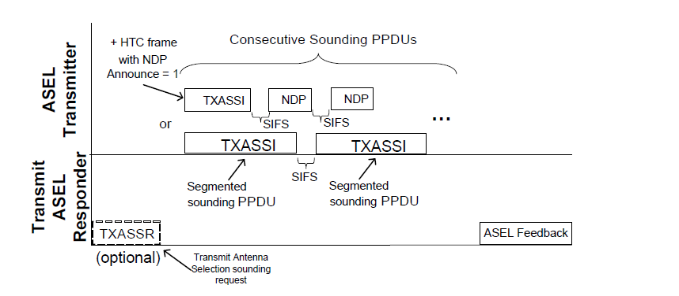
Sectorized Beam Training Request/Feedback -2
(Sector Training Announcement) HT NDP Announcement=1
VHT Sounding NDP with Nsts=1
Propose to use a VHT Action frame (8.5.23.1 in 11ac) for (solicited and unsolicited) Sector ID feedback.
  VHT action = 3 (or higher)
  Sector ID index (format TBD)
AP
STA
Sector ID FB
(Sector Training Req)
Order | Information
1 | Category
2 | VHT Action
3 | Sector ID Index

Slide 24
Part 2: Type 0 Sectorization Scheme: More Details

Slide 25
Type 0 Sectorization Mode
In this mode the AP broadcast some of the beacons sector beamformed in regular schedule
There are two categories of station operation modes:
    Sectorized STA
    Non sectorized STA
Those sectorized STAs that received the beamformed beacon are allowed to transmit data during the sector interval.
All the stations (sectorized STAs and non-sectorized) are allowed to transmit during omni interval
The non-sectorized STAs are allowed to transmit during the sector interval even if they don’t hear the sector beamformed beacon but they can transmit in omni interval.
The mode of operation (sectorized or non-sectorized) for STA (or traffic) is established at association ( by the type of station or just by the type of traffic if a STA carries multiple types of traffic)
After association a STA could change its mode of operation – for instance via a management frame from AP or via indications in beacons
Example of operation: offloading stations/traffic could transmit with no restrictions, the sensor traffic transmit only during their sector time interval
Besides the beamformed beacon broadcast, the AP operates without spatial restrictions, being able to receive from and transmit to all directions
Stations that are allowed to transmit have no restrictions in transmit direction
Note: The sector only BSS would be realized if all STAs are sectorized STA. This would eliminate the needs for omni reception by AP.

Slide 26
Type 0 sectorization
Sectorized STA
AP coverage
Beamformed Beacon Coverage
Non-sectorized STA
Beacon
Sector 1
Beacon
Sector 2
Beacon
Sector 3
Omni
Beacon
Access STAs in Sector 1
Access STAs in sector 2
Access STAs in sector 3
Access all STAs in the BSS
Sector Interval 1
Sector Interval 2
Sector Interval 3
Omni Interval

Slide 27
IE for Type 0 Sectorization Scheme
Type 0 sectorization schemes should be indicated in beacon, probe response, association confirmation to inform STAs.
At each beacon interval, a different sector is used
Proposed IE for Type 0 Scheme
  S Scheme: 0 - Type 0 sectorization scheme
  the complete rotation period (# of beacon intervals) for all sectors
  omni-directional sector indicator: 1 = omni, 0 = non-omni (In omni, all STAs can access the medium)
  the current sector ID
  Group ID 1, …, Group ID k corresponding to the current sector ID
  the sub-period for current sector ID (sub-period* integer = complete period)
Sector 0
Sector 1
Sector 2
Sector 1
Sector 0
Sub-period for Sector 1
Complete rotation period for all sectors
IE #
# Bytes
S. Scheme
C.R. Period
O. Ind
Sector ID
Group ID1
Group ID k
Sub-period
Rvd
8 bits
1 bit
6 bits
1 bit
3 bits
? bits
? bits
5 bits
7 bits

Slide 28
Straw Poll 1
Do you support the proposed IE for indicating Type 1 Sectorization as described in Slide 16

Slide 29
Straw Poll 2
Do you support to include an 1 bit early sector indicator from reserved bits for the sectorized transmission in NDP CTS-to-self (which precedes SO condition 1 or SO Condition 2) to facilitate the detection of SO conditions

Slide 30
Straw Poll 3
Do you support to use the
  HT Variant HT Control Link Adaptation Field for
    Requesting sector training,
    NDP announcement,
  Sector ID feedback frame
as described in Slides 18 and 19

Slide 31
Straw Poll 4
Do you support the proposed IE for indicating Type 0 Sectorization as described in Slide 23

Slide 32
Motion 1
Move to include the IE for indicating Type 1 Sectorization as described in Slide 16

Slide 33
Motion 2
Move to include an 1 bit early sector indicator from reserved bits for the sectorized transmission in NDP CTS-to-self (which precedes SO condition 1 or SO Condition 2) to facilitate the detection of SO conditions

Slide 34
Motion 3
Move to use the
  HT Variant HT Control Link Adaptation Field for
    Requesting sector training,
    NDP announcement,
  Sector ID feedback frame
as described in Slides 18 and 19

Slide 35
Motion 4
Move to include the IE for indicating Type 0 Sectorization as described in Slide 23

Slide 36
Backup Charts

Slide 37
SO (Spatially Orthogonal) Condition - 1
AP can use omni-preamble to set up TXOP protection for the sectorized beam transmission.
Once the proper TXOP protection is set up with a long preamble, the sectorized transmission (with greenfield BF) shall be used for the remainder of the TXOP.
SO condition is confirmed by an OBSS STA/AP not receiving
  STA1’s transmission (OBSS STA expects a following STA1 transmission when it sees Ack Ind= 00, 10, Ack Ind=11/Ack Policy=00 in the AP1 Omni packet packet),
  and the AP1’s sectorized transmission portion within the long packet
Example TXOP Protection
Omni-Preamble
Sectorized Beam
AP1
Omni Packet
Long Packet
NAV
NAV protected BF duration
ACK or RSP
ACK
STA1
NAV
Can be spatially re-used by SO OBSS STA and AP

Slide 38
SO (Spatially Orthogonal) Condition - 2
AP can also use the short-preamble with omni-transmission to set up TXOP protection for the sectorized beam transmission.
As shown in the examples, the TXOP protection is set up at the second transmission by AP
Once the proper TXOP protection is set up, the sectorized transmission (with greenfield BF) shall be used for the remainder of the TXOP.
SO condition is confirmed by an OBSS STA/AP not receiving
  STA1’s transmission (OBSS STA expects a following STA1 transmission when it sees Ack Ind= 00, 10, or Ack Ind=11/Ack Policy=00 in the AP1 Omni packet packet)),
  and the AP1’s sectorized transmission (following the omni packet with ACK Policy=Block Ack*).
Example TXOP Protection
Omni-Beam
Sectorized Beam
ACK Policy=BACK or NO ACK*
AP1
Omni packet
short packet
short packet
NAV
NAV
ACK or RSP
ACK or RSP
STA1
NAV
Can be spatially re-used by SO OBSS STA and AP
*Note: maybe easier to have a new indicator in SIG for a following sectorized beam packet

Slide 39
SO (Spatially Orthogonal) Condition 3 - RTS/CTS
Example TXOP Protection
Omni-Preamble
Sectorized Beam
AP1
RTS
Long Preamble
Short Preamble
NAV
NAV protected BF duration
STA1
CTS
ACK
NAV
Can be spatially re-used by SO OBSS STA and AP
Ack Policy=BACK or No ACK*
AP1
RTS
Short Preamble
Short Preamble
NAV
NAV protected BF duration
STA1
CTS
ACK
NAV
Can be spatially re-used by SO OBSS STA and AP
*Note: maybe easier to have a new indicator in SIG for a following sectorized beam packet

Slide 40
SO (Spatially Orthogonal) Condition - 4
The followings illustrate an exchange initiated by STA
TXOP
Omni-Preamble
Sectorized Beam
AP
long packet
PS-Poll/Trigger/ Other Frame
NAV
ACK or RSP
STA
NAV
Can be spatially re-used by out-of-rang OBSS STA and AP, if the AP transmission can be identified as the response frame to PS-Poll/Trigger from STA
TXOP
Omni-Preamble
Sectorized Beam
Ack Policy=BACK or No ACK*
AP
short packet
short packet
PS-Poll/Trigger/ Other Frame
NAV
STA
ACK or RSP
NAV
Can be spatially re-used by out-of-rang OBSS STA and AP (if the AP transmission can be identified as the response frame to PS-Poll/Trigger)
Note: If the AP transmission cannot be identified as a response to STA’s frame, the SO OBSS condition to be confirmed by slide 14 or 15
*Note: maybe easier to have a new indicator in SIG for a following sectorized beam packet

