Slide 1
802.11mc
TXOP Limits
Date: 2012-12
Authors:

Slide 2
Abstract
This document contains a discussion and proposals relating to the EDCA Parameter Set element for TXOP Limit.

Slide 3
Background
TXOP Limits are recommended in Table 8.106
AC | TXOP Limit (802.11b) | TXOP Limit (802.11a/g/n)
BK | 0 | 0
BE | 0 | 0
VI | 6.016ms | 3.008ms
VO | 3.264ms | 1.504ms
A TXOP limit value of 0 indicates that a single (A-) MSDU/(A-MPDU)
or MMPDU may be transmitted…”

Slide 4
Why TXOP Limit?
Within a TXOP, the sender can transmit packets separated by SIFS as against every packet having to contend.
The objective is to increase the efficiency for EDCA, especially AC_VI
.
Points:
TXOP Limit of 0 means just one packet (of any length) may be transmitted per TXOP.
Retries may exceed the TXOP Limit, but if so they should be sent using the standard Back off and not allowed to use the SIFS spacing.
TXOP Limit was introduced to increase efficiency for 11a/b/g
11n efficiency is by the use of aggregation not TXOP Limit.

Slide 5
Problem with A-MPDUs and TXOP Limit
If the existing recommended TXOP limits are used for 11n, and in particular A-MPDUs, then the following results:
  A VI (or VO) aggregated packet is constrained to the TXOP limit
  BUT
  A BE or BK aggregated packet is not constrained
  Simple options that have been considered include:
  A – TXOP limit is only for subsequent packets
  No difference for BE but now VI is on an equal footing.
  Disadvantage of this is that if a finite TXOP limit is applied to BE, then it does not restrict BE as the first packet can still be exceedingly long
  B – A TXOP limit of 0 indicates “aggregation not allowed”
  Disadvantage is that this restricts BE to be inefficient. And probably liability issue, and doesn’t help for low PHY rates (e.g. 1 Mbps)
  Note: A 1Mbps 1500B packet is about 13ms in duration (restricted to 10ms)

Slide 6
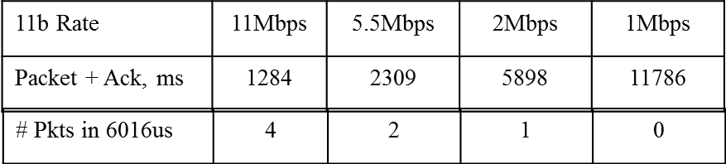
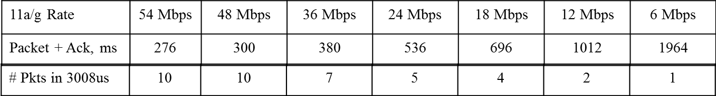
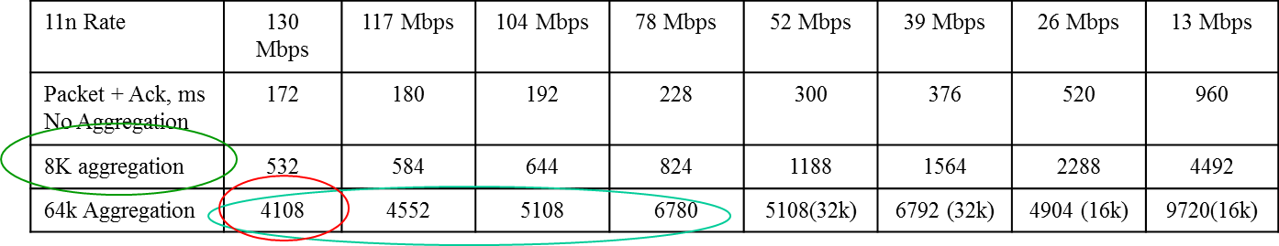

Packet Times – VI 1316B, AES

Slide 7
Discussion
Suggest using following criteria to select the TXOP Limit
  Long enough to allow real efficiency improvement for non-aggregated packets (11a/g)
  Not too long so as make packets very long (~10ms) on retries
Note that an A-MPDUs can be (re) assembled to fit the limit
  Also can be re assembled for ‘re-tries’
Limit for a single MPDU at lowest PHY Rate should not exceed 10ms
  Except for video at 1Mbps, this does not happen (see slide)
  {What happens if a retry from 2Mbps to 1Mbps, can it be sent? Different subject}
  8K A-MSDUs results in 5.036ms duration at 13Mbps, and 9.964ms at 6.5Mbps (phew!)
For Video (1316B packets)
64k A-MPDU provides for 42 MPDUs and at 130Mbps is 4.108ms.
  This seems like a reasonable candidate.
Alternative is to stay with 3.008ms, this allows 33 MPDUs in the A-MPDU at 130Mbps.
Another alternative is to allow only one A-MPDU at AC_VI

Slide 8
Proposed TXOP Limits BE, BK
Options:
Make BE and BK same as VI, allow similar durations and rely on the priority to favor VI
Make the limit half of VI, give VI a definite advantage while still allowing reasonable number of back-to-back packets at BE, e.g. 5 BE vs 10 VI
Propose the 50% rule.
11b
The 6.016ms VI TXOP Limit allows 4 packets at 11Mbps
Hence TXOP Limit set to 3.008ms for BE and BK, 2 packets at 11Mbp
11a/g
3.008ms VI TXOP Limit allows 10 packets at 54Mbps
Hence TXOP Limit set to 1.504ms for BE and BK, 5 packets at 54Mbps.
11n
4.128ms VI TXOP Limit allows 42 packets at 130Mbps
3.008ms VI TXOP Limit allows 33 packets at 130Mbps
Hence TXOP Limit set to 2.064ms, or 1.504ms for BE and BK
Could leave 11b alone, as very rarely used

Slide 9
Same TXOP Limits for 11a/g/n?
Use the proposed limits for 11n also for 11a/g
4.128ms, compared to 3.008ms for AC_VI
11a/g Rate | 54 Mbps | 48 Mbps | 36 Mbps | 24 Mbps | 18 Mbps | 12 Mbps | 6 Mbps
Packet + Ack, ms | 276 | 300 | 380 | 536 | 696 | 1012 | 1964
Pkts in 3008us | 10 | 10 | 7 | 5 | 4 | 2 | 1
11a/g Rate | 54 Mbps | 48 Mbps | 36 Mbps | 24 Mbps | 18 Mbps | 12 Mbps | 6 Mbps
Packet + Ack, ms | 276 | 300 | 380 | 536 | 696 | 1012 | 1964
Pkts in 4128us | 14 | 13 | 10 | 7 | 5 | 4 | 2
Suggest that single set of limits will work
Keeping the present 3.008ms may be better politically (least change the better?)
Using 4.128ms does allow full 64k aggregation at 130Mbps.
Could go higher as A-MPDUs can be re-assembled on re-tries..

Slide 10
VO considerations
At present it has been simply set to 50% of AC_VI. Why?
What is the Use case for TXOP Limits for VO?
Voice Packets are sent at the rate of one MSDU at a minimum service interval of 10ms (usually 20ms), so never need for back to back packets.
G711 (biggest data packet) is 160B at 20ms intervals.
  2538ms at 1Mbps
  1468ms at 2Mbps (long Preamble)
  396us at 6.5Mbps
  For worse case, need to add time for RTS/CTS (628us for 1Mbps)
    2538 + 628 = 2986 -> 3008
Interesting to note that in 11g network, a G711 voice packet could not be sent at 1Mbps with present limit. (TXOP Limit 1.504ms).
11b used 3.264ms for VO, which is OK. (3.008ms plus some margin?)
  If we use a single set of TXOP Limits for 11/a/g/n, then should we allow the voice packet at 1Mbps, i.e. 3.008ms? Or stick with the 1.504ms?
  A voice Packet would need to be fragmented at 1Mbps, is this desirable? NO
  Suggest we stick to the 50% of AC_VI and keep it simple.

Slide 11
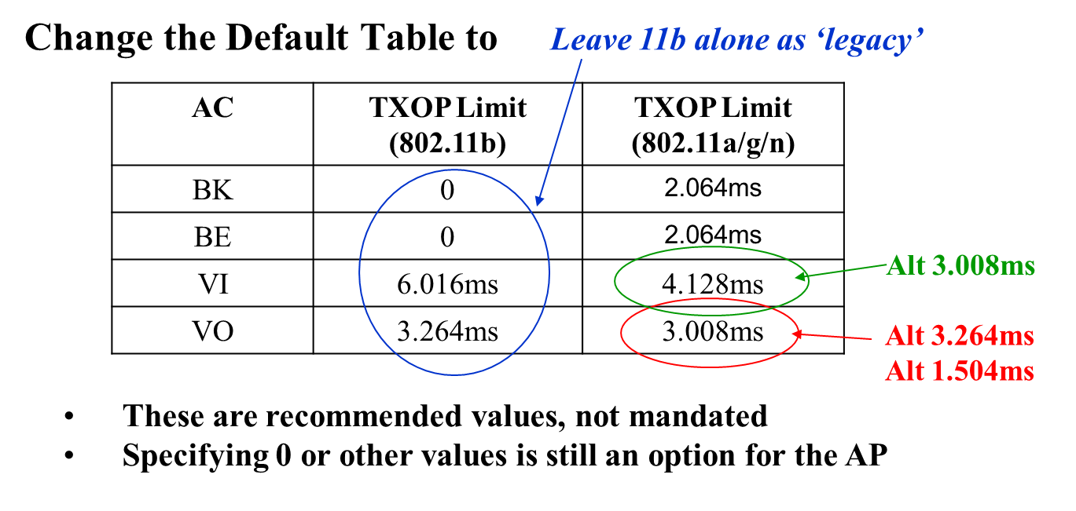
Proposal A for 11a/b/g/n BSS
2.064ms

Slide 12
Proposal B 11a/b/g/n BSS
Change the Default Table to
Does solve the long 1Mbps packet ‘problem’
AC | TXOP Limit (802.11b) | TXOP Limit (802.11a/g/n)
BK | 3.264ms | 2.064ms
BE | 3.264ms | 2.064ms
VI | 6.016ms | 4.128ms
VO | 3.264ms | 2.064ms
These are recommended values, not mandated
Specifying 0 or other values is still an option for the AP

Slide 13
Discussion
The proposed default TXOP Limits are compatible with aggregated packets and also still cater for 11a/g
These are the recommended Default settings and do not effect the result of the AP setting its own values.
There is no intended fundamental change to the basic rule of TXOP Limit = 0 meaning one packet, of any length.

Slide 14
Proposal 11a/b/g/n BSS
Change the Default values for TXOP Limits in Table 8-106
AC | TXOP Limit (802.11b) | TXOP Limit (802.11a/g/n)
BK | 3.264ms | 2.064ms
BE | 3.264ms | 2.064ms
VI | 6.016ms | 4.128ms
VO | 3.264ms | 2.064ms
These are default values, not mandated
Specifying 0 or other values is still an option for the AP
STRAW POLL :
Agree?
Yes/ No/ “Need more time to study/think about it”

