Slide 1
802.11mc
Annex N Discussion/Proposals
Date: 2012-12
Authors:

Slide 2
Abstract
This document contains a discussion and proposals relating to Annex N of Std 802.11 – 2012
What does “do not care” mean in N.1? This is the only place in the Standard that this appears. What if “we do care” in certain circumstances?
Should N.2.2. deriving Medium Time be expanded to be clear on how to deal with A-MPDUs and/or A-MSDUs?
N.3.2. deals with SBA, and it is not of value.

Slide 3
Annex N
General Point – Heading is “Admission Control”
Should be TSPECs and Admission Control?

Slide 4
N.1 Example use of TSPEC for Admission Control
In Table N.1 – “Admissible TSPECS”, the column for Contention Based CBR traffic (EDCA) includes the following:
  Nominal MSDU size S (specified)
  Mean Data Rate S
  Surplus Bandwidth Allocation S
  Minimum Service Interval DC (do not care)
  Maximum Service Interval DC
  Inactivity Interval DC
  Delay Bound X (unspecified)
“do not care” only appears this one time in the entire Standard. What does it mean? Propose to replace with “Optional”. BUT….

Slide 5
Service Interval
TSPEC parameter | Continuous time QoS traffic (HCCA) | Controlled- access CBR traffic (HCCA) | Bursty traffic (HCCA) | Unspecified non-QoS traffic (HCCA) | Contention- based CBR traffic (EDCA)
Nominal MSDU Size | S | S | X | DC | S
Minimum Service Interval | S | Nominal MSDU size/mean data rate, if specified (VoIP typically uses this) | Mean data rate/ nominal MSDU size, if mean data rate speci- fied | DC | DC
Maximum Service Interval | S | Delay bound/ number of retries (AV typi- cally uses this) | Delay bound/ number of retries, if delay bound present | DC | DC
Inactivity Interval | Always specified |  |  |  | DC
Why only CBR?
This is wrong
Scheduler uses max SI
CBR traffic, e.g. voice call, MP3 audio
For CBR traffic should set both Min and Max SI to same value
E.g Voice call set max and min SI to 20ms.
The scheduler needs to send packets at 20ms intervals.
  Also, consider Delay Bound 50ms (limit for voice latency over 802.11).
  Retries? Say 7 (see later text in this Annex), but then <min SI
  Say 1 retry, then 50 or 25ms, which is wrong, needs to be 20ms

Slide 6
Service Interval
For scheduled QoS
CBR traffic should set min and max SI to same value
VBR traffic should set the min SI to 0 and the max SI to a value corresponding to the mean latency that the application can accept, or to the rate that the codec is expecting packets.
  For real time video this is 0ms and 16ms
  For one way video with buffering maybe this is higher (I do not know enough about video codecs).
  The point is that the TSPEC now reflects VBR or CBR
  As the scheduler uses the max SI it is important to get it right

Slide 7
Proposal for SI in N.1
TSPEC parameter | Continuous time QoS traffic (HCCA) | Controlled- access CBR traffic (HCCA) | Bursty traffic (HCCA) | Unspecified non-QoS traffic (HCCA) | Contention- based traffic (EDCA)
Nominal MSDU Size | S | S | X | Opt | S
Minimum Service Interval | S | Nominal MSDU size/mean data rate, if specified (VoIP typically uses this) | S Usually set to 0 | Opt | X
Maximum Service Interval | S | Same as min SI | S | Opt | Opt Used to indicate aggregation limits
Inactivity Interval | Always specified |  |  |  | Opt
Removed “CBR”
“DC” replaced
with “Opt”
Never needed
This comes next

Slide 8
11n aggregation and EDCA TSPEC
Aggregating MPDUs or MSDUs introduces delay to the packets. More aggregation the more latency.
How does a device know the aggregation limit in order to meet a latency requirement? For voice not a problem – no aggregation
Video Example: 1316B packets (nom MSDU = 1364B)),
For a video stream, say max latency = 16ms (to match codec)
  For a 1Mbps video application stream
    PPS = 1 x 10^6 / (1316 x 8) = 94.98 (or every 10.53ms)
    Pkts per max latency = PPS x 0.016 = 1.52
    Hence, only 1 MSDU can be sent , i.e. no aggregation.
  For a 5Mbps stream, 7 MSDUs can be sent
Hence, if there is a limit to the Aggregation that can be used, the “max SI’ field can be used.

Slide 9
Aggregation, Medium Time, and QoS
As shown, decision on how many MSDUs to aggregate requires the STA to know the QoS requirements of the stream.
In HCCA, Service Interval and Delay Bound are used.
  SI reflects the codec type (e.g. video)
  Delay Bound is acceptable life of the packet.
  HCCA TSPEC information informs on aggregation limits
In EDCA, if aggregation is used, max SI can be used in order to indicate limit of aggregation. Delay Bound is useful if packets get delayed.

Slide 10
Aggregation
Use of aggregation is to be encouraged.
Also, it is beneficial if Medium Time could be calculated based on some aggregation.
  It is realized that TSPECs tend to refer to the lowest (pessimistic) case
An AP could ‘force’ aggregation by providing a Medium Time that required it.
Nominal MSDU is for MSDU and A-MSDU. As long as the max SI is specified the application knows the extent of aggregation that can be used ( or even assumed by the AP) – we need examples.

Slide 11
Example 1 with Aggregation
Video packet = 1316B nom MSDU = 1364 (LLC, IP, UDP, RTP, Eth typ)
Example TSPEC: Mean Data Rate = 4Mbps
Nom MSDU size = 1364B
Max SI = 16ms
Nom MSDUs per SI= INT [4 x 10^6 / (1364 x 8)] = 3
Hence, AP and STA know that max aggregation is 3 MSDUs
If Nom MSDUs per SI < 1 then invalid TSPEC
Medium Time = 137830us (with 39Mbps PHY Rate)
BUT if A-MPDU used, Medium Time would be 116813us
15% less Medium Time
(Note: if A-MSDU used, Medium Time would be 114190us, 17% less )
In theory the AP could return the ‘aggregated Medium Time value’.

Slide 12
Example 2 with Aggregation
A-MSDU has 14B plus 0-3B pad added to each MSDU.
Video packet = 1316B
Nom A-MSDUs 2= 2758B 3=4137B 4=5516B
Example TSPEC: Mean Data Rate = 10Mbps
Nom MSDU size = 4137B
Min and Max SI = 16ms
MSDUs per SI = INT [10 x 10^6 / (4137 x 8)] = 4
Hence, AP and STA know that further aggregation is possible
Medium Time is returned based on the nom MSDU

Slide 13
Video Example – aggregation limits
VIDEO
SI = 16ms | Nom MSDUs per SI
Data Rate, Mbps | MSDU | A-MSDU (2) | A-MSDU (3) | A-MSDU (4)
1 | 1 | 0 | 0 | 0
2 | 2 | 1 | 0 | 0
3 | 4 | 2 | 1 | 1
4 | 5 | 2 | 1 | 1
5 | 7 | 3 | 2 | 1
6 | 8 | 4 | 2 | 2
7 | 10 | 5 | 3 | 2
8 | 11 | 5 | 3 | 2
9 | 13 | 6 | 4 | 3
10 | 14 | 7 | 4 | 3

Slide 14
Summary
If encouraging aggregation then the TSPEC for EDCA Admission Control should include value for Max Service Interval
Nom MSDUs per max SI
= Mean Data Rate/(Nom MSDU x 8) x max SI
Invalid TSPEC if Nom MSDUs per Max SI <1
Amount of A-MPDU = INT (Nom MSDUs per Max SI)
All this, of course, similarly applies to HCCA TSPEC.

Slide 15
Proposal for N.1
Agree to changes as per Slide 7 to the Table N.1
  Delete “DC” (do not care) and replace with “Optional”
  Delete “CBR” on (EDCA)
  Change text for SI boxes
Add a new section on “Use of TSPEC with aggregated MSDUs and MPDUs” explaining using Max SI to indicate aggregation and latency.
Straw Poll
Yes/No/ Haven’t a clue

Slide 16
N.2.2 Deriving Medium Time
This will be covered in contribution with the text.
Needs to inform on conditions such as:
  Non A-MSDU and non MPDU
  A-MSDU but not A-MPDU
  A MPDU
Propose to use same text to that proposed by Mark Rison in another world.

Slide 17
N.3.2 TSPEC Construction
Service Interval:
  Minimum SI = Nominal MSDU size/mean data rate
  Maximum SI = Delay Bound/number of retries possible
  Already covered this but the wording needs to be changed to reflect the Table N.1

Slide 18
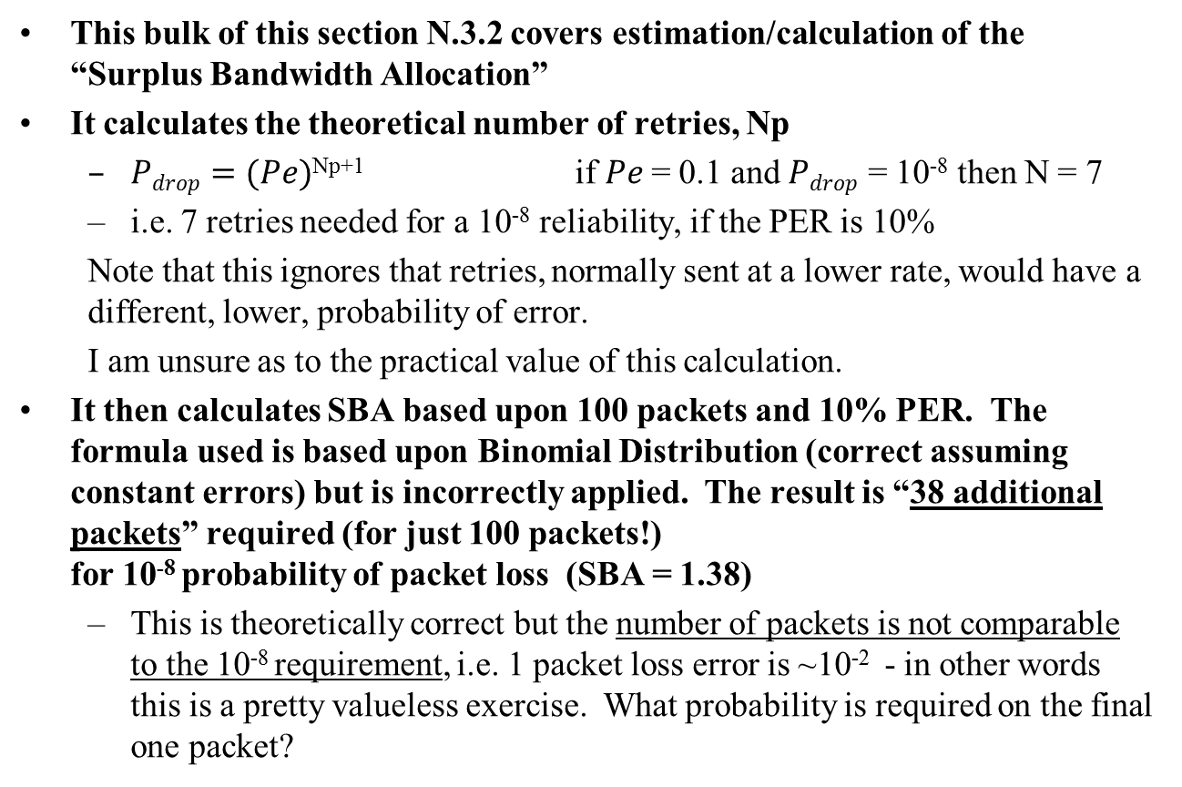
SBA
This bulk of this section N.3.2 covers estimation/calculation of the “Surplus Bandwidth Allocation”
It calculates the theoretical number of retries, Np
  $Pdrop=(Pe)$^{Np+1} if $Pe$ = 0.1 and $Pdrop$ = 10⁻⁸ then N = 7
  i.e. 7 retries needed for a 10⁻⁸ reliability, if the PER is 10%
  Note that this ignores that retries, normally sent at a lower rate, would have a different, lower, probability of error.
  I am unsure as to the practical value of this calculation.
It then calculates SBA based upon 100 packets and 10% PER. The formula used is based upon Binomial Distribution (correct assuming constant errors) but is incorrectly applied. The result is “38 additional packets” required (for just 100 packets!)
for 10⁻⁸ probability of packet loss (SBA = 1.38)
  This is theoretically correct but the number of packets is not comparable to the 10⁻⁸ requirement, i.e. 1 packet loss error is ~10⁻² - in other words this is a pretty valueless exercise. What probability is required on the final one packet?

Slide 19
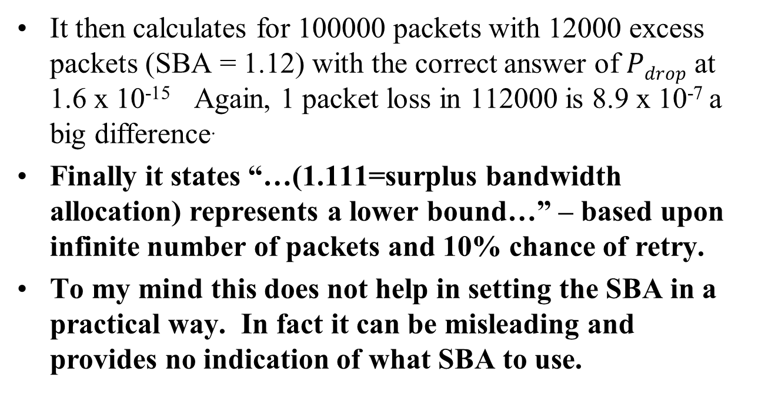
N.3.2 continued
  It then calculates for 100000 packets with 12000 excess packets (SBA = 1.12) with the correct answer of $Pdrop$ at 1.6 x 10⁻¹⁵ Again, 1 packet loss in 112000 is 8.9 x 10⁻⁷ a big difference.
Finally it states “…(1.111=surplus bandwidth allocation) represents a lower bound…” – based upon infinite number of packets and 10% chance of retry.
To my mind this does not help in setting the SBA in a practical way. In fact it can be misleading and provides no indication of what SBA to use.

Slide 20
SBA Discussion
We need useful information for “TSPEC Surplus Bandwidth Allowance”
Medium Time is based upon 1 second intervals
11aa introduced HCCA Medium Time also based upon 1 second intervals. (When calculating admission both HCCA and EDCA TSPECs should be aggregated).
Hence, the number of packets in one second is the useful criteria for calculating the desired SBA

Slide 21
SBA - Voice example
Voice – 50 packets per second
  PER = 10% (Probability of success, p = 0.9)
  Number of packets desired, s = 50
  Number of packets required, n = 50 + N
  1 lost packet = 1/(50+N)
  Probability of not having 50 successes
  = BINOMDIST(s, n, p, TRUE) cumulative distribution function
Look for value of N where the Probability of not having 50 successful packets, is less than the single lost packet odds.
Result, N= 13 SBA = 1.26
1 lost packet = 1.59% 1/(50+13)
Probability of not having 50 packets = 0.87%
Note: HCCA TSPEC SBA is different, more later

Slide 22
SBA – Video Example
Video Packet is 7 x 188 bytes = 1316B
1Mbps video = 95 packets/sec (1.5pkts per 16ms max SI)
For PER 10%, N = 21 SBA = (95+21)/95 = 1.22
Note that for a 1Mbps video, only 1 packet per max SI (16ms). To allow at least one retry, the SBA needs to be at 2.0 for HCCA TSPEC
HCCA SBA = (1+1)/1
For 4Mbps video, 380 packets per second (6pkts per 16ms max SI)
For PER 10%, N = 64 SBA = 1.168
One retry = 7 pkts per max SI,
hence min SBA for HCCA = (6+1)/6 = 1.167
In this case use the EDCA SBA.

Slide 23
Video SBA
Using this methodology, we see that SBA varies with the video data rate. Also, the SBA must be enough to allow at least one retry for HCCA.
Video, Mbps | Pkts per SI | Min HCCA SBA | SBA, EDCA
1 | 1 | 2.000 | 1.221
2 | 3 | 1.333 | 1.189
3 | 4 | 1.250 | 1.179
4 | 6 | 1.167 | 1.168
5 | 7 | 1.143 | 1.164
6 | 9 | 1.111 | 1.160
7 | 10 | 1.100 | 1.156
8 | 12 | 1.083 | 1.154
9 | 13 | 1.077 | 1.151
10 | 15 | 1.067 | 1.151
20 | 30 | 1.033 | 1.139
We see that SBA also varies with the rate of packets
For HCCA use the larger

Slide 24
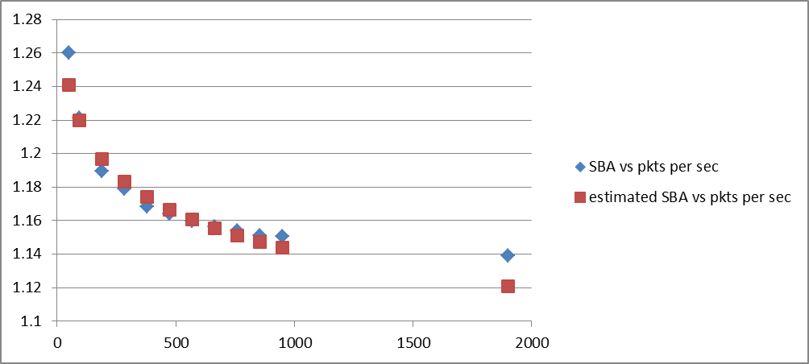
EDCA SBA estimate
SBA varies with the number of packets per second
Packets/sec | SBA | Estimated SBA
50 | 1.26 | 1.241
95 | 1.221 | 1.220
190 | 1.189 | 1.197
285 | 1.179 | 1.183
380 | 1.168 | 1.174
475 | 1.164 | 1.167
570 | 1.160 | 1.161
665 | 1.156 | 1.156
760 | 1.154 | 1.151
855 | 1.151 | 1.147
950 | 1.151 | 1.144
1900 | 1.139 | 1.121
A reasonable estimate for EDCA SBA
SBA = -0.033 ln (Pkts/sec) + 1.37

Slide 25
SBA Suggested Value
Calculate Packets per sec
  PPS = Mean Data Rate / (Nominal MSDU x 8)
  Note: Nominal MSDU = MDSU or A-MSDU
Calculate EDCA SBA
  EDCA SBA = -0.033 Ln (PPS) + 1.37
EDCA Admission Control TSPEC uses EDCA SBA
For HCCA TSPEC
  Calculate packets per SI, PPSI
  PPSI = Mean Data Rate bps /(Nominal MSDU x 8) x SI (in secs)
  HCCA SBA = MAX [EDCA SBA, (PPSI + 1)/PPSI)]

Slide 26
SBA – discussion points
SBA can be set to whatever the application wants.
This ‘suggested’ value is useful
Remember that TSPEC is usually pessimistic
SBA can be increased if stream having trouble.

Slide 27
Straw Poll N.3.2
Do you agree that N.3.2 should be re-written along the lines discussed in this presentation and the ‘suggested SBA’ idea with the formula included?
Yes /No / “Haven’t understood a word of this”

Slide 28
Minimum, Mean and Peak Data Rate
Clarify the use of these fields for CBR and VBR traffic
  CBR populate all three with same value, or for HCCA just Mean and rely on the two SI values to indicate CBR
  VBR must populate Mean but specify Peak and Min if possible
Add a clause based upon the use of these fields for statistical multiplexing
  Use the Mean and STDEV formula used in 11aa.

Slide 29
Text
See contribution on the text for Annex N

