Slide 1
Channel Measurement for IEEE 802.11aj (45 GHz)
Date: 2013-4-24
Authors/contributors:

Slide 2
Outline
Transmission Scenario
Measurement Setup
Channel Measurement Results
Notes:
This presentation is outlined into four parts.
Firstly, let’s quickly review the PAR of IEEE 802.11aj at 45 GHz band.

Slide 3

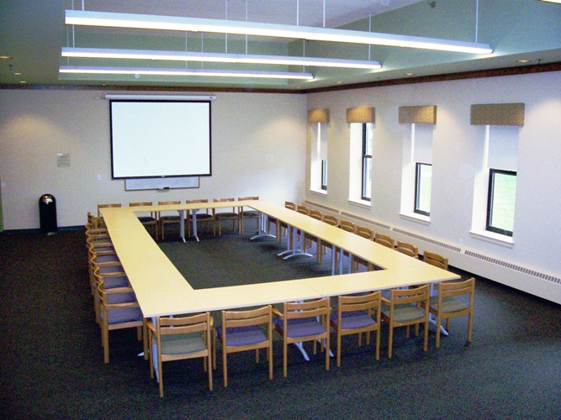
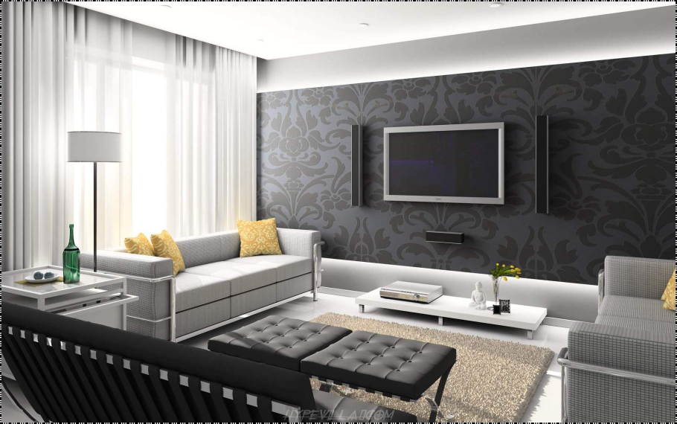
Transmission Scenarios
Conference room
Cubicle room
Living room

Slide 4
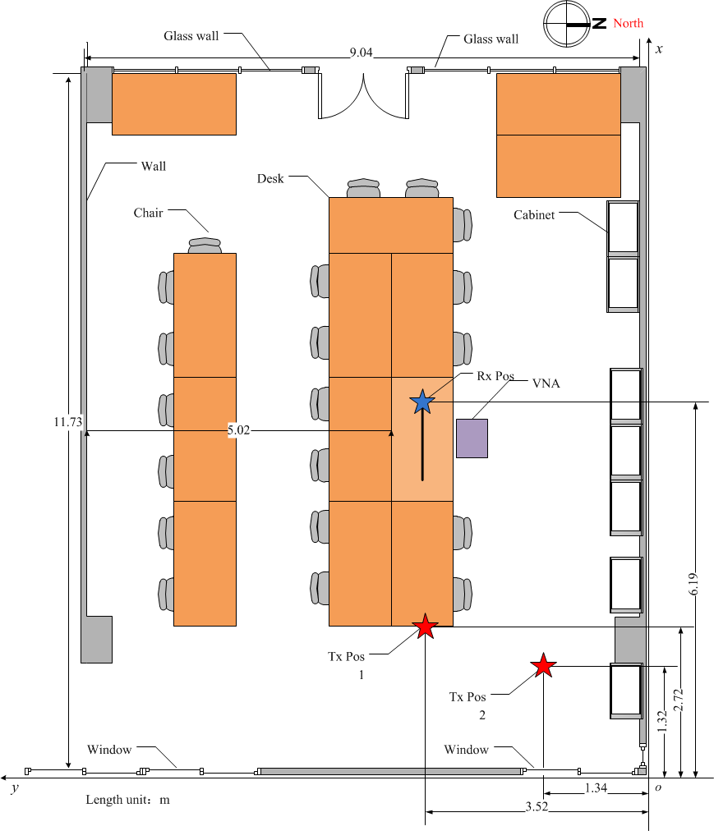
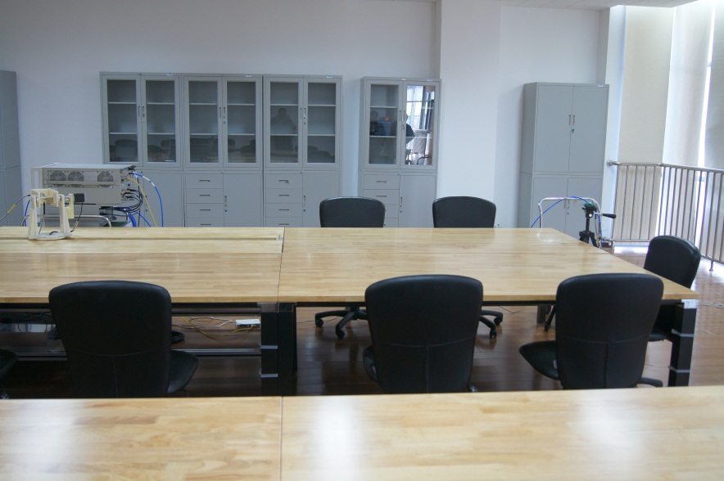
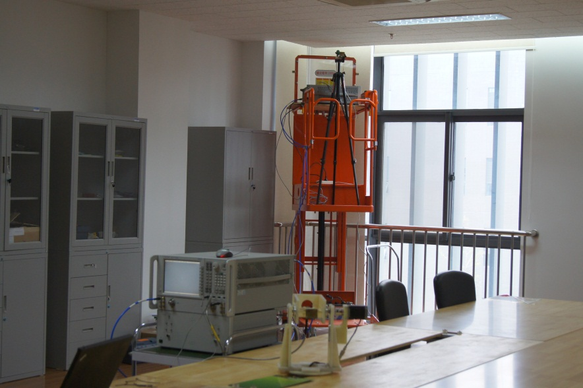
Conference Room

Slide 5
Outline
Transmission Scenario
Measurement Setup
Channel Measurement Results
Notes:
This presentation is outlined into four parts.
Firstly, let’s quickly review the PAR of IEEE 802.11aj at 45 GHz band.

Slide 6
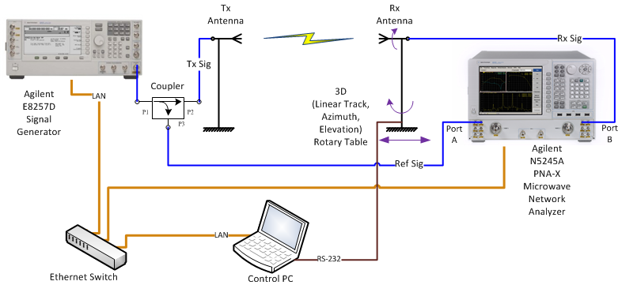
Channel Measurement Setup
A PC is used to not only control the rotary table with an RS-232 port but also control the signal generator and network analyzer with LAN ports.
The signal generator transmits CW signal at each frequency, then Rx power and channel frequency response are obtained by the network analyzer. The positions of Tx and Rx antennas and measured data are simultaneously recorded.

Slide 7
Parameters of Q-band Channel Measurement
Parameter | Value
Frequency band | 45 GHz (45. 115~45.385 GHz)
Method | Signal Generator and VNA Sweep Frequency
Subcarrier Spacing | 4.21875 MHz (adjustable)
Bandwidth | 270 MHz (adjustable, 540, 1080 MHz)
Sweep Frequency Points | 64 (128, 256)
Sweep Frequency Duration | 80 ms (adjustable)
Tx Power | 0 dBm (adjustable, max 10 dBm)
Cable Length | 2 m at both ends
Antenna | Horn antenna / Open ended waveguide antenna
Measurement Scenario | Conference room (Cubicle room, Living room)

Slide 8
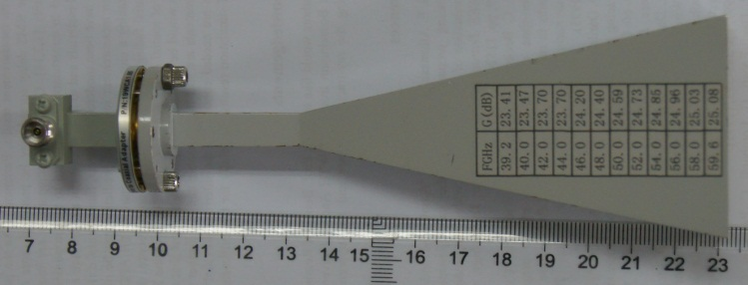
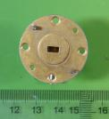
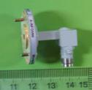
Antennas for Channel Measurement
Type I: Horn antenna with 23.7-dBi gain
H-Plane
E-Plane
Pattern (dB)
Angle (degree)
Type II: Open-ended waveguide (OEW) antenna with 6-dBi gain

Slide 9
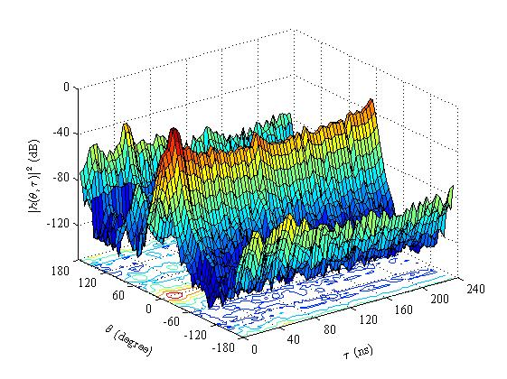
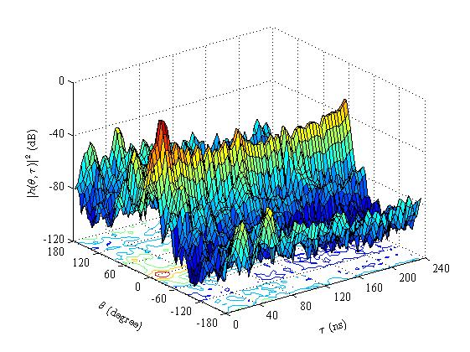
Power Delay Profile (PDP) of STA-STA
Fig. 1 STA-STA Transmission
d_{TR} = 3.47 m, h_{T}=h_{R} = 1.04 m, φ_{T} =φ_{R} = 0⁰, P_{T}= 0 dBm
BW: 270 MHz, f_{c}: 45 GHz
Tx Ant: Type I, Rx Ant: Type I
Fig.2 STA-STA Transmission
d_{TR} = 3.47 m, h_{T} = h_{R} = 1.04 m, φ_{T} = φ_{R} = 0⁰
P_{T}= 0 dBm, BW: 270 MHz, f_{c}: 45 GHz
Tx Ant: Type II; Rx Ant: Type I
Notes:
tau_bar: Mean excess delay
signam_tau: rms delay spread

Slide 10
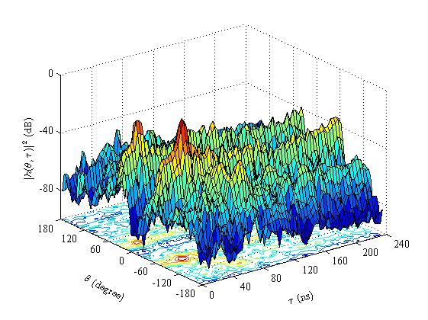
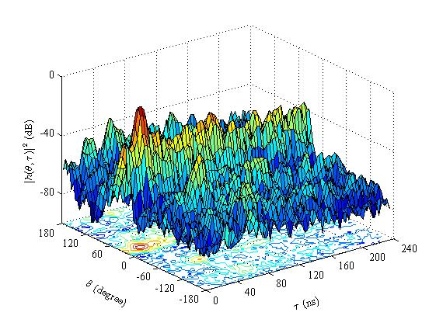
Power Delay Profile (PDP) of AP-STA
Fig. 1 AP-STA Transmission
d_{TR} = 5.59 m, h_{T} = 2.72m , h_{R} = 1.04 m, φ_{T} = -15⁰ , φ_{R} = 0⁰
BW: 270 MHz, f_{c}: 45 GHz
Tx Ant: Type I, Rx Ant: Type I
Fig.2 AP-STA Transmission
d_{TR} = 5.59 m, h_{T} = 2.72m, h_{R} = 1.04 m, φ_{T} = -15⁰ , φ_{R} = 0⁰
P_{T}= 0 dBm, BW: 270 MHz, f_{c}: 45 GHz
Tx Ant: Type II; Rx Ant: Type I
Notes:
tau_bar: mean excess delay
signam_tau: rms delay spread

Slide 11
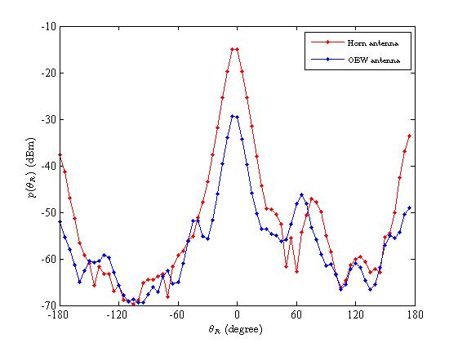
Power Angle Profile (PAP) of STA-STA
Fig. 1 PAP of STA-STA Transmission
d_{TR} = 3.47 m, h_{T}=h_{R} = 1.04 m,
φ_{T} =φ_{R} = 0⁰, P_{T}= 0 dBm
BW: 270 MHz, f_{c}: 45 GHz
Tx Ant: Horn antenna or OEW antenna
Rx Ant: Horn antenna
For horn antenna,
For OEW antenna,
Notes:
Lambda: Angular spread
gamma: angular constriction
theta_max: maximum AoA angle

Slide 12
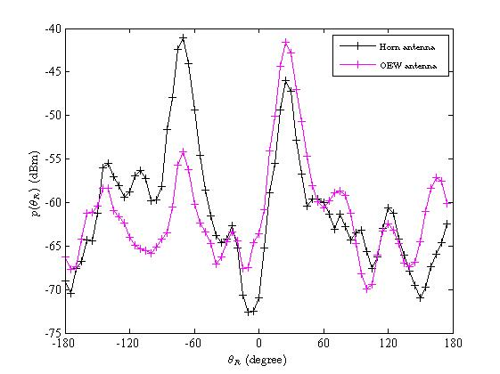
Power Angle Profile (PAP) of AP-STA
Fig. 1 PAP of STA-STA Transmission
h_{T} = 2.7m , h_{R} = 1.3 m, d_{TR} = 5.83 m
φ_{T} = -15⁰ , φ_{R} = 0⁰
P_{T}= 0 dBm
BW: 270 MHz, f_{c}: 45 GHz
Tx Ant: Horn antenna or OEW antenna
Rx Ant: Horn antenna
For horn antenna,
For OEW antenna,
Notes:
Lambda: Angular spread
gamma: angular constriction
theta_max: maximum AoA angle

Slide 13
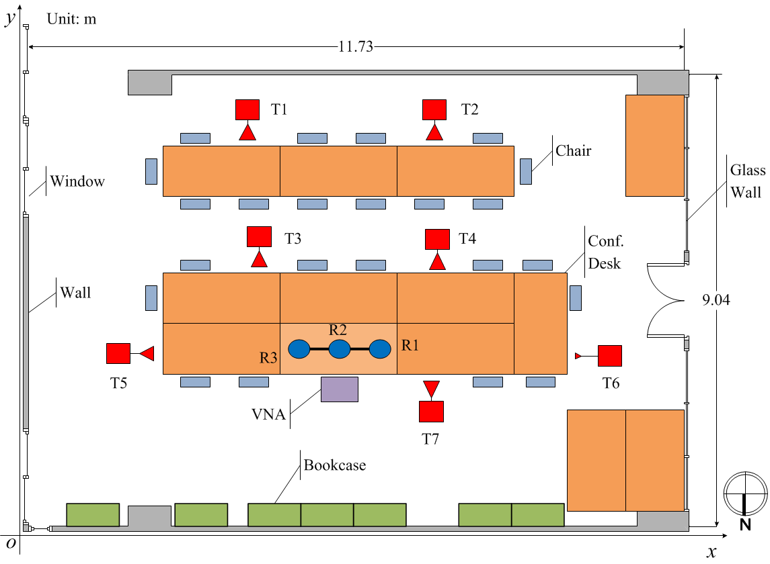
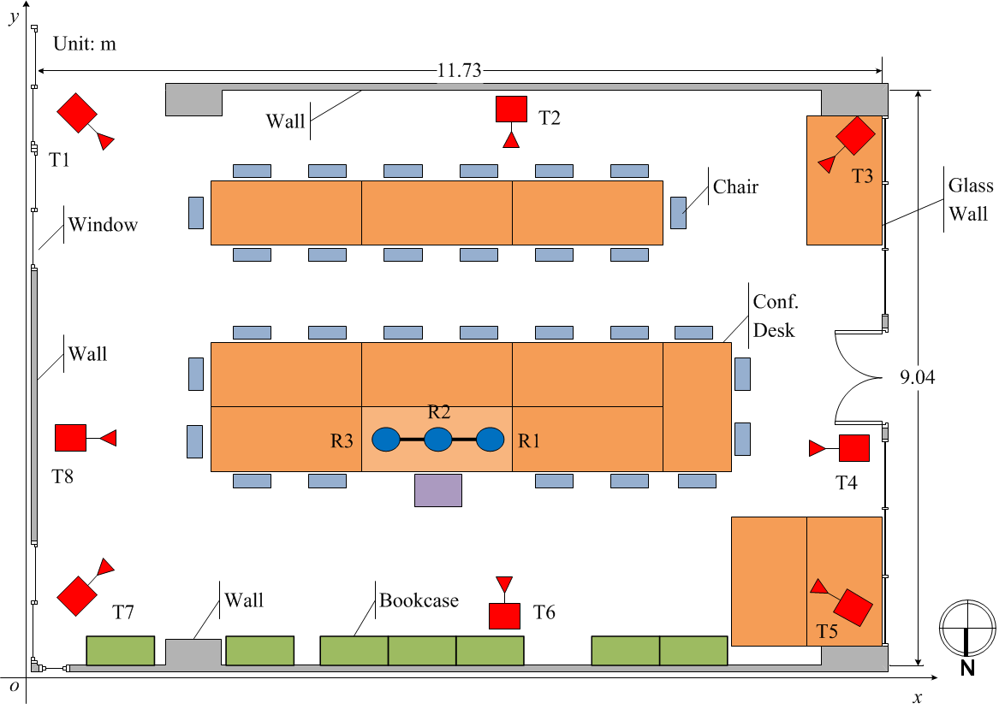
More Measurement Positions in a Conf. Room
Fig 1. Meas. Positions of STA-STA
Fig 2. Meas. Positions of AP-STA

Slide 14
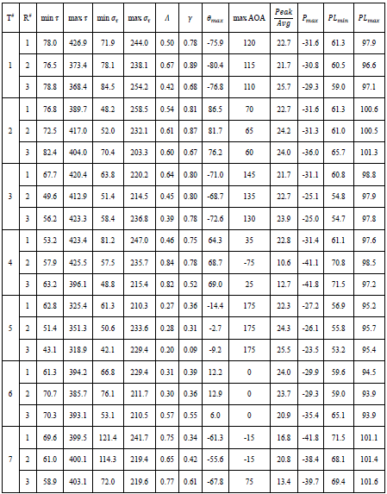
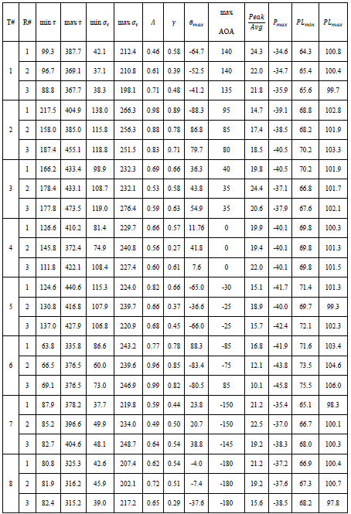
Statistical Parameters
TABLE I STA-STA
TABLE II AP-STA

Slide 15
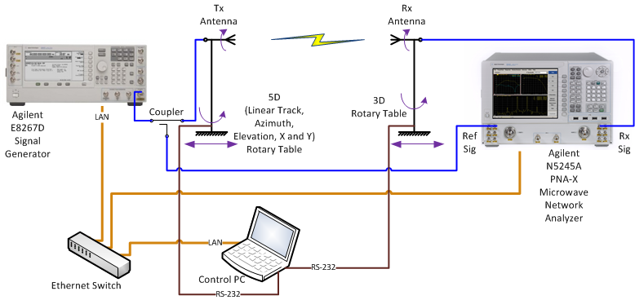
Joint AoA and AoD Measurement Setup
A PC is used to not only control two rotary tables with two RS-232 ports but also control the signal generator and network analyzer with LAN ports.
The signal generator transmits CW signal at each frequency, then Rx power and channel frequency response are obtained by the network analyzer. The positions and angles of Tx and Rx antennas and measured data are simultaneously recorded.

Slide 16
PAP of STA-STA Transmission

Slide 17
Future Works
The 45 GHz band channel will be measured in conference room, cubicle room and living room;
More measurement data will be obtained, which will be used for statistical channel modeling;
Penetration losses for different kinds of walls and blockage objects will also be measured;
Some parameters, for example penetration losses, PAP and PDP of multipath will be compared between 45 GHz and 60 GHz bands.

Slide 18
Revision History
Rev | Comments | Date | Remark
R0 | Initial version of Channel Measurement for IEEE 802.11aj (45 GHz) | 12-Nov-2012
R1 | Add more results of one-direction measurement Add joint AoA and AoD measurement | 23-Apr-2013
R2 | Add revision history Editorial revision | 23-Apr-2013

Slide 19
Thank you very much for your attention!

