Slide 1
Frequency Selective Transmission
Date: 2012-11-12
Authors:

Slide 4
Abstract
Frequency Selective “Narrow-band” Transmission by STA associated in a “wide BW” BSS

Slide 5
Frequency Selective Transmission
The main motivation is to reduce the probability of deep fades that are much more likely to occur with transmissions over 1 or 2MHz channels in 11ah as opposed to WiFi’s traditional 20MHz channels.
  We assumed 1MHz gains 13dB in link budget over 20MHz ‘by default’ but there is high risk of giving up most of the gains due to absence of frequency diversity especially in indoor channels as will be shown
  1MHz indoors is equivalent to 2-3 tones in current .11 systems
The proposed optional scheme allows a device who wants (or limited) to operate on a 1/2MHz subband in a BSS supporting higher BW, e.g.8MHz, to find the best subband and send/receive transmissions on that subband
A device may, for example, only be interested in finding a better subband to operate on if its transmission MCS on its initial subband choice is low – a mere 3dB gain can double the bit rate of a device using MCS0 and halve its power consumption.
Implementation of subband selection turns narrowband transmission to an advantage rather than disadvantage because a device can ride the peak of the channel

Slide 6
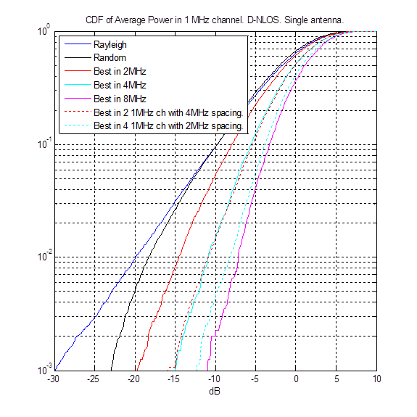
11nD Channel Results (1x1)
Significant gain (7dB at 1 percentile) can be achieved by just selecting the better one 1MHz channel out of two 1MHz channels spaced 4MHz apart.
The gain is almost the same as selecting the best 1 MHz channel out of four consecutive 1MHz channel
4dB worse than selecting the best 1 MHz channel in the 8MHz BSS

Slide 7
Outdoor SCM Results (1x1)
With larger delay spread the required margin is reduced (and especially Urban Macro exhibits good diversity within 1MHz) but gains from choosing best band are still high (8dB for Suburban Macro)

Slide 8
Outdoor SCM Urban Micro with low Doppler
Achieving gain with pedestrian speeds require faster subband selection than every 100mS but static STA get the full gain even with 0.5sec delay between subband selection and utilization

Slide 9
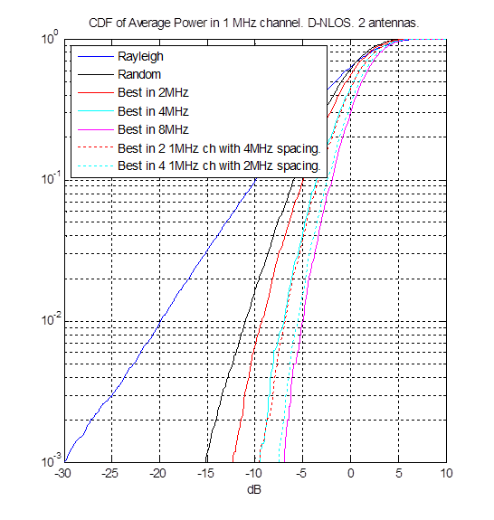
11nD SIMO (1x2) Results

Slide 10
Sounding for Best Subchannel
PIFS separated sounding
PIFS separated sounding
PIFS separated other
PIFS separated sounding
TBTT
TBTT
PIFS separated Beacon
TBTT
TBTT
TBTT
Data
BCN
BCN
BCN
BCN
BCN
BCN
NAV on CH1
NAV on CH1
NAV on CH1
NAV on CH1
NAV on CH1
AP sends Beacon that optionally announces subsequent sounding signal
  AP sends series of single or multi-channel sounding signals
    Sounding can be NDP or additional Beacons or any packet transmitted by the AP
    Sounding signal number, type (e.g. NDP, Beacon, other) and frequency location is indicated in the Beacon
    NAV can be set by Beacon to cover sounding signals
  AP can choose exactly how much time is dedicated to sounding operations
  STA can determine which channels can be sounded during any cycle by examining beacon
STA chooses best subchannel based on the sounding signal(s)
  STA chooses to switch or not switch to additional channels based on Beacon info

Slide 11
Indication of Selected Subchannel
Selected subchannel is implicitly communicated to the AP
  STA tunes to selected subchannel
  STA transmits UL frame on selected subchannel
  AP receipt of UL frame implicitly describes selected subchannel
  AP cannot send DL frame until selection is made known
    AP has option to send DUP, QUAD, OCT frame to selected STA
    STA responds on the selected subchannel – i.e. STA is forced to send UL which reveals channel selection
    AP can then send narrower DL TX on selected subchannel
  No explicit channel change messaging required – receipt of UL frame is good enough
  If STA changes channels but has nothing to send, it is not necessary to signal channel change until it has something to send or expects something in the DL direction
  AP assumes that STA remains on channel unless it is notified of a change

Slide 12
Hidden Nodes
Expected 11ah topology and propagation will create a large number of hidden nodes
The use of a non-primary sub-channel for transmission can introduce additional hidden node situations
  Is the FST hidden node any different from the traditional hidden node?
    Not if STA transmit on subchannels only when AP can hear them
  Will existing hidden node defenses work effectively for the FST case?
    YES
Hidden node solutions will always be part of 11ah. Solutions can use any of the following schemes
  RAW
  TWT
  Low density/low probability of TX
    E.g. low BW sensor network
  Channel polling
  DUP, Quad, Oct RTS/CTS
  Beacon with subchannel permission bitmap
    Indicates on which channels AP is able to detect and receive narrow packets (sounding is signaled separately)
    AP can set any bits in the bitmap
    All STA must obey bitmap settings
    Allows single-correlator AP front end design
      I.e. by AP setting only one bit in bitmap at a time

Slide 13
SP1
Do you support:
The inclusion in the SFD of the allowance of a STA to choose one 2 MHz subchannel of a wideband BSS on which to transmit and receive when permitted by the AP?
The inclusion in the SFD of the option for the beacon to include information about subsequently transmitted frames that allow for sounding measurements to be made at recipient STAs, e.g. number of signals, type of signals, frequency location and timing ?
The inclusion in the SFD the allowance for an AP to send more than one Beacon per TBTT on more than one subchannel of the BSS?

Slide 14
SP2
Do you support the inclusion in the SFD of the concept of a subchannel permission bitmap in the Beacon to identify on which subchannels associated STA may transmit?

