Slide 1
Two-Hop Relay Function
Date: 2012-11-12
Authors:
Eric Wong, Broadcom

Slide 2
Authors:

Slide 3
Authors:

Slide 4
Outline
Support for longer range in TGah has increased PPDU duration, and higher power consumption for STAs at the edge of BSS coverage
STAs (e.g. smart meters) have limited battery lifetime, and long replacement cycle
Location of STAs may have exceeded the coverage of AP, and requires additional network elements for range extension
Use of relays are considered for this problem
Consider relay on wall-powered and assume outdoor device-to-device path loss between relay and STA

Slide 5
Problem
Servings STAs with same traffic load but poorer link budget reduces power efficiency
Particularly STAs at the edge of BSS coverage have limited MCS headroom, are prone to suffer from hidden nodes and OBSS, and are constrained on battery lifetime
STAs may be located outside AP coverage
Proposed use of relays for these STAs
Side effects of introducing relays in the network
  More contentions for channel access, i.e. effectively more STAs
  Contention between frames with same payload, i.e. source TX and relay TX
  Increased interference within home and neighboring BSS
  Complexity for relay path setup and teardown
  Require buffer management at the relays
  Increase in latency for data delivery

Slide 6
Scenario 1
Relay
V₁
V₂
U₁
STA
AP
Relay positioned equal distance between AP and STA
Two paths available – Direct and Relay
Comparing to the direct path, path via relay needs more frames with shorter PPDU duration for the same number of bytes
Require separate channel access for next frame transmission over the relay-STA hop
A shorter TX-RX cycle via the relay path allows STA to operate with lesser power consumption
If STA falls outside AP coverage, there is no direct STA-AP path

Slide 7
Typical Uplink Transfer
Via Direct Path
AckInd=10
ACK
AP
AckInd=00
SIFS
T_{A}(U₁)
DATA
STA
T_{D}(U₁)
Transmission may be hidden from other STAs
Via Relay Path
AckInd=10
ACK
AP
AckInd=10
AckInd=00
T_{A}(V₂)
ACK
DATA
RELAY
AckInd=00
T_{A}(V₁)
T_{D}(V₂)
SIFS
Extra access delay
SIFS
DATA
STA
T_{D}(V₁)
Transmission may be hidden from other STAs

Slide 8
Scenario 2
Relay
V₂
V₁
U₁
STA
AP
Relay positioned closer to STA than AP
STA proximity to Relay permits the use of higher MCS and consumes lesser power for hop V₁
Relay requires separate channel access for next hop
Relay may be another sensor on wall-power, and path loss is outdoor device-device

Slide 9
Scenario 3
Relay
V₁
V₂
U₁
STA
AP
Relay positioned closer to AP and away from STA
Relay path may be suboptimal than direct path
  relay selection = path selection
If Relay is another sensor and STA-Relay hop is outdoor device-device path loss, then Relay may not be reachable by STA with the same MCSs

Slide 10
More Discussion
U₁ (Outdoor Macro)
V₁ (Outdoor Dev-Dev)
V₂ (Outdoor Macro)
STA
Relay
AP
Suppose STA-Relay-AP are arranged in a straight line, and STA sends one uplink DATA (see slide - Uplink with Explicit ACK)
Total Medium Time,
PPDU(V₁) + ACK(V₁) + PPDU(V₂) + ACK(V₂) + 3 x SIFS
STA ON Time,
PPDU(V₁) + ACK(V₁) + SIFS
STA-Relay Factor,
Distance (V₁)
Distance (U₁)

Slide 11
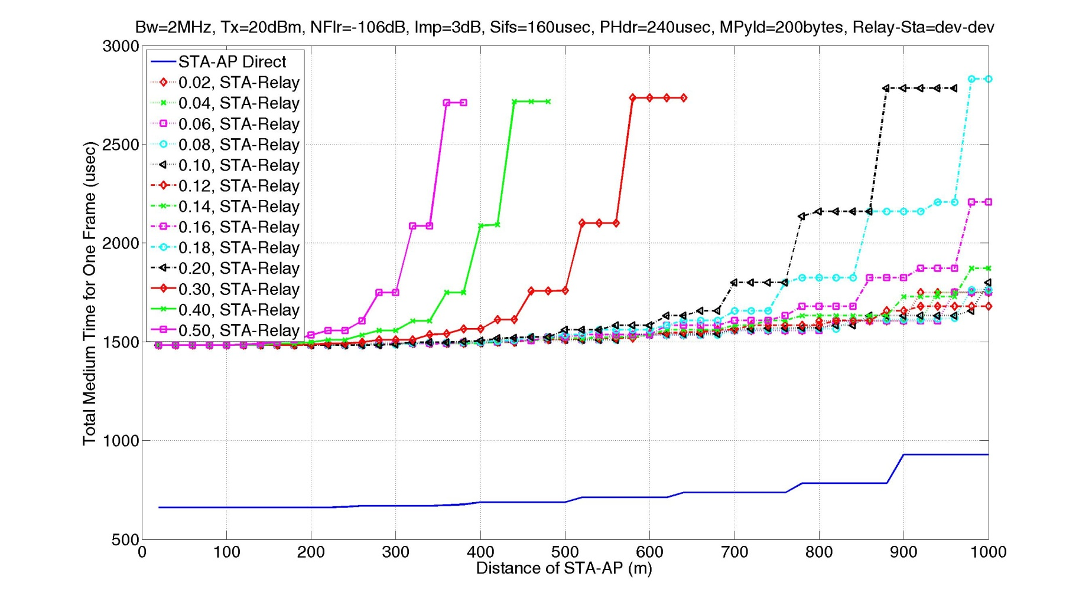
Total Medium Time for 1 Frame
(200 bytes)

Slide 12
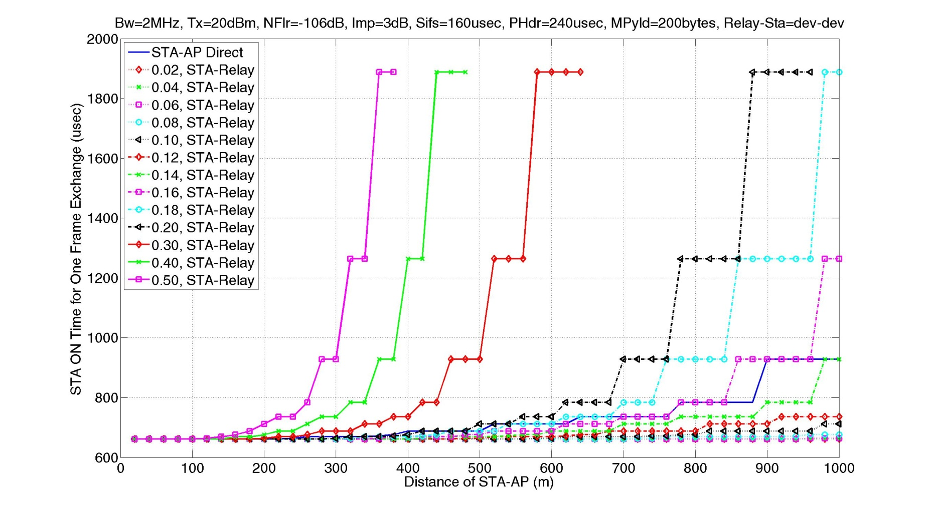
STA ON Time for 1 Frame
(200 bytes)

Slide 13
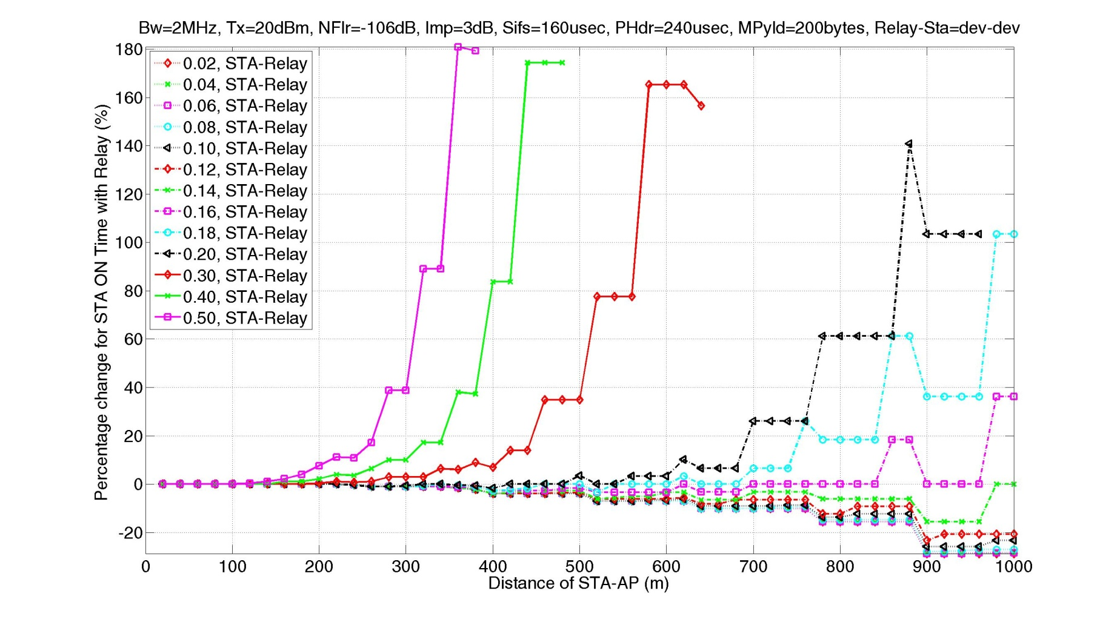
STA ON Time Change for 1 Frame
(200 bytes)

Slide 14
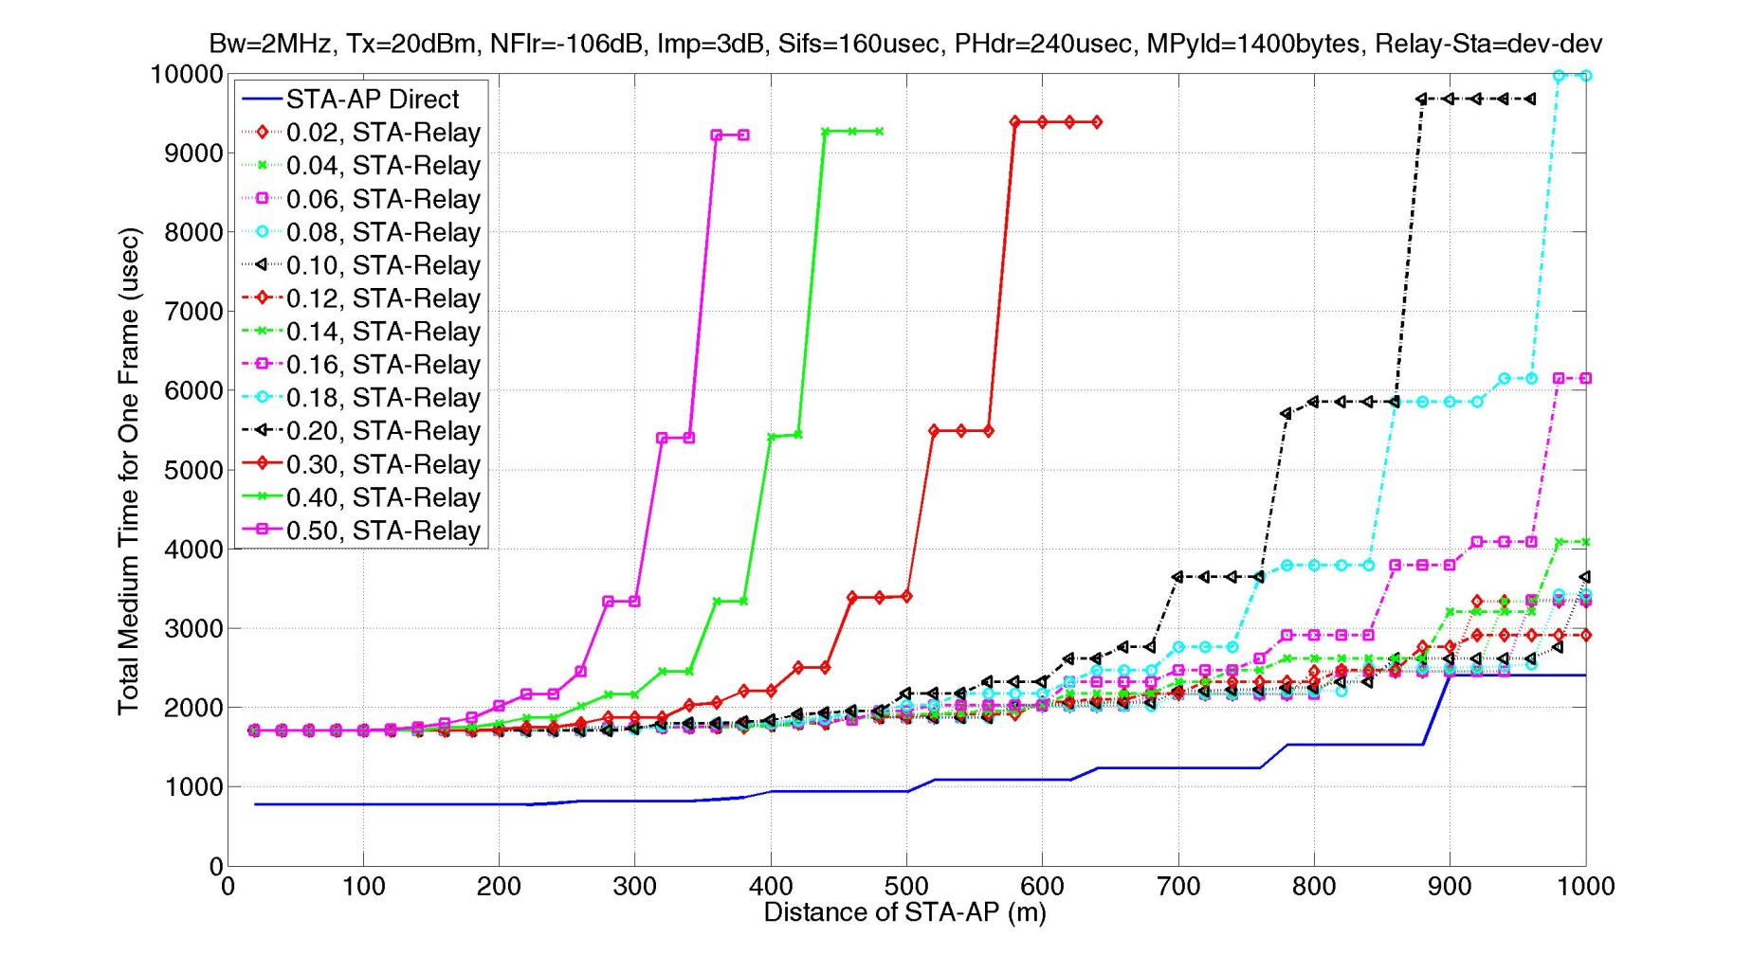
Total Medium Time for 1 Frame
(1400 bytes)

Slide 15
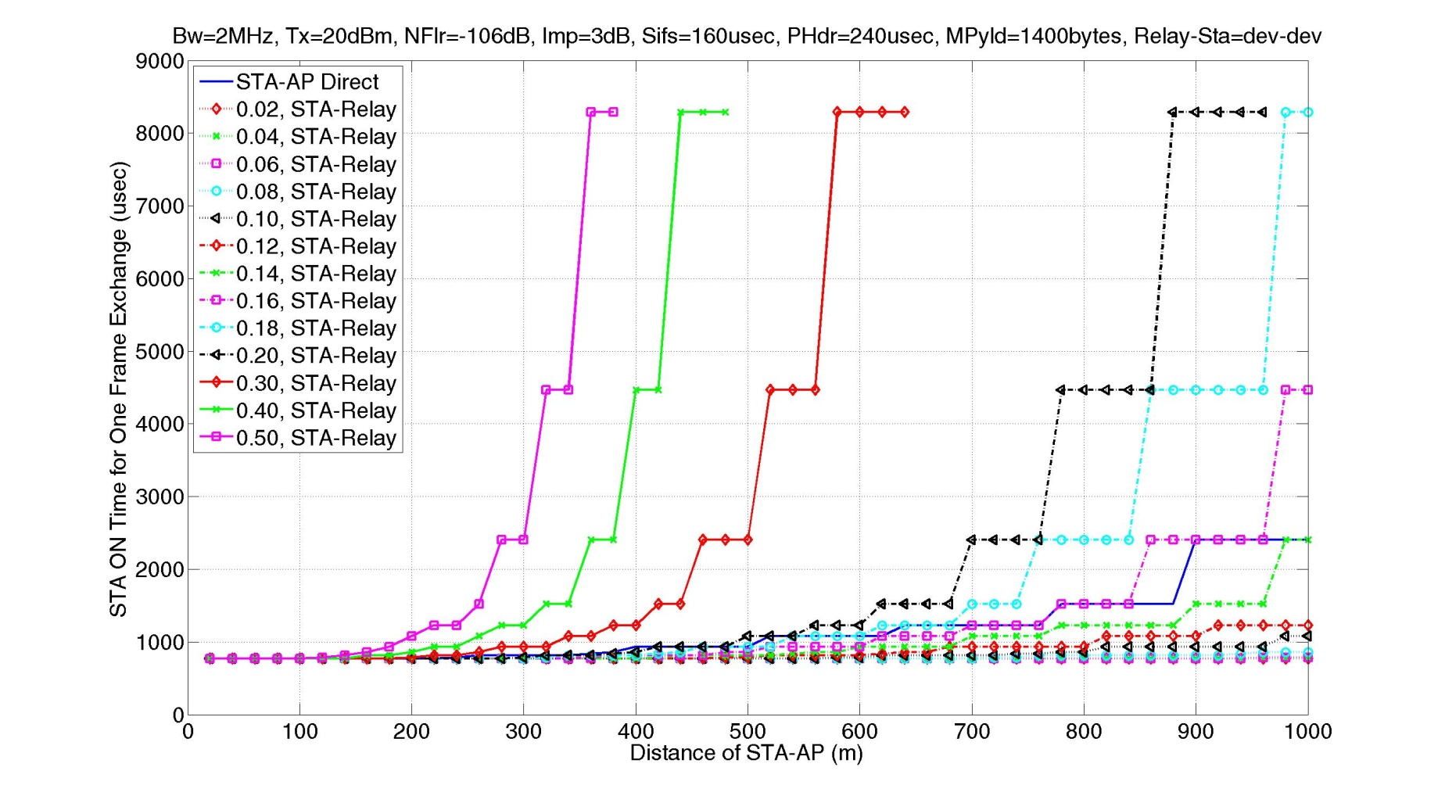
STA ON Time for 1 Frame
(1400 bytes)

Slide 16
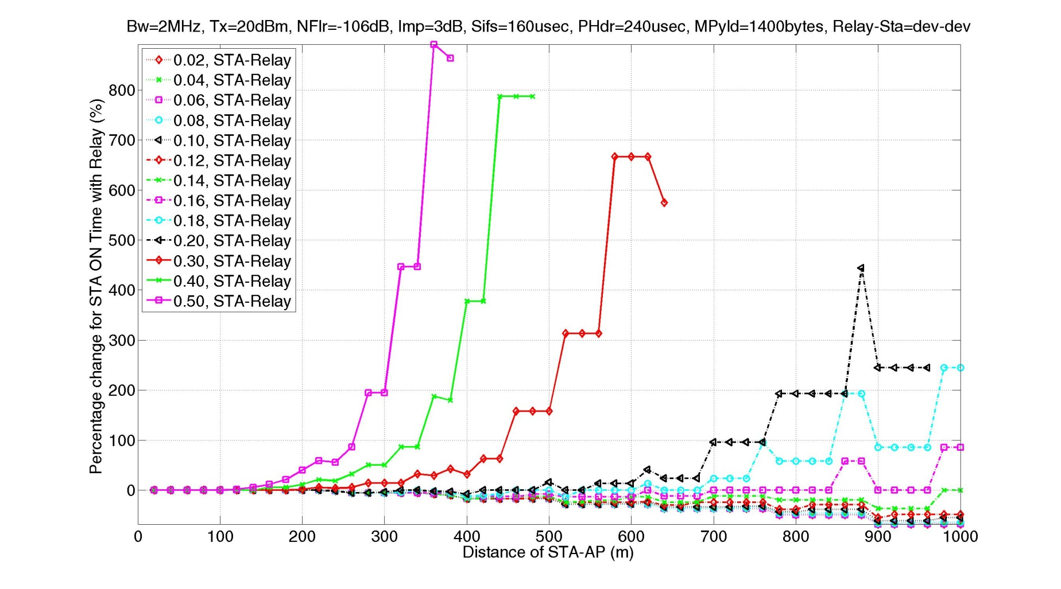
STA ON Time Change for 1 Frame
(1400 bytes)

Slide 17
Proposed Solution
Propose a bi-directional two-hop MAC relay function
  Route management is simpler, no forwarding tables at relays
  Multi-hop requires multiple use of the channel for each DATA frame
  Multi-hop path requires path maintenance management
Propose shared TXOP for relay
  Reduces number of contentions for channel access
Need buffer management at the relay
  Relay UL TX might fail, so relay needs to buffer MPDU for retry attempt because it already ACK’ed to the originator (see timing diagrams)
Use Probe Request for relay discovery
  Include information in PREQ on AP-STA link budget (if available) to allow reduced response

Slide 18
Relay Discovery
Consider use of Probe Request for relay discovery
STA initiates the discovery process and decides the requirements for relaying, and sends information on U₁ (if available) plus additional link requirement
Relay knows the link quality of V₁ and V₂, and along with requirements from STA, a relay can decide whether it is a relay candidate for this STA
Only eligible relays that meet the link budget requirements will respond to this STA, which is similar in concept to the inclusion and exclusion lists defined for Probe Response criteria defined in TGai [1]
STA selects a relay based on the Probe Responses received

Slide 19
Downlink with Explicit ACK
AP sends downlink DATA frame with Ack Indication bits set to 00 to relay
After receipt of ACK, AP removes frame from buffer, and defers MAX_PPDU + ACK + 2*SIFS before next event
AckInd=00
T_{D}(V₂)
Relay sends ACK, and set Ack Indication bits to 11 for next outgoing frame
AckInd=11
AckInd=00
ACK
DATA
T_{A}(V₂)
SIFS
T_{D}(V₁)
SIFS
In SIFS time, relay sends DATA with a different MCS and Ack Indication bits set to 00. Relay buffers frame until successful delivery or reaching of retry limit
AckInd=10
T_{A}(V₁)

Slide 20
Uplink with Explicit ACK
AckInd=10
Relay sends ACK, and set Ack Indication bits to 11 for next outgoing frame
T_{A}(V₂)
AckInd=11
AckInd=00
ACK
DATA
T_{A}(V₁)
SIFS
T_{D}(V₂)
SIFS
AckInd=00
In SIFS time, relay sends DATA with a different MCS and Ack Indication bits set to 00. Relay buffers frame until successful delivery or reaching of retry limit
T_{D}(V₁)
STA sends uplink DATA frame with Ack Indication bits set to 00 to relay
After receipt of ACK, STA removes frame from buffer, and defers MAX_PPDU + ACK + 2*SIFS before next event

Slide 21
Buffer Management at Relay
Channel conditions may cause frames to be continuously buffered at the relay, and subsequently leading to an queue overflow
Source node is unaware of the downstream congestion, and continues to forward frames to the relay
Retransmission at the cost of MAC efficiency is undesirable
For example, use the relay can use a bit in MAC header to signal the source node to stop, and restart after some timeout

Slide 22
Conclusion
Proposed a bidirectional two-hop MAC relay function
  Reduce power consumption on STA with battery constraints, and limited MCS range
  Sharing one TXOP for relay and reduces the number of contentions for channel access
  Address buffer overflow at relay with a flow control mechanism at the relay
  Use Probe request for relay discovery and include information on AP-STA link budget (if available) to reduce number of responses

Slide 23
Straw Poll 1
  Do you support a simple bidirectional relay that is limited to two hops only?
  Yes
  No
  Abstain
Eric Wong, Broadcom

Slide 24
Straw Poll 2
Do you support the concept of sharing one TXOP for relay (for explicit ACK exchange) to reduce the number of channel contentions?
  Yes
  No
  Abstain
Eric Wong, Broadcom

Slide 25
Straw Poll 3
Do you support a flow control mechanism at the relay?
  Yes
  No
  Abstain

Slide 26
Straw Poll 4
Do you support to use Probe Request for Relay discovery, and optionally include information on AP-STA link budget?
  The STA initiates the discovery process
  The STA selects a relay based on the Probe Responses received
  Yes
  No
  Abstain

Slide 27
References
[1] J. Kneckt et al., “Response Criteria for Probe Response,” IEEE 11/12-553r4
[2] IEEE 802.11 REVmb D12.0

