Slide 1
RAW Slot Assignment
Date: 2012-11-12
Authors:

Slide 2
Authors:

Slide 3
Authors:

Slide 4
Introduction
General procedures of uplink and downlink channel access (4.2.1, 4.2.2, 4.2.3) were adopted in the TGah SFD [1].
R.4.2.2.A describes the concept of using the TIM IE to determine the slot boundary of a STA to start channel access
  “Paged STA starts the contention at slot boundary defined as a function of STA position in the TIM IE and additional info determined by Association or Beacon frame.”
This presentation proposes a simple slot assignment scheme using TIM IE and RAW PS IE

Slide 5
RAW Parameter Set Element
4.4.3.1.2 in the TGah SFD defines the fields in the RAW PS IE:
Feature | Value | Interpretation
Page ID | TBD bits | Indicates the page index for hierarchical AID (based on hierarchical AID) of the allocated group
Block Offset | TBD bits | Assuming 32 blocks per page, these bits indicate the starting block index of the allocated group
Block Range | TBD bits | Indicates the number of blocks (starting from the block offset) for the allocated group
RAW Start Time | 8 bits | Duration in TU from end of beacon transmission to RAW Start time
RAW Duration | TBD bits | Duration of RAW in TU
Access restricted to paged STA only | 2 bits | Bit 1: Set to 1 if only STA with their TIM bit set to 1 are allowed to perform UL transmissions Bit 2: Set to 1 if RAW is reserved for frames with duration smaller than slot duration, such as PS-Polls / trigger frames (ignored if Bit 1 is not set)
Group/Resource allocation frame indication | 1 bit | Set to 1 to indicate if STAs need to wake up at the beginning of the RAW to receive group addressed frames such as resource allocation (format of the resource allocation frame TBD)
Slot definition | TBD bits | Include Slot duration signaling Slot assignment to STA Cross boundary transmissions allowed/not allowed Format is TBD

Slide 6
Slot Assignment using TIM IE
Example
TIM bitmap
1
0
1
0
0
1
0
0
1
0
1
0
0
1
0
AID:
x
M
N
N+1
STA with AID = x mapped to i -th slot
Beacon
TIM IE
RAW Parameter Set IE
Number of slots
in the RAW = N_{RAW}
Slot
Boundary
Slot
Boundary
Slot
Boundary
Slot
Boundary
Slot
Boundary
Slot
Boundary
Slot i
…
Slot duration (T_{s} ) = T_{RAW} / N_{RAW}
RAW Start Time
(T_{RAW START})
Restricted Access Window (RAW) duration = T_{RAW}

Slide 7
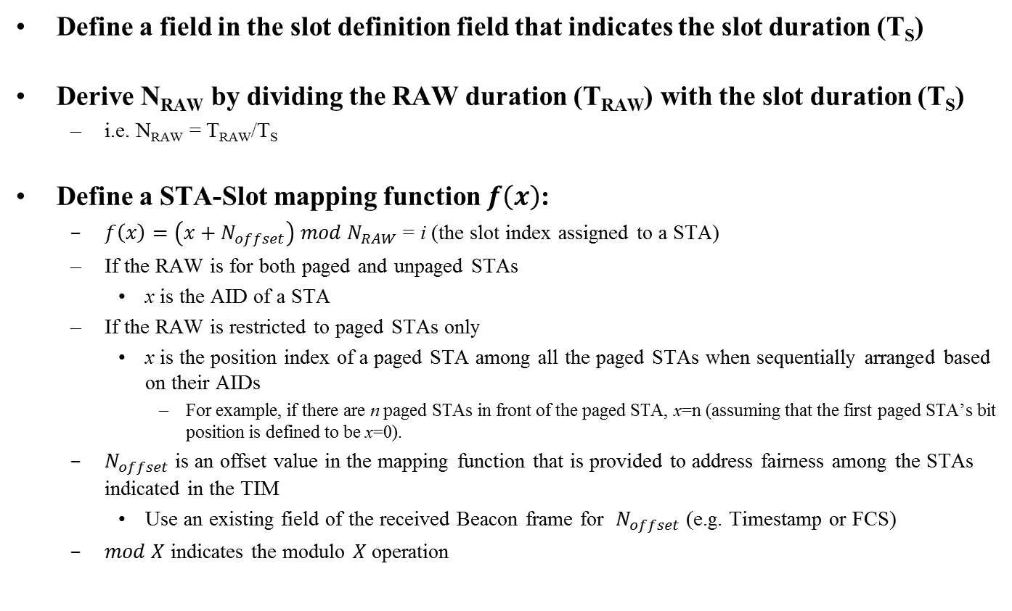
Proposal
Define a field in the slot definition field that indicates the slot duration (T_{S})
Derive N_{RAW} by dividing the RAW duration (T_{RAW}) with the slot duration (T_{S})
  i.e. N_{RAW} = T_{RAW}/T_{S}
Define a STA-Slot mapping function $f\left(x\right)$:
  $f\left(x\right)=\left(x+N_{offset}\right) mod N_{RAW}$ = i (the slot index assigned to a STA)
  If the RAW is for both paged and unpaged STAs
    x is the AID of a STA
  If the RAW is restricted to paged STAs only
    x is the position index of a paged STA among all the paged STAs when sequentially arranged based on their AIDs
      For example, if there are n paged STAs in front of the paged STA, x=n (assuming that the first paged STA’s bit position is defined to be x=0).
  $N_{offset}$ is an offset value in the mapping function that is provided to address fairness among the STAs indicated in the TIM
    Use an existing field of the received Beacon frame for $N_{offset}$(e.g. Timestamp or FCS)
  $mod X$ indicates the modulo $X$ operation

Slide 8


Example 1a
Both paged and unpaged STAs are allowed to access RAW
Number of AIDs = $N_{RAW}$
TIM bitmap
1
0
1
0
0
1
0
0
1
0
1
0
0
1
0
9
10
11
12
13
14
x=AID:
1
2
3
4
5
6
7
8
15
Slot index= f(14) = (14+3) mod 15 = 2
Beacon
TIM IE
RAW Parameter Set IE
  $N_{offset}=3$
Slot index= f(7) = (7+3) mod 15 = 10
Number of slots
in the RAW = N_{RAW}=15
Slot 0
Slot 1
Slot 2
Slot 3
…
Slot 10
…
Slot 14
Slot duration (T_{s} ) = T_{RAW} / N_{RAW}
RAW Start Time
(T_{RAW START})
Restricted Access Window (RAW) duration = T_{RAW}

Slide 9


Example 1b
Both paged and unpaged STAs are allowed to access RAW
Number of AIDs > $N_{RAW}$
TIM bitmap
1
0
1
0
0
1
0
0
1
0
1
0
0
1
0
9
10
11
12
13
14
AID:
15
1
2
3
4
5
6
7
8
Slot index= f(7)
= (7+3) mod 8 = 2
Beacon
TIM IE
RAW Parameter Set IE
  $N_{offset}=3$
Slot index= f(15)
= (15+3) mod 8 = 2
Two STAs (AID=7 and AID=15) mapped
to one slot (slot index =2) in the RAW
Slot 2
Slot 0
Slot 1
Slot 3
…
Slot 7
Slot duration (T_{s} ) = T_{RAW} / N_{RAW}
RAW Start Time
(T_{RAW START})
Restricted Access Window (RAW) duration = T_{RAW}
Number of slots
in the RAW = N_{RAW}=8

Slide 10
Example 2
Restricted to paged STAs only (i.e. AID bit = 1 in TIM IE) to access RAW
TIM bitmap
1
0
1
0
0
1
0
0
1
0
1
0
0
1
0
9
10
11
12
13
14
AID:
15
1
2
3
4
5
6
7
8
x=Position index of a STA among
all the paged STAs
0
1
2
3
4
5
Slot index= f(5) = (5+3) mod 6= 2
Beacon
TIM IE
RAW Parameter Set IE
  $N_{offset}=3$
Number of slots
in the RAW = N_{RAW}=6
Slot index= f(2) = (2+3) mod 6 = 5
Slot 0
Slot 1
Slot 2
Slot 3
Slot 4
Slot 5
Slot duration (T_{s} ) = T_{RAW} / N_{RAW}
RAW Start Time
(T_{RAW START})
Restricted Access Window (RAW) duration = T_{RAW}

Slide 11
Straw Poll
Do you support the slot assignment scheme as outlined in slide 7?
  Y/N/A

Slide 12
Motion
Move to accept in the SFD the slot assignment scheme outlined in slide 7.
  Y/N/A

Slide 13
Reference
[1] TGah Specification Framework, IEEE 802.11-11/1137r11

