Slide 1
Beamforming Feedback for Single Stream
Date: 2012-11-12
Authors:

Slide 2
Authors continued:
Slide 2

Slide 3
Authors continued:

Slide 4
Background
In 11ah, the beamforming sounding exchange duration (especially the feedback packet) is ~10x of that in 11ac, but the coherence time (hence sounding interval) does not increase by the same magnitude.
  Feedback frame results in a relatively larger overhead than in 11ac.
It is desirable to seek approaches to reduce the feedback overhead.
  Here we target the most common case: single stream Nx1 beamforming.
We propose to reuse the exact 11ac beamforming feedback format and parameters, with a small change in the case of single stream beamforming matrix feedback to reduce the overhead.

Slide 5
Discussions
11n and 11ac are mainly “MIMO-Centric” technologies.
  Compressed Feedback angle precision is mainly designed for MIMO scenarios.
  Example: in 11ac the lowest precision is (bϕ=4, bψ=2)—lower precisions will not work well for multi-stream cases.
11ah should mainly be a SISO (single SS) technology, hence it makes sense that the compressed feedback design gives some considerations for Nc=1 scenarios.
  In particular, 2x1 V matrix will be the major TxBF usage case.
A viable solution here is to define a slightly different angle bitwidth (indicated by “codebook info” in MIMO Ctrl field) interpretation and angle alignment table in the case of single column feedback for SU, to reduce the feedback overhead.

Slide 6
Recall: 11n/11ac V Matrix Compression Procedure
Use 4x1 as an example.
Feedback
(ϕ angles preserves phase info of V; and ψ angles preserves amplitude info of V)

Slide 7
Feedback Only ϕ Angles for SU Feedback Nc=1
It is well-know that the ideal V is SVD (MRT).
  Example of 4x1:
Magnitude information of V matrix will most likely be removed/distorted by the beamformer.
  For example, transmitter tries to maximize output power, so each antenna output the same maximum possible power from its PA—”PA Balancing”.
  Therefore only phase information of the SVD V matrix may be effectively preserved without much distortion at beamformer side.
Not feeding back Ψ is equivalent to equal gain combining (EGC).
  It is well-known that EGC is near optimal for single stream.
  The gap between EGC and SVD is even smaller when PA balancing is applied.
  If Ψ is not fed back, BFer may skip PA balancing logic to reduce complexity.
Furthermore, by simulations (will show), we found ϕ angle is very insensitive to its quantization precisions in single SS cases.

Slide 8
Φ-only Feedback Compression Procedure
Use 4x1 as an example.
  Beaformer may assume Ψ angles being:
    i.e. derived by equal amplitude among elements of V
Feedback

Slide 9
PER Simulations
2MHz, 4MHz, 2x1, 4x1, 2x2, 1SS, Compressed FB, Ng=1 or Ng=4.
DNLOS channel, or SCM UrbanMacro and UrbanMicro Channels.
MCS7 or 3
Beamforming computation using optimal SVD (MRT)
Note: for Φ-only Feedback, with or without PA Balancing gets the same performance as discussed earlier.
  Hence PA balancing is bypassed in the simulations.

Slide 10
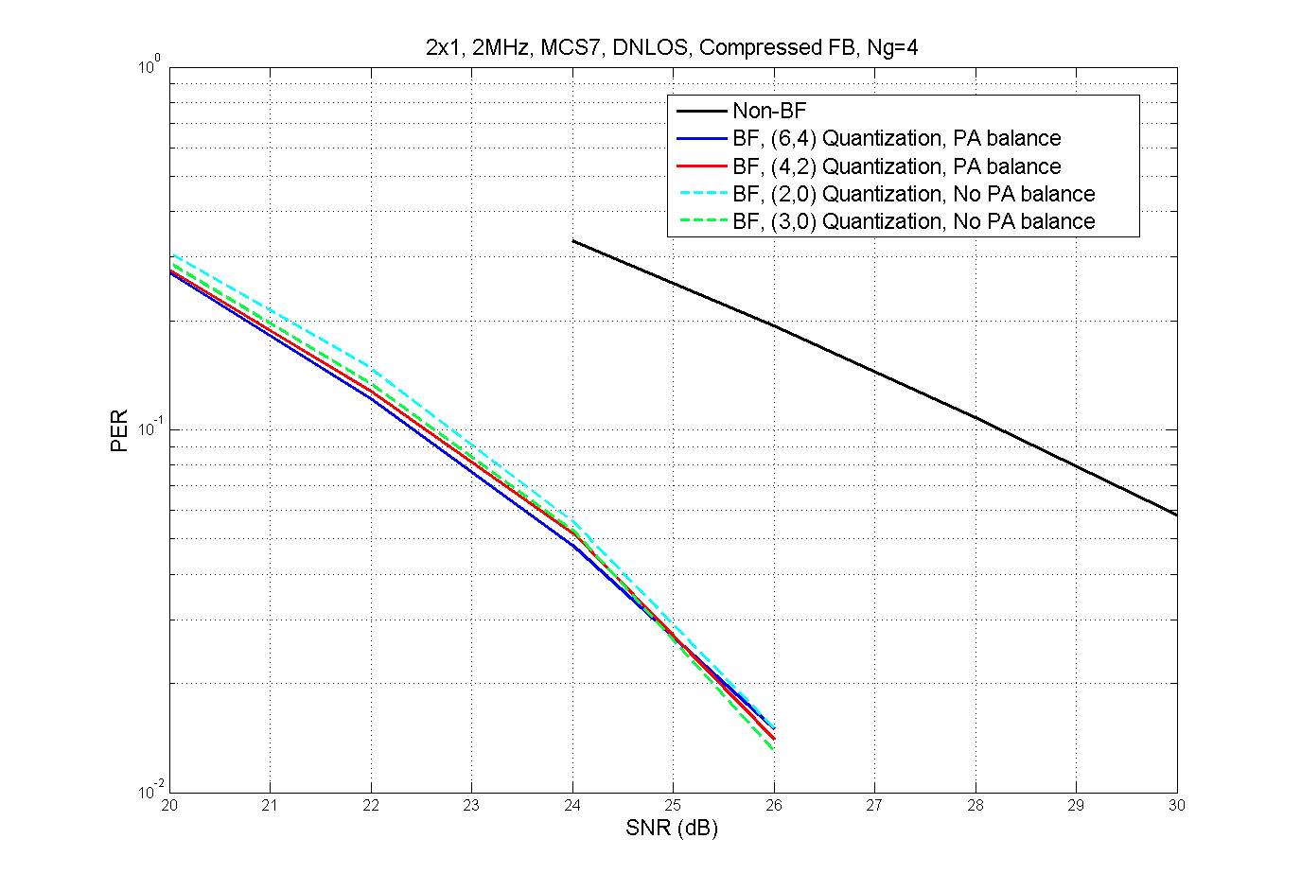
2x1 DNLOS, MCS7, 2MHz, Ng=4

Slide 11
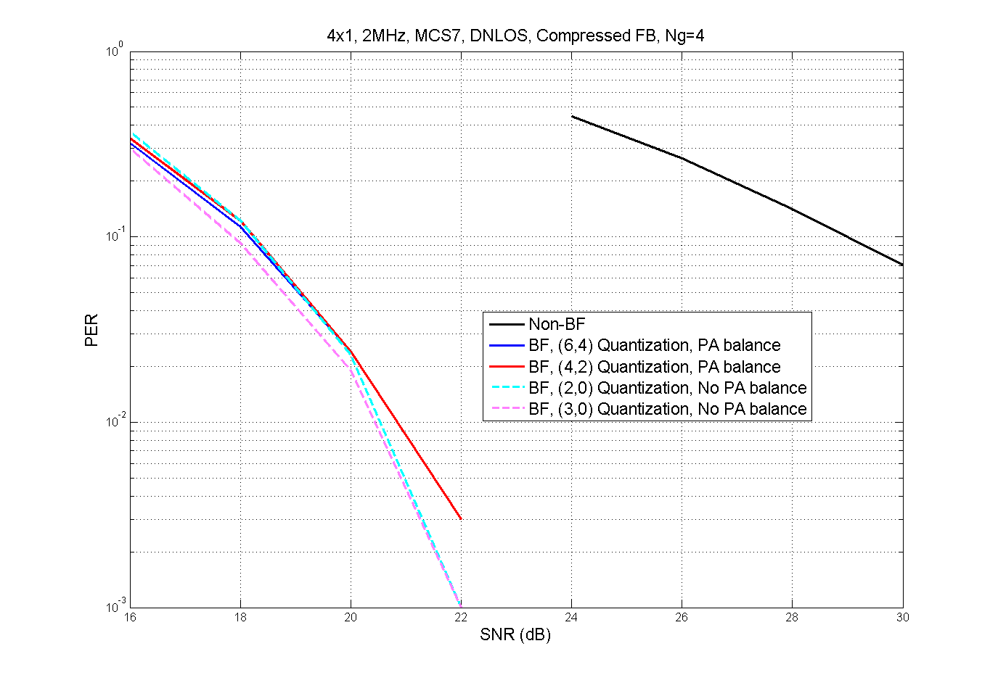
4x1 DNLOS, MCS7, 2MHz, Ng=4

Slide 12
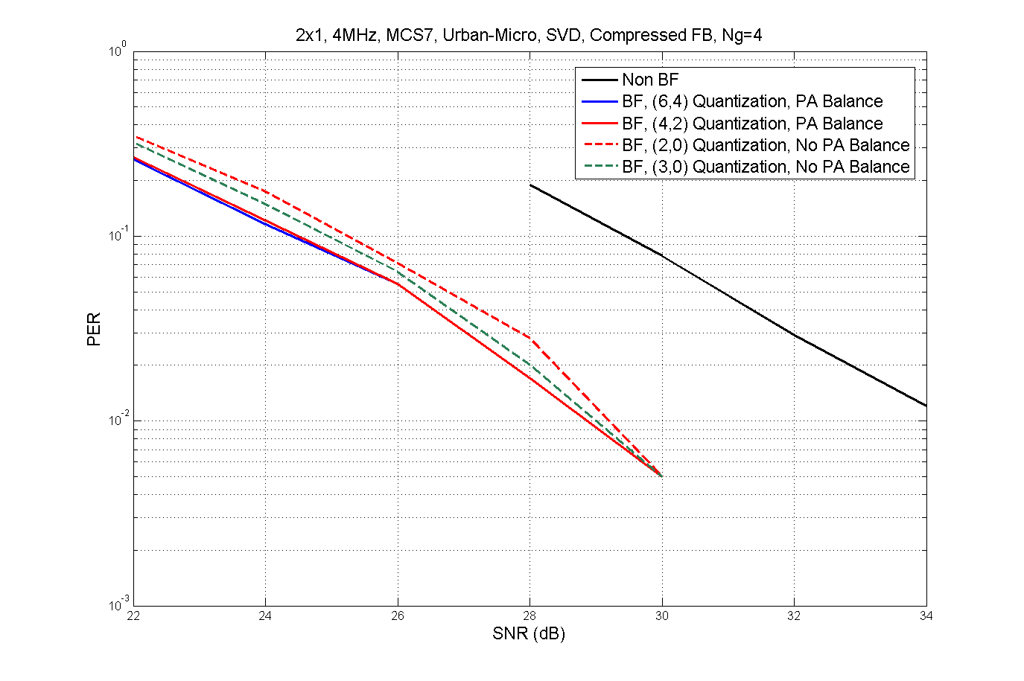
2x1 SCM-UMI, MCS7, 4MHz, Ng=4

Slide 13
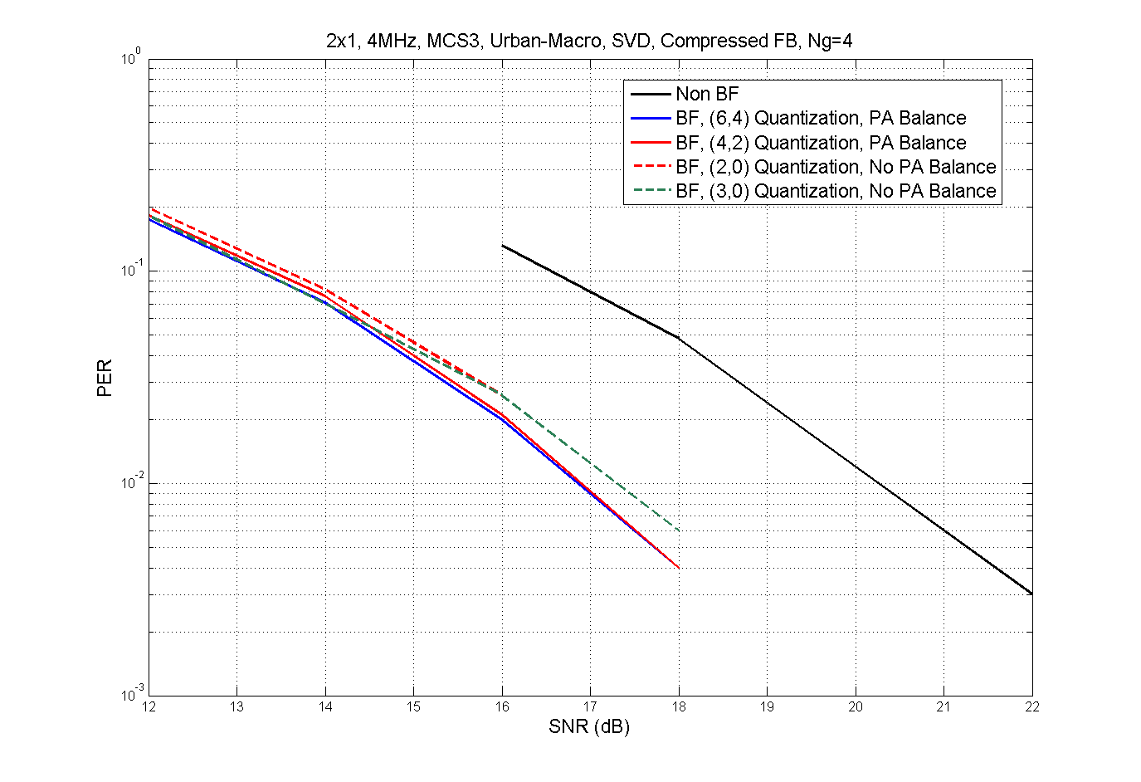
2x1 SCM-UMA, MCS3, 4MHz, Ng=4

Slide 14
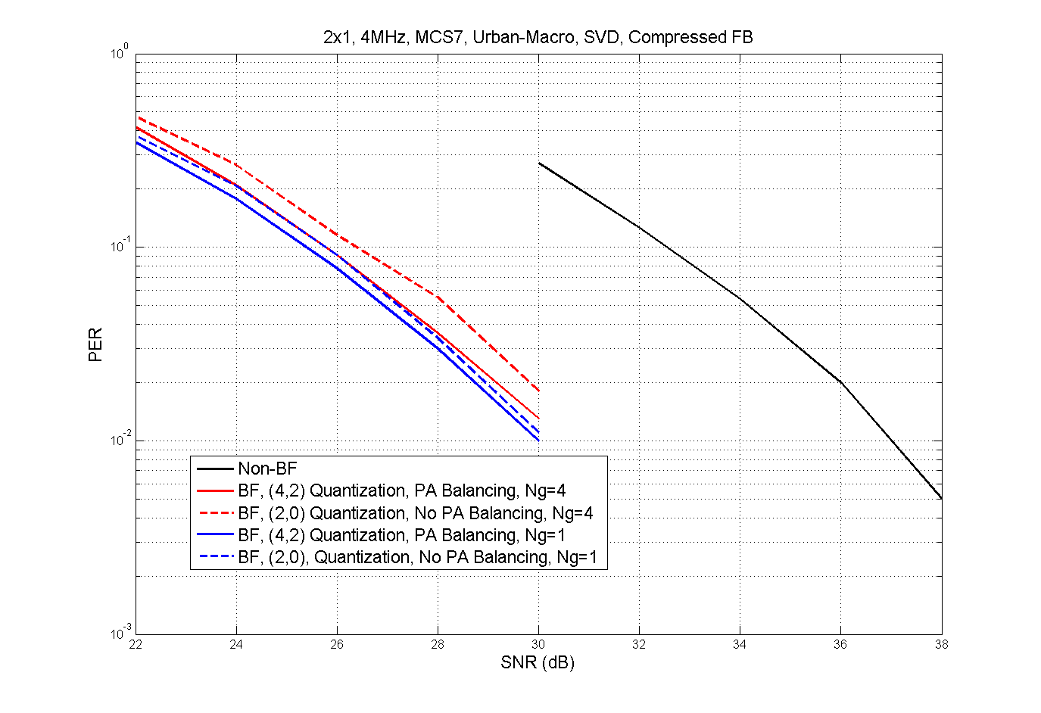
2x1 SCM-UMA, 4MHz, Ng=4 or 1

Slide 15
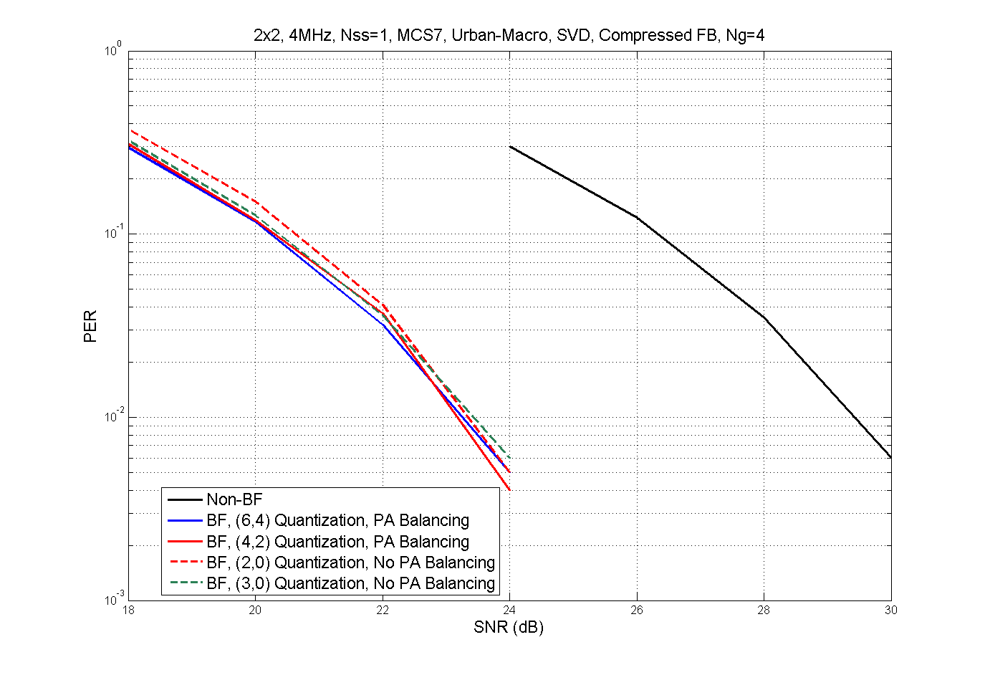
2x2 SCM-UMA, 1SS, MCS7, 4MHz, Ng=4

Slide 16
Discussions
Simulation results show comparable performances between Φ-only Feedback (2,0) and 11ac full angle feedback (6,4)/(4,2) for single stream cases.
  This observation is constant across all different channels, different antenna configurations, different MCSs and different Ng values.
By doing the Φ-only feedback, we may get significant feedback overhead reduction
  Refer to next 2 slides.
Here we propose to re-interpret one choice of the Codebook info subfield in MIMO control field in the case of SU FB and Nc=1 as (2,0), and keep the other choice as (4,2).
  For MU or SU with multi-stream, we still use the 11ac parameters.
Also propose to keep the same Ng options as in 11ac.

Slide 17
Feedback Overhead (Ng=1)
Nr=2, Nc=1 (N_{TX}=2, N_{RX}=1)
Compressed Beamforming Report
BW | Ns | Ns’ | Bits for V
 |  |  | Prop (bΦ=2) | bΦ=4, bΨ =2
1 MHz | 24 | 12 | 48 | 144
2 MHz | 52 | 30 | 104 | 312
4 MHz | 108 | 58 | 216 | 648
8 MHz | 234 | 122 | 468 | 1404
16 MHz | 468 | 244 | 936 | 2808
67% reduction in size of compressed
beamforming report field

Slide 18
Feedback Overhead (Ng=1)
Nr=4, Nc=1 (N_{TX}=4, N_{RX}=1)
Compressed Beamforming Report
BW | Ns | Ns’ | Bits for V
 |  |  | Prop (bΦ=2) | bΦ=4, bΨ =2
1 MHz | 24 | 12 | 144 | 432
2 MHz | 52 | 30 | 312 | 936
4 MHz | 108 | 58 | 648 | 1944
8 MHz | 234 | 122 | 1404 | 4212
16 MHz | 468 | 244 | 2808 | 8424
67% reduction in size of compressed
beamforming report field

Slide 19
Pre-Motion
Do you agree to insert the following sub-bullets in SFD R.3.5.A?
  Tone grouping values (Ng) and the corresponding tone map for each Ng when bandwidth >=2MHz are the same as in 11ac with the same FFT sizes.
  For MU feedback, and SU feedback with Nc>1, angle alignment, angle quantization bitwidth and the definition of the codebook info subfield of VHT MIMO Control field are the same as in 11ac.
  For SU feedback with Nc=1, modify the codebook info subfield of VHT MIMO control field as below:
    Set to 0 for 2 bits for ϕ, and ψ is not fed back.
    Set to 1 for 2 bits for ψ, and 4 bits for ϕ.
  The angle alignment table is as below (next slide).
  Beamformer shall be capable of receiving and processing a beamforming feedback frame with any tone grouping and angle quantization bitwidth.
  When the ψ angle is not included in the feedback frame, in the case of SU feedback Nc=1, ψ angle values are assumed as given below, which correspond to the first column of the V matrix having elements with equal magnitude:

Slide 20
Pre-Motion—cont’d
 | Order of angles in the Compressed Beamforming Feedback Matrix subfield if the Feedback Type is SU
Size of V (Nr × Nc) | Codebook Information Field | Number of angles (Na) | The order of angles in the Compressed Beamforming Feedback Matrix subfield
2×1 | 0 | 1 | φ11
2×1 | 1 | 2 | φ11, ψ21
2×2 | 0 or 1 | 2 | φ11, ψ21
3×1 | 0 | 2 | φ11, φ21
3×1 | 1 | 4 | φ11, φ21, ψ21, ψ31
3×2 | 0 or 1 | 6 | φ11, φ21, ψ21, ψ31, φ22, ψ32
3×3 | 0 or 1 | 6 | φ11, φ21, ψ21, ψ31, φ22, ψ32
4×1 | 0 | 3 | φ11, φ21, φ31
4×1 | 1 | 6 | φ11, φ21, φ31, ψ21, ψ31, ψ41
4×2 | 0 or 1 | 10 | φ11, φ21, φ31, ψ21, ψ31, ψ41, φ22, φ32, ψ32, ψ42
4×3 | 0 or 1 | 12 | φ11, φ21, φ31, ψ21, ψ31, ψ41, φ22, φ32, ψ32, ψ42, φ33, ψ43
4×4 | 0 or 1 | 12 | φ11, φ21, φ31, ψ21, ψ31, ψ41, φ22, φ32, ψ32, ψ42, φ33, ψ43

Slide 21
Pre-Motion—cont’d
 | Order of angles in the Compressed Beamforming Feedback Matrix subfield if the Feedback Type is MU
Size of V (Nr × Nc) | Codebook Information Field | Number of angles (Na) | The order of angles in the Compressed Beamforming Feedback Matrix subfield
2×1 | 0 or 1 | 2 | φ11, ψ21
2×2 | 0 or 1 | 2 | φ11, ψ21
3×1 | 0 or 1 | 4 | φ11, φ21, ψ21, ψ31
3×2 | 0 or 1 | 6 | φ11, φ21, ψ21, ψ31, φ22, ψ32
3×3 | 0 or 1 | 6 | φ11, φ21, ψ21, ψ31, φ22, ψ32
4×1 | 0 or 1 | 6 | φ11, φ21, φ31, ψ21, ψ31, ψ41
4×2 | 0 or 1 | 10 | φ11, φ21, φ31, ψ21, ψ31, ψ41, φ22, φ32, ψ32, ψ42
4×3 | 0 or 1 | 12 | φ11, φ21, φ31, ψ21, ψ31, ψ41, φ22, φ32, ψ32, ψ42, φ33, ψ43
4×4 | 0 or 1 | 12 | φ11, φ21, φ31, ψ21, ψ31, ψ41, φ22, φ32, ψ32, ψ42, φ33, ψ43

Slide 22
Motion
Move to adopt the proposed SFD changes as shown in the pre-motion in slides 19~21.

