Slide 1
TGai FILS Authentication Protocol and State Machine
Date:
Authors:
Name | Affiliations | Address | Phone | email
Robert Sun; | Huawei Technologies Co., Ltd. | Suite 400, 303 Terry Fox Drive, Kanata, Ontario K2K 3J1 | +1-613-2871948 | Rob.sun@huawei.com

Slide 2
Abstract
Nov 2012
This submission is aiming at providing in depth analysis of the FILS authentication scheme and FILS state machine in respective and also providing the technical ground for proposed texts in 11-12-1282r0

Slide 3
Conformance w/ TGai PAR & 5C
Conformance Question | Response
Does the proposal degrade the security offered by Robust Security Network Association (RSNA) already defined in 802.11? | No
Does the proposal change the MAC SAP interface? | No
Does the proposal require or introduce a change to the 802.1 architecture? | No
Does the proposal introduce a change in the channel access mechanism? | No
Does the proposal introduce a change in the PHY? | No
Which of the following link set-up phases is addressed by the proposal? (1) AP Discovery (2) Network Discovery (3) Link (re-)establishment / exchange of security related messages (4) Higher layer aspects, e.g. IP address assignment | 3

Slide 4
FILS Authentication Design
The desirable FILS authentication design should consider:
  Reusable: possibly most of the existing AKM protocols, cipher suites
  Less impact: on 802.1x and EAP state machine; no need to drastically re-design the WiFi security system.
  Cost effective: easier to implement and no tangible IPR liability.
How to design the FILS authentication scheme
  System level design: How can a system architecture help to make FILS authentication/FILS easier?
  Other relevant performance hog components: ie, DHCP/DNS, remote TTP server. How can we make them fly for FILS?
  Re-authentication vs Initial Authentication: How to make re-authentication design to be compatible with Initial Authentication

Slide 5
What’s the main contributors of the Delay
Authentication and 4 way handshake are taking too long (in range of 100ms to 1000ms)
  12/041r1 contribution has the detailed performance analysis of 802.11EAP authentication.
  https://mentor.ieee.org/802.11/documents?is_dcn=41&is_group=00ai
  Authentication at some occasions also involves backend systems which adds significantly to the overall delay in BSS.
    Certification reading and verification
    Authentication Key initialization and generation.
    EAP interlock state machine
    Chatty EAP-TLS handshake
IP layer functions taking too long
  802.1x state machine blocks the DHCP and Other IP layer functions till the STA is authenticated.
    Can we do the piggy-back way (i.e piggy-back DHCP over other messages) ?

Slide 6

FILS System Design
Secured Network
Network A:
  -TTP authentication/Authorization
  -802.1X/EAP based RSNA architecture
Network B:
  -Wall Gardened Architecture for FILS client
  - Routed FILS connectivity within Wall Gardened zone
  -802.1x (EAP is optional, ie. PSK) based RSNA architecture
  - Similar to Guest 802.1x port in implementation.
  Ref: http://www.cisco.com/en/US/docs/solutions/Enterprise/Network_Virtualization/AccContr.pdf
WiFi Host
AP
Authentication Server
Secured Network
WiFi Host
“FILS Link”
AP
Wall –Gardened
Network
DHCP Server
Authentication
Server

Slide 7
For Network A
Existing IEEE 802.11 components
  802.1X PAE (including state machine and Management Entities, MIB)
  EAP (EAP-TLS, RFC 5216 and RFC 3748) (Only as reference model)
  4-way handshake
    Note: IEEE 802.11ad is reliant on 4-way handshake to delivery information??
Mandates strong WPA/WPA2 security requirements
  Mutual authentication with 4 way handshake (RSNA)
  Link Setup time requirements can not degrade the security property.

Slide 8
IEEE 802.11 TGai FILS Authentication
Supplicant
AP /
Authenticator
AS
1) 802.11 Beacon
EAPOL-Start Triggers the 802.1X PAE
EAPOL-Start TLV carries the NID information (i.e Certificate)
2) 802.11 Probe Request
State 1
State 1
3) 802.11 Probe Response
4) |802.1x EAP OL-Start with Security Parameters for FILS handshake)
Remove EAP-ID req/response
RFC 3748 states: EAP-ID Request/Response not necessarily the first message, in section 2
Access Request (EAP Request)
State 5
EAPOL-EAP ( EAP Authentication Protocol Exchange)
AS Generates
PMK
EAPOL-EAP ( EAP Authentication Protocol Exchange)
State 5
Accept/ EAP Success/ PMK
5) msg 1: EAPOL-KEY (Anounce, Unicast))
Authenticator
Stores PMK
And Generate
Anounce
Supplicant
Generates PMK
Supplicant
Derives PTK

Slide 9
IEEE 802.11 TGai FILS Handshake
(Revising 802.11Revmb Section 4.10.3.2)
Supplicant
AP /
Authenticator
Supplicant with
PTK
State 5
6) Msg 2: EAPOL-Key (Snounce, Unicastm MIC)
State 5
Authenticator with
PTK |GTK|IGTK
7) Msg 3: EAPOL-Key (Install PTK, unicast, MIC, Encrypt (GTK, IGTK) ))
8) Msg 4: EAPOL-Key (Unicast, MIC)
State 4
Install PTK, GTK
IGTK
Install PTK, GTK
IGTK
State 4
Secure Data Communication

Slide 10
Protocol Analysis
Pros:
  Keep IEEE 802.11 RSNA architecture (Authentication then Data Communication)
  Omit the IEEE 802.11 open authentication handshake and association handshake. (FILS association is done when the FILS authentication is completed)
  Keep the 4 way handshake intact (No need to evaluate the security property)
  Generally applicable to TTP based authentication and IBSS based authentication.
  No piggyback datagram on Frames (Piggyback datagram on frame is violating the IEEE 802.1x design principles)
  No impact on relevant Standards and implementations
Cons:
  No improvements on EAP-(TLS) multiple rounds of handshake given fragmentation could take place
    EAP based authentication with Remote AAA server still takes significant time
    IP layer functions (DHCP and DNS) is still taking its toll in making FILS authentication slow

Slide 11
For Network B
Enable the Wall gardened FILS solution
  Enable Virtual Port on IEEE 802.1X PAE on both supplicant and Authenticator to guide the FILS specific authentication scheme into a “Wall Garden” /VLAN.
  Note: Section 12.1 of IEEE 802.1X Rev-d4.
  AP (authenticator) can choose most flexible authentication scheme (PSK, or no authentication) to provide minimum effort in authentication.
  STA and AP can still utilize the 4 way handshake to generate keying materials (PTK, GTK|IGTK) to protect the OTA communication.
  The DHCP / DNS could be arranged locally (on AP or collocating with AP)
    Or using Frame-IP-Address (Radius Attribute 8) to allocate IP address to device during the authentication process
  FILS traffic are contained within the “zone” (with Firewall or other means) which regulates the traffic which is beyond the scope of IEEE 802.11TGai

Slide 12
What is Virtual Port
As defined in IEEE 802.1X rev d4
  A MAC Service or Internal Sublayer service access point (D.4) that is created on demand. Virtual ports can be used to provide separate secure connectivity associations over the same LAN.
  How to create and delete the Virtual ports on Authenticator’s PAE is based on section 12.7 of IEEE 802.1X.
  Within the virtual port, the FILS station can maintain different security association than “regular” association.

Slide 13
IEEE 802.11 TGai FILS Authentication with 4 way handshake
Supplicant
AP /
Authenticator
AS
1) 802.11 Beacon
2) 802.11 Probe Request
State 1
State 1
3) 802.11 Probe Response
VLAN ABC
4) |802.1x EAP OL-Start with FILS
FILS authentication Scheme (TBD)
AP create the Virtual Port on
Receipt of EAPOL-Start
State 5
Authentication Scheme (TBD)
AS Generates
PMK
EAPOL-EAP ( EAP Authentication Protocol Exchange)
State 5
5) msg 1: EAPOL-KEY (Anounce, Unicast))
If enable the Frame-IP-address
on EAP request, then DHCP
Can be omitted
Supplicant
Generates PMK
Authenticator
Stores PMK
And Generate
Anounce
Supplicant
Derives PTK

Slide 14
IEEE 802.11 TGai FILS Handshake
(Option 1: With 4 Way handshake))
Supplicant
AP /
Authenticator
VLAN ABC
Supplicant with
PTK
State 5
6) Msg 2: EAPOL-Key (Snounce, Unicastm MIC)
State 5
Authenticator with
PTK |GTK|IGTK
7) Msg 3: EAPOL-Key (Install PTK, unicast, MIC, Encrypt (GTK, IGTK) ))
8) Msg 4: EAPOL-Key (Unicast, MIC)
State 4
Install PTK, GTK
IGTK
Install PTK, GTK
IGTK
State 4
Secure Data Communication

Slide 15
Protocol Analysis
Utilizing the “Virtual Port” to contain the FILS traffic and regulate on the basis of backend security system design.
Enable separate FILS security association which can separate the FILS state from regular Association
Inheriting the 4 way handshake to make sure the OTA communication is secured
Local Authentication (At the proximity of the AP) which should be faster
Timer or Event triggers the FILS device to do the Full authentication/Full association.

Slide 16
Implication of FILS Authentication State Machine

Slide 17
Modified 802.11 FILS Authentication and Association State Machine
State 1
Unauthenticated,
Unassociated
Class 1 Frames
FILS
Deauthentication
(Timer or Event)
Successful
802.11 Authentication
Deauthentication
Successful FILS
Authentication
State 2
Authenticated,
Unassociated
Class 1 & 2 Frames
Successful
(Re)Association –RSNA Required
Deassociation
State 5
Unsuccessful
(Re)Association
(Non-AP STA)
FILS Authenticated
Class 1, 2 &3 Frames
IEEE 802.1x controlled Port
unblocked
State 3
Successful
802.11
Authentication
Authenticated,
Associated
(Pending RSN Authentication)
Class 1 ,2 & 3 Frames
IEEE 802.1X Controlled Port Blocked
Deauthentication
FILS Key Confirmed
4- way Handshake Successful
Unsuccessful
(Re)Association
(Non-AP STA)
Deauthentication
State 4
Disassociation
Authenticated,
Associated
Class 1 ,2 & 3 Frames
IEEE 802.1X Controlled Port
UnBlocked
Successful
802.11 Authentication
Successful
(Re) Association
No RSNA required or
Fast BSS Transitions
Slide 17

Slide 18
References
IEEE 802.1X Rev D4-5

Slide 19
The Security Model of RSNA
STA
AS
Policy
Decision
Point
Authenticate to derive
MSK
Policy
Decision
Point
2: Derive PMK from MSK
AP
Policy
Enforcement
Point
Policy
Enforcement
Point
3: Use PMK to enforce
802.11 channel access
Derive and use PTK
Reference: “IEEE 802.11i Overview”, 2002, Nancy Cam-Winget, et al

Slide 20
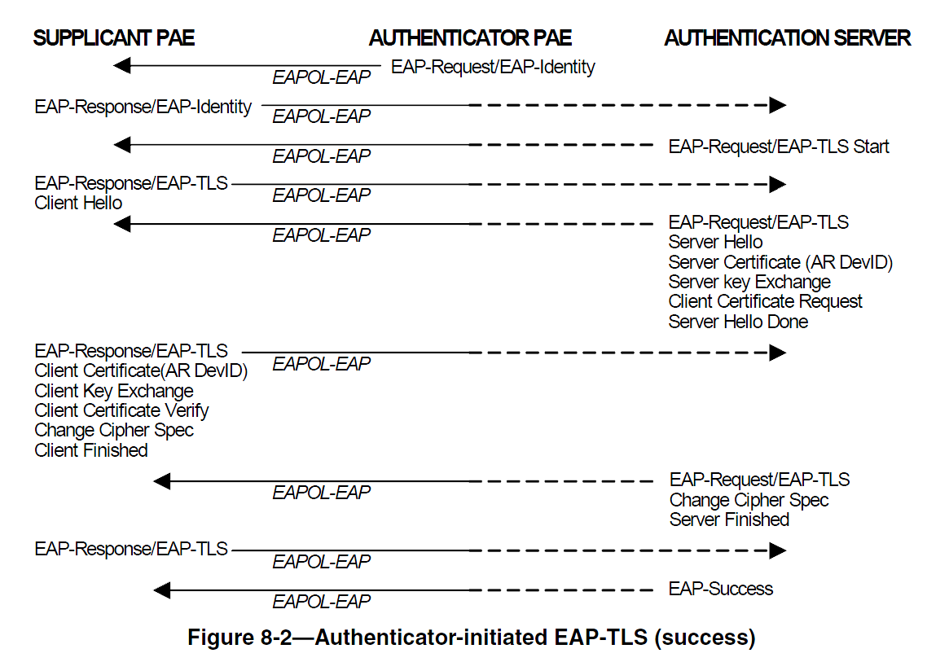
802.1X-REV/D4.5

Slide 21
Stroll Poll
Straw-Poll-1:
Do you support the proposal of the FILS Authentication Procedure as described in Slide 13 and 14 of this contribution?
Result Yes No Abstain_______________

Slide 22
Questions & Comments

