Slide 1
Partial subcarrier mode to co-exist with ISDB-T based area one-segment system
Date: 2012-11-12
Authors:

Slide 2
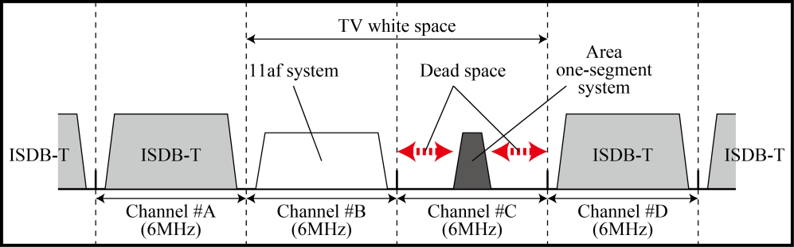
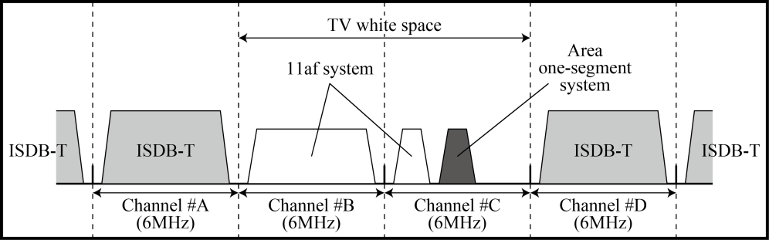
Abstract
The partial subcarrier mode is proposed for co-existing with ISDB-T based area one-segment broadcasting system (Area-one-seg).
The dead space on both sides of the Area-one-seg system can be effective used by IEEE802.11af.
Appropriate number of subcarriers of IEEE802.11af are nulled, in order to effectively use the dead spaces.
Conventional
Proposed

Slide 3
Agenda
Introduction
  ISDB-T based area-one-segment system
  Requirement of co-existence with area one-segment system
Proposed
  Proposed partial subcarrier system
  Subcarrier allocation
  Frame configuration
  Interleaver parameter
  BER, PER, Throughput performance

Slide 4
Introduction
ISDB-T based Area one-segment system
  In Japan, area one-segment systems (area limited broadcasting service in TV white space) have already being used.
  In order to achieve efficient frequency usage, co-existence scheme with one-segment systems is required for IEEE802.11af WLAN system.

Slide 5
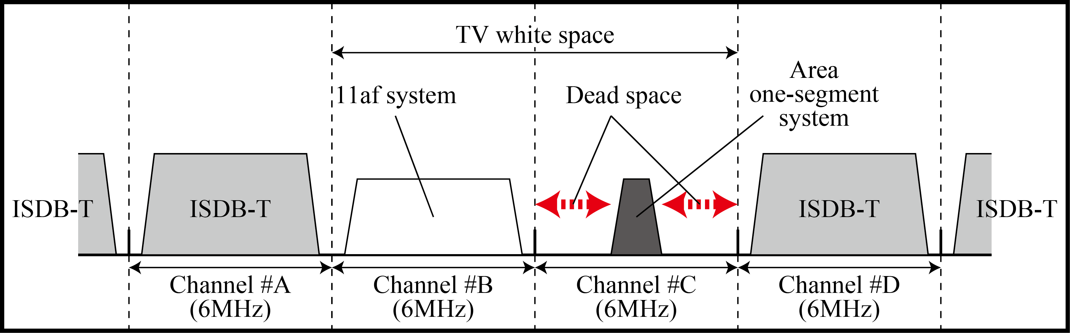
Requirement of co-existence with area one-segment system
On each side of the Area-one-seg system, large dead space exists.
Channel aggregation mode of IEEE802.11af might not work well as shown in the figure.

Slide 6

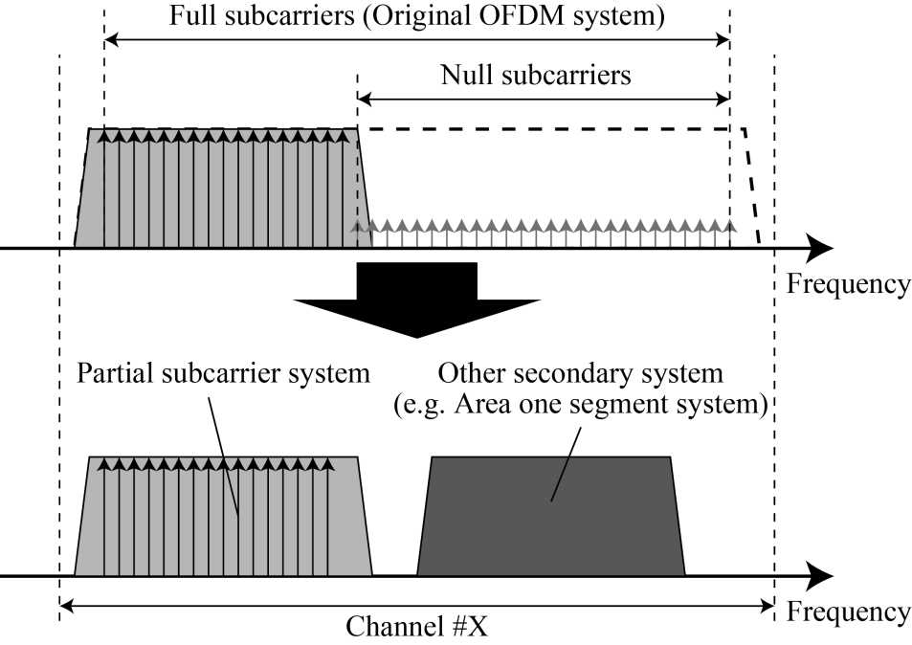

Proposal: Partial subcarrier mode
To effectively use TVWS under the environment of coexisting with Area-one-seg system in the same channel, appropriate number of subcarriers of IEEE802.11af should be nulled.
Partial subcarrier mode

Slide 7
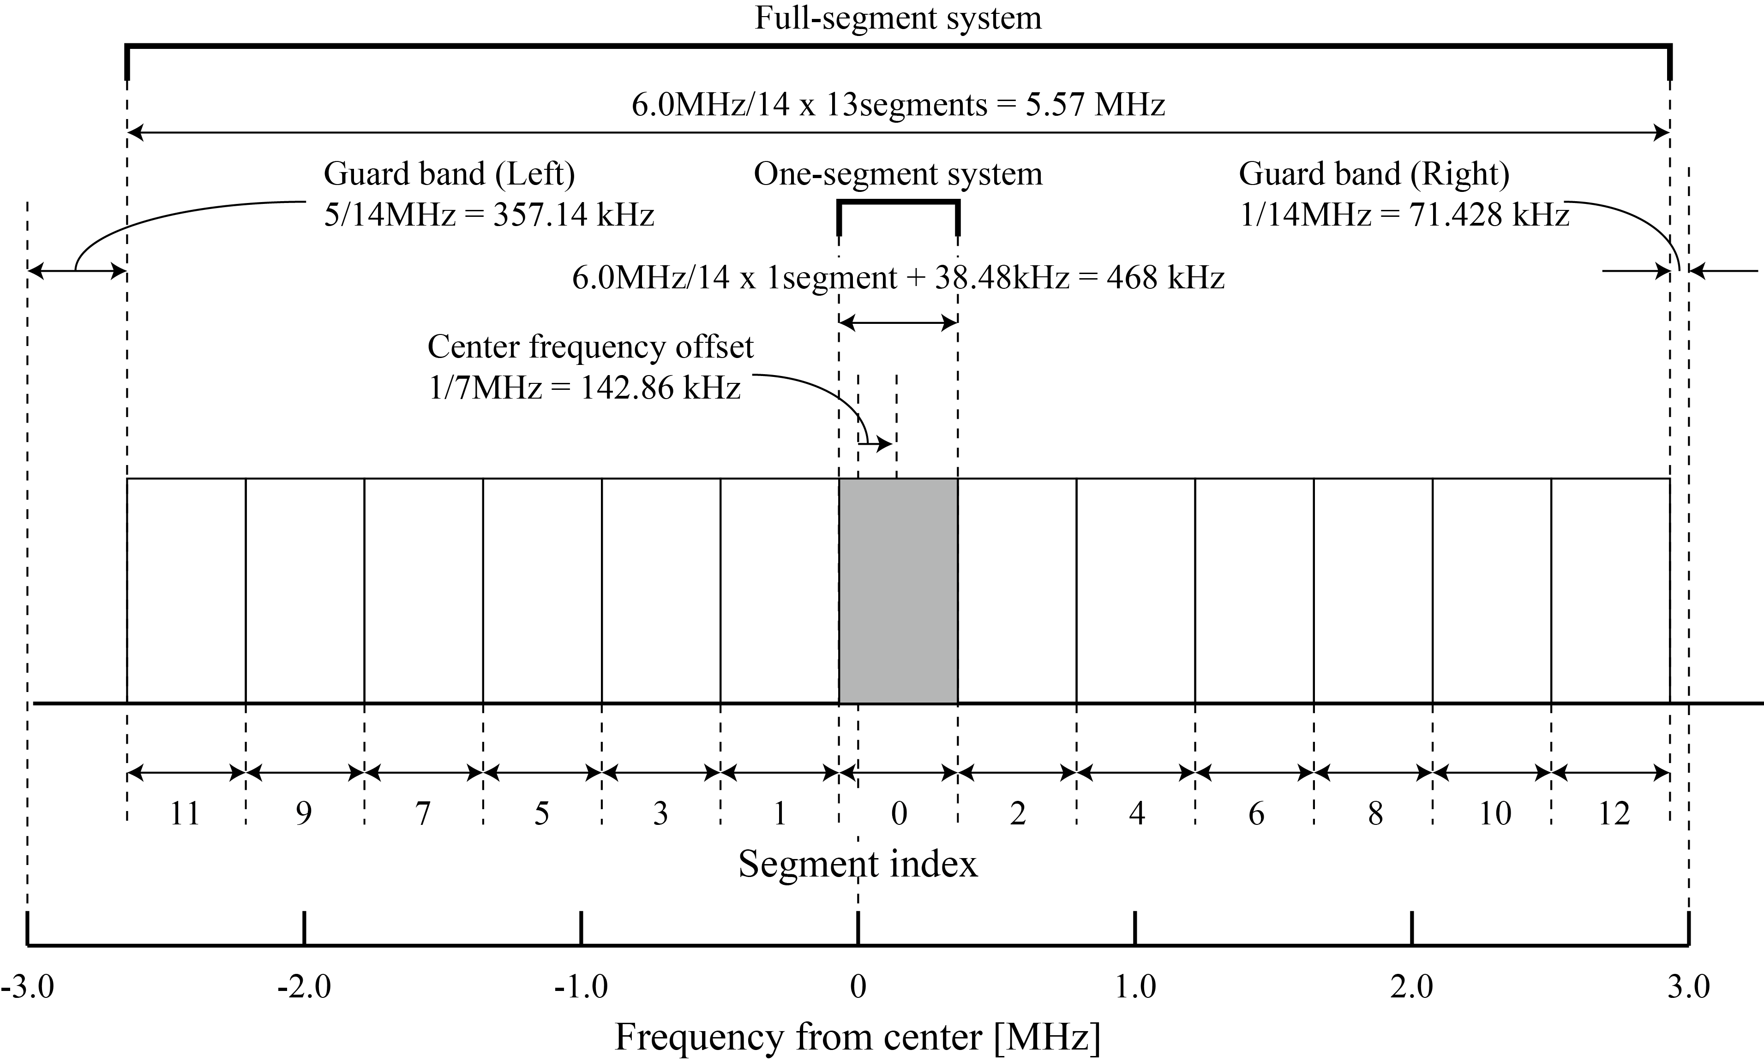
ISDB-T based Area one-segment system
Segment allocation

Slide 8
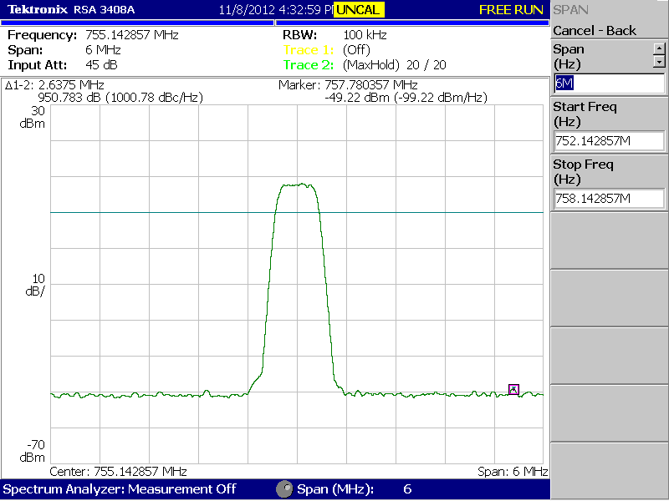
ISDB-T based Area one-segment system
Spectrum of one-segment system

Slide 9
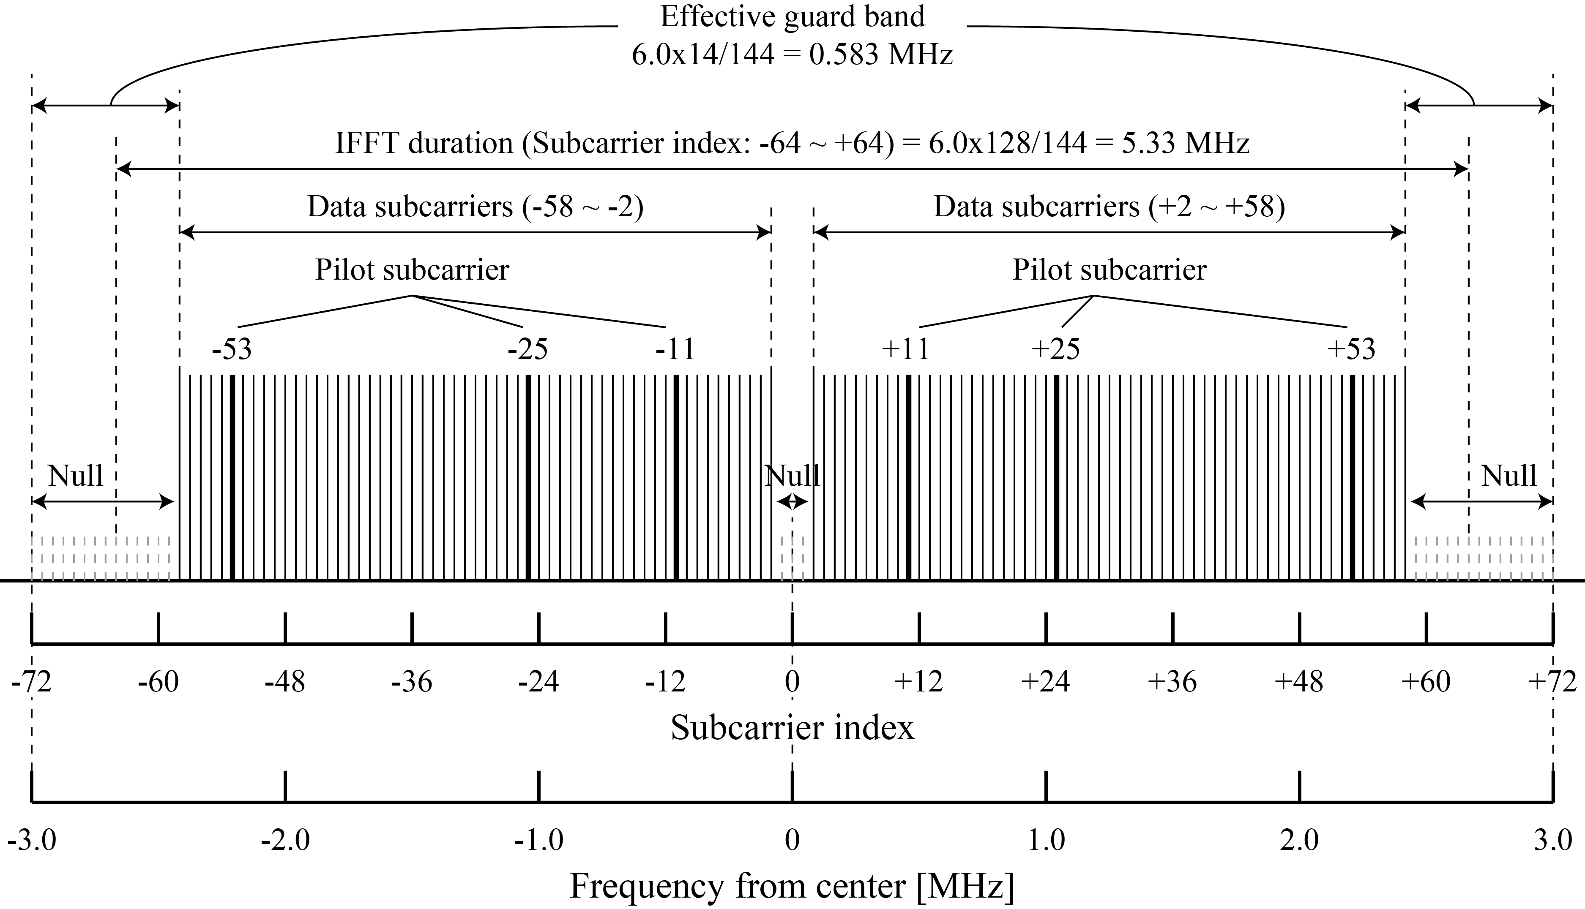
Subcarrier allocation
IEEE802.11af (TVHT_MODE_1)

Slide 10
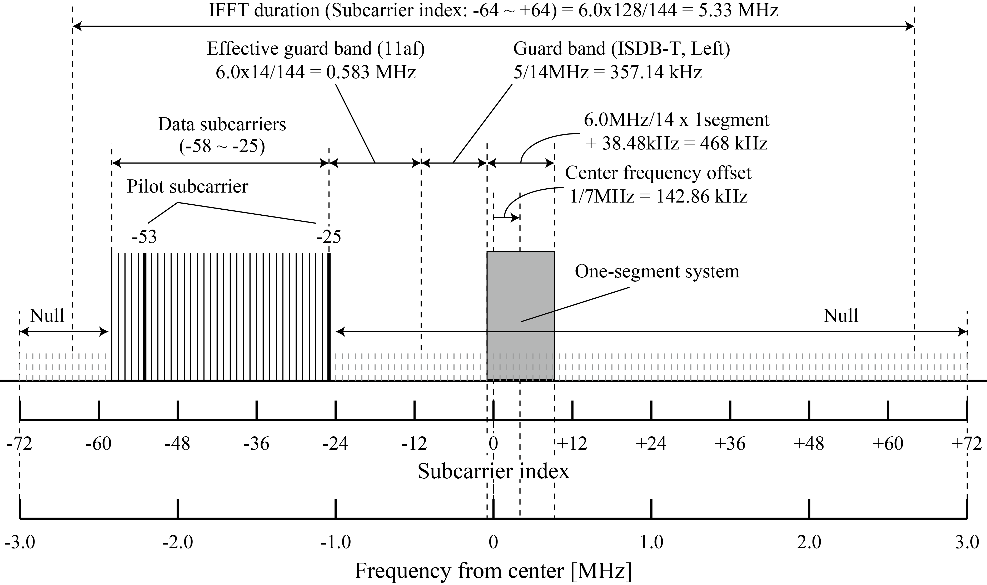
Subcarrier allocation
Partial subcarrier mode (L: left)
  34 subcarriers (32 data, 2 pilot) can be increased

Slide 11
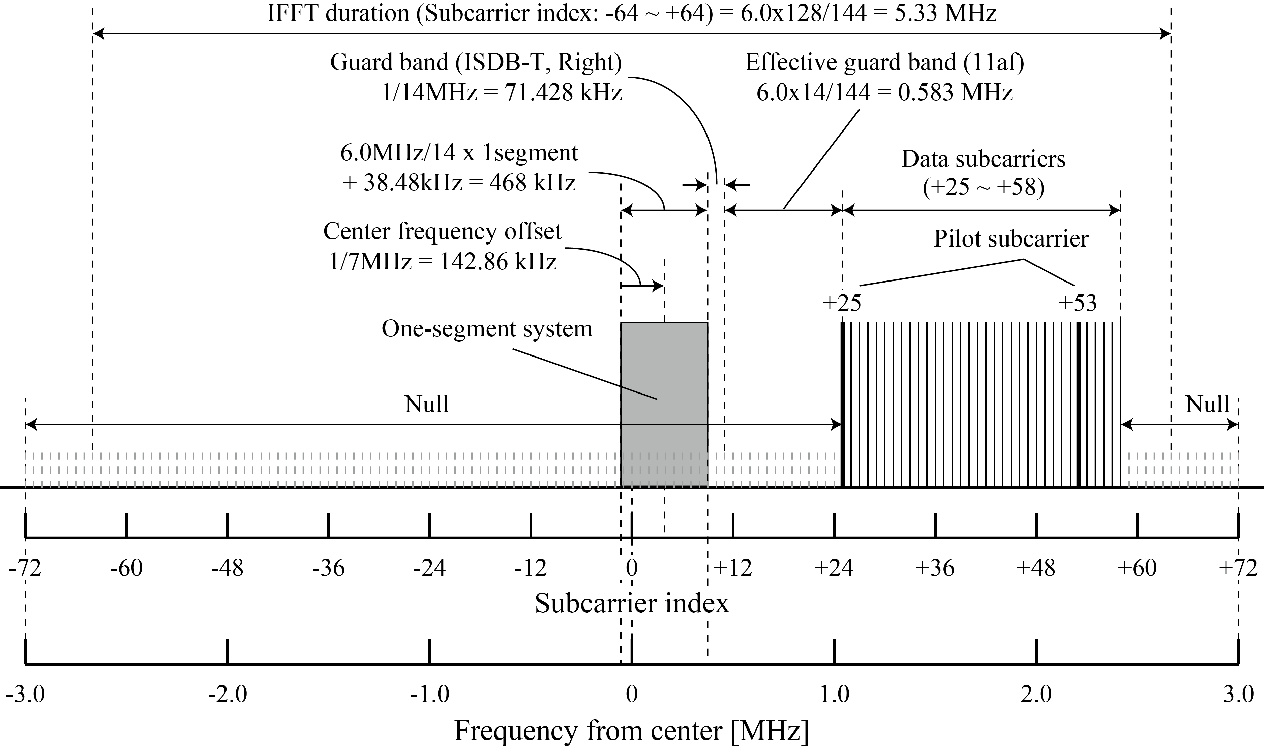
Subcarrier allocation
Partial subcarrier mode (R: right)
  34 subcarriers (32 data, 2 pilot) can be increased

Slide 12
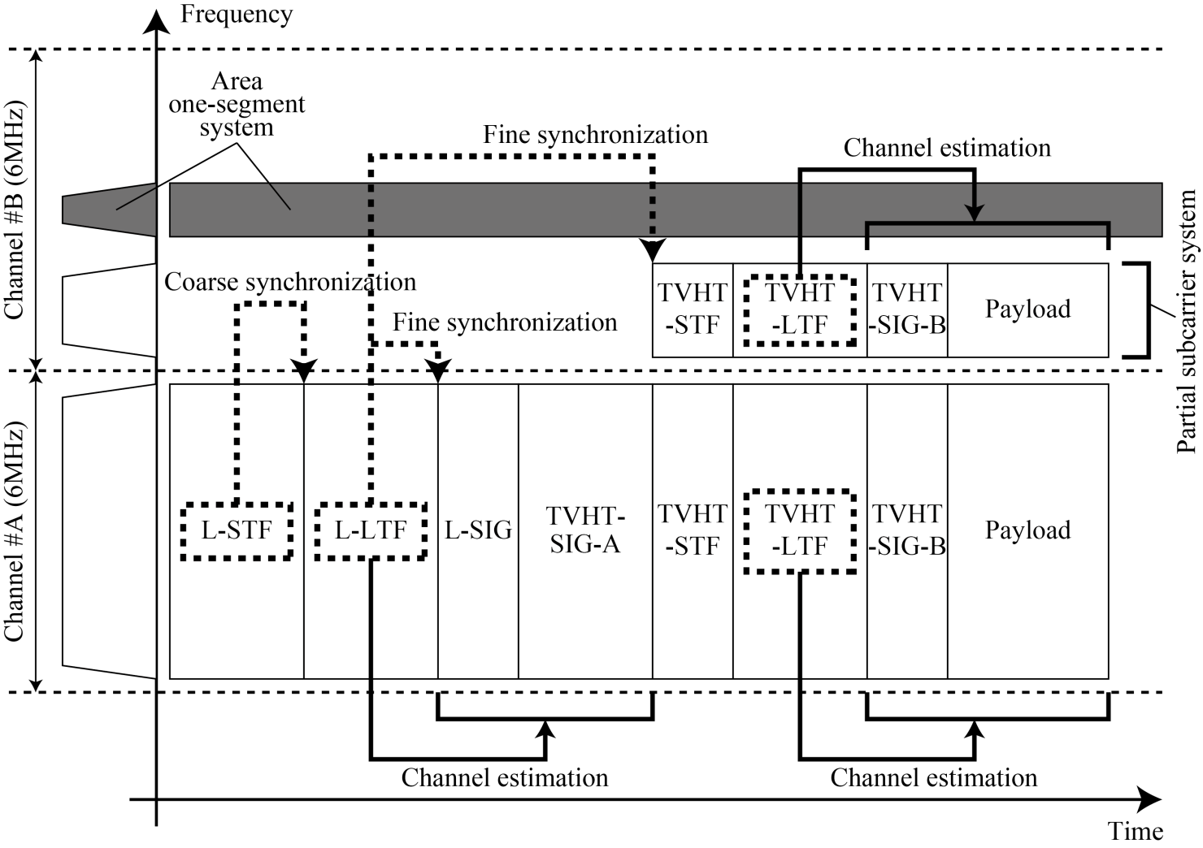
Proposal: Partial subcarrier mode
Frame configuration
  In the partial subcarrier channel, the synchronization information of the adjacent full subcarrier channel is used.

Slide 13
Proposal: Partial subcarrier mode
11af
Area-one-seg
Partial subcarrier usage pattern
MODE | Amount of data subcarriers
TVHT_MODE_2CP_L | (108 + 32) = 140
TVHT_MODE_2CP_R | (32 + 108) = 140
TVHT_MODE_4CP_L | (108 + 108 + 108 + 32) = 356
TVHT_MODE_4CP_R | (32 + 108 + 108 + 108) = 356
TVHT_MODE_4CP_LR | (32 + 108 + 108 + 32) = 280
TVHT_MODE_4NP_LL | (108 + 32) + (108 + 32) = 280
TVHT_MODE_4NP_RR | (32 + 108) + (32 + 108) = 280
TVHT_MODE_4NP_LR | (108 + 32) + (32 + 108) = 280
TVHT_MODE_4NP_RL | (32 + 108) + (108 + 32) = 280

Slide 14
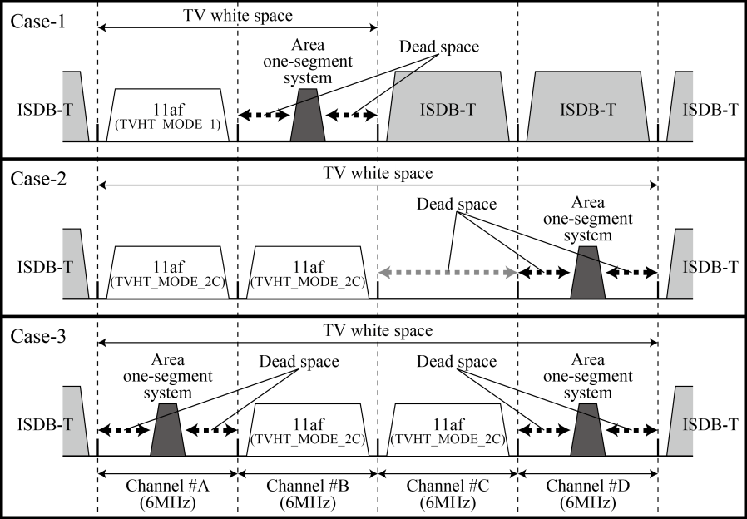
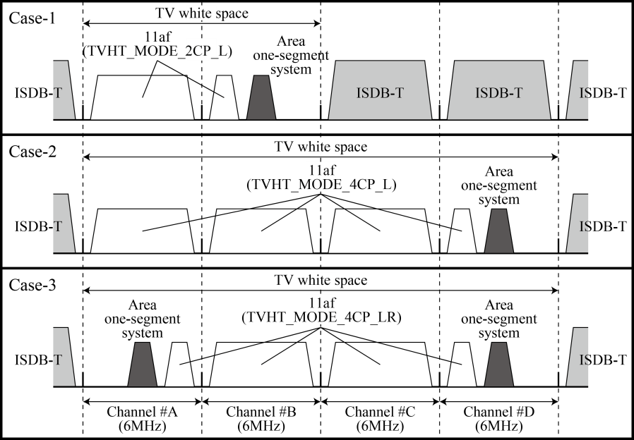
Simulation
Parameter
Parameter | Value
Channel bandwidth | 6 MHz
MCS index | 4 (16QAM, ¾ coding rate, BCC)
GI rate | ¼ long GI
Packet length | 500 octet
Channel model | SCM Urban Micro
Conventional
Proposed

Slide 15
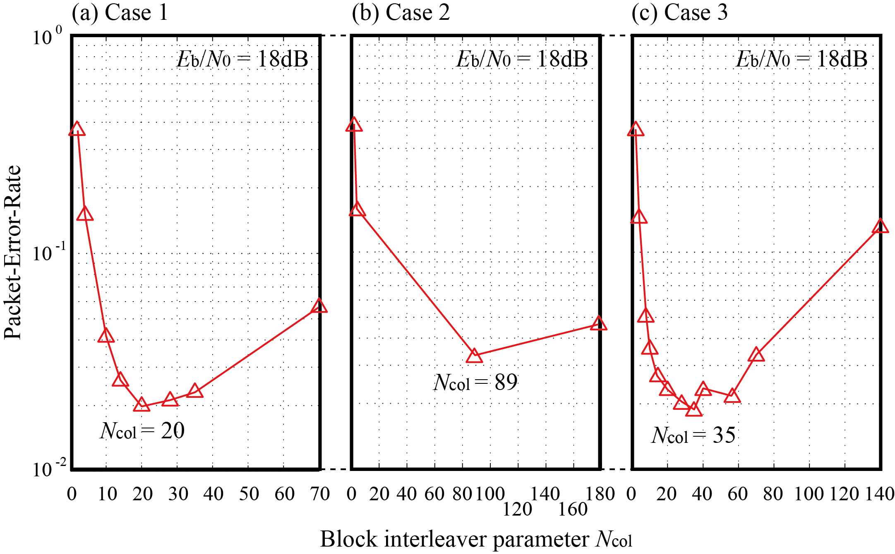
Simulation
Interleave factor

Slide 16
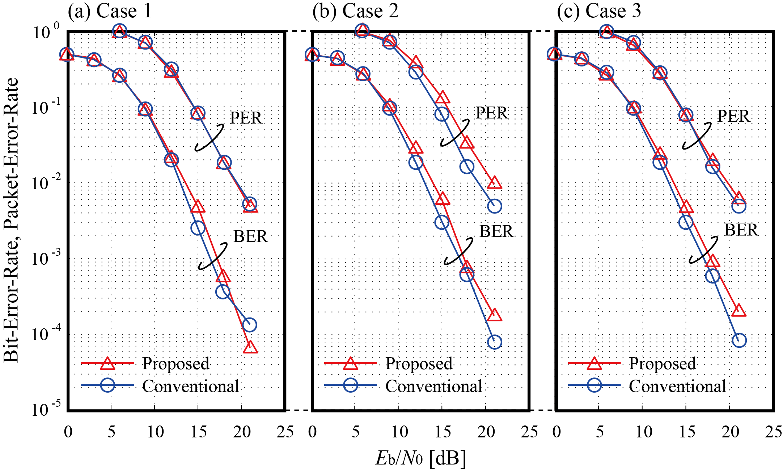
Simulation
BER and PER

Slide 17
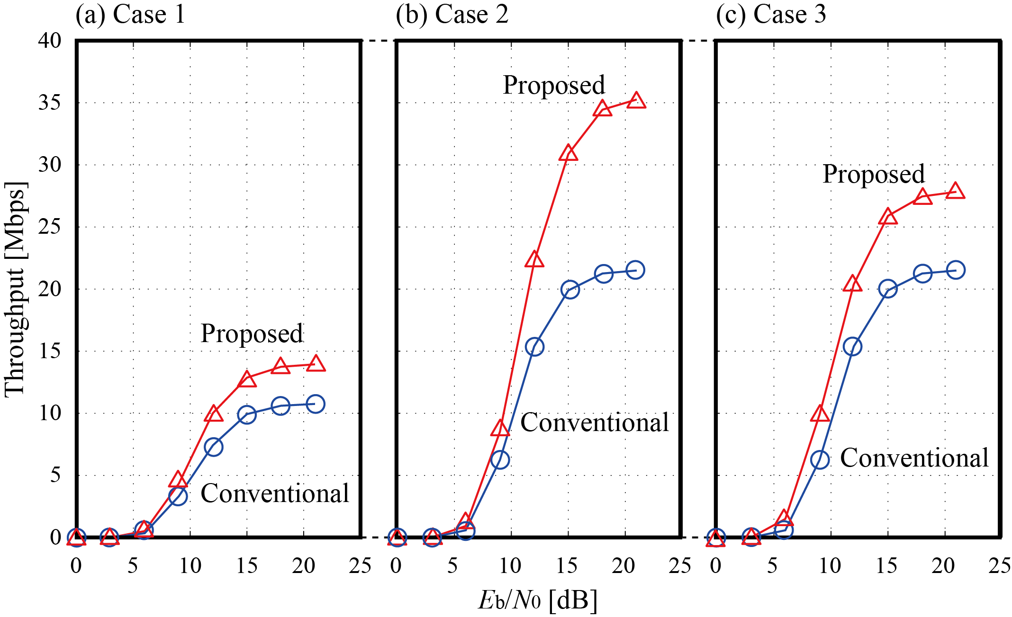
Simulation
Throughput
60% gain
30% gain
30% gain

Slide 18
Conclusion
Partial subcarrier mode is proposed for effective co-existence with ISDB-T area-one-segment system
Amount of subcarriers are 140, 356, 280, and Ncol are 20, 89, 35 respectively.
Throughput can be improved up to 60%.

