Slide 1
Rapid Scanning Procedure
Date: 2012-11-14
Authors:

Slide 2
Abstract
The presentation describes an improvement to the Active Scanning mechanism to reduce the delay on unused channels during the AP discovery phase.
This presentation will focus on comparing the enhancement of Rapid Scan to Active Scan compared to the current status of only using Active Scan.

Slide 3
Conformance w/ TGai PAR & 5C
Conformance Question | Response
Does the proposal degrade the security offered by Robust Security Network Association (RSNA) already defined in 802.11? | No
Does the proposal change the MAC SAP interface? | No
Does the proposal require or introduce a change to the 802.1 architecture? | No
Does the proposal introduce a change in the channel access mechanism? | Yes
Does the proposal introduce a change in the PHY? | No
Which of the following link set-up phases is addressed by the proposal? (1) AP Discovery (2) Network Discovery (3) Link (re-)establishment / exchange of security related messages (4) Higher layer aspects, e.g. IP address assignment | 1

Slide 4
Recap, Active Rapid Scanning
Rapid Scanning was presented during the last meeting:
Benefits include:
  Major latency improvement.
  Major power improvement.
  Does not needlessly load channels without 11ai support.
No response identified STA goes to next channel within < 80usec
~230usec
MAC message
Time uncertainty <
Min_Probe_Response_Time
STA performing
Rapid Scan
Rapid Scan
Request
G1 == SIFS
T
G3 == DIFS
G1
~5.350msec
STA waits 5msec for AP to response than switch to next channel
STA performing
Active Scan
Probe Req
G3
Min_Probe_Response_Time

Slide 5
Recap, Active Rapid Scanning
Rapid Scanning was presented during the last meeting:
Benefits include:
  Major latency improvement.
  Major power improvement.
  Does not needlessly load channels without 11ai support.
MAC message
No response by non 11ai AP. STA goes to next channel within < 80usec
~230usec
Time uncertainty <
Min_Probe_Response_Time
Rapid Scan
Request
G1 == SIFS
STA performing
Rapid Scan
G3 == DIFS
T
G1
STA waits 10-15msec only to discover non 11ai APs on channel.
STA performing
Active Scan
Probe Req
Probe Rsp
ACK
Probe Rsp
ACK
G3
Min_Probe_Response_Time
Max_Probe_Response_Time

Slide 6
Recap, Active Rapid Scanning
Concerns raised on the following:
  Creation of a new control message (action frames are too slow to analyze and acknowledge).
  Replying on ACK for a group broadcast address.
We propose to answer these by using an acknowledged existing Probe Request message to achieve same goal of decreased scan duration.

Slide 7
Using Probe Request for Rapid Scan
By using a OUI and Probe Request
  The OUI indicates a unicast address allocated to indicate FILS capable AP (same as in 11ae).
  The Probe Request message indicates an ACK.
  FILS capable AP acknowledges the Probe Request (non FILS capable AP ignores it).
  STA identifies the ACK frame and continues to decode the medium for at least Min_Probe_Response_time; enabling the receiving of a Probe Response.
  STA acknowledges the Probe Response.
STA performing
Rapid Scan
Probe
Req
ACK
T
ACK
Probe
Response
FILS capable
AP # 1
SIFS
SIFS
T
Min_Probe_Response_Time
MAC message
Time uncertainty <
Min_Probe_Response_Time

Slide 8
Using Probe Request for Rapid Scan
If a single FILS capable AP operates over the channel:
STA performing
Rapid Scan
Probe
Req
ACK
T
ACK
Probe
Response
FILS capable
AP # 1
SIFS
SIFS
T
Min_Probe_Response_Time
MAC message
Time uncertainty <
Min_Probe_Response_Time

Slide 9
Using Probe Request for Rapid Scan
If multiple FILS capable APs operates over the channel:
STA performing
Rapid Scan
Probe
Req
ACK
T
ACK
Probe
Response
FILS capable
AP # 1
T
ACK
Probe
Response
FILS capable
AP # 2
SIFS
SIFS
Min_Probe_Response_Time
DIFS
Max_Probe_Response_Time
MAC message
Time uncertainty <
Min_Probe_Response_Time

Slide 10
Using Probe Request for Rapid Scan
If only non FILS capable APs operates over the channel:
After SIFS + preamble STA switches to another channel.
STA performing
Rapid Scan
Probe
Req
T
Non FILS
Capable AP
Non related
MPDU
SIFS
T
DIFS
MAC message
Time uncertainty <
Min_Probe_Response_Time

Slide 11
Using Probe Request for Rapid Scan
If no AP operates over the channel:
After SIFS + preamble STA switches to another channel.
STA performing
Rapid Scan
Probe
Req
T
Non FILS
Capable AP
SIFS
T
MAC message
Time uncertainty <
Min_Probe_Response_Time

Slide 12
Summary
Benefits of using Probe Request/Response for Rapid Scanning:
  Reuse of existing resources and procedures (management message, ACK procedure).
  Fast separation between regular and FILS capable (~1/10-1/20 of current duration).
  Power efficient procedure enables more frequent polling supporting the faster automatic discovery.
References:
  11-12-1261-00-00ai-probe-request-based-rapid-scan-text.docx
  11-12-1033-02-00ai-rapid-scan.pptx
  11-12-1040-01-00ai-rapid-scan-amendment-text.docx

Slide 13
Motion
Insert the following text on clause 6 of the SFD (11-12/0151r12):
The amendment should define a mechanism to reduce the FILS capable AP presence discovery duration. The procedure will enable the STA to identify FILS capable AP coverage within SIFS plus ACK message delay post request by STA by using decoding an ACK message or using CCA in case of a collision.
Yes:
No:
Abstain:

Slide 14
Backup

Slide 15
Rapid Scan using dedicated message
Post AP coverage STA continues to perform active scanning
Multiple APs respond after SIFS and identified by STA’s CCA
Post AP coverage STA continues to perform active scanning
Post AP coverage STA continues to perform active scanning
STA sends a Rapid Scan Request
AP coverage discovery
Existing Active Scan procedure – AP identity discovery
STA performing
Rapid Scan
Rapid Scan
Request
Probe
Request
T
Responder
# 1
Probe
Response
T
Responder
# 2
T
G1
G3
G1
~230usec
~5-10msec
MAC message
Rapid Scan Ack
Probe Response ACK
Time uncertainty < Min_Probe_Response_Time
G1 == SIFS
G3 == DIFS

Slide 16
Rapid Scan using dedicated message
Post AP coverage STA continues to perform active scanning
Multiple APs respond after SIFS and identified by STA’s CCA
Post AP coverage STA continues to perform active scanning
Post AP coverage STA continues to perform active scanning
STA sends a Rapid Scan Request
AP coverage discovery
Existing Active Scan procedure – AP identity discovery
STA performing
Rapid Scan
Rapid Scan
Request
Probe
Request
T
Responder
# 1
Probe
Response
T
Responder
# 2
T
G1
G3
G1
~230usec
~5-10msec
MAC message
Rapid Scan Ack
Probe Response ACK
Time uncertainty < Min_Probe_Response_Time
G1 == SIFS
G3 == DIFS

Slide 17
Dedicated RSR – clear channel case
No response identified STA goes to next channel within ~80usec
~230usec
STA performing
Rapid Scan
Rapid Scan
Request
STA waits 5msec for AP to response than switch to next channel
T
G1
~5.350msec
STA performing
Active Scan
Probe Req
G3
Min_Probe_Response_Time
MAC message
Time uncertainty <
Min_Probe_Response_Time
G1 == SIFS
G3 == DIFS

Slide 18
Dedicated RSR – in case of non 11ai capable APs
No response identified STA goes to next channel within ~80usec with minimal impact on medium
~230usec
STA performing
Rapid Scan
RSR
STA takes up substantial medium resource.
Procedure takes 10msec to identify no 11ai support.
T
G1
10usec
STA performing
Rapid Scan
Probe
Req
Probe
Response
ACK
Probe
Response
ACK
T
G1
G1
T
G3
Min_Probe_Response_Time
G3
T
Max_Probe_Response_Time = ~10msec

Slide 19
Suggested Improvement – mix of 11ai and non 11ai APs
Post AP coverage STA continues to perform active scanning
Multiple APs respond after SIFS and identified by STA’s CCA
Post AP coverage STA continues to perform active scanning
Post AP coverage STA continues to perform active scanning
STA sends a Rapid Scan Request
AP coverage discovery
Existing Active Scan procedure – AP identity discovery
~
~
STA performing
Rapid Scan
Rapid Scan
Request
Probe
Request
T
~
Probe
Response
~
Responder
# 1
T
~
~
Responder
# 2
T
G1
G3
G1
~230usec
~10msec
MAC message
Rapid Scan Ack
Probe Response ACK
Time uncertainty < Min_Probe_Response_Time
G1 == SIFS
G3 == DIFS

Slide 20
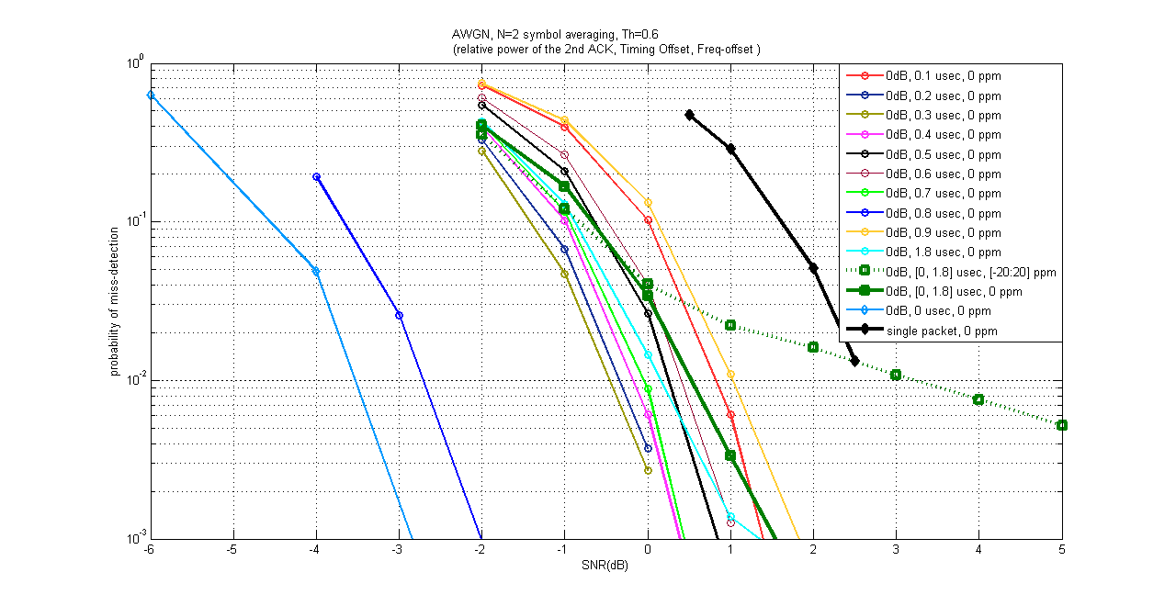
AWGN, Probability of Miss-Detection
Fixed timing offsets, without freq-offset
Addition of P2 increases the received power, and hence P-miss curves detection in negative SNR.
When P1 and P2 are completely aligned it has 6dB improvement compared to a single packet
No symmetry is observed among time delays due to addition of noise and existence of non-overlapped 0.8usec STS

Slide 21
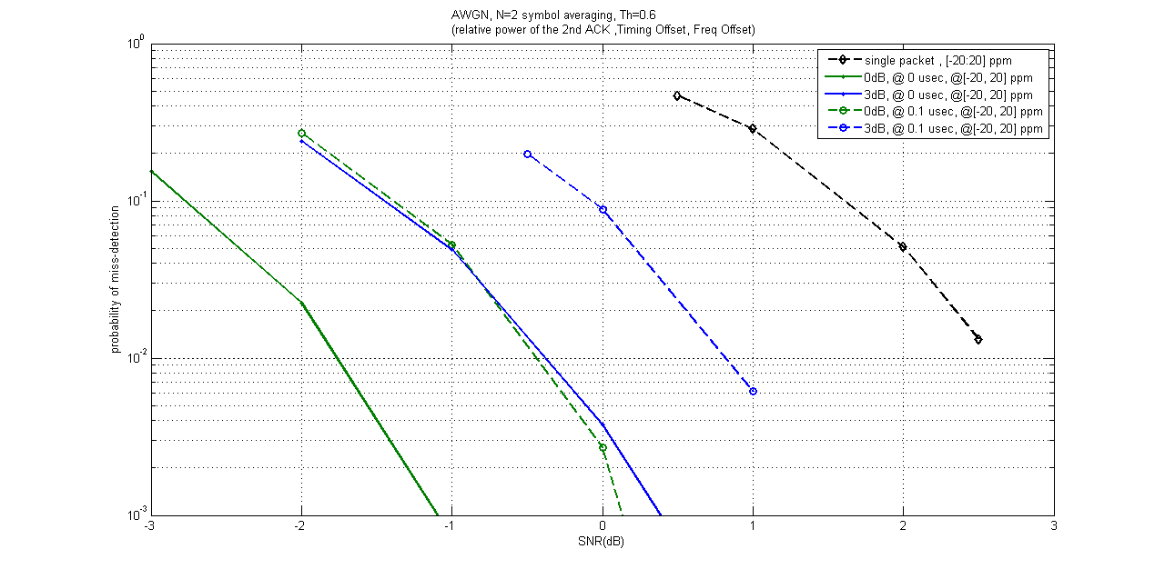
AWGN, Probability of Miss-Detection
0 usec timing, max freq-offset
Combination of time-offset and freq-offset causes performance degradation as expected

Slide 22
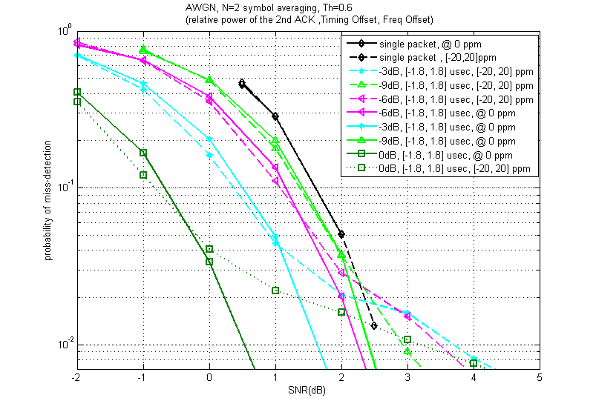
Probability of Miss-Detection AWGN
prob-miss at 10% point (std req) benefits from the additional energy in the 2nd packet
As interference power decreases the negative impact of freq-offset on prob-miss below ~2% diminishes

Slide 23
Summary
Receive of a 2nd packet with different freq-offset and at different timing does not have any negative impact on 90% (std. req) probability of detection, in fact, it benefits from the additional received energy.
  It decreases the slope of the curve for prob-miss below 2% (or slope of the curve for probability of detection above %98), in particular, when two packets are received at same power level, 0.5 dB performance degradation is observed at 1% prob-miss (vs. the std. 10% req) despite the additional energy of the 2nd packet.

