Slide 1
CSN & 802.11 BSS Bridging
Date: 2012-10-15
Authors:

Slide 2
Abstract
This presentation describes how CSNs and 802.11 BSS could be modelized as Distributed L2 Bridge

Slide 3
The issue
802.11 non-AP STA devices are end devices that do not bridge to external networks. This:
  limit the topology of 802.11 BSS to “stub networks”
  do not allow a (STA-)AP-STA wireless link to be used as a connecting path (backbone) between other networks
Partial solutions exist to overcome this lack of bridging functionality but these solutions are:
  proprietary only
  limited to certain type of traffic
  or/and based on Layer 3 (such IP Multicast to MAC Multicast translation, NAT - Network Address Translation)

Slide 4
Coordinated Shared Network (CSN)
Contention-free, time-division multiplexed-access, network of devices sharing a common medium and supporting reserved bandwidth based on priority or flow (QoS).
  one of the nodes of the CSN acts as the network coordinator, granting transmission opportunities to the other nodes of the network.
Physically a shared medium, in that a CSN node has a single physical port connected to the half-duplex medium,
but logically a fully-connected one-hop mesh network, in that every node can transmit frames to every other node over the shared medium.
Supports two types of transmission:
  unicast transmission for point-to-point (node-to-node)
  transmission and multicast/broadcast transmission for point-to-multipoint (node-to-other/all-nodes) transmission.

Slide 5
(GW Centric) Heterogeneous Home Network

Slide 6
Heterogeneous Network Bridge Model

Slide 7
Heterogeneous Network Bridge Model - 1

Slide 8
GW Centric Home Network – P2P Model

Slide 9
Hidden Nodes…
On both 802.11 and 1901 networks, nodes could be hidden to other nodes…
…but both 802.11 AP and 1901 CCo see all nodes
AP
CCo
STA 1
STA 3
Node 1
Node
3
X
X
STA 2
Node 2
Relaying

Slide 10
CSNs behave as L2 Bridges…
Eth Port_3
CTRL plane
Eth Bridge
L2 Bridge
Eth Port_1
Eth Port_2
BPDU
Port Cmd
Unicast Eth PDU
FWD Engine
Multicast Eth PDU
Broadcast Eth PDU
Eth Port_4
Ctrl Network Protocol Entities
Eth Port_3
“Ctrl Plane”
Node 3
“Selected Node”
CSN Network
Eth Port_1
Port Cmd
Eth Port_2
BPDU
Unicast Eth PDU
FWD
Multicast Eth PDU
Broadcast Eth PDU
Node 1
Node 2
Node 4
CSN Network
Eth Port_4

Slide 11
CSN as Distributed Bridge - Pros
10 12
Scalable:
  Single bridge per CSN regardless # of nodes
    vs P2P mesh where each node is a bridge
Optimized for “heavy”/”light” nodes
  (single ctrl plane node + n-1 “dumb” ports rather than n bridges)
No duplication of resources
  1 single Ctrl plane entity per CSN
Reuse of standard L2 Ctrl protocol entities
  requires only a simple adaptation layer
  (cf “White Paper: Control Plane Implementation on Coordinated Shared Networks (CSN)”
  http://www.ieee802.org/1/files/public/docs2011/avb-phkl-wp-csn-ctrl-plane-1111-v01.pdf )

Slide 12
CSN as Distributed Bridge – Pros (cont.)
10 12
Support ranking
  without modification of the underlying network protocol
Network agnostic interface to underlying network
  simple interface
  CSN bridging method is kept “internal” (including “node relaying” when applicable)
This model is already used by MSRP for CSN and 802.11 BBS (IEEE 802.1Q-2011, Annex C)

Slide 13
Selected Node Architecture
Route BPDU to BP service
Provide BPDU with CSN network
topological information
BP Service
BPDU
Node IDs
QoS Cmd
Ethernet Port
SN
Device
Management
MAC
PHY

Slide 14
BPDU Propagation over CSN
Ingress Node i
Selected Node d
BP Service
Ethernet CSN
BPDU
BPDU
I_NID
D_NID
BPDU , I_NID
MC Frame
CSN (Unicast) BPDU Ctrl Frame
BPDU Msg &
Ingress Node ID
Egress Node e
Ethernet CSN
CSN Unicast MPDU
BPDU MC Frame & Destination Node ID
BPDU
BPDU
D_NID
E_NID
BPDU , E_NID
Port_CMD
D_NID
E_NID
Port_Cmd
Egress Node f
CSN (Unicast) Port_Cmd Ctrl Frame
Ethernet CSN
CSN Unicast MPDU
BPDU MC Frame & Destination Node ID
BPDU
BPDU
D_NID
F_NID
BPDU , F_NID
Port_CMD
D_NID
E_NID
Port_Cmd
CSN (Unicast) Port_Cmd Ctrl Frame

Slide 15
MSRP Example

Slide 16
Heterogeneous Network Bridge Model - 2

Slide 17
GW Centric Home Network – Bridge Model

Slide 18

Heterogeneous Networks are Bridged LANs
802.11 BSS handled as other CSN networks
802.1 Bridge
802.1 Port
802.1 Port
802.1 Port
802.1 Port
802.3 MSDUs
802.1 Port
802.1
Bridge
MoCA
Node
802.1 Port
1901
Node
802.1 Port
802.11 STA/Bridge
802.1 Port
MoCA
Network
1901
Network
802.11
“Bridging”
BSS
Bridges
MoCA
Node
1901
Node
802.11 STA/Bridge
802.1 Port
802.1 Port
802.1 Port
802.1 Port
802.3 MSDUs
802.1 Bridge
802.1 Port
802.1 Port
802.1 Port
802.1 Port

Slide 19
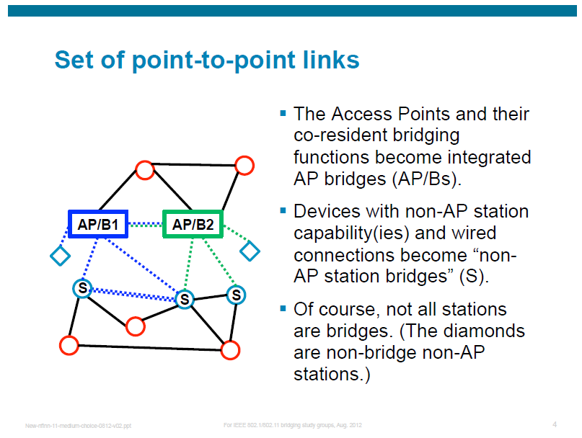
Reminder – Model #1: P2P Link Model
Source - Norm Finn’s presentation www.ieee802.org/1/files/public/docs2012/new-nfinn-11-medium-choice-0812-v02.pdf

Slide 20
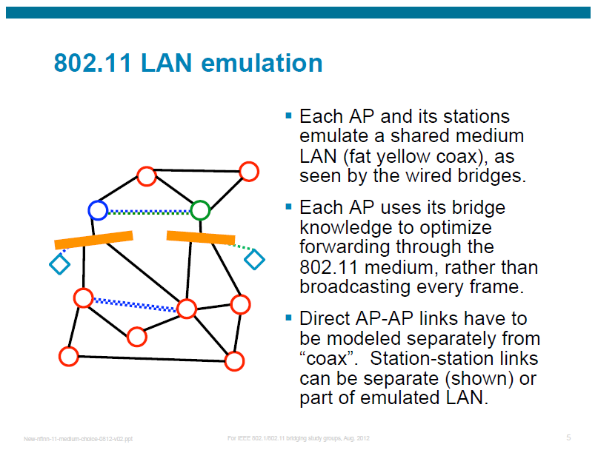
Reminder – Model #2 : Emulated LAN Model
Source - Norm Finn’s presentation www.ieee802.org/1/files/public/docs2012/new-nfinn-11-medium-choice-0812-v02.pdf

Slide 21
Proposal - Model #3 : Emulated Bridge Model
Each BSS (Access Point and its non-AP stations) emulate a single, separated bridge [B1] [B2].
An AP with wired connections is logically separated into an BBS bridge port (AP) and a wired bridge (B).
Each non-AP station/bridge is logically separated into an BSS bridge port and a (virtual) wired bridge (B) (with wires to each component).
B
B
AP1
AP2
B1
B2
S
S
S
S
B
B
B
Based on slide, courtesy of Norm Finn

Slide 22
BSS Bridging Model

Slide 23
BSS Bridging Model (Single Ctrl Plane)
L2 Bridge Protocol
Ctrl Entity
BPDU
Port Ctrl (Action Frame)
BPDU

Slide 24
New AP Bridging Traffic Type

Slide 25
AP Bridging
BSS
Bridging Table
DA | RA
MAC_1 | MAC_2
MAC_5 | MAC_4
SA
[MAC_1]
STA
[MAC_2]
AP
[MAC_3]
STA
[MAC_4]
DA
[MAC_5]
MSDU
DA = MAC_5 SA = MAC_1
FromDS = 1 ToDS = 1
FromDS = 1 ToDS = 1
DA = MAC_5 SA = MAC_1
DA = MAC_5 SA = MAC_1
DA = MAC_5 SA = MAC_1
TA = MAC_2 RA = MAC_3
TA = MAC_3 RA = MAC_4

Slide 26
BSS Bridging
The whole BSS is modeled as a distributed bridge overlaying the 802.11 protocol
  AP acts as the Bridge’s Control Plane
  Non-AP Stations act as Bridge Ports

Slide 27
BSS Bridging (cont.)
Modifications to 802.11 are limited to:
  [ToDS=Set , FromDS=Set] mode behavior redefined at ingress AP and ingress non-AP Stations
  Broadcast “Echo Cancellation” Method <TBD> Could be:
  APs broadcast MSDUs without modifying the Sequence Number & non-Stations filter out broadcasted MSDUs they originated on SN matches
  Non-Stations filter out broadcasted MSDUs they originated on TID matches
  Additional Parameters to MLME-DLS primitives

Slide 28
Addition to the 802.11 Standard
New Element in Beacon and Probe Response
  AP indicates it BSS Bridging Capability in a new BSS Bridging Element in Beacon and Probe Response
  AP BSS bridging Capability is controlled by a dot11BSSBridgingCapabilityEnabled parameter
New Action Frames <TBD>
  AP control to non-Station ports (i.e. block port…)

Slide 29
New [To DS = Set, From DS = Set] Handling
Non-AP Station originated MSDU received by AP:
  AP performs a lookup to the AP Bridging table with the Destination Address (DA) to retrieve the MAC address of the non-AP Station bridging the DA and use it as the Receiver Address (RA) of the forwarded MSDU
  MSDU with unknown or Multicast DA addresses are broadcasted by the AP
AP originated MSDU received by non-AP Station:
  If the DA is a Broadcast/Multicast Address, the non-AP Station checks the MSDU Sequence Number or TDI ( to match any of the SNs (or TIDs) of the latest Multicast MSDUs by this non-AP Station:
    If match, the non-AP Station discards the receive frame
    Otherwise the non-AP Station extracts the (DA,SA) and uses them as the (DA,SA) of the MSDU bridged by the non-AP Station

Slide 30
New DLS Bridging Traffic Type

Slide 31
DLS Mode Bridging
For Direct Link Setup mode, a new MLME-BDLS request primitive could be specified with the DA MAC address replacing the non-AP Station MAC address as parameter:
MLME-BDLS.request (
PeerDAMACAddress,
DLSTimeoutValue,
DLSResponseTimeout)
The associated confirm primitive returns the non-AP Station MAC address bridging the DA MAC address :
MLME-BDLS.confirm (
PeerDAMACAddress,
PeerSTAMACAddress,
ResultCode,
CapabilityInformation,
DLSTimeoutValue,
SupportedRates)

Slide 32
GW Centric Heterogeneous Home Network

Slide 33
GW Centric Data Planes
GW is the Designated Node for each CSN:
CSN Bridge Data Planes are co-hosted on the GW

Slide 34
GW Centric Data Plane
For Network Control Protocols (such RSTP)
  each CSN bridge runs its owns control plane
  same 802.1 standard protocol entity instantiated per CSN bridge
Standard NCP entity
Standard NCP entity
Standard NCP entity
NCP Primitives
NCP Primitives
NCP Primitives
CSN_k network specific APIs
CSN_l network specific APIs
CSN_m network specific APIs
For Network Service Protocols (such MSRP)
  a single control plane for all the CSNs
  NSP primitives mapped to each CSN specific APIs
Standard NSP entity
NSP Primitives
CSN_k network specific APIs
CSN_l network specific APIs
CSN_m network specific APIs

Slide 35
GW Centric Data Plane
Optimized case for IS-IS:
  Single IS-IS Database
  Immediate topology change “propagation”
    Immediate coherency
    No traffic overhead between bridges
    Optimized resource
IS-IS Database
CSN_k Ctrl Plane
CSN_l Ctrl Plane
CSN_m Ctrl Plane

Slide 36
References
  [1] White Paper: Control Plane Implementation on Coordinated Shared Networks (CSN): http://www.ieee802.org/1/files/public/docs2011/avb-phkl-wp-csn-ctrl-plane-1111-v01.pdf
  [2] IEEE 802.1Q-2011, Annex C http://standards.ieee.org/getieee802/download/802.1Q-2011.pdf

