Slide 1
Data Rate and Spectrum Requirements for
IEEE 802.11aj (45 GHz)
Date: 2012-09-27
Authors:

Slide 2
Outline
Review of PAR of IEEE 802.11aj (45GHz)
Prediction of Data Rate Requirements
Spectrum in Chinese 45 GHz Band
Initial Results of Channel Measurements
Notes:
This presentation is outlined into four parts.
Let’s review the PAR of IEEE 802.11aj at 45 GHz.

Slide 3
IEEE 802.11aj (45GHz) PAR
Scope of the project:
  The amendment also defines modifications to the PHY and MAC layers to enable the operation in the Chinese 45 GHz frequency band. The amendment maintains the 802.11 user experience.
Need for the project:
  The Chinese WPAN group has made a request to the Radio Management Bureau of the Ministry of Industry and Information Technology of the People's Republic of China for the use of the 45 GHz (43.5~47 GHz) frequency band.
  As the 45 GHz frequency band has better propagation characteristics than the 60 GHz frequency band, this amendment enables larger coverage area and portable devices with lower-power supporting more application scenarios than 802.11ad.
Expected Date of submission of draft to the IEEE-SA for Initial Sponsor Ballot: 07/2015
Notes:
In the scope of this project, the amendment not only defines a new PHY layer but also a new MAC layer. Of course, this amendment shall maintain the 802.11 user experience.
A request for the Chinese 45 GHz band has been submitted to the radio management bureau of the MIIT. And Mr. Chang who is the official of the radio management bureau mentioned this request in this Monday’s forum.
In July 2015, the draft of 11aj will be submitted to the IEEE-SA.

Slide 4
Outline
Review of PAR of IEEE 802.11aj (45GHz)
Prediction of Data Rate Requirements
Spectrum in Chinese 45 GHz Band
Initial Results of Channel Measurements
Notes:
Part two gives our prediction of data rate requirements for the new WLAN systems.

Slide 5
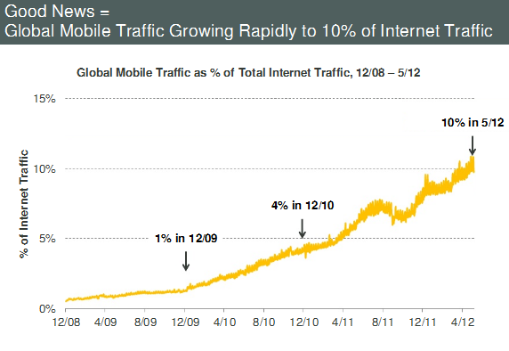
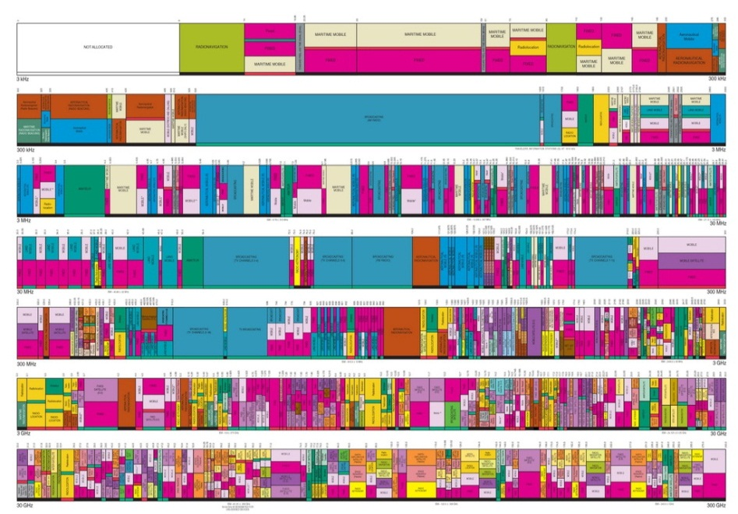
Mobile Traffic
In May 2012, global mobile traffic exceeds 10% of total Internet traffic, and it still grows very rapidly.
Mobile
Internet Traffic
Spectrum
A few hundred MHz of spectrum has been allocated to WLAN application below 6 GHz.
Notes:
In the past a few years, the mobile traffic grows rapidly thanks to the explosion of smart devices such as smart phones and all kinds of tablets. In this May, the global mobile traffic exceeds 10 percent of the total Internet traffic. And it still grows rapidly.
The mobile operators are eager to offload traffic from the conventional cellular networks. For example, China big three mobile operators China Mobile, China Telecom and China Unicom have built millions of WiFi hotspots in the past two years. And more and more WiFi APs will be built.
2) However, only a few hundred MHz of spectrum has been allocated to WLAN application below 6 GHz.
3) In the mean time, a lot of bandwidth in millimeter-wave band is not used.
4) So, can we use mmWave band for short-range mobile traffic?

Slide 6
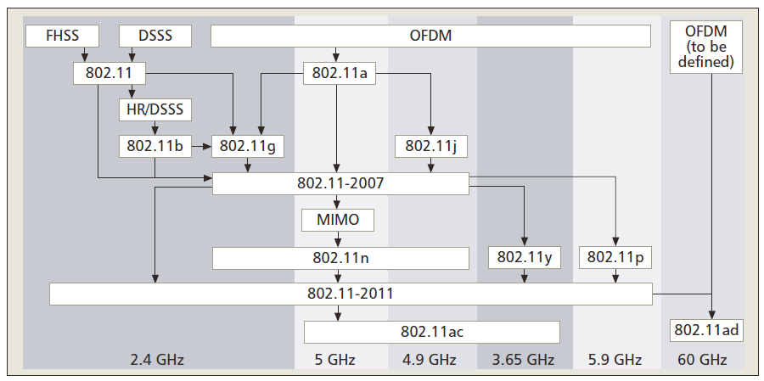
IEEE 802.11 PHY Layers
802.11aj
45 GHz
* G. R. Hietrtz, et al., “The IEEE 802.11 Universe,” IEEE Commun. Mag., pp. 61-68, Jan. 2010
Notes:
This slide shows all available IEEE 802.11 PHY layers. The 11aj (45 GHz) uses a new frequency band. And new PHY and MAC layers are expected using state-of-art research results.

Slide 7
Data Rates of IEEE 802.11 WLAN PHYs
No. | M./Y. | PHY | Data Rate
1 | 3/1999 | IEEE 802.11 | 2 Mbps (20 MHz) @ 2.4GHz
2 | 9/1999 | IEEE 802.11b | 11 Mbps (20 MHz) @ 2.4GHz
3 | 9/1999 | IEEE 802.11a | 54 Mbps (20 MHz) @ 5.8GHz
3 | 6/2003 | IEEE 802.11g | 54 Mbps (20 MHz) @ 2.4GHz
4 | 9/2009 | IEEE 802.11n | 600 Mbps (HT) (40 MHz) @ 2.4 GHz and 5 GHz
5 | 12/2012 | IEEE 802.11ad | ~7Gbps (VHT) (2160MHz) @ 60 GHz
6 | 2014 | IEEE 802.11ac | ~7Gbps (VHT) (160MHz) @ 5 GHz
7 | 2016 | IEEE 802.11aj (45GHz) | >10 Gbps (UHT) @ 45 GHz
Notes:
1) In this slide, we show that maximum data rates of all kinds of 802.11 PHY layers. In our opinion, the maximum data rate of greater than 10 Gbps is required for 11aj (45 GHz) to satisfy the next-round mobile traffic growth.
2) By the way, Gbps Ethernet and HT WLAN are very common today. Obviously, Ten-Gbps Ethernet and VHT WLAN will be commonly used soon. Therefore, we need to continue to develop a new WLAN standard to achieve the UHT WLAN or the Ten-Gbps WLAN.

Slide 8
Outline
Review of PAR of IEEE 802.11aj (45GHz)
Prediction of Data Rate Requirements
Spectrum in Chinese 45 GHz Band
Initial Results of Channel Measurements
Notes:
Part three discusses the spectrum in the Chinese 45 GHz.

Slide 9
Bandwidth vs. Data Rate
Standard | BW | Maximum Data Rate | Coding and Modulation
GSM/EDGE/ EDGE + | 200 kHz | 14.4 kbps (GSM) (1 slot) 473.6 kbps (8 slots, EDGE) 1.89 Mbps (8 slots, EDGE+) | GMSK (GSM) 8PSK (EDGE) QPSK, 16QAM, 32QAM (EDGE+)
EVDO Rev. B | 5 MHz (3X) | 14.7 Mbps | 64QAM, rate 1/3, rate matching
HSPA+, R7/R8 | 5 MHz | DL: 28 Mbit/s (MIMO 2x2, 16QAM) DL: 42.2 Mbit/s (MIMO 2x2, 64QAM) | DL: QPSK, 16QAM, 64QAM UL: Dual BPSK, 16QAM
3GPP LTE | 1.4, 3, 5, 10, 15, 20 MHz | 326.4 Mbps for MIMO 4x4 172.8 Mbps for MIMO 2x2 | QPSK, 16QAM, 64QAM, code rate: 1/3, rate matching
IEEE 802.11n | 20 MHz | 288.8 Mbps (4 data streams) | 64QAM, code rate: 5/6
 | 40 MHz | 600 Mbps (4 data streams)
IEEE 802.11ac | 20, 40, 80, 160 MHz | 6933 Mbps (8 data streams, BW=160MHz) | Mod: BPSK, QPSK, 16QAM, 64QAM, 256QAM, code rate: 1/2, 2/3, 3/4, 5/6
IEEE 802.11ad | 2.16 GHz | 6756.75 Mbps (OFDM PHY) | 64QAM, code rate: 13/16
IEEE 802.15.3c | 2.16 GHz | 5775 Mbps | 64QAM, code rate: 5/8
Notes:
Before talking about the 45 GHz spectrum, let’s review the bandwidth and the maximum data rate for different wireless communications standards.
For the very widely used GSM standard, only 200 kHz bandwidth is used and the maximum data rate is less than 2 Mbps even for the evolved version EDGE+.
For the nearly deployed 3GPP LTE systems, the bandwidth is flexible. There are six configurations. When 4x4 MIMO is used, the maximum data rate is slightly greater than 300Mbps.
The developing 11ac, the maximum wide bandwidth is 160 MHz and the maximum data rate is expected to be about 7 Gbps when 8-data stream Multi-User MIMO technology is used.
For 11ad and 15.3c, the channel bandwidth is all 2.16 GHz and the maximum data rate is also about 7 Gbps. I think that this configuration means multi-Gbps is achieved using greater than 1 GHz bandwidth in millimeter-wave band.

Slide 10
RF parameters
Parameter | Value
Frequency range: | 43.5~47 GHz
Carrier frequencies: | Consider the reference crystal frequency 27 MHz
Bandwidth: | 270 MHz (216 MHz), 540 MHz (432 MHz), 1.08 GHz (864 MHz)
Spurious emission: | Transmit Mask refers to IEEE 802.11ad, using normalized BW B₀
Antenna: | Using integrated antenna
Maximum Tx power: | +20dBm (Antenna port)
Tx frequency tolerance: | 100×10⁻⁶
ACLR: | -30dBc
Notes:
This slide shows the RF parameters for 45 GHz 11aj. There is 3.5 GHz bandwidth available. Three bandwidth configurations are considered. And other parameters are also defined.

Slide 11
Channelization and Carrier Frequencies
CH ID | Carrier Frequency f_{c}（GHz）
 | B₀=270 MHz | B₀=540 MHz | B₀=1080 MHz
1 | 43.74 | 43.875
2 | 44.01 |  | 44.145
3 | 44.28 | 44.415
4 | 44.55
5 | 44.82 | 44.955
6 | 45.09 |  | 45.225
7 | 45.36 | 45.495
8 | 45.63
9 | 45.90 | 46.035
10 | 46.17 |  | 46.305
11 | 46.44 | 46.575
12 | 46.71

Slide 12
EIRP of Unlicensed 45 GHz Band
Point-to-Multipoint |  |  | Point-to-Point
Tx Power (Antenna Port)（dBm） | Max Antenna Gain（dBi） | EIRP (dBm) | Tx Power (Antenna Port)（dBm） | Max Antenna Gain（dBi） | EIRP (dBm)
20 | 6 | 26 | 20 | 6 | 26
17 | 9 | 26 | 19 | 9 | 28
14 | 12 | 26 | 18 | 12 | 30
11 | 15 | 26 | 17 | 15 | 32
8 | 18 | 26 | 16 | 18 | 34
5 | 21 | 26 | 15 | 21 | 36
2 | 24 | 26 | 14 | 24 | 38
 |  |  | 13 | 27 | 40
 |  |  | 12 | 30 | 42
 |  |  | 11 | 33 | 44
 |  |  | 10 | 36 | 46
Notes:
Slide 12 shows the maximum EIRP for two communications scenarios. One is point-to-multipoint scenario and this is for WLAN systems. The other one is point-to-point link. The second configuration is expected to be used for long-range communications. By the way, the maximum EIRP is 46 dBm.

Slide 13
Outline
Review of PAR of IEEE 802.11aj (45GHz)
Prediction of Data Rate Requirements
Spectrum in 45 GHz
Initial Results of Channel Measurements
Notes:
The last part presents our initial results of channel measurements at 45 GHz.

Slide 14
Q-band Channel Measurement: Parameters
Parameter | Value
Frequency band | 40~43.5 GHz
Method | VNA Sweep Frequency
Sweep Frequency Points | 12801
Sweep Frequency Duration | 300 ms
TX Power | 20 dBm
Cable Length | 4 m at both ends
Antenna | Horn antenna with 24.7 dBi gain
Measurement Scenario | Indoor

Slide 15
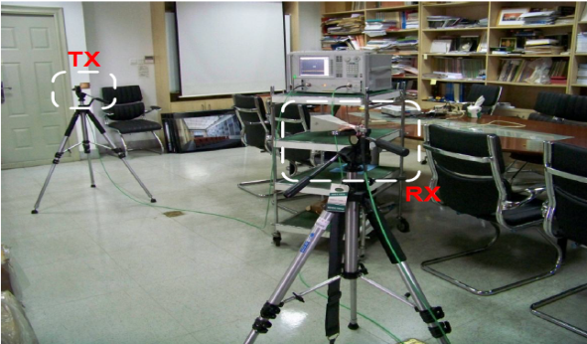
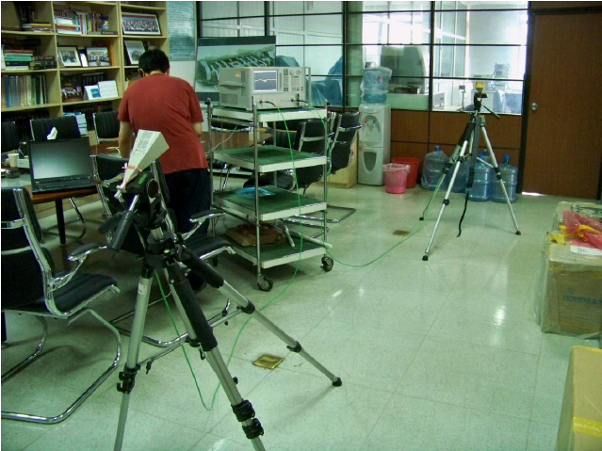
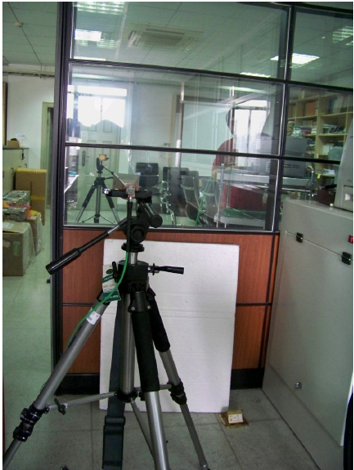
Q-band Channel Measurement: Scenarios
S1: Horn antennas are face-to-face without block. The TR distance is 3 m and height is 1.15 m.
S2: Horn antennas are toward the ceiling without block. The TR distance is 3 m.
S3: Horn antennas are face-to-face across a glass window door. The TR distance is 3 m and the height is 1.15 m.
S4: Horn antennas are face-to-face across a fiberboard door. The TR distance is 3 m and the height is 1.15 m.

Slide 16

Q-band Channel Measurement: Scenarios
Reflection Plane
S5: Horn antennas face to the bookcase. The transmitted signal is reflected by the bookcase. The TR distance is 3 m and the height is 1.15 m.
S6: Horn antennas are face-to-face across a concrete wall with thickness about 24 cm. The additional path loss is greater than 35 dB. The VNA can not receive any signal. So no data has been recorded.

Slide 17
Q-band Channel Measurement: Path Loss
The measured average path loss is about 76 dB at the TR distance 3 m. The dynamic range of received signal is about 35 dB.
* The values of the y axis do not consider the total gains of Tx and Rx antennas, 49.4 dBi.

Slide 18
Q-band Channel Measurement: Multipath Delay Spread
With channel frequency response recorded using the VNA, the channel impulse response can be calculated using IFFT. Then the multipath delay spread is obtained.

Slide 19
Thank you for your attention!

