Slide 1
TIM Compression for No Buffered Unicast Traffic
Date: 2012-09-17
Authors:

Slide 4
Introduction
In order to support a large number of STAs，Block-level TIM encoding method [1] was accepted as the baseline of TIM structure in TGah specification framework document (SFD).
We propose to further promote the design by clarifying how to encode the TIM when there is no buffered individually addressed data for any STA with the same page index, and when there are buffered group addressed data.

Slide 5
What’s that done in 11n?
As defined in 802.11-2012, the TIM element contains four fields: DTIM Count, DTIM Period, Bitmap Control, and Partial Virtual Bitmap.
  Bit 0 of the Bitmap Control field contains the Traffic Indicator bit for group addressed MSDUs/MMPDUs buffered at the AP.
  The remaining 7 bits of the Bitmap Control field form the Bitmap Offset.
When there is no buffered individually addressed data for any STA,
  The TIM element has to be sent to update DTIM count and to broadcast DTIM Period.
  The Partial Virtual Bitmap field is encoded as a single octet equal to 0, which informs the receivers of no buffered unicast traffic.
  The Bitmap Offset subfield is 0, and the Length field is 4.

Slide 6
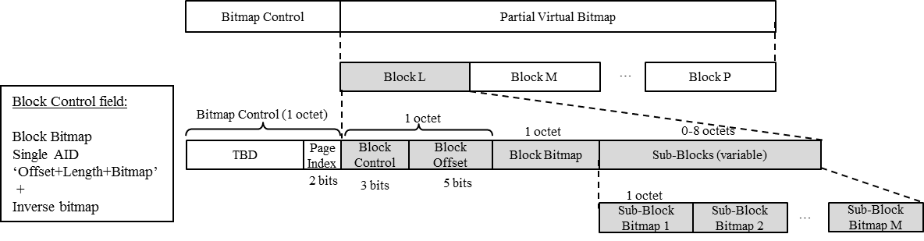
A brief of accepted TIM format in TGah SFD
Block-level TIM encoding method[1]
Block bitmap encoding:
  The n-th bit position of the Block Bitmap indicates whether the n-th Sub-Block Bitmap is present in the Sub-Block field
  The m-th bit position of the Sub-Block Bitmap indicates whether the m-th STA has data buffered at the AP
Single AID:
  When there is a single AID in a Block, 6 bits of the Block Bitmap field is used to indicate the 6 LSBs of the AID
Inverse bitmap:
  if there are many 1s in the bitmap of a Block, inverse the bitmap and encode the inversed bitmap
Offset+Length+Bitmap: encodes more than 8 Sub-Block Bitmaps
  The Block Bitmap field is used to indicate the length of Sub-Block Bitmaps following the Block Bitmap field.

Slide 7
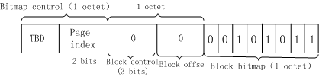
Why 802.11-2012 method cannot be reused for indicating no buffered unicast traffic?
Based on the Block-level TIM encoding method[1], Block bitmap encoding mode might be used where there is no buffered individually addressed data for any STA within the same page
If reuse 802.11-2012 method to indicate no buffered unicast traffic, both Block control and Block offset subfield should be encoded as a single octet equal to 0 which may cause ambiguity.
  As defined in current Block-level TIM encoding method, 3-bit block Control subfield is set to 0 to indicate bitmap encoding mode, 5-bit block offset subfield is set to 0 to indicate block with offset “0”.

Slide 8
Proposed TIM Encoding
Based on accepted TIM format, 2 options could be used to indicate no buffered unicast traffic for any STA with the same page index :
  Option 1: Using dedicated Length field value in TIM so that the TIM does not include the encoded TIM bitmap
  Option 2: Define one new mode in block control field
Further, current 802.11 method can be reused to indicate group addressed buffered data
  Bit 0 of the bitmap control field is set to 1 with a value of 0 in the DTIM Count field when one or more group addressed MSDUs/MMPDUs are buffered

Slide 9
Option 1 of indicating no buffered unicast traffic
(Preferred)
  TIM does not include the encoded TIM bitmap and use a dedicated Length field value for indicating no buffered unicast traffic in TIM
    No partial virtual bitmap field will be carried in TIM ,the length field in TIM shall be set to a dedicated value (eg. Set to 3) to indicate no buffered data.
      Pros : smallest overhead.
      Cons：Introducing the functionality of no buffered unicast traffic indication to the length field of the TIM

Slide 10
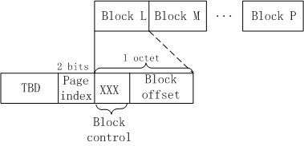
Option 2 of indicating no buffered unicast traffic
Define one new mode for indicating no buffered unicast traffic in TIM
  In current concept of Block-level TIM encoding method，3 encoding modes have been proposed
    The block control field indicates which mode is used for the TIM element
  Add one new mode to indicate there is no buffered unicast traffic
    The block control field is set to ‘XXX’ for “no buffered data” mode. Eg. “101”
  One more byte Overhead than option 1.

Slide 11
Conclusions
Bit 0 of the bitmap control field is used to indicate group addressed MSDUs/MMPDUs buffered at the AP.
Two options to indicate no buffered unicast traffic in slide 9 and 10 respectively are proposed for group decision.
  Option1 (slide 9) is preferred.

Slide 12
Straw Poll 1
Do you support to add the texts below in the TGah SFD 4.3.3 TIM encoding:
  R.4.3.3.B: the Group Addressed Buffered Data field (Bit 0 of the Bitmap Control field) is set to 1 when one or more group addressed MSDUs/MMPDUs are buffered at the AP.

Slide 13
Straw Poll 2
  Do you support to add the texts below in the TGah SFD 4.3.3 TIM encoding:
  R.4.3.3.C: If there is no bit in the traffic indication bitmap set to 1 in the TIM IE, the Encoded TIM Bitmap field is not present and the Length field is set to 3

Slide 14
References
[1] TGah Spec Framework document, 11-11/1137r10

Slide 15
Thank you!

