Slide 1
Response considerations in Active Scanning
Date: 2012-09-19
Authors:
Name | Affiliations | Address | Phone | email
Jing-Rong Hsieh | HTC Corp. | 1F, 6-3 Baoqiang Road, Xindian district, New Taipei City, Taiwan |  | jing_hsieh@htc.com
Notes:
2012.05.07
2012.05.25
2012.06.07
2012.06.20

Slide 2
Abstract
This contribution introduces further considerations regarding “6.2.6 Omission of Probe Response” of TGai SFD.

Slide 3
Conformance w/ TGai PAR & 5C
Conformance Question | Response
Does the proposal degrade the security offered by Robust Security Network Association (RSNA) already defined in 802.11? | No
Does the proposal change the MAC SAP interface? | No
Does the proposal require or introduce a change to the 802.1 architecture? | No
Does the proposal introduce a change in the channel access mechanism? | No
Does the proposal introduce a change in the PHY? | No
Which of the following link set-up phases is addressed by the proposal? (1) AP Discovery (2) Network Discovery (3) Link (re-)establishment / exchange of security related messages (4) Higher layer aspects, e.g. IP address assignment | 1

Slide 4
Fast Network Discovery (11-12/0153r12)
6.2.6 Omission of Probe Response (11-12/0153r12)
  An FILS Capable AP may omit transmission of Probe Response frame to FILS capable STAs if the TBTT occurs within a predefined time interval.
  (11-12/0655r5) Probe request may contain new information that would enable an AP to make the decision whether to respond to a probe request. Examples of this kind of information include:
    Link Quality parameters
    AP Capabilities
    QoS Requirement
    Address/ID

Slide 5
Background and motivations
The defined behavior of AP discovery in current spec
  The AP shall respond to any probe request with matching ID
Observations
  Weak links may occupy air resource for a BSS/ESS and harm FILS
    Low transmission rate and higher probability for problems such as hidden node
  For the purpose of WiFi offloading, it may degrade user experience for offloading them to a slower link than the original one
  In office or hotspot scenarios, there are usually many APs with the same SSID nearby but differentiated by the signal strength and operating channel
  Connection manager on user device shows only the SSID with best downlink signal
    It is also the AP that user will associate with if it is selected
    The hidden APs may be ignored during scan for the goal of FILS
    The same logic should be applied for filtering APs in active scan

Slide 6
Considerations:
Devices has different transmit power capability and sensitivity level
If transmit power control is used by APs, link asymmetric may be induced
AP
AP
AP
AP
STA
STA
Low power case
High power case

Slide 7
Criterion of not responding to probe request
AP may choose not to respond with a unicast probe response
  Consider link asymmetric and the decision for a STA to join a BSS or not is based on downlink signal quality
  Sol: Based on the estimated RSSI (of the intended probe response) for the scanning STA
    The probe request can attach transmit power and a desired RSSI for the STA-side (downlink)
      Path loss can be measured
      The RSSI of the intending probe response can be derived
    The AP chooses not to respond if the estimated RSSI for the STA is weaker than the desired RSSI

Slide 8
Example of including Link Quality parameters in FILS Request element
Element Id | Length | Parameter Control Bitmap | FILS Criteria | Max Delay Limit | Minimum Data Rate | Transmit Power | Desired RSSI | OUI Response Criteria
Octets: 1 | 1 | 1 | 0 or 1 | 0 or 1 | 0 or 3 | 0 or 1 | 0 or 1 | 0 or 2
The Transmit Power field is set to the transmit power used to transmit the Probe Request frame containing the FILS Request element
The Desired RSSI field is set to a desired value of downlink RSSI perceived by the STA for the intending probe response

Slide 9
Conclusion
Reducing airtime occupancy is critical to reduce the latency for FILS
In this contribution we propose to add link quality information in the probe request to reduce number of probe responses and the corresponding possible retransmissions
By the notion of hybrid scanning fashion introduced in TGai, those APs disqualified can still be discovered via the passive scanning way

Slide 10
Straw Poll
Do you support to utilize transmit power and desired RSSI as the link quality parameters for the AP to omit Probe Response?
Yes:
No:
Abstain:

Slide 11
Backup
Laptops typically transmit at a maximum power of 100 mW, but may be set lower to conserve battery power.
Phones are often capable of the same power level, but higher transmit power does decrease battery life. A good compromise is to set the network for a maximum power of 30-50 mW.
20.3.21.5.2 CCA sensitivity in 20 MHz
For an HT STA with the operating channel width equal to 20 MHz, the start of a valid 20 MHz HT signal at a receive level equal to or greater than the minimum modulation and coding rate sensitivity of –82 dBm shall cause the PHY to set PHY-CCA.indicate(BUSY) with a probability > 90% within 4 μs.)

Slide 12
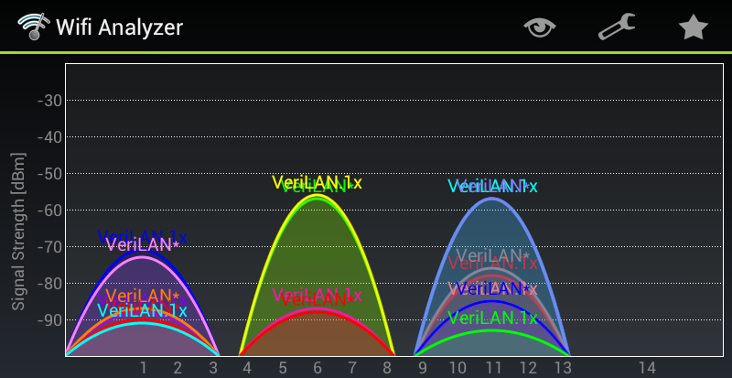
An example of WiFi Analyzer or connection manager

Slide 13
8.4.2.ai1 FILS Request Parameters element (12/1053r0)
Figure 8-ai2 – Parameter Control Bitmap field
  Received Signal Strength Limit
The Received Signal Strength Limit (RSSL) field is an unsigned integer. The receiver of Probe Request frame is obliged to respond, if the reception power of the frame is equal or higher than -82dBm + RSSL value * 0.5dBm. Value 255 indicates that receiver is obliged to respond regardless of the reception power of the Probe Request frame.

Slide 14
Rationale: If a STA decides to join a network, the downlink signal strength is considered to be acceptable. Reversely, the uplink signal strength at this stage is representative.
STA
AP
Probe Request
Probe Response
Auth Request
Auth Response
Assoc Request
Assoc Response (with RCPI of Assoc Request)
….
Received channel power indicator (RCPI): An indication of the total channel power (signal, noise, and interference) of a received frame measured on the channel and at the antenna connector used to receive the frame.

Slide 15
Criterion of not responding to probe request
AP may choose not to respond with a unicast probe response
  Consider known SSID (connected before)
  Sol: Based on the RCPI of the received probe request and info
    The probe request can attach a target RCPI info along with the SSID
    The target RCPI info can be measured by AP with same SSID previously
      RCPI were attached in the Association Response and can be recorded as reference like desired SSID
        An indication that the STA had decided to join the SSID before with the recorded RCPI value
    The scanned AP can decide if it should respond to the request with the target RCPI
Element Id | Length | Parameter Control Bitmap | FILS Criteria | Max Delay Limit | Minimum Data Rate | Desired RCPI | OUI Response Criteria
Octets: 1 | 1 | 1 | 0 or 1 | 0 or 1 | 0 or 3 | 0 or 1 | 0 or 2

