Slide 1
Access distribution in initial link setup
Date: 2012-09-06
Authors:
Name | Affiliations | Address | Phone | email
Giwon Park | LG Electronics | LG R&D Complex 533, Hogye-1dong, Dongan-Gu, Anyang, Kyungki, 431-749, Korea | +82-31-450-1879 | giwon.park@lge.com
Kiseon Ryu | LG Electronics | 10225 Willow Creek Rd, San Diego, CA, 92131, USA | +1 (858)-635-5209 | kiseon.ryu@lge.com
Jinsam Kwak | LG Electronics | LG R&D Complex 533, Hogye-1dong, Dongan-Gu, Anyang, Kyungki, 431-749, Korea | +82-31-450-7902 | Jinsam.kwak@lge.com
Jinsoo Choi | LG Electronics | LG R&D Complex 533, Hogye-1dong, Dongan-Gu, Anyang, Kyungki, 431-749, Korea | +82-31-450-1879 | Jinsoo.choi@lge.com

Slide 2
Abstract
This contribution proposes the mechanism to distribute the access time of STAs attempting the initial access with the AP in case of passive scanning mode.

Slide 3
Conformance w/ TGai PAR & 5C
Conformance Question | Response
Does the proposal degrade the security offered by Robust Security Network Association (RSNA) already defined in 802.11? | No
Does the proposal change the MAC SAP interface? | No
Does the proposal require or introduce a change to the 802.1 architecture? | No
Does the proposal introduce a change in the channel access mechanism? | No
Does the proposal introduce a change in the PHY? | No
Which of the following link set-up phases is addressed by the proposal? (1) AP Discovery (2) Network Discovery (3) Link (re-)establishment / exchange of security related messages (4) Higher layer aspects, e.g. IP address assignment | 1

Slide 4
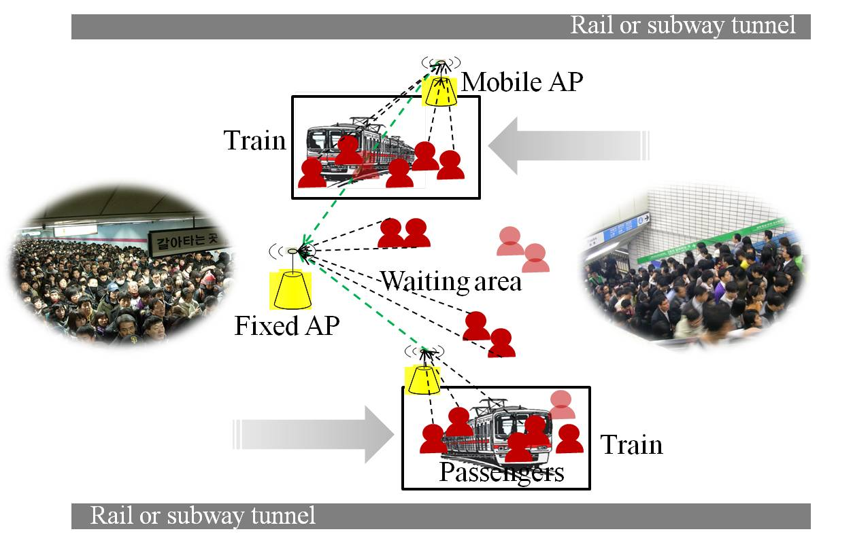
Background (1/4)
11ai use case
Figure 1. 11ai use case
Large number of devices simultaneously access to the AP.
It may produce the severe collisions.

Slide 5
Background (2/4)
Problem 1) Large number of STA’s initial link setup
Large number of STAs may transmit management frames (i.e. authentication, association frames) to associate with the AP in a bursty manner.
Probability of access collision can be highly increased, which causes degradation of the network performance (i.e., access quality, QoS, utilization of the wireless channel, etc).
Collision among STAs in passive scanning mode is more problematic than that of STAs in active scanning mode.
In addition, only some users may be able to successfully associate with the AP during a certain time interval.

Slide 6
Background (3/4)
Problem 2) Current access related parameters for management frame
Default QMF policy of IEEE 802.11ae-2012
It defines the access category of each management frame based on management subtype value, category value, and action value.
Access category of the Association Request frame is set to AC_VO.
Draft P802.11REVmb_D12.0
In 18.4.4 OFDM PHY characteristics, CWmin and CWmax are set to 15, 1023 respectively.
Based on the above description and Default EDCA parameter set element parameter(in Draft P802.11REVmb_D12.0), values of AIFSN, CWmin and CWmax of AC_VO are 2, 3 and 7 respectively.
CWmin of AC_VO in default EDCA parameter: (aCWmin+1)/4 – 1
CWmax of AC_VO in default EDCA parameter: (aCWmin+1)/2 – 1

Slide 7
Background (4/4)
Using the current values of access related parameters (i.e., AIFSN, CWmin and CWmax) for transmission of management frames does not fully support large number of STA’s initial link setup.
passive scanning mode is more problematic than that of STAs in active scanning mode.

Slide 8
Proposal
Thus, 11ai shall define the ‘passive scanning specific access parameters set’ for supporting large number of STA’s initial link setup.
STA performing the passive scanning is delay tolerant rather than the STA performing the active scanning. Thus, for access distribution of the initial link setup, STA performing the passive scanning can use the higher EDCA value rather than STA performing the active scanning.
passive scanning specific access parameters set
The value of this parameters can be a multiple of existing EDCA parameters set.
e.g.,) in case STA sends the Association Request frame → STA can apply the following value to send the Association Request Frame.
“ N * AC_VO parameters”
N * CWmin
N * CWmax
N * AIFSN
STA may acquire the Variable ‘N’ through the Beacon frame during the passive scanning.

Slide 9
Straw poll
Do you agree the following concept?
During the passive scanning, after receiving the Beacon frame from the target AP, when the STA sends the management frame to the target AP, in case of only 1st management frame, STA can apply the higher value of the EDCA parameters set rather than existing value of the EDCA parameters set based on QoS Management Policy to avoid the collision among the STAs (i.e., Associated STAs, STAs performing the active scanning and STAs performing the passive scanning).
Yes:
No:
Abstain:

Slide 10
Motion
Insert the following text on clause 6 of the SFD (11-12/0151r12):
During the passive scanning, after receiving the Beacon frame from the target AP, when the STA sends the management frame to the target AP, in case of only 1st management frame, STA can apply the higher value of the EDCA parameters set rather than existing value of the EDCA parameters set based on QoS Management Policy to avoid the collision among the STAs (i.e., Associated STAs, STAs performing the active scanning and STAs performing the passive scanning).
Mover:
Seconder:
Result:
Yes No Abstain_______________

