Slide 1
Band adjustment for fasat AP discovery
Date: 2012-09-18
Authors:
Name | Affiliations | Address | Phone | email
Giwon Park | LG Electronics | LG R&D Complex 533, Hogye-1dong, Dongan-Gu, Anyang, Kyungki, 431-749, Korea | +82-31-450-1879 | giwon.park@lge.com
Kiseon Ryu | LG Electronics | 10225 Willow Creek Rd, San Diego, CA, 92131, USA | +1 (858)-635-5209 | kiseon.ryu@lge.com
Jinsam Kwak | LG Electronics | LG R&D Complex 533, Hogye-1dong, Dongan-Gu, Anyang, Kyungki, 431-749, Korea | +82-31-450-7902 | Jinsam.kwak@lge.com

Slide 2
Abstract
This contribution introduces the band redirection (between 2.4GHz and 5GHz) for fast scan.

Slide 3
Conformance w/ TGai PAR & 5C
Conformance Question | Response
Does the proposal degrade the security offered by Robust Security Network Association (RSNA) already defined in 802.11? | No
Does the proposal change the MAC SAP interface? | No
Does the proposal require or introduce a change to the 802.1 architecture? | No
Does the proposal introduce a change in the channel access mechanism? | No
Does the proposal introduce a change in the PHY? | No
Which of the following link set-up phases is addressed by the proposal? (1) AP Discovery (2) Network Discovery (3) Link (re-)establishment / exchange of security related messages (4) Higher layer aspects, e.g. IP address assignment | 1

Slide 4
Current multiband operation (1/3)
Band steering (Implementation)
With the new dual-radio access points (APs) just introduced by HP Networking, it makes perfect sense to also add the intelligence to steer 5GHz-capable clients away from the crowded 2.4GHz band.
System only allow STAs to connect the 5GHz. AP ignores Probe Request or Authentication Request of 2.4GHz.
However, this band steering take such a long time (i.e., several seconds)
Moreover, the Wi-Fi standards did not define any mechanism to direct clients to connect a specific radio.
Thus, the 802.11ai standard shall define any mechanism to direct STAs to connect a specific radio.

Slide 5
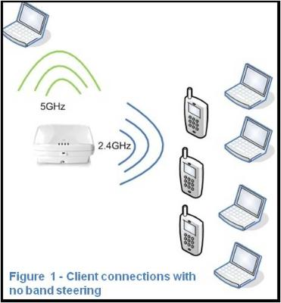
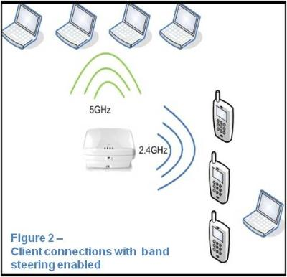
Current multiband operation (2/3)
Example of Band steering
http://h30507.www3.hp.com/t5/HP-Networking/How-to-make-the-most-of-cool-amp-fast-new-Wi-Fi-technology/ba-p/88817

Slide 6
Current multiband operation (3/3)
Other band information
In 6.1.3 Operational Channels of SFD 12/0151r12, a FILS STA may announce other band (or channel) information to the FILS non AP STAs. Based on this information, FILS non-AP STA can monitor the other band (or channel) for AP discovery.
Use case of using other band information
FILS non AP STA uses the other band of information only when it performs the scanning procedure for discovering the APs which are operating on other band.
Thus, AP may include this other band information for band redirection (e.g., 2.4GHz → 5GHz) of the STAs.

Slide 7
Band redirection
Band redirection between 2.4GHz and 5GHz
FILS non-AP STA sends the Probe Request to the AP in 2.4GHz.
AP may respond to the Probe Request in 2.4GHz.
If the AP load of 2.4GHz is not enough to accommodate new coming STAs, AP may redirect the STAs into the 5GHz by including the 5GHz band information to the Probe Response.
Following information may be included in Probe Response for band redirection.
Band ID, Operation class, Channel list, TBTT of the APs, Interworking IE of the APs.

Slide 8
Straw poll 1
Do you agree the following concept?
“The 802.11ai standard shall define any mechanism to redirect STAs to connect a specific radio.”
Yes:
No:
Abstain:

Slide 9
Straw poll 2
Do you agree inserting the following text on clause 6 of the SFD (11-12/0151r12)?
6.4 Band adjustment
If the AP load of current band is not enough to accommodate new coming STAs, AP may redirect the STAs into the other band by including the neighbor AP information of other band to the Probe Response or Beacon.
Yes:
No:
Abstain:

Slide 10
Motion 1
Insert the following text on clause 6 of the SFD (11-12/0151r12):
6.4 Band adjustment
The 802.11ai standard shall define any mechanism to redirect STAs to connect a specific radio.
Mover:
Seconder:
Result:
Yes No Abstain_______________

Slide 11
Motion 2
Insert the following text on clause 6 of the SFD (11-12/0151r12):
6.4 Band adjustment
If the AP load of current band is not enough to accommodate new coming STAs, AP may redirect the STAs into the other band by including the neighbor AP information of other band to the Probe Response or Beacon.
Mover:
Seconder:
Result:
Yes No Abstain_______________

