Slide 1
Band adjustment (between 2.4GHz and 5GHz) for AP discovery
Date: 2012-09-06
Authors:
Name | Affiliations | Address | Phone | email
Giwon Park | LG Electronics | LG R&D Complex 533, Hogye-1dong, Dongan-Gu, Anyang, Kyungki, 431-749, Korea | +82-31-450-1879 | giwon.park@lge.com
Kiseon Ryu | LG Electronics | 10225 Willow Creek Rd, San Diego, CA, 92131, USA | +1 (858)-635-5209 | kiseon.ryu@lge.com
Jinsam Kwak | LG Electronics | LG R&D Complex 533, Hogye-1dong, Dongan-Gu, Anyang, Kyungki, 431-749, Korea | +82-31-450-7902 | Jinsam.kwak@lge.com

Slide 2
Abstract
This contribution introduces the band adjustment (between 2.4GHz and 5GHz) scheme for fast AP discovery.

Slide 3
Conformance w/ TGai PAR & 5C
Conformance Question | Response
Does the proposal degrade the security offered by Robust Security Network Association (RSNA) already defined in 802.11? | No
Does the proposal change the MAC SAP interface? | No
Does the proposal require or introduce a change to the 802.1 architecture? | No
Does the proposal introduce a change in the channel access mechanism? | No
Does the proposal introduce a change in the PHY? | No
Which of the following link set-up phases is addressed by the proposal? (1) AP Discovery (2) Network Discovery (3) Link (re-)establishment / exchange of security related messages (4) Higher layer aspects, e.g. IP address assignment | 1

Slide 4
Current multiband operation (1/3)
Band steering (Implementation)
  With the new dual-radio access points (APs) just introduced by HP Networking, it makes perfect sense to also add the intelligence to steer 5GHz-capable clients away from the crowded 2.4GHz band.
  System only allow STAs to connect the 5GHz. AP ignores Probe Request or Authentication Request of 2.4GHz.
  The Wi-Fi standards did not define any mechanism to direct clients to connect a specific radio.

Slide 5
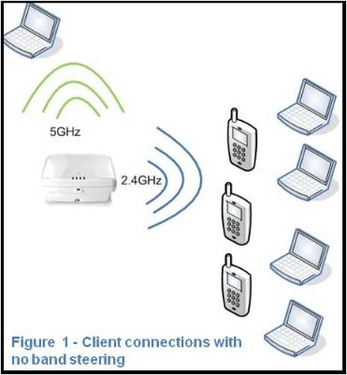
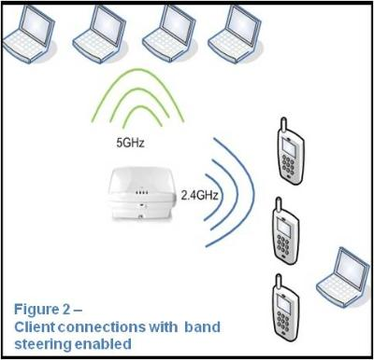
Current multiband operation (2/3)
Example of Band steering
http://h30507.www3.hp.com/t5/HP-Networking/How-to-make-the-most-of-cool-amp-fast-new-Wi-Fi-technology/ba-p/88817

Slide 6
Current multiband operation (3/3)
Other band information
  In 6.1.3 Operational Channels of SFD 12/0151r12, a FILS STA may announce other band (or channel) information to the FILS non AP STAs. Based on this information, FILS non-AP STA can monitor the other band (or channel) for AP discovery.
  For example, STA can acquire 5GHz band channel information through the Beacon frame or Probe Response frame in 2.4GHz. However, without any specific indication from the AP, generally STA may perform the passive scanning using acquired 5GHz channel information for AP discovery. This may increase the AP discovery delay.

Slide 7
Motivation
Probe Request transmission in 5GHz channel
  In non-DFS band of the 5GHz, STA can perform the active scanning.
  In DFS band of the 5GHz, STA can not perform the active scanning.
    Generally STA performs the passive scanning to find the AP/Network instead of the active scanning in DFS band. In case of the multiband environment (2.4 and 5GHz), this have the delay issue of the AP/Network discovery because the passive scanning have the longer delay than the active scanning to discover the AP/Network.
FILS in multiband (between 2.4GHz and 5GHz)
  The solution for supporting the fast initial link setup in multiband environment is needed in 802.11ai.

Slide 8
Proposal (1/4)
Band adjustment between 2.4GHz and non-DFS band of the 5GHz
  FILS non-AP STA sends the Probe Request to the AP in 2.4GHz.
  AP may respond to the Probe Request in 2.4GHz.
    The Probe Response of 2.4GHz may include the information for FILS non-AP STA to send the Probe Request to the AP in non-DFS band of the 5GHz.
  Based on the acquired information through the 2.4GHz Probe Response, FILS non-AP STA may send the Probe Request in non-DFS band of the 5GHz.

Slide 9
Proposal (2/4)
Band adjustment between 2.4GHz and DFS band of the 5GHz
  Active scanning is not allowed to find the AP/Network in the DFS band of the 5GHz.
  We propose that based on acquired information through the 2.4GHz Probe Response, FILS non-AP STA can perform the Authentication / Association procedure without scanning procedure in the DFS band of the 5GHz.
    Probe Response of 2.4GHz may include the information for STA to associate to the AP in DFS band of the 5GHz without scanning procedure.
      Because the active scanning is not allowed in DFS band and passive scanning causes longer delay for AP discovery.

Slide 10
Proposal (3/4)
Band adjustment between 2.4GHz and DFS band of the 5GHz (cont.)
  FILS non-AP STA sends the Probe Request to the AP in 2.4GHz.
  AP may respond to the Probe Request in 2.4GHz.
    Probe Response of 2.4GHz may include the information for STA to associate to the AP in DFS band of the 5GHz without scanning procedure.
      Necessary information in the 2.4GHz Probe Response to direct STAs to connect a specific radio (5GHz) without scanning procedure are TBD.
        Open for discussion.
  Based on the acquired information through the 2.4GHz Probe Response, FILS no-AP STA may perform the authentication / association procedure without scanning procedure in DFS band of the 5GHz.

Slide 11
Proposal (4/4)
Example of band adjustment (between 2.4GHz and DFS band of the 5GHz)
  If the BSS load of the 2.4GHz is high, STA may switch its band into other band (5GHz).
  Moreover, based on the acquired information through the 2.4GHz Probe Response, STA may perform the authentication / association procedure without scanning procedure in DFS band of the 5GHz.

Slide 12
Straw poll 1
Do you agree the following concept?
  “The 802.11ai standard shall define any mechanism to direct STAs to connect a specific radio (e.g., 5GHz).”
Yes:
No:
Abstain:

Slide 13
Straw poll 2
Do you agree inserting the following text on clause 6 of the SFD (11-12/0151r12)?
  6.4 Band adjustment (between 2.4GHz and 5GHz)
  The FILS non-AP STA should send the Probe Request including the 5GHz operation capability indicator.
  The Probe Response of 2.4GHz may include the information for FILS non-AP STA to associate to the AP in DFS band of the 5GHz without scanning procedure.
  Based on the acquired information through the 2.4GHz Probe Response, FILS non-AP STA may perform the authentication / association procedure without scanning procedure in DFS band of the 5GHz.
Yes:
No:
Abstain:

Slide 14
Motion 1
Insert the following text on clause 6 of the SFD (11-12/0151r12):
  6.4 Band adjustment (between 2.4GHz and 5GHz)
  The 802.11ai standard shall define any mechanism to direct STAs to connect a specific radio (e.g., 5GHz).
Mover:
Seconder:
Result:
Yes No Abstain_______________

Slide 15
Motion 2
Insert the following text on clause 6 of the SFD (11-12/0151r12):
  6.4 Band adjustment (between 2.4GHz and 5GHz)
  The FILS non-AP STA should send the Probe Request including the 5GHz operation capability indicator.
  The Probe Response of 2.4GHz may include the information for FILS non-AP STA to associate to the AP in DFS band of the 5GHz without scanning procedure.
  Based on the acquired information through the 2.4GHz Probe Response, FILS non-AP STA may perform the authentication / association procedure without scanning procedure in DFS band of the 5GHz.
Mover:
Seconder:
Result:
Yes No Abstain_______________

