Slide 1
WG11 Plenary - Supplementary Information - September 2012
Date: 2012-09-17
Authors:
Abstract: Additional Information on topics for the 802.11 interim meeting – September 2012
Notes:
November 2011

Slide 2
Monday
Notes:
November 2011

Slide 3
IEEE LOA Database
Monday Agenda Item 3.2.1
http://standards.ieee.org/about/sasb/patcom/pat802_11.html
8 entries with 2012 submission dates

Slide 4
Joint Meetings
Monday Agenda Item 4.1.3
External: Non planned
Internal: None planned

Slide 5
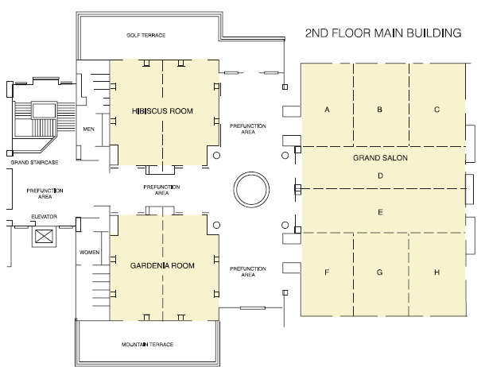
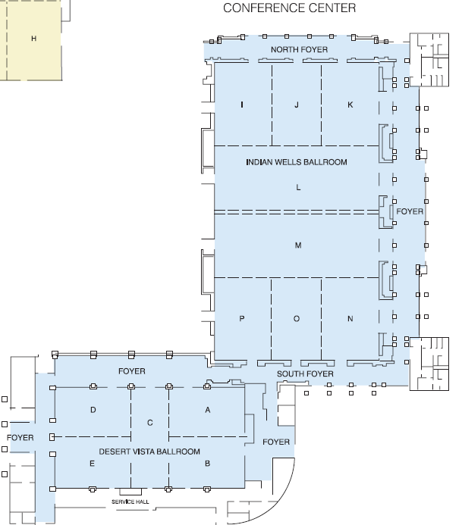
Hyatt Grand Champions – meeting rooms
Monday Agenda Item 4.1.5
Notes:
November 2011

Slide 6
Group Room assignments
Monday Agenda Item 4.1.5
WG | Room | Level
16 | Gardenia B, Salon C & B | 2 Main
18 | Salon A | 2 Main
19 | Gardenia A, Salon H | 2 Main
21 | Salon G | 2 Main
22 | Salon F | 2 Main
Notes:
November 2011

Slide 7
WG Agendas
Monday Agenda Item 4.1.5
15: Agenda
https://mentor.ieee.org/802.15/dcn/12/15-12-0444-02-0000-september-2012-802-15-wg-agenda-graphic.xlsx
16: Agenda
http://ieee802.org/16/meetings/mtg81/agenda.html
18: Agenda: 18-12-0081-01
19: Agenda
https://mentor.ieee.org/802.19/dcn/12/19-12-0145-00-0000-sept-2012-wg-agenda.xls
21: Agenda
https://mentor.ieee.org/802.21/dcn/12/21-12-0108-00-0000-sesssion-52-agenda.docx
22: Agenda
https://mentor.ieee.org/802.22/dcn/12/22-12-0075-00-0000-september-interim-wg-agenda.xls

Slide 8
September – 802.11 China (TGaj) interim Beijing, China November 11-16, 2012
Monday Agenda Item 4.1.10
Hotel Registration - Open
Meeting Registration – Open
See: http://www.ieee802.org/11/Meetings/201209ChinaInterim.html for details

Slide 9
November – San Antonio, TX, California November 11-16, 2012
Monday Agenda Item 4.1.10
Session information: http://802world.org/plenary
Hotel Registration - open
Meeting Registration - open
Early bird registration expires
Friday 2012-10-05

Slide 10
Other Special Events
Monday Agenda Item 4.1.11
Breakfast – Verde Vista Terrace + LM Foyer
Breaks – Verde Vista Terrace + LM Foyer
Lunch – Indian Wells LM
Wednesday Social 6:30 pm start
Badge needed for admission – Guest also
Location: Verbena Terrace (Main Building)

Slide 11
802.1 Architecture Document
Monday Agenda Item 4.1.14
D1.5 of the P802 is latest version
Comment collection period started on D1.5
802.11 members can provide comments following
http://www.ieee802.org/11/LetterBallots/CC3ARC/CC3_instructions.html

Slide 12
802.24 – Smart Grid WG
Monday Agenda Item 4.1.15
One ad-hoc meeting will be held
Tuesday 2012-09-18, 16:00-18:00
The agenda will be to review action items from July and prepare for our first official meeting during the November plenary.
Meeting set up in IMAT so that attendance credit can be claimed for 802.11.

Slide 13
Wednesday Plenary Topics
Monday Agenda Item 4.1.16
Liaisons
Any other?

Slide 14
Tutorials
Monday Agenda Item 4.1.17
None during September 2012
November 2012 tutorials:
Monday
AVB (Sponsored by Tony Jeffree)
L2 Routing (Sponsored by Bob Heile)
Medical Device Interop (Sponsored by Bob Heile)
Tuesday
Smart Grid TAG overview (Sponsored by James Gilb)

Slide 15
Wednesday
Notes:
November 2011

Slide 16
Social
Wednesday Agenda Item 2.7
Wednesday Social 6:30 pm start
Badge needed for admission – Guest also
Location: Verbena Terrace (Main Building)
Drinks free for first hour.

Slide 17
Wednesday Agenda Item 5.2
Room Changes
??
Notes:
November 2011

Slide 18
Wednesday Agenda Item 5.3
Mid-week Officer Changes
If needed

Slide 19
4-hour rule clarification
4-hour rule applies only to the time between a submission being placed on the server and a motion being made to modify the draft referencing that submission.
The 4-hour rule does not apply to:
A submission be placed on the server that proposes changes to a draft and presentation or discussion of those changes.
A submission supporting a motion that does not modify the draft.
Any other kinds of submission.

Slide 20
Friday

Slide 21
Announcements
Friday Agenda Item 2.07
Coffee will be continuously available from 7:30am to 11:00am
When we reach 10:00 we will determine if we take a break
Break = Recess
Reconvene at 10:15

Slide 22
IEEE LOA Database
Friday Agenda Item 2.08
http://standards.ieee.org/db/patents/pat802_11.html
8 entries with 2012 submission dates

Slide 23
IEEE Store Contents - Sept 2012
Friday Agenda Item 2.09
Amendment | Draft in Shop July 18 | Draft in Members Area | Publication in Techstreet Sept | Publication in Get 802
P802.11.2
802.11s-2011 |  |  | $5
802.11 -2012 |  |  | $5
802.11aa-2012 |  |  | $5
802.11ae-2012 |  |  | $5
P802.11ac | - | 3.0 | D3.0 $5
P802.11ad | - | 9.0 | D9.0 $5
k, n, p, y, r, w, u, v, z
802.11-2007
http://www.techstreet.com/ieeegate.html
Notes:
November 2011

Slide 24
802.11 drafts to ISO/IEC JTC1/SC6
Friday Agenda Item 2.10
Task Group | After Okinawa | After Atlanta | After Jacksonville | After Waikoloa | After Atlanta | After San Diego
TGad |  |  | D5.0 | D7.0 | D8.0 | D9.0
TGac | - |  | D2.0 |  | D3.0
The WG told SC6 it would liaise 802.11ac as soon as it passes a LB
802.11-2012 was submitted to SC6 when approved by the SASB – April 2012
Notes:
November 2011

Slide 25
Tutorials
Friday Agenda Item 2.11
None during September 2012
November 2012 tutorials:
Monday
AVB (Sponsored by Tony Jeffree)
L2 Routing (Sponsored by Bob Heile)
Medical Device Interop (Sponsored by Bob Heile)
Tuesday
Smart Grid TAG overview (Sponsored by James Gilb)

Slide 26
Future Venues - 2012
Friday Agenda Item 6.3
2012
# 131 January 15-20, 2012 ----Hyatt Regency, Jacksonville, FL
Including 802.16 and 802.21
# 132 March 11-16, 2012 –Hilton Waikoloa, Big Island, HI
# 133 May 13-18, 2012, Hyatt Regency Atlanta, Atlanta, Georgia, USA
# 134 July 15-20, 2012 Grand Hyatt Manchester, San Diego, CA, USA
# 135 September 16-21, 2012, Hyatt Grand Champion, Indian Wells, CA
# 135.5 Sep 26-27, 2012 Hotel Nikko New Century, Beijing, China
# 136 Nov 11-16, 2012 Grand Hyatt San Antonio, San Antonio, TX, USA
Notes:
November 2011

Slide 27
Future Venues -2013
Friday Agenda Item 6.3
2013
# 137 January 13-18, 2013 - --Hyatt Regency Vancouver, BC, CA 137.1 Jan 21-25 – China Interim (TGaj), Location TBD
# 138 March 17-22, 2013 –Caribe Royale, Orlando, FL, USA
# 139 May 12-17, 2013 ----Hilton Waikoloa, Big Island, HI 139.1 April 22-26 – China Interim (TGaj), Location TBD
# 140 July 14-19, 2013 --- Geneva , CH ITU headquarters
# 141 September 15-20, 2013----Confirmed– Nanjing, China
TGaj will meet at this interim
# 142 Nov 10-15, 2013 Hyatt Regency Dallas, TX, USA
Notes:
November 2011

Slide 28
Future Venues - 2014
Friday Agenda Item 6.3
2014
# 143 January 19-24, 2014 - --Hyatt Century Plaza, Los Angeles, CA, US
143.1 Jan 6-10 – China Interim (TGaj), Location TBD
# 144 March 16-21, 2014 –Hyatt Regency Atlanta, Atlanta, GA, US
# 145 May 11-16, 2014 ----Hilton Waikoloa, Big Island, HI
145.1 May 20-24 – China Interim (TGaj), Location TBD
# 146 July 13-18, 2014 --- Manchester Grand Hyatt, San Diego, CA, US
# 147 September 14-19, 2014----1st priority– Kobe, Japan
147.1 Sept 23-27 – China Interim (TGaj), Location TBD
# 148 November 2-7, 2014 Hyatt Regency San Antonio, TX, US
Notes:
November 2011

Slide 29
November – San Antonio, TX, California November 11-16, 2012
Monday Agenda Item 4.1.10
Session information: http://802world.org/plenary
Hotel Registration - open
Meeting Registration - open
Early bird registration expires
Friday 2012-10-05

Slide 31
