Slide 1
TGai Scanning Topics (Ad-Hoc Agenda)
Date: 2012-07-17
Authors:

Slide 2
Abstract
Agenda and presentation slide set of TGai Scanning Ad-Hoc
NOTE: Rev 01 to reflect changes based on ad hoc discussion

Slide 3
Agenda
Tuesday, PM1 Scanning AdHoc Agenda
  Structure remaining scanning related presentations
  Decide which to consider in TGai main plenary and which to address in ad-hoc
  Produce one set of suggested changes to the SFD based on presentations discussed in ad-hoc

Slide 4
Categorizing submissions
Three kind of presentations:
  Problem statements: what TGai should address
  → address in another ad-hoc or consider under unfinished business
  Further details enhancing the SFD: clear addition of another level of detail to existing SFD
  → consider in TGai plenary
  Full text proposals addressing content of the SFD
  → consider in TGai plenary
  New concepts and ideas: how to change the standard
  → work on merger during ad-hoc; TGai plenary only to consider merger

Slide 5
Problem Statements
Current values of access related parameters (i.e., AIFSN, CWmin and CWmax) for transmission of management frames does not fully support large number of STA’s initial link setup (11-12/776)
Suggestion:
  Request for presentation during upcoming phone conference or as a agenda point at the end of the week under unfinished business
  Request authors to revise presentation:
    Avoid adding a problem statement / what should be avoided to the SFD but
    Make a clear statement what should be added to the standard / what needs to be changed

Slide 6
Further details for agreed SFD contents
Addresses SFD item “6.1.6 Omission of Probe Response”
  Use of bitmasks to enable complex inclusion lists (11-12/775)
  AP should not respond with a unicast probe response if the Received channel power indicator (RCPI) is below a threshold contained in the probe request (11-12/758)
Suggestion to TGai:
  Consider entire presentation in plenary
Notes:
Talk to HTC regarding motion in 12/758 → correct it

Slide 7
Full text proposals addressing agreed SFD contents
SFD-related-active-scanning-text (11-12/726)
Suggestion:
  Query TGai plenary for consideration

Slide 8
Overview: (Active) scanning concepts
Beacon pointer (11-12/743)
Simplified probe request (11-12/791)
Simplified probe response (11-12/791)
Reduction of Probe Requests via trigger information (11-12/550)
Dynamic adjustment of Probe Timer for active scanning (11-12/788)
Operation channel information in Beacon / Probe Res. (11-12/761)
Inclusion of “AP performance parameters” in Beacon / Probe Res. (11-12/762)
AP selection of preferred operating channel based on its SSID (11-12/779)
Avoidance of association bursts by distributing link set-up over time interval (11-12/786)
Suggestion: Merge in ad-hoc; TGai only to consider merger

Slide 9
Note on (new) Scanning Concepets:
Only two of the active scanning topics were brought in front of TGai before, namely:
  761r0 by Katsuo Yunoki (KDDI): presented as 13r0 in January
  786r0 by Lin Cai (Huawei): presented as 569r0 in May and 249r0 in March
Presenters should make more efficient use of telephone conference time
Suggestion:
  Work on merger during ad-hoc and only allow outcome of merger to go into TGai main group
  Per call for contributions: Suggest to TGai _not_ to consider any the existing and future presentations of active scanning but only consider the outcome of this ad-hoc in form of a merged, converged view on active scanning features to be added to the SFD
  Require for future sessions, that presentations presenting new ideas or adding details to the SFD are required to present during a phone conference to allocate agenda time during a face-to-face meeting, or only allow presentations on a “time permit bases”

Slide 10
Suggestion to TGai Pleanary
Suggestion to the TGai plenary wrt. addressing scanning related submission:
  Submissions providing further details for agreed SFD contents will be handled in the TGai plenary
  Amendment text proposals providing text for concepts included in the SFD will be handled in the TGai plenary
  Problem statements will be handled under unfinished business
  New concepts / ideas will be addressed only in the ad-hoc targeting at a merged contribution. TGai plenary will only address the joint contribution
  Require for future sessions, that presentations presenting new ideas or adding details to the SFD are required to present during a phone conference to allocate agenda time during a face-to-face meeting, or only allow presentations on a “time permit bases”

Slide 11
One-Slide Summary of new Concepts and Ideas

Slide 12
Concept: Beacon Pointer
Related DCN: 11-12/743r1
Concept:
  Inform STA when the _next_ beacon is sent
  Information (= beacon pointer) contained in
    Probe response
    Beacon
Probe Response
w/ Beacon Pointer
Beacon
Beacon
AP
t
Time offset
Beacon Interval * N
Probe Request
Omit
Probe Request
STA
STA may go into power saving mode.
t
Probe Delay
Obtained Beacon Pointer from the desired AP
Probe Delay
Wake up.

Slide 13
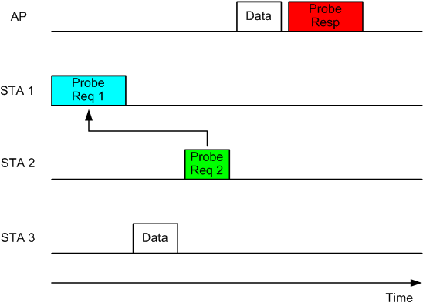
Concept: Simplified Probe Request
DCN: 11-12/791
Concept:
    STA may reference a probe request transmitted by another STA and only contain in the probe request additional information requested for
    AP transmits Probe Response containing information requested in both probe requests.
    Probe response may be sent via broadcast (answering both requests) or unicast to each requesting STA

Slide 14
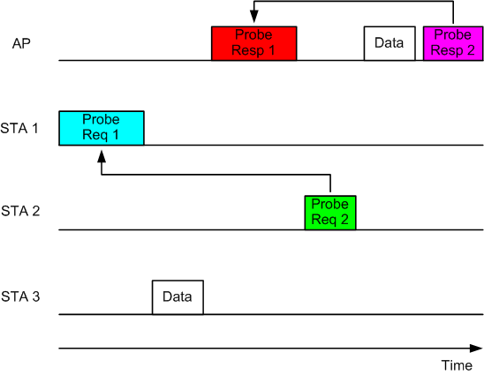
Concept: Simplified Probe Response
DCN: 11-12/791
Concept
  The AP first sends a regular Probe Response frame in response to a Probe Request sent by an STA (e.g. STA1)
  the AP sends a simplified Probe Response to STA2, by referencing to the regular Probe Response that
  was sent earlier
Notes:
How can we assure that STA has received previous / referenced Probe Response?
How can the AP know this?

Slide 15
Concept: Reduction of Probe Requests via trigger information
DCN: 11-12/550
Concept:
  Probe requests contain information “triggering” information to be included in the probe response or limiting the transmission of probe responses (avoid transmissions)
  Non-AP STA overhears such probe requests sent to a broadcast address → avoid sending another (own) probe request if „trigger information“ would be the same
  AP responds with broadcast probe response
  Note: trigger information not specified in presentation

Slide 16
Concept: Dynamic adjustment of ProbeTimer for active scanning
DCN: 11-12/788
Concept
  Adjust ProbeTimer for active scanning based on CCA:
    CCA busy primitive is not detected → ProbeTimer = MinChannelTime
    CCA busy primitive is detected, and STAs receive some messages with hard evidence of APs’ existence (e.g. data frames, management frames, etc) → ProbeTimer = MaxChannelTime
    CCA busy primitive is detected, but there is no hard evidence of Aps’ presence →ProbeTimer =MedChannelTime, where MinChannelTime<=MedchannelTime<= MaxChannelTime
Expected scanning delay
over each channel (ms)
Number of APs M

Slide 17
Concept: Operation channel information in Beacon / Probe Res.
DCN 11-12/761
Concept:
  Multi-band operation of APs common
  Include “extended neighborhood report” in beacon / probe response
    AP includes information on all channels where APs (also ohters) operate on
    Mark those channels where the AP providing the information is the DFS owner
  STAs may use information to determine where to scan next
  STAs may immediately access channels under the DFS control of the AP (e.g. immediate active scanning)
Single Device / Box
2.4 GHz AP
5 GHz AP
Internal Mgmt. Not accessible by user
Active scan → receive 5GHz channel list
Optional passive scan on channel for verification
Link-Set Up
Non-AP STA
2.4 & 5 GHz operation

Slide 18
Concept: Inclusion of “AP performance parameters” in Beacon / Probe Res.
DCN: 11-12/762
Concept:
  preferred for STAs to avoid associations with APs which the performance of communication is supposed to be poor, even if the required time for association is very short by FILS
  AP may include some performance related indicators in Beacon and Probe Response.
  STA can determine whether it goes to association process with that AP or not, by verifying these indicators.
  The information may be, for example:
    BSS load,
    BSS average access delay,
    BSS available admission capacity

Slide 19
Concept: AP selection of preferred operating channel based on its SSID
DCN: 11-12/779
Concept:
  Scanning times can be reduced if non-AP STA knew (higher probability) on which channel an AP of a given SSID would operate on
  AP generates (preferred order) of operating channels based on its SSID
  [Question from editor: common hash function at STAs ?]

Slide 20
Concept: Avoidance of association bursts by distributing link set-up over time interval
DCN: 11-12/786 (& 12/787)
Concept:
  Bursts of link association cause delay
  Users may have different delay tolerance levels for network association; greedy/immediate association only reduces the association efficiency but not guarantee fast link setup
  Allow STAs to associate with an AP at different time intervals, based on their priorities
    Similar concept to different access classes as found in EDCA
    Association priority
      E.g. based on traffic type, user type, etc
      Decided by other parties, e.g., WFA [editor: → just provide categories and config parameter which to use (e.g. MIB value)]
AIFS[AC3]
AIFS[AC2]
AIFS[AC1]
AIFS[AC0]
BackOff[AC3]
BackOff[AC2]
BackOff[AC1]
BackOff[AC0]
Class 3
Class 2
Class 1
t0
t1
t2
Class 1
Class 2
Class 3

Slide 21
Resulting / Requested additions to SFD

Slide 22
Resulting / Requested additions to SFD
6.1.X Beacon pointer in probe response
  TGai compliant AP may include Beacon Pointer in Probe Response which indicates time offset to the next Beacon.
  TGai compliant STA may execute Active/Passive scanning at the Beacon timing guessed by Beacon Pointer.
6.1.X Simplified Probe Request
  STA may send a simplified Probe Request by referencing to a regular Probe Request that was received earlier and by removing the redundant information elements that are already in the referenced Probe Request from the simplified Probe Request.
6.1.X Simplified Probe Response
  AP may send a simplified Probe Response by referencing to a regular Probe Response that was sent earlier and by removing the redundant information elements that are already in the referenced Probe Response from the simplified Probe Response.
6.1.X
  Triggering information for broadcast Probe Response transmission may be included in the Probe Request.
  [Editor note: where is this different from existing 6.1.4 Cls. In SFD ?]

Slide 23
Resulting / Requested additions to SFD (cont.)
6.1.X Dynamic ProbeTimer Adjustment for active scanning [NOTE: text drafted by editor]
  The value of the ProbeTimer for active scanning shall be adjusted reflecting the following situations:
    A) CCA indicates the channel idle
    B) CCA indicates the channel busy and ‘evidence of 802.11 frame exchange on the channel is given’
    C) CCA indicates the channel busy but “no evidence of 802.11 frame exchange on the channel is given’
6.1.X Operating channels information [note: text partially drafted by editor]
  TGai compliant AP may include Operating Channels information in Beacon and Probe Response in order to
    make faster to find the other operating channels of that AP
    indicate channels that the AP issuing the information is the DFS owner of
    allow non-AP STAs to immediatly access channels that are marked as „under the DFS ownership of the AP“

Slide 24
Resulting / Requested additions to SFD (cont.)
6.1.X AP Operational Status
  TGai compliant AP may include Operational Status information in Beacon and Probe Response. The information may be, for example:
    BSS load,
    BSS average access delay,
    BSS available admission capacity
6.1.X [editor: section title not specified]
  11ai should have mechanism to support that AP select its working channel according to its SSID, and STA scan a target AP with known SSID from the channel according to the SSID
  [editor rewording: 11ai should have mechanism to support that AP select its working channel according to its SSID, and non-AP STAs scan for APs with known SSIDs using an order to scan channels based as derived from the SSID]
6 QoS Provisioning in FILS
  [editor: just add new top level header, no subheadings specified yet]

Slide 25
Resulting / Requested additions to SFD (cont.)
X.X.X Differentiated link set-up [editor: no section header specified, wording by editor]
  FILS devices shall support differentiated initial link setup
  [editor: alternative wording below
  FILS non-AP STAs should delay the link-set up according to their association priority
  The association priority shall be set based on [choose here]
    traffic type, user type, etc
    a MIB variable (value to be determined by other, external entity, e.g. WFA)
  ]

Slide 26
Summary / Outcome of Scanning Ad Hoc
--Ad Hoc Report--

Slide 27
Summary / Outcome of Scanning Ad Hoc
Categorized presentations identifying those that require to be presented in TGai main plenary
Discussed the high level concepts of 9 presentations
  initial feedback to the presenters on issues that need to be addressed in a follow up presentation
  None of the suggested additions to the SFD had strong support at this point;
  but group requested to revisit

Slide 28
Suggestion to TGai Pleanary
Suggestion to the TGai plenary wrt. addressing scanning related submission:
  Submissions providing further details for agreed SFD contents will be handled in the TGai plenary
  Amendment text proposals providing text for concepts included in the SFD will be handled in the TGai plenary, discuss in TGai plenary if full text should be considered
  Problem statements will be handled under unfinished business, unless refined presentation is provided by authors
  New concepts / ideas will be addressed
    only in the ad-hoc targeting at a merged contribution. TGai plenary will only address the joint contribution
    Request additional time in ad-hoc mode
  Require for future sessions, that presentations presenting new ideas or adding details to the SFD are required to present during a phone conference to allocate agenda time during a face-to-face meeting, or only allow presentations on a “time permit bases”

