Slide 1
Signal to Noise+Interference (SNIR) Variations on multiple
TVWS channels
September17, 2012
Authors:
UPDATE: This contribution contains additional simulation results (on slides 7-10) addressing a comment from LGE raised in July meeting. This version shows the single MCS performance degradations using a “best effort” MCS selection for each simulation point. Independent MCS selection still provides significant performance advantages.

Slide 2
Interference Scenarios
Highly Changeable SNIRs on Aggregated TVWS Channels
  Interference components of TVWS channels
Extremely noisy TVWS channels [1]
Fixed strong TV interference
Powerful, e.g., 200kW, transmissions from TV transmitters
Up to 30dB interference variation between adj. and non-adj. [1]
e.g., ≥50% (or 30%) available channels adjacent to DTV in Europe (or USA) [2]
Dynamic interference from peer TVBDs
Uncoordinated TVWS channel usage among co-existing secondary networks
→ Fluctuated interference levels on different channels
  The interference level difference may be as much as 15 dB among TVWS channels [3], and even up to 30db when close to DTV transmitter [1].

Slide 3
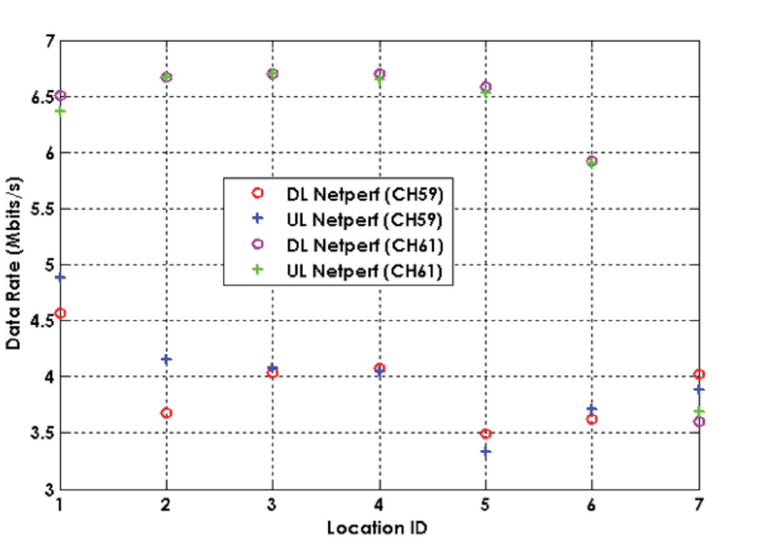
Cambridge TVWS Trial Results
Cambridge trial results [4] show significant spectrum quality difference between TVWS Channels 59 and 61
  Location dependent difference in channel quality
  High interference level from Tacolneston transmission presents on Channel 59
  Channel 61 exhibits interference from Waltham 6dB lower than Channel 59
Fig. 15 of [4]: distinct achieved throughputs due to unequal interference levels

Slide 4
Main factors impacting SNIR of TVWS channels [5]
  Allowable transmit power for a given type of TVWS device
    Location and channel dependency
    Up to 4dB variation of transmit power/5MHz band on different type of channel (adjacent vs. non-adjacent).
      May cause different desired signal levels on aggregated channels
  Path loss dependency on operational frequency
    Better propagation characteristics in the lower part of UHF bands than in the upper part
  Level of interference and noise
  Interference from DTV signal on adjacent channels
FCC Power spectrum density (PSD) requirement [6]
Type of Devices | Fixed | Personal/ portable (adj. ) | Sensing-only | All other personal/ portable
PSD limit/100kHz | 12.6dBm | -1.4dBm | -0.4dBm | 2.6dBm

Slide 5
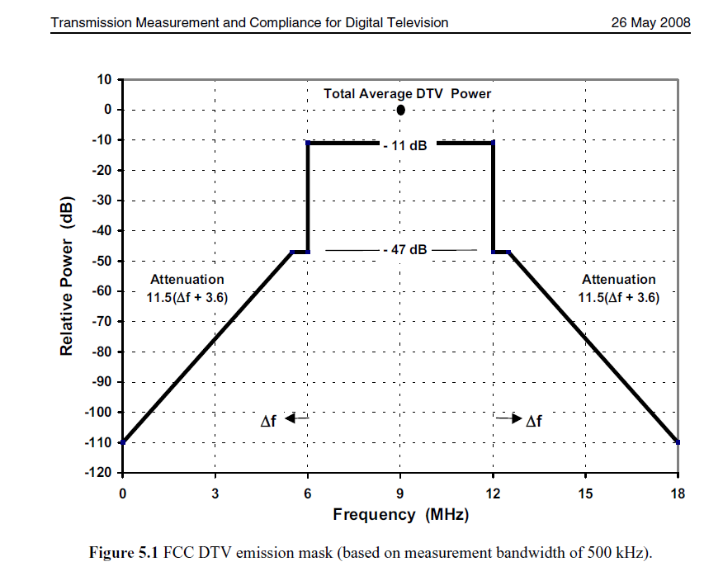
DTV Adjacent Channel Leakage Level (chan. N±1)
According to the Figure provided above in reference [12]
  The first adjacent channel OOBE is calculated to be roughly -55 dBc
  For instance, if the DTV occupied channel power measured at the TVBD receiver antenna port is at -28 dBm (e.g. 25km from WBFF in Baltimore)
  The first adjacent channel OOBE level is -83 dBm = (-28 -55) dBm
  If DTV Tx filter has 3 dB margin, then first adjacent OOBE power becomes -86 dBm
  This produces TVWS SNIR variance as high as 35 db close to DTV transmitters.

Slide 6
Multichannel operation requires independent MCS selection
Assumptions:
DTV operated on Channel N
DTV out-of-band emission to Channel N+1 = -86dBm [7]; no DTV leakage to Channel N + 4
Aggregation of Channel N+1 and Channel N+4 for TVBD communication
Thermal Noise PSD = -174 dBm/Hz, Noise Figure = 5dB
1 Tx Antenna, 2 Rx Antenna (chosen for simplicity)
Target PER = 10 %
MCS Selection in reference to 40MHz [8]
Path Loss Model @ f = 600MHz [9]
  Channel Model E, e.g. large office
Total Tx power for Portable TVBD = 20 dBm
  20 dBm = TxPowN+1(16dBm) + TxPowN+4(17.5dBm)
  No antenna gain
d(m) | 50 | 55 | 60 | 65 | 70 | 75 | 80 | 90 | 100 | 110 | 120 | 130 | 140 | 150 | 160 | 170 | 180 | 190 | 200
Path Loss (dB) | 74 | 75 | 77 | 78 | 79 | 80 | 81 | 83 | 85 | 86 | 87 | 89 | 90 | 91 | 92 | 93 | 93 | 94 | 95

Slide 7
UDP Throughput Analysis
Assumptions
  Operation timeline is down clocked by a factor 7.5 [10]
  Block ACK used in TXOP
    BA: 24 bytes, BAR: 32 bytes(compressed bitmap)
  Access Category: Video
  One PPDU includes preamble, overhead and data
    DATA length = 1000 bytes
    Overhead (service filed, MAC, IP, etc) = 45 bytes
    Preamble time = 40 * 7.5 = 300 µs
  MAC layer aggregation
UDP Throughput calculation
  Total time used for one packet transmission: T_PPDU = PreambleTime + MACOverhead+ Data + RIFS
  Number of PPDUs transmitted within one TXOP: N_PPDU = (TXOP – SIFS – BAR - BA )/T_PPTU
  Throughput for a channel = N_PPDU * DATA_LENGTH * ( 1 – PER ) * 8 bits/(ContentionPeriod + TXOP)
    PER selection is based on the averaged SINR [8]
  Total Throughput = (Tput for Channel N+1)+ (Tput for Channel N+4)
Assumed Parameters (unit: µs)
TxOP | aSlotTime | aSIFTime | AIFS[VI] | Average Backoff[VI]
22,500 | 24 | 16 | 64 | 180
QoS Data Access and Data Transmission with Block ACK in MAC Layer Aggregation

Slide 8
Numerical Results (1/2)
Four cases are investigated:
  Independent MCS selection: MCS selection based on each channel SINR
  Single MCS schemes: common MCS applied in aggregated channels
    Max MCS selection: Higher MCS among two channels used for both channels
    Min MCS selection: Lower MCS among two channels used for both channels
    Best Intermediate MCS selection:
      When there is more than one MCS value between Min and Max, the MCS between Min and Max to achieve the highest throughput is applied on both channels
      When there is no MCS between Min and Max, Max MCS is used for both channels

Slide 9
Numerical Results (2/2)

Slide 10
UDP Throughput Gains from Independent MCS Selection
Independent MCS selection provides the best UDP throughput performance
  In the larger coverage range (e.g., ≥170m), the total throughput is dominated by the better channel
    Independent MCS selection offers less gains over Max MCS selection
    Min MCS selection provides much lower throughput due to the conservative selection
  For high SINR cases (e.g., d ≤ 70m), all selection methods lead to the same MCS selection on both channels and similar PER performance, thus similar throughput
  Best intermediate MCS selection favors
    The MCS closer to the minimum MCS in middle distances (e.g., 80-140m)
    The MCS closer to the maximum MCS in large distances (e.g., >140m)
Larger TCP throughput gain would be expected
Ind. MCS Selection against | Average Tput Gain | Maximum Tput Gain
Max MCS Selection | 43% from 80 to 180 m | 67% @ 100m
Best Intermediate MCS Selection | 32% from 80 to 180 m | 48% @ 140m

Slide 11
Summary
Highly variable SNIR levels on aggregated TVWS channels:
  Different received power on different TVWS bands/channels
  High variance fixed and dynamic interference environment, especially on DTV adjacent channels
Single MCS utilization for multichannel leads to significant degradation and waste of spectrum
Independent MCS for multichannel permits efficient use of resources in real TVWS environments.
TGaf draft requires use of single MCS for multichannel and needs to be changed to permit effective multichannel operation using independent MCS selection.

Slide 12
References
[1] Neul, “Using White Space for M2M”, Weightless, June 2011
[2] Jaap van de Beek, Janne Riihijärvi, Andreas Achtzehn and Petri Mähönen, “TV white space in Europe”, IEEE Trans. On Mobile computing, vol. 11, no. 2, pp. 178-188, Feb. 2012
[3] Mubaraq Mishra, Anant Sahai, “How much white space is there?” Department of Electrical Engineering and Computer Science, UC Berkeley, Tech. Rep. EECS-2009-3,Jan. 2009
[4] “Cambridge TV white spaces trial: a summary of the technical findings,” 2012 Cambridge White Spaces Consortium
[5]“Recommendations from implementing the use of white spaces: conclusions from Cambridge TV White Spaces Trials”, 2012 Cambridge White Spaces Consortium
[6] FCC-12-36A1 Third Order, April, 2012
[7] Hou-Shin Chen and Wen Gao, “Spectrum sensing for FM wireless microphone signals,” in IEEE DySPAN 2010, Singapore, April, 2010
[8] “Joint proposal team PHY simulation results,” IEEE 802.11-06/0067r02
[9] Eldad Perahia and Robert Stacey, Next Generation Wireless LANs – Throughput, Robustness, and Reliability in 802.11n, Cambridge, 2010
[10] Bcom/Qcom,11-12-0699-00-00af-revised-phy-proposal
[11] TGaf PHY proposal, IEEE 802.11-12/0809r0
[12] ATSC Recommended Practice: Transmission Measurement and Compliance for Digital Television Document A/64B, 26 May 2008

