Slide 1
Analysis, simulation and resultant data from a 6-9GHz OFDM MAC/PHY
Date: 2012-07-17
Authors:

Slide 2
Abstract
This paper is a presentation of analysis, simulation results and actual data from an OFDM MAC/PHY running in 6-9GHz.

Slide 3
Legacy UWB summary
Channelization
  3~10GHz frequency allocated in USA
  ROW has slightly different rules; generally 6-9GHz
  Transmitter limit, -41.3dBm/MHz
  Each band group has three bands of 528MHz spectrum
  Hopping each symbol across three bands, it uses 1.584GHz spectrum
  10 TFI channels for each band group
Phy-rate
  Gen-1 53Mbps ~ 480Mbps phy-rate using QPSK, DCM
  Gen-2 extension up to 1024Mbps phy-rate using MDCM
  Gen-3 extension up to 2048Mbps phy-rate using 2x2 MIMO
EVM performance
  Legacy UWB requirement: -21dB EVM
  Need to have higher EVM to enable higher order of modulation scheme like 32/64QAM
OFDM with 128-FFT
  Viterbi with Interleaving ( <= 480 Mbps ) for Gen-1
  LDPC ( greater than 480 Mbps ) for Gen-2/3
  STBC, Spatial Multiplexing for Gen-3

Slide 4
UWB Channel Summary
Wireless Channel Model
  CM 1, LOS 0 ~ 4 meter; CM 2, NLOS 0 ~ 4 meter;
  CM 3, NLOS 4 ~ 10 meter;
  CM 4, fit to have 25ns RMS delay spread to represent an extreme NLOS multipath channel
  100 Channel Realization
Delay Spread Spectrum
  Prefix length : 60.6 ns
  This prefix length may not be enough in some case
Short range wireless ( < 10 meter )
Maximum payload length
  Legacy UWB’s coherence in time : 614.6us
  157KB payload @2048Mbps phy-rate
  Concatenated data frame required for actual higher throughput
Ranging feature
  28.4 cm uncertainty @ 1056MHz clock
  Useful for space-channel management
UWB antennas
  Widely available: Chip antenna, dipole antenna, PCB antennas
  Covers 3~9 GHz, most of them has average 0dBi gain
65KB payload length example

Slide 5
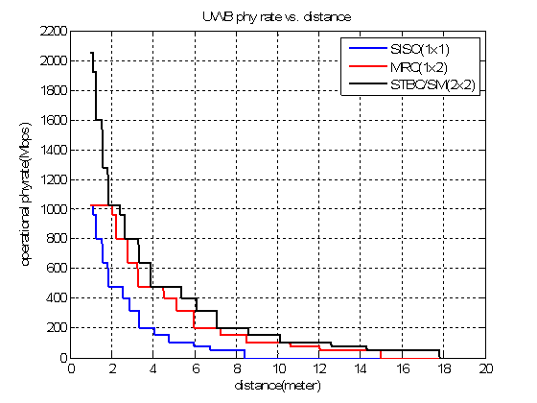
UWB Operational Rate vs. Range
Transmitter power
  -41.3dBm/MHz ( integrated -14dBm ) , non-hopping feature.
  500 MHz bandwidth
PL₀ = 50 dB, PL at 1meter
  Depending on center frequency
PL= PL₀ +20*log10(dist.)
Modulation :
  MDCM ( equivalent to 16QAM using diversity matrix )
  DCM ( equivalent to QPSK using diversity matrix )
  QPSK
Gain from SISO¹⁾
  MRC, 5 dB
  2x1 STBC, 1.5 dB
  2x2 STBC , 5.5 dB
Desktop Application
In-ROOM Application
Note 1, Medium phy-rate : 400Mbps case

Slide 6
Technology comparison
Items | Alereon Gen-1 UWB | Alereon Gen-2 UWB | Alereon Gen-3 UWB
Maximum Data rate( desktop ) | 480Mbps | 1024Mbps | 2048 Mbps
Minimum Data rate (In-room) | 53.3Mbps | 53.3Mbps | 26Mbps
ECC | Viterbi | Viterbi, LDPC | Viterbi, LDPC
Maximum Payload length | 4095 B | 16 KB | 157 KB
Concatenated data Frame | No | No | Yes
Ranging support | No | No | Yes
Preamble | Legacy Preamble | Legacy Preamble | Turbo Preamble
1GHz channel bonding support | No | No | YES
Signal processing improvement for CM1/2 | SISO | MRC | 2x2 MIMO, STBC
Signal processing improvement for CM3/4 | SISO | MRC | 2x2 MIMO, STBC Signal Processing for the longer delay spread spectrum

Slide 7
Alereon Gen-3 Target Performance
Power Consumption
  Including MAC/BBP IP with data-converters( ADC/DAC )
  excluding Interface IP such as CODEC, HDMI, USB3.0
  PHY/MAC Total Target Power consumption ( GEN3, 2Gbps )
    TX : 185mW, RX : 275mW
Radio Link improvement for NLOS channel condition
  Targeting channel model, UWB CM3/CM4
  Develop Turbo Preamble for superior packet acquisition
  Link improvement using diversity, and state-of-art receiver signal processing.
Operational mode | Target Power consumption
TX | < 60mW
1Gbps RX | < 100mW
2Gbps RX | < 150mW
RFIC – GEN2 ( TX/RX ) | ~ 230 mW
RFIC – GEN3 ( TX/RX ) | ~ 125 mW

Slide 8
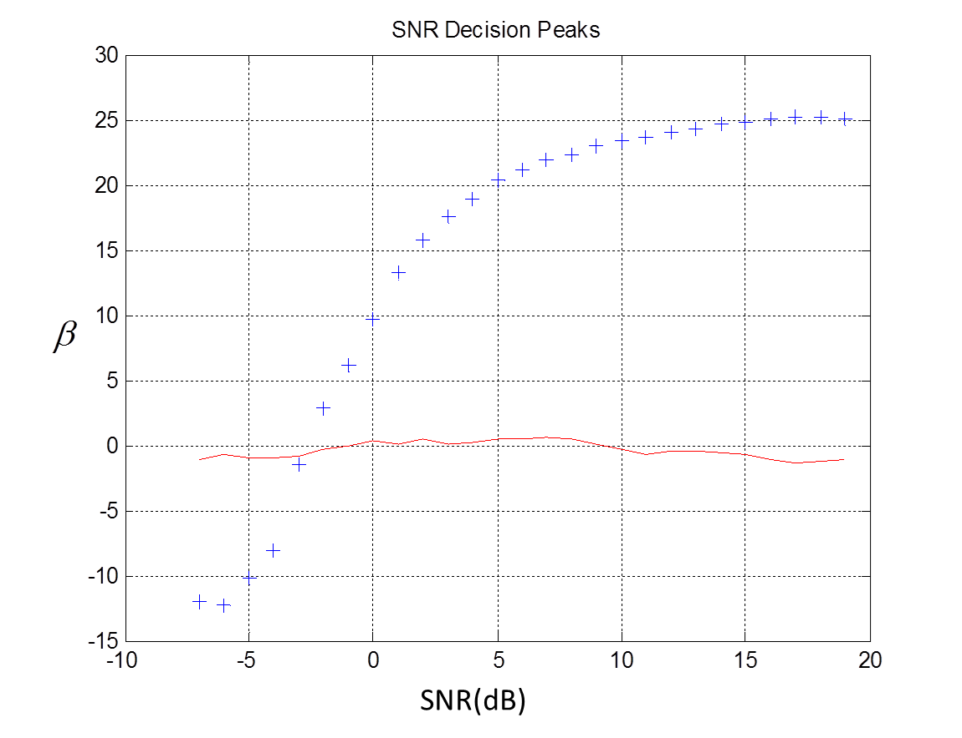
Packet detection Improvement
+ : desired peak composite correlation
-- : false peak composite correlation
β : composition correlation
for packet detection of turbo preamble.
Alereon Gen-3 uses Turbo Preamble
Alereon Gen-3 improves packet detection performance
  GEN1 preamble will be inadequate for future applications
  Performance simulated over AWGN, all 100 CIR of CM1/2/3/4.
  It works reliably when SNR is greater than -3dB.
Improved HER( Header Error Rate )
  Simulated 2dB enhancement than legacy preamble case

Slide 9

500MHz Typical STBC/SM example
Band1
Band2
Band1
The Same data or different data transmitted at two antennas
FFT
STBC/SM Detector
MRC
LLR demod
Channel Separation by using different Band
LDPC Decoder
Band1
FFT

Slide 10
Band MRC example
Band1
Band2
Two independent channel state information for MRC
Band1
The Same data repeated at two antennas
FFT
MRC
LLR demod
Channel Separation by using different Band
LDPC Decoder
Band2
FFT

Slide 11
Two SISO channel bonding example
Band1
Band2
Two independent SISO demodulation
Band1
FFT
SISO demod
Channel Separation by using different Band
Two different data stream at two antennas
LDPC Decoder
Band2
FFT
SISO demod

Slide 12
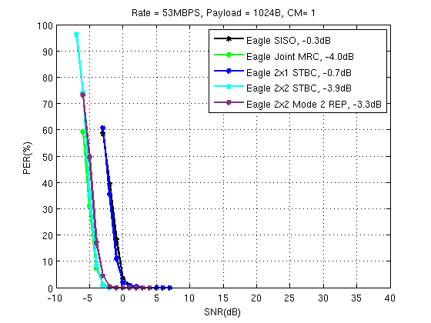
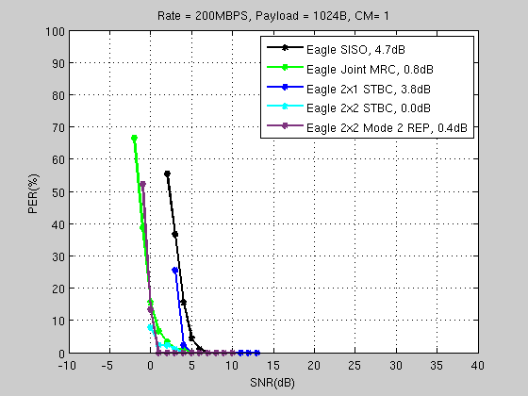
Performance Simulation

Slide 13
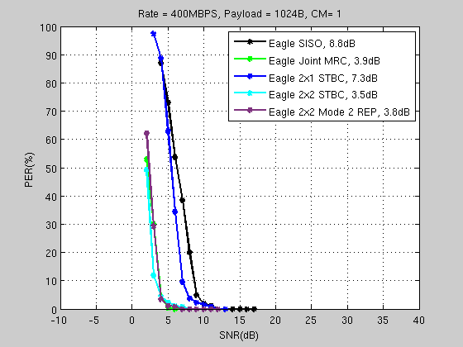
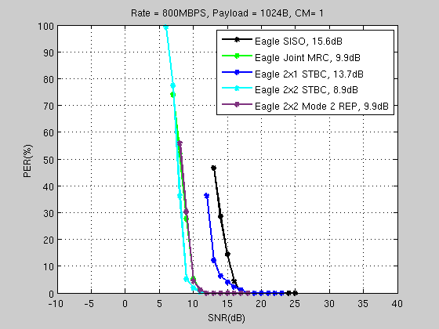
Performance Simulation

Slide 14
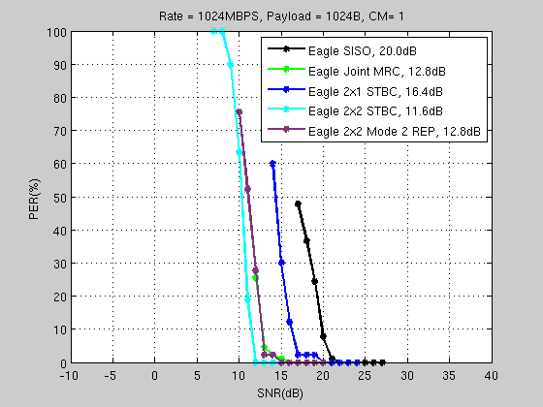
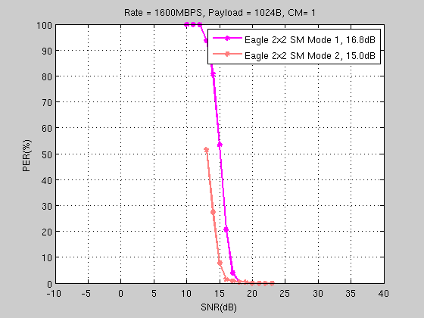
Performance Simulation

Slide 15
Summary
The Alereon Gen3 PHY/MAC silicon
  Utilizes the 6-9GHz UWB spectrum available worldwide
  Peak phy rate using MDCM of 2Gbps
  Supports 1x1, 1x2, 2x1, 2x2 antenna configuration
  Improvements for more robust CM3/4
  Low power; Complete PHY/MAC less than 400mW including IO blocks.
  Widely available UWB antenna choices
  Suitable for desktop and in-room applications

Slide 16
Backup

Slide 17
QPSK/DCM/MDCM
QPSK
DCM, 200 coded bit to 50 groups of 4 bits ( equivalent to QPSK )
MDCM, 400 coded bits group to 50 groups of 8 bits ( equivalent to 16QAM )

Slide 18
DCM constellation
(a) First subcarrier mapping k (b) Second subcarrier mapping k+50

