Slide 1
802.11ah Multi-User Aggregation PDU
Date: 2012-July-16
Authors:

Slide 2
Abstract
This presentation proposes to support aggregation of MPDUs for multiple receivers into a single PDU only used for transmission from AP to multiple stations. It also proposes a new ACK format, which carries multiple ACKs, destined to different stations. Both of these proposals can improve spectral efficiency for short PDU transmission significantly.

Slide 3
Low efficiency in short frame
The spectral efficiency, measured in bit/Hz/Sec, is significantly lower for short frame as the relative transmission overhead increases
Transmission overhead includes
Transmission gaps: SIFS/DIFS/Backoff
Preamble transmission
Example of short frames
Small-sized data PDU (for some applications)
ACK frame

Slide 4
Improving efficiency for short PDU
For some applications, such as sensor network and health care etc, traffic duty cycle (per station) is low; existing aggregation of MPDUs (to/from the same station) will cause increased transmission latency
For these applications, typically, the number of stations in the BSS is high. Aggregation of multiple PDUs addressing different stations (multi-user aggregation PDU, from AP to stations) can improve efficiency without increasing latency
Requires a new frame format for Multi-User Aggregation PDU

Slide 5
Multi-User Aggregation PDU frame
A MUA indicator in SIG; A MUA-Header (2 bytes) per MPDU indicating the length of the MPDU
Each MPDU separately coded and CRC protected
May add a bitmap in the start of MUA-MPDU indicating a group of STAs, whose MPDUs are aggregated
Aggregation size may vary

Slide 6
Selecting stations for aggregation
As the aggregation frame is targeting multiple stations, the lowest MCS (among the MCSs selected for stations to be aggregated) is chosen for the aggregation frame
In implementation, AP will select stations with similar channel condition (i.e. with similar selected MCS) for aggregation to achieve optimal spectrum efficiency
As the number of stations is high for sensor network, of finding from two to eight stations with PDUs to transmit and similar MCS should be difficult

Slide 7
Acknowledgement rule for MUA-PDU
Medium is reserved for transmission of all ACK frames corresponding to aggregated unicast-only PDUs; the DUR field in each MAC header is set to reserve the transmission time for the following ACKs.
Transmission order of ACK frame (from station) is determined by the order of the unicast PDUs in the aggregation frame
ACK timeout timer needs to be increased depending the order the ACK transmitted
No time slot is reserved for ACKs corresponding to multicast/broadcast PDUs aggregated in the MUA-PDUs

Slide 8
Example for ACK frame timing
Three stations aggregated as example, not limited to three in real operation

Slide 9
Quantitative efficiency study (1)
Transmit total 8 PDUs, 2MHz channel
11ah frame structure (normal CP)
Data rate (DR) : MCS (0..7); same MCS for all frames
SIFS = 160 us, Back off count = 7 (average of Cwin=15)
Success transmission on the first attempt
Aggregation level : 1, 2, 4, 8

Slide 10
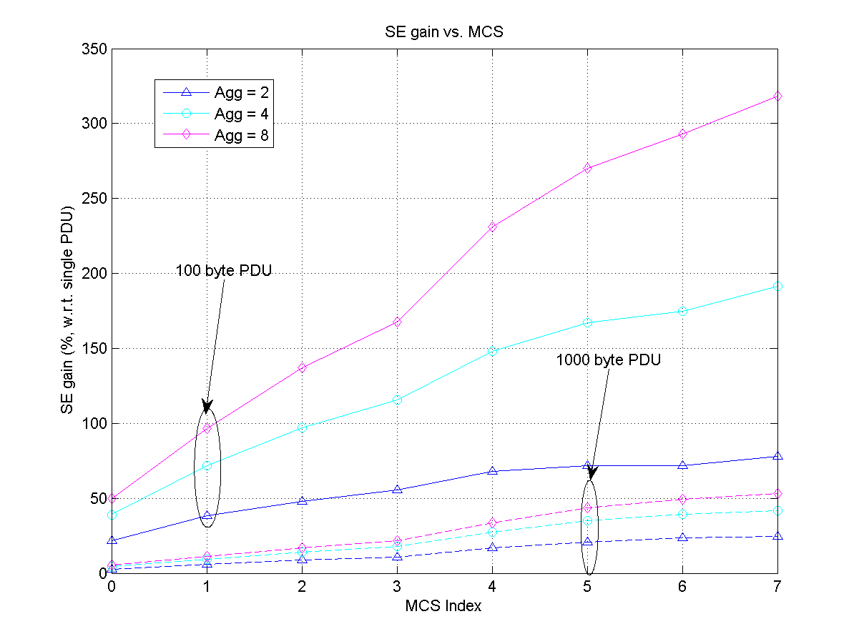
Spectral efficiency gain (percentage) for transmitting 8 unicast PDUs (same MCS)
MCS | DR (Mb/s)
MCS 0 | 0.65
MCS 1 | 1.3
MCS 2 | 1.95
MCS 3 | 2.6
MCS 4 | 3.9
MCS 5 | 5.2
MCS 6 | 5.85
MCS 7 | 6.5

Slide 11
Quantitative efficiency study (2)
Transmit total 8 PDUs for stations
Random MCSs for 8 stations; minimum MCS is used for when stations are aggregated in one frame;
Within the 8 stations, careful grouping is taken so that loss of data rate due to the aggregation is minimised.
Other parameters are the same as previous study

Slide 12
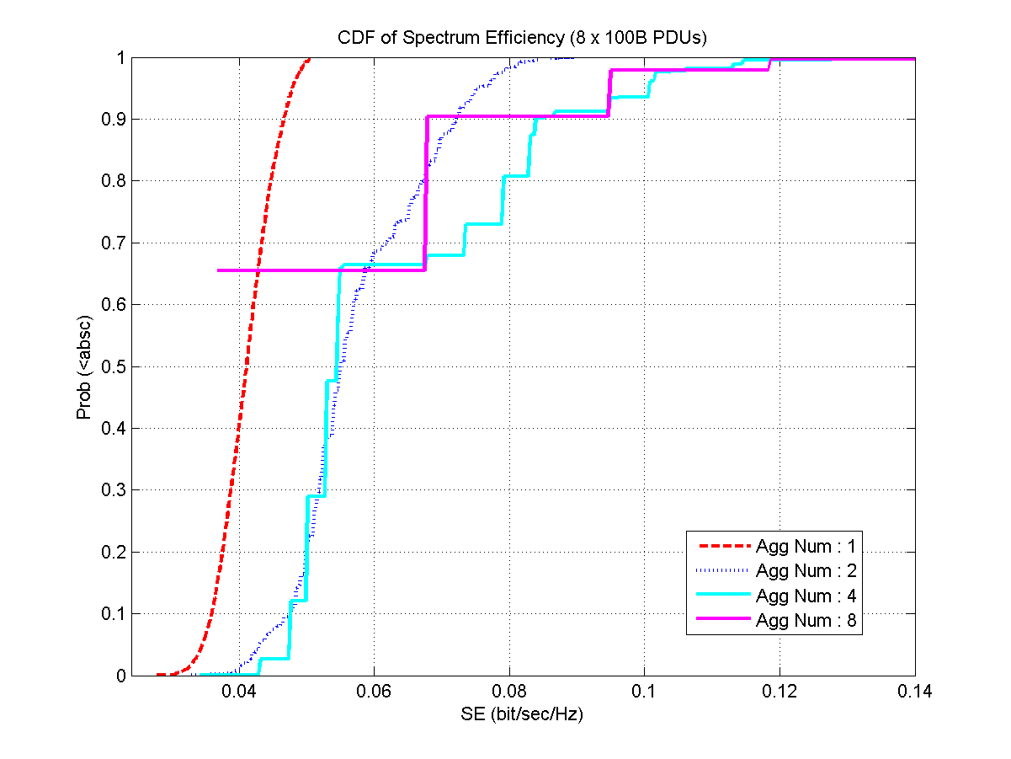
CDF of Spectral efficiency for transmitting 8 unicast PDUs (random MCS)

Slide 13
Aggregate multi-users’ ACK
ACK frame is very inefficient when the PDU is short; existing block ACK causes high latency for low duty cycle traffic
Multi-users’ ACK (from AP) can be aggregated in one frame (aggregation size may vary);
ACK frame overhead can be further reduced by introducing a new PDU

Slide 14
Timeout rules when using MUA-ACK
Station configured using MUA-ACK will need to set a longer timeout value
Arrival of a new beacon frame will also trigger ACK time out

Slide 15
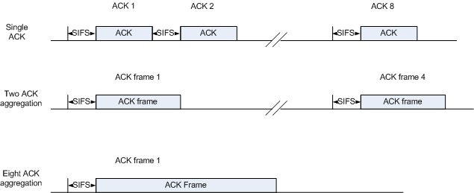
Quantitative efficiency study
Transmit 8 ACK back-to-back, 2MHz channel
Compared to normal ACK and short ACK frame
Data rate (DR) : MCS (0..7), SIFS = 160 us
Aggregation level : 1, 2, 4, 8

Slide 16
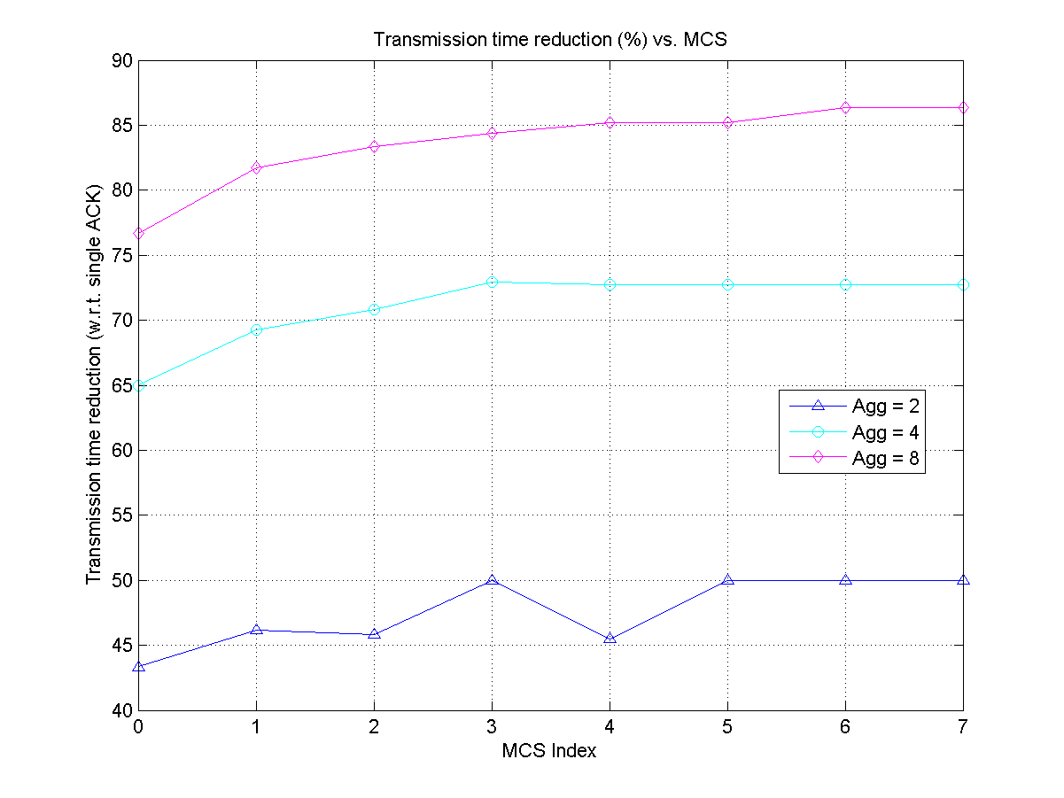
Transmission time saving using MUA-ACK
MCS | DR (Mb/s)
MCS 0 | 0.65
MCS 1 | 1.3
MCS 2 | 1.95
MCS 3 | 2.6
MCS 4 | 3.9
MCS 5 | 5.2
MCS 6 | 5.85
MCS 7 | 6.5
Total transmission of eight ACK frames back to back to focus on the saving of ACK transmission

Slide 17
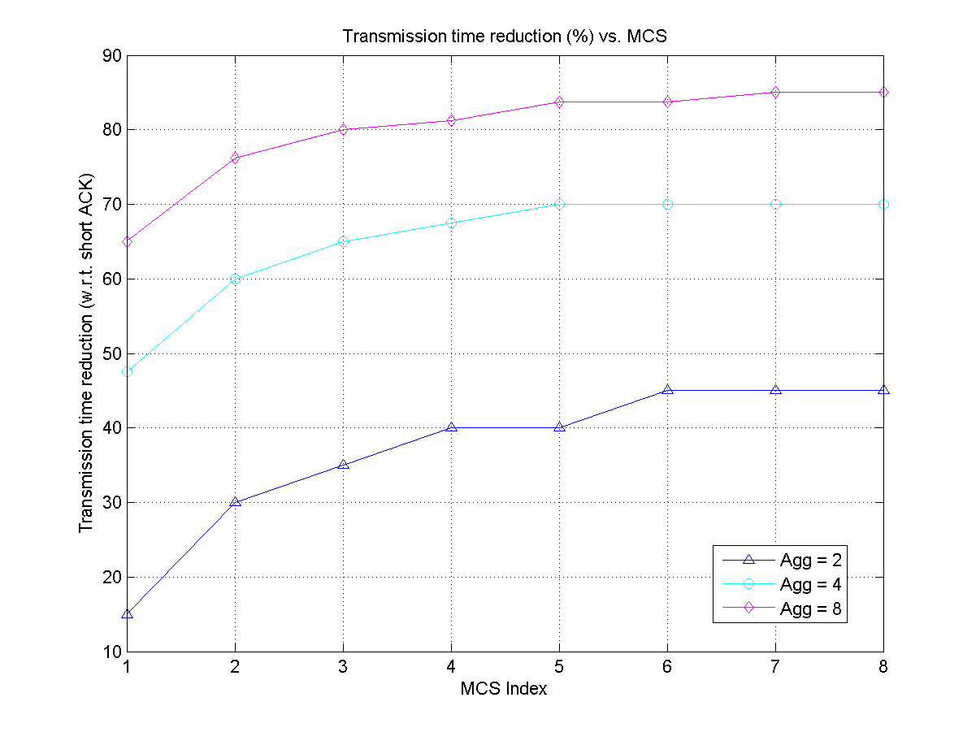
Transmission time saving using MUA-ACK
MCS | DR (Mb/s)
MCS 0 | 0.65
MCS 1 | 1.3
MCS 2 | 1.95
MCS 3 | 2.6
MCS 4 | 3.9
MCS 5 | 5.2
MCS 6 | 5.85
MCS 7 | 6.5
Comparison to short ACK frame (frame with preamble only)

Slide 18
Summaries
For small PDU and low duty cycle traffic, MUA-PDU and MUA-ACK (from AP to stations) can improve spectrum efficiency without causing latency increasing
Moderate aggregation level (such as 4 or 8) can achieve 50% spectrum efficiency improvement (w.r.t. to single PDU transmission) for MUA-PDU
Moderate aggregation level (such as 4 or 8) can save more than 60% of the time used for ACK transmission

Slide 19
References
802.11-12-0324r2, George Calcev et al, Considerations on short packet transmission overhead
802.11-11-1254r0, Yong Liu et al, Short Ack

