Slide 1
802.11ah Channel Access Enhancement
Date: 2012-01-16
Authors:

Slide 2
Abstract
This presentation discusses channel access enhancement for supporting energy efficient operation with large number of STAs per access point
Notes:
doc.: IEEE 802.11-yy/xxxxr0

Slide 3
Introduction
In 11ah the AP should be able to support large number of associated STAs which may operate on very strict energy budget
Such devices could be e.g. battery powered sensors which transmit and receive data very rarely and stay in the low power operation mode for relatively long periods of time
For certain use cases (e.g. the smart metering) it can be assumed that
there would be low amount of traffic
the STA may have uncertainty when this DATA will be transmitted
the packet sizes are small
Meters/sensors may be battery powered and expected operation time is counted in years
In our earlier contributions (e.g. 11/1515, 12/0090) we discussed the performance issues due to downclocking and channel access with large number STAs (12/0028, 12/0374)

Slide 4
Frame Exchange Enhancement
Relatively long SIFS/DIFS periods and potentially large number of STAs contending for the channel (may ) result in bad system performance as pointed out in the earlier studies
Once a STA has gained access to the channel the transmission and reception of frames should be efficient to conserve energy and avoid unnecessary delays
When waking periodicity is decreased the likelihood of both DL and UL data is increased
Sensor could easily make uplink activity to collide with configured Polling periodicity
In sensor use cases the DCF overhead (IFSs and backoff + protocol headers) should be minimized for small data packets

Slide 5
Example of Current Frame Exchange
Currently the access point responds to the PS-poll frame with immediate DATA for the STA or with ACK where it indicates that the traffic delivery for the STA is deferred and delivered later.
An ACK response to the STA’s PS-poll indicates the deferred delivery and would mean that STA would have to stay awake and wait for the delivery
Figure showing the example of downlink and uplink data exchange

Slide 6
Proposed Frame Exchange
A
Could be an implicit PS-poll (request for DL data)
DL DATA indication
B
- STA indicates in the UL DATA frame that it can receive immediate data response
A: the ACK is multiplexed with DATA
B: the ACK is transmitted separately, followed by the DATA after SIFS -> better protection for ACK reception for UL data

Slide 7
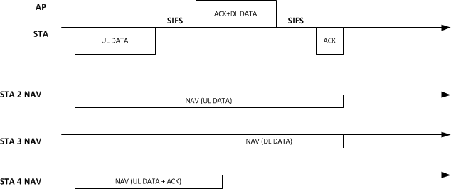
Example on the NAV setting for overhearing STAs
DIFS
Miss
Defer
DIFS
Defer
DIFS
STA could e.g. estimate the packet size (and MCS) that it receives from AP to set the duration in UL DATA
STA 2 sets NAV based on UL DATA information
STA 3 sets NAV based on the APs ACK+DL DATA
STA4: in case the STA does not estimate the DL DATA duration: STA4 sets NAV for UL DATA+ACK but notices the ongoing TX on DL and defers access

Slide 8
Conclusions
Frame exchange options suitable for 11ah use cases were discussed
Proposed options could enhance STAs operation in ‘awake’ state
It is beneficial for the battery powered STAs to utilize the awake periods efficiently and enter low power state as fast as possible

Slide 9
Straw Poll 1
Do you support to include in the 11ah Specification Framework the concept of having a UL DATA frame which indicates also a PS-poll to AP (details TBD)
Y:
N:
A:

Slide 10
References
[1] 12/881r0 PS Mode Enhancements with Timing Indication

