Slide 1
TGaf PHY Overview
Date: 2012-07-20
Authors:

Slide 2
Outline
Provide high level description of the PHY design for TGaf as described in clause 23

Slide 3
Design Requirements
High ACLR – 55dB at the channel edge for transmissions at maximum allowed power
  Much higher than current 802.11 where channel edge spectral mask value is at around -20dBr
Support for 3 basic channel widths – 6,7,8MHz
Support for contiguous and non-contiguous transmission of the basic channel unit (due to scarcity of spectrum in urban area)
  Unlike 11ac where non-contiguous is supported only for the third largest BW
Re-use 11ac with modifications specific to TGaf
Support for longer delay spread outdoor deployments

Slide 4
PHY Details – One Channel
The PHY for one TVWS channel is based on the 11ac 40MHz PHY as-is with a sampling frequency clock change
  Sampling clock change increases symbol length and delay spread tolerance to meet 11af requirements. The alternative of using 20MHz PHY was considered but it was decided that it doesn’t provide long enough delay spread for outdoor applications (increase by less than 3 for 8MHz channels is insufficient)
  VHT and non-HT DUP modes are the only supported modes
Signal BW occupies about 81% (compared to 91% in 11ac) of the TVWS channels in 6MHz and 8MHz regulatory domains.
  This enables larger guard bands to allow filter roll off to achieve -55dBr ACLR
In order to reduce PHY implementation options:
  7MHz regulatory domains re-use the 6MHz PHY
  Same PHY design for 6MHz and 8MHz channels with only a sampling clock change

Slide 5
Cont. – Multiple Channels
TVWS channels are divided into an even number of tones. This enables transmission and reception of multiple contiguous channels using one IFFT/FFT as in 11ac. 144 tones were chosen to meet the desired signal BW.
The PHY for multiple channels is based on the PHY for one channel.
  This concept is similar to the 11ac design of 160MHz and 80+80MHz whereby the tone location of DATA and pilots are the same as in 80MHz.
  All basic channel units (termed frequency segments in clause 23) are connected via a single encoder and interleaver in order to maximized frequency diversity gain (11af channels are much narrower than 11ac, 11af can be used in lower delay spread environments such as indoors where diversity in one channel is limited)

Slide 6
Clause 23 Structure
Clause 23 describes the PHY for TGaf. The methodology used in creating clause 23 is by copying all the section titles of 11ac (clause 22) and filling them only with differential information explaining the delta relative to clause 22 when applicable
Example: clause 23.3.8.1.2 L-STF definition using five lines to modify 20+ lines including a lot of math:
The L-STF field for each frequency segment in any transmission mode is defined by Equation (20-9) in 20.3.9.3.3 (L-STF definition).
The time domain representation of the signal on frequency i_{Seg} segment in transmit chain i_{TX} is specified in Equation (22-16) and where γ_{k,BW} is replaced by γ_{k,M} as defined in Table 23-7 (Transmission mode and) with N_{SR} as defined in Table 23-3 (Timing-related parameters).

Slide 7
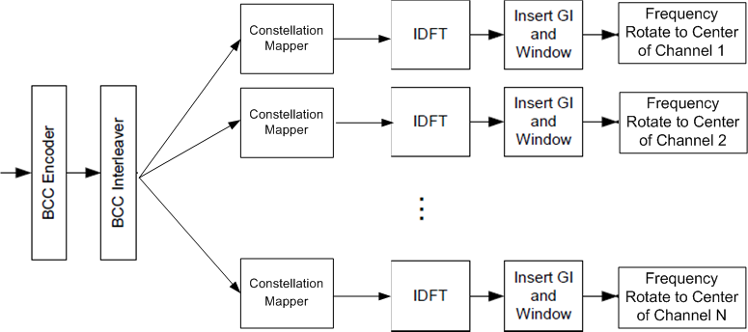
Example: Multi-Channel Transmitter
Due to the structure of the of the PHY, the same design holds for contiguous and non-contiguous channels

Slide 8
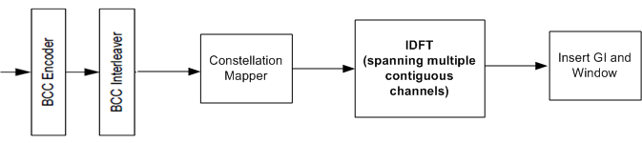
Example: Contiguous Multi-Channel Transmitter
Due to the fact that each channel consists of an integer and even number of tones some implementation can use one IFFT (or FFT at the receiver)

