Slide 1
AP Assisted Medium Synchronization
Date: 2012-09-17
Authors:

Slide 2
Authors:

Slide 3
Authors:

Slide 4
Introduction
The Synch frame concept was accepted in TGah Specification Framework document (SFD) in the July IEEE meeting [1] :
  R.4.2.E: When requested by a STA, the AP sends a synch frame (the frame type is TBD) at the slot boundary or the target wake time of the STA, if the channel is idle, to help the STA quickly synch to the medium. (optional to AP and STA)
This is a follow up presentation proposing a frame type for the synch frame (slide 12,13,15)

Slide 5
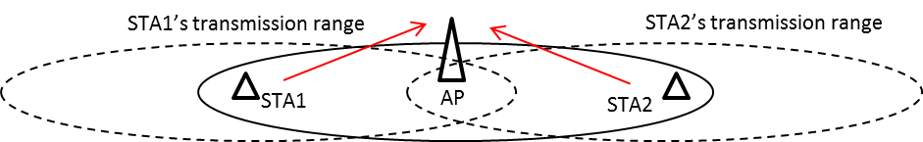
Overview
In STD 802.11-2012, a STA has to follow the rule below:
  “A STA that is changing from Doze to Awake in order to transmit shall perform CCA until a frame sequence is detected by which it can correctly set its NAV, or until a period of time equal to the ProbeDelay has transpired.”
This is to first have the STA synchronized to the medium and then access the channel in order to prevent potential collisions with transmissions from hidden nodes
STA2 cannot hear STA1’s transmission
STA1
Data
AP
Ack
Ack
STA2
Data
ProbeDelay
= Max PPDU+SIFS+BA (or ACK)
STA1 hidden from STA2
STA2:Doze to Awake
STA2 detects
transmission in the channel
(synched with the activities in the channel)

Slide 6
Problem
It is hard to set the ProbeDelay value to a fixed value due to two conflicting goals:
1) address hidden node problem and 2) minimize power consumption
  In STD 802.11-2012, ProbeDelay = N/A
Case 1: ProbeDelay = Max PPDU + SIFS + BA
Case 2: ProbeDelay = 0
Case 1a
STA2 cannot hear STA1’s transmission
Case 2a
STA2 cannot hear STA1’s transmission
STA1
Data
STA1
Data
AP
Ack
Ack
AP
STA1 and STA2 collide at the AP
STA2
Data
STA2
Data
ProbeDelay= Max PPDU+SIFS+BA
ProbeDelay = 0
STA2:Doze to Awake
STA2 detects
transmission in the channel
(synched with the activities in the channel)
STA2:Doze to Awake
STA2 cannot hear STA1’s transmission
STA2’s transmission collides with STA1
Case 1b
Case 2b
STA2 stays awake
STA2 stays awake
STA1
STA1
AP
Ack
AP
Ack
STA2
Data
STA2
Data
ProbeDelay= Max PPDU+SIFS+BA
ProbeDelay = 0
STA2:Doze to Awake
STA2 stays awake sensing the channel to
detect potential transmissions from
hidden nodes but nothing is on the channel.
STA2:Doze to Awake
STA2 wakes up, sends a packet to the AP and then
goes back to sleep (Doze) to minimize power consumption

Slide 7
Discussion
Case 1: ProbeDelay set to a large value (e.g. ProbeDelay = MaxPPDU + SIFS + BA)
  Case 1a: when the channel is busy at the AP
    addresses hidden node problem
  Case 2a: when the channel is idle at the AP
    STA consumes power sensing the channel for MaxPPDU + SIFS +BA (>20mS or 40mS) just to find that there is nothing in the channel
Case 2: ProbeDelay set to a small value (e.g. ProbeDelay = 0)
  Case 2a: when the channel is busy at the AP
    Collision happens at the AP side; does not address the hidden node problem
  Case 2b: when the channel is idle at the AP
    STA consumes minimum power to send a packet without any collision

Slide 8
AP assisted medium synchronization (adopted in TGah SFD R.4.2.E)
Basic idea
  An AP indicates to a STA a time slot boundary at which the STA is allowed to start to access the channel
    STA may request to the AP the time (e.g. target wakeup time (TWT) [1]) at which it wants to access the channel
    AP can assign time slot boundary per each STA through TIM
  If requested by the STA, the AP shall send a short “synch” frame (TBD) at the time slot boundary or the TWT if the channel is idle
    The short synch frame may use
      a legacy frame: CTS, CF-End, QoS+CF-Poll …
      a new frame in the NDP format to minimize the channel occupancy
  The STA wakes up at its time slot boundary or its TWT to access the channel
    The channel access follows 802.11-2012 STD
  Case 1) If the AP senses that the channel is idle at the slot boundary, the AP transmits a short synch frame.
      If the STA receives the short synch frame from the AP at the slot boundary, the STA starts to access the channel right after the reception of the short synch frame
      The channel access follows the EDCA rules
      The STA does not need to sense the channel for a long ProbeDelay time to synch to the medium
Slot boundary
Short “synch” frame: AP sends a short frame (TBD) at the slot boundary
if the channel is idle to help a station to quickly synch to the medium
ACK
Data
Beacon
Beacon
STA in the awake state
receiving a Beacon
STA wakes up at
slot boundary and
waits for channel synch
STA synchs to the channel
by receiving the Synch frame from the AP
and starts channel access following the DCF rules

Slide 9
AP assisted medium synchronization (continued)
      Case 2) If the AP senses that the channel is busy or the AP is in the middle of receiving a packet at the slot boundary , the AP does not generate a short synch frame.
        The STA waits until it is synched to the medium by receiving a synch frame or any other frame or until a period of time equal to the ProbeDelay has transpired
Observation:
  If the channel is busy with many STAs actively accessing the channel, the AP generates fewer synch frames
  If the channel is most of the time idle with very few packet transmissions, the AP generates more synch frames
Slot boundary
If the AP senses the channel is busy or is receiving a packet at the slot boundary,
the AP does not generate a synch frame.
ACK
Data
(STAn->AP)
ACK
Data
Beacon
Beacon
STAx -> AP
STA synchs to the channel
by receiving the ACK from the AP
STAx is already transmitting a packet
to the AP crossing the next slot boundary
(hidden from STAn)
STA wakes up at the slot boundary and
waits for a packet to synch to the medium
(STA does not hear the Data packet from STAx)

Slide 10
Assisting Medium Synch for a Long Sleeper (Z-Class Devices[2])
A STA schedules its TWT (target wake time) with the AP
When requested by the STA, the AP sends a short synch frame at the TWT if the channel is idle
  Reduces the medium synch time → reduces power consumption
1. With a synch frame at TWT:
Target Wake Time
(TWT)
Short “synch” frame (format TBD):
AP sends a synch frame at the TWT if the channel is idle
to help a station to quickly synch to the channel
ACK
ACK
Data
Beacon
UL
DL
STA wakes up before
the TWT and
waits for channel synch
STA synchs to the channel
by receiving a short synch frame
from the AP and starts channel
access following the EDCA rule
STA goes back
to sleep
2. Without a synch frame at TWT:
Target Wake Time
(TWT)
Extra time (i.e. ProbeDelay) needed for the STA
for the medium synch when a synch frame is not used
ACK
ACK
Data
Beacon
UL
DL

Slide 11
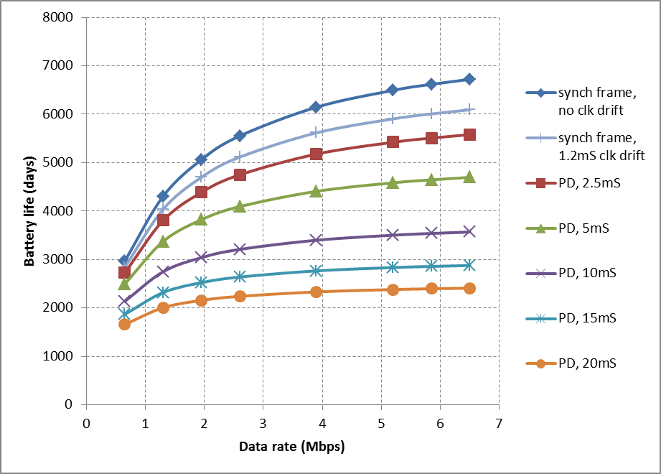
Comparison
parameters | values | units
aSlotTime | 45 | uS
aSIFSTime | 64 | uS
aDIFSTime | 154 | uS
aPreambleLength | 240 | uS
Battery capacity | 900 | mAh
Tx power | 500 | mW
Rx power | 100 | mW
Sleep power | 10 | uW
Wake up period | 60 | Sec
Tx packet size | 200 | Bytes
Rx packet size | 200 | Bytes
Ack frame | 240 | uS
Synch frame | 240 | uS
Proposed scheme
(1)
(2)
^{a)}
Not using a synch frame;
ProbeDelay: 2.5mS – 20mS
Proposed scheme (2) over ProbeDelay
  Gain over ProbeDelay=5mS : 14~30% longer battery life
  Gain over ProbeDelay=10mS : 33~71% longer battery life
^{a)} 1.2mS advanced wakeup due to +-10ppm clock drift

Slide 12
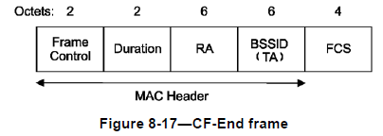

Discussion on “Synch” Frame
Option1: CF-End frame
  Behavior is the same as the current spec
    NAV is reset after receiving the CF-End frame
    Any STA participates in the channel access after receiving the CF-End frame
    The STA accesses the channel after DIFS + CW Backoff
    A new NDP CF-End frame may be needed to minimize the channel occupancy
    Cannot reserve a time duration for one specific STA
Option2: (NDP-)CTS frame (preferred)
  The NDP type CTS frame (the Short CTS frame) is already defined in TGah SFD 4.4.2.3 [1].
  CTS frame reserves a time interval for a STA that is scheduled to wake up at the slot boundary (or TWT)
    RA field: the address of the STA that is scheduled to wake up at the slot boundary
    Duration field: set to an estimated value to protect the transmission from the STA to the AP
  The STA accesses the channel after SIFS following the CTS frame
    Shorter channel access delay compared to the CF-End frame case
  The medium can be freed by sending a CF-End frame if the AP does not receive a frame from the STA PIFS after transmitting the CTS frame
  Duration field can be set to 0 to have the same effect as using a CF-End frame of Option1
CF-End
CW
Backoff
ACK
DIFS
Data
STA1→ AP
Target Wake Time
Option1: using CF-End as a synch frame
NDP-CTS frame
CTS(STA1, NAV)
ACK
SIFS
Data
SIFS
STA1→ AP
Target Wake Time
NAV(CTS)
Option2: using (NDP-) CTS as a synch frame

Slide 13
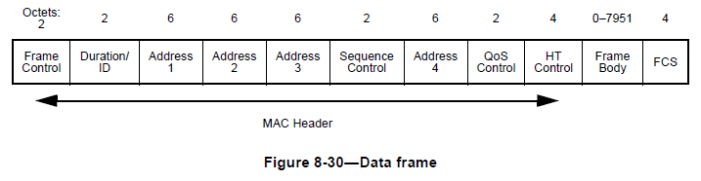
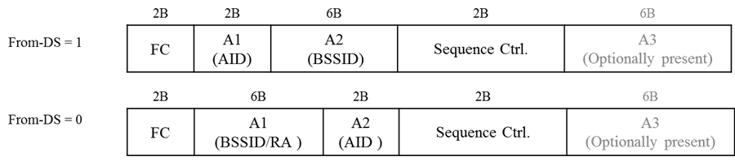
Discussion on “Synch” Frame (continued)
Option3: QoS+CF-Poll frame
  RA field: the address of the STA that is scheduled to wake up at the slot boundary
  Duration field [802.11-2012, 8.2.5.3]:
    If TXOP limit > 0: SIFS + TXOP limit
    If TXOP limit=0: one MPDU of nominal MSDU size + ACK + 2SIFS
  A new NDP type QoS+CF-Poll frame may be needed to minimize the channel occupancy
    Legacy/Short MAC header formats need 30/12 bytes for the QoS+PS-Poll frame
  QoS+CF-Poll is a Data Type frame used for channel access during CFP
QoS+CF-Poll(STA1, NAV)
ACK
SIFS
Data
SIFS
STA1→ AP
Target Wake Time
NAV(QoS+CF-Poll)
Option3: using QoS+CF-Poll as a synch frame
(1) Using the Data Type frame format in STD 802.11-2012
- 30 bytes for the QoS+CF-Poll frame
(2) Using the Short MAC header format in TGah SFD r10
- 12 bytes for the QoS+CF-Poll frame

Slide 14
Summary
Synch frame options:
  CF-End
  NDP-CTS (the Short CTS frame)
  QoS+CF-Poll
Based on the discussion in slide 12 and 13, the Short CTS frame defined in TGah SFD 4.4.2.3 is recommended as a synch frame.

Slide 15
Straw Poll
Do you support to make the changes below in the TGah SFD R.4.2.E:
  “R.4.2.E: When requested by a STA, the AP sends a synch frame (the frame type is TBD) at the slot boundary or the target wake time of the STA, if the channel is idle, to help the STA quickly synch to the medium. (optional to AP and STA) [49, 56]
    It is recommended that the AP sends a Short CTS frame defined in 4.4.2.3 as a synch frame.”

Slide 16
References
[1] TGah Specification Framework, IEEE 802.11-11/1137r10
[2] “Target Wake Time,” IEEE 802.11-12/823

