Slide 1
Interleaver Parameters
Date: 2012-07-16
Authors:

Slide 2
Outline
Propose values for Ncol for 2 frequency segments and 4 frequency segments
Recall the value of Ncol for one frequency segment is as in 11ac 40MHz PHY and equals 18.
Recall also Ncol determines the interleaver depth and is a divisor of the number of DATA tones (216 for 2 frequency segments and 432 for 4 frequency segments)
Potential values for 2 frequency segments are : 6 8 9 12 18 24 27 36 54
Note that 2 frequency segments are roughly equivalent to 80MHz PHY and the Ncol value for 80MHz is 26.
Potential values for 4 frequency segments are : 6 8 9 12 16 18 24 27 36 48 54

Slide 3
Simulation Scenarios
5000 channel realizations
1000byte per packet, ideal receiver
3 channel models similar to 11ah outdoor channel model
SCM Suburban Macro, SCM Urban Micro, SCM Urban Macro – denoted in the plots as scm1,scm2,scm3 respectively.
Contiguous (channels 1 and 2) and non-contiguous (channels 1 and 4) frequency segments
Frequency segments have equal SNR (default) or unequal SNR (specified) in which case one or frequency segments have 3dB higher SNR and the other 3dB lower SNR than what’s shown on the x-axis
This reflects a 6dB difference as was observed in the Cambridge trials.

Slide 4
Simulation Results
Results for 2 frequency segments are shown in Appendix A and 4 frequency segments in Appendix B.
For 2 frequency segments there is no clear winner across all MCS and all scenarios but several choices are consistently the best (12,18,24,27,36). In many cases 36 or 24 or 27 are the best.
We propose the value 24 as this value is close to the value used for 80MHz in 11ac and is among the best options for MCS7 scm2 (slide 16) .
For 4 frequency segments there is no clear winner across all MCS and all scenarios. Looking at MCS7 and MCS5 results 36 seems a good choice.

Slide 5
Straw Poll
Do you support the following values for Ncol
2 frequency segments (modes 2C,2N) – 24
4 frequency segments (modes 4C,4N) – 36
Y
N
A

Slide 6
Appendix A – Two Frequency Segment Results

Slide 7
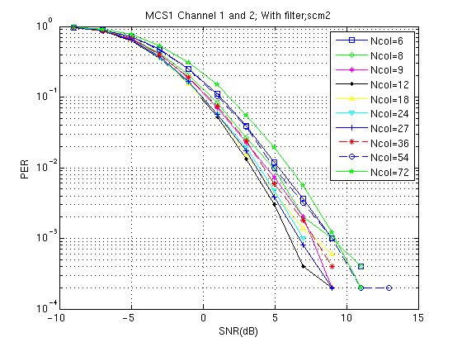
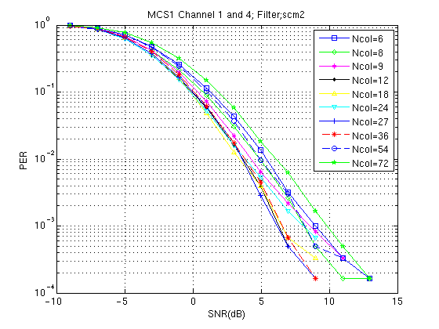
MCS1-scm2 (Contiguous & Non-Contiguous)

Slide 8
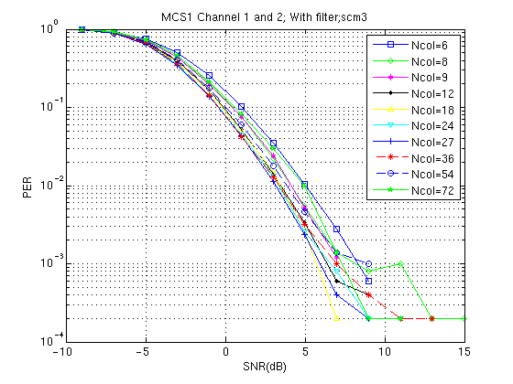
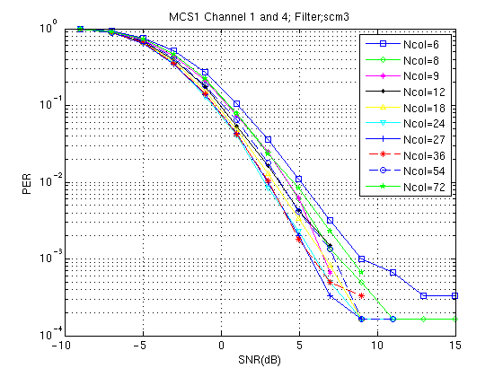
MCS1-scm3

Slide 9
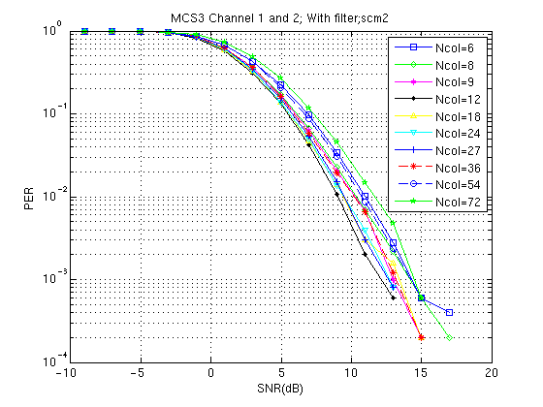
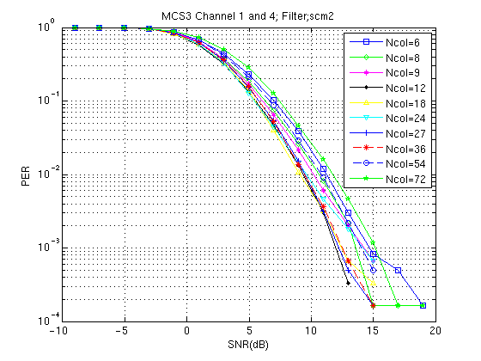
MCS3-scm2

Slide 10
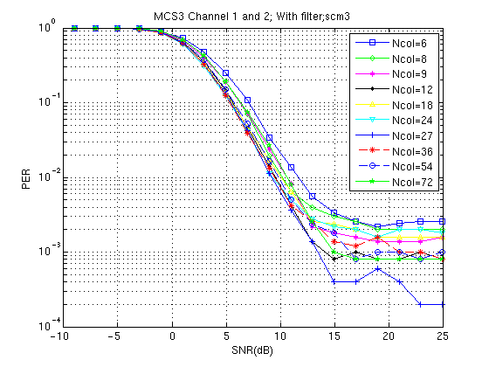
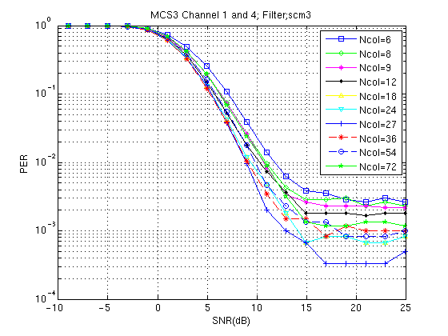
MCS3-scm3

Slide 11
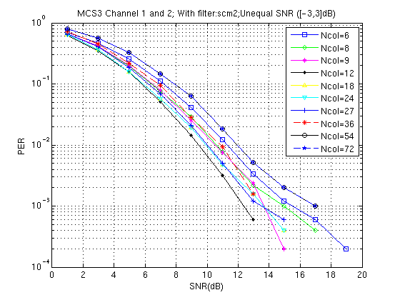
MCS3-scm2-Contiguous with [-3,3]dB SNR

Slide 12
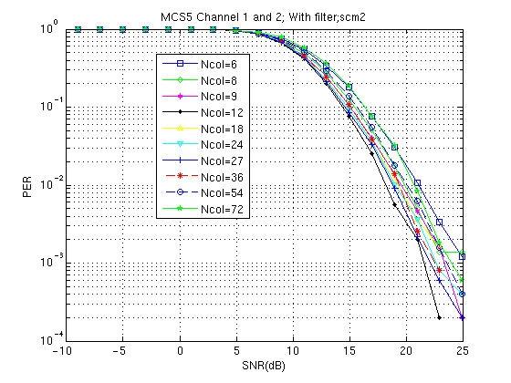
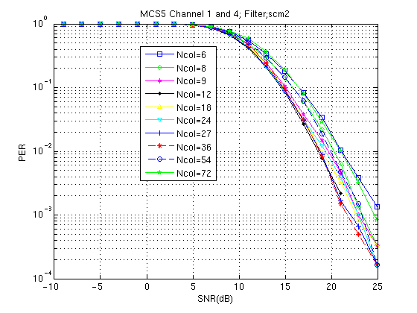
MCS5-scm2

Slide 13
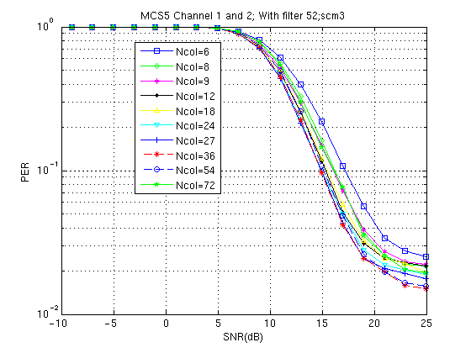
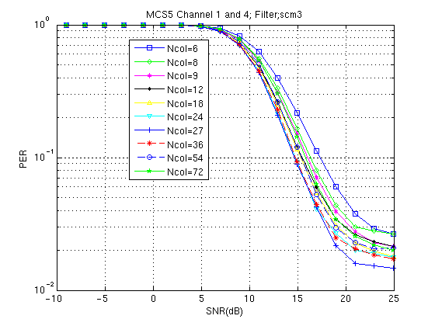
MCS5-scm3

Slide 14
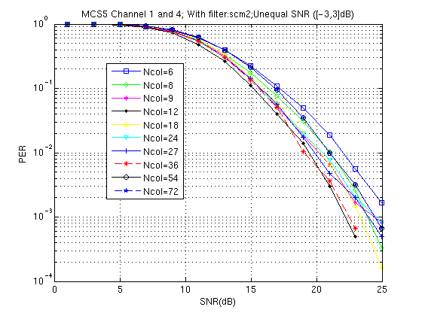
MCS5-scm2-Non Contiguous with [-3,3]dB SNR

Slide 15
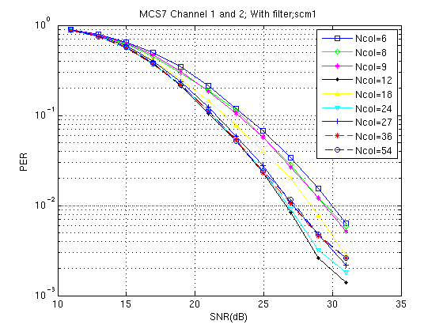
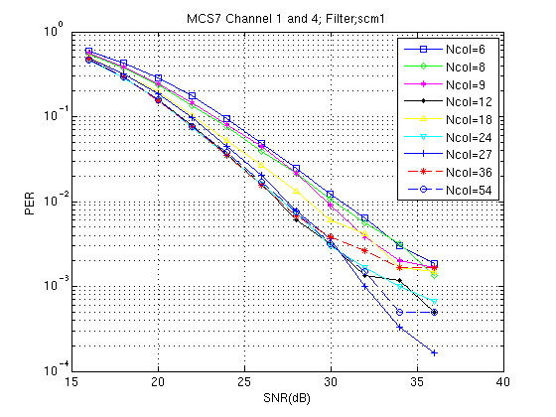
MCS7-scm1

Slide 16
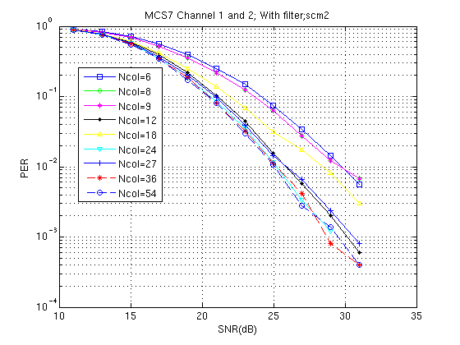
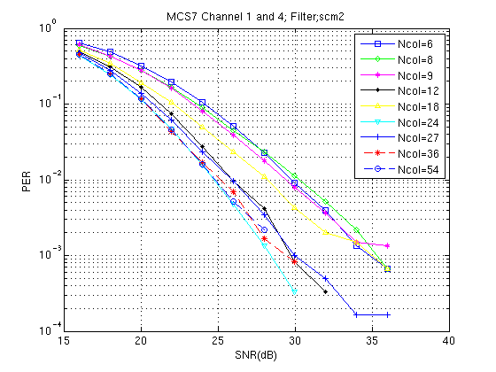
MCS7-scm2

Slide 17
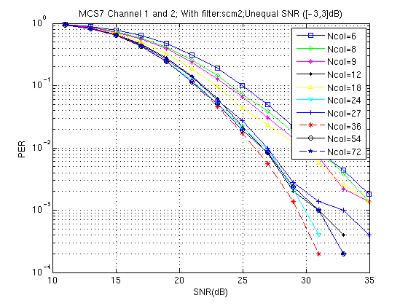
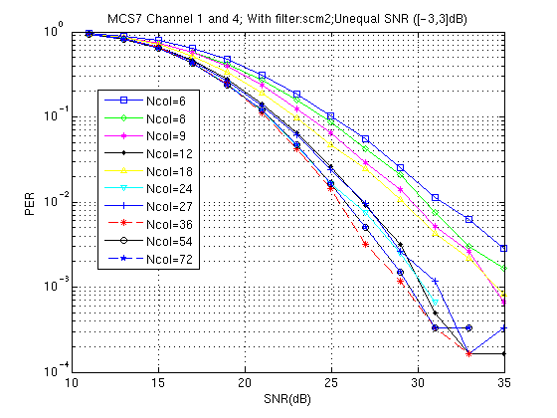
MCS7-scm2- with [-3,3]dB SNR

Slide 18
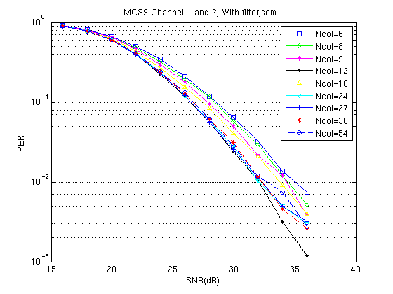
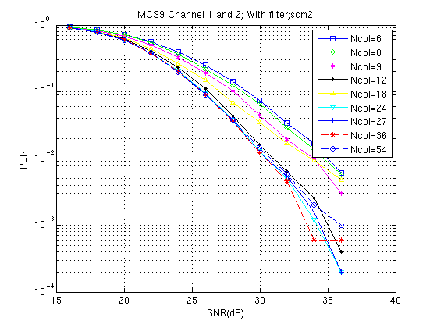
MCS9-scm1

Slide 19
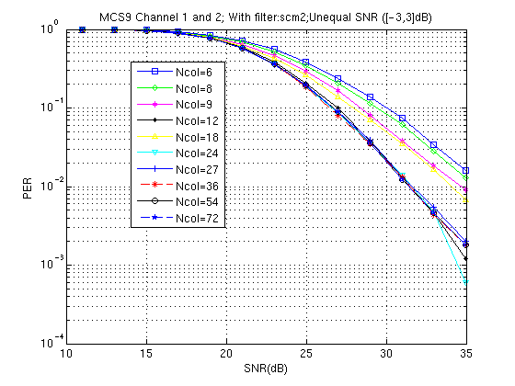
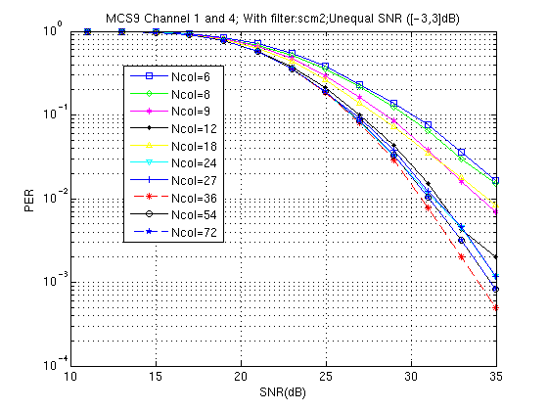
MCS9-scm2-with [-3,3]dB SNR

Slide 20
Appendix B – Four Frequency Segment Results

Slide 21
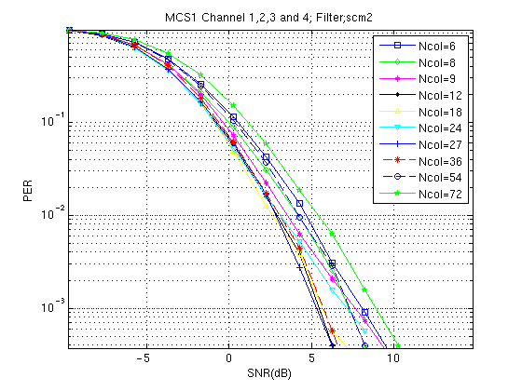
Contiguous 4 channel (Equal SNR)-MCS1

Slide 22
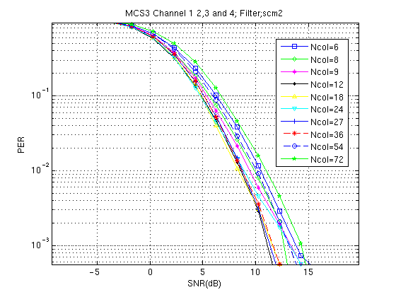
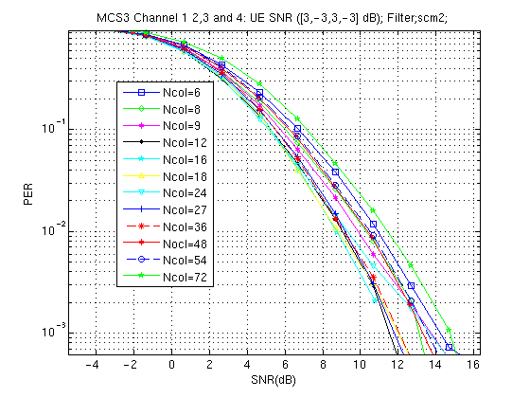
Contiguous 4 channel -MCS3

Slide 23
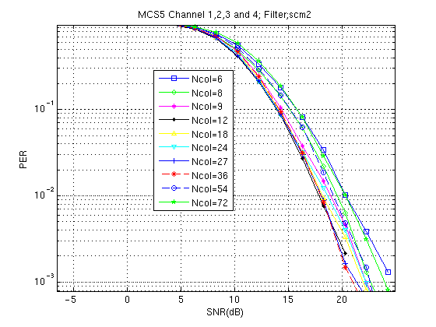
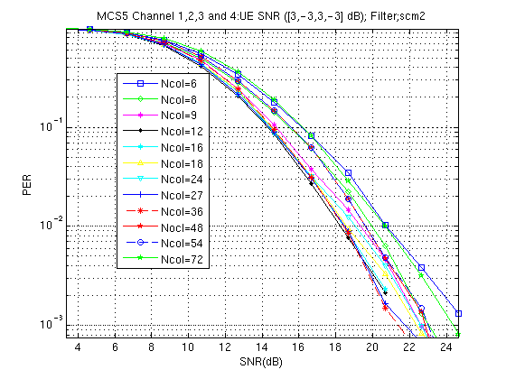
Contiguous 4 channel - MCS5

Slide 24
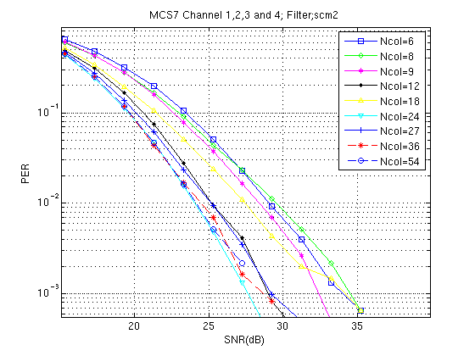
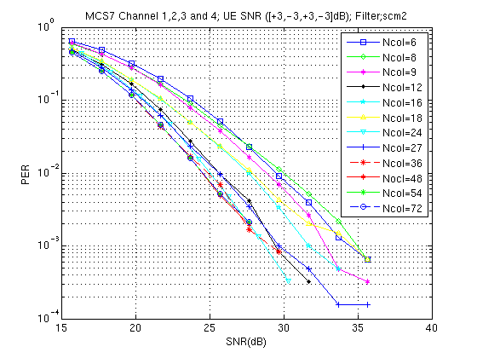
Contiguous 4 channel - MCS7

